Slide 1




Lake-Sumter MPO Vision Zero Action Plan
Initial Findings Workshop
November 21, 2025

Slide 2

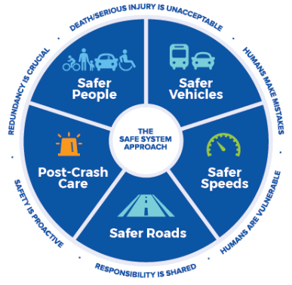
WHAT IS VISION ZERO & SS4A?
THE SAFE SYSTEM APPROACH
Vision Zero is a holistic approach to road safety to achieve zero traffic fatalities and serious injuries. This approach can be called the Safe System Approach.
Safe Streets for All (SS4A) federal funding program to fund regional, local, and Tribal initiatives through grants to prevent roadway fatalities and serious injuries.
Lake~Sumter MPO Vision Zero Safety Action Plan

Slide 3
LAKE-SUMTER MPO: UCF SS4A GRANT
INTRODUCTION
Safe Streets 4 all
Federal Grantor
Lead Analysis, Reporting, & Recommendations
Inform Safety Element of LRTP & Report Progress
Coordinate with County VZ Efforts
August 2025- April 2026
UCF Role
MPO Role
Relationship to Lake and Sumter
County’s Vision Zero Plans
Schedule
Lake~Sumter MPO Vision Zero Safety Action Plan

Slide 4
TAC/CAC ROLE
Role of TAC/CAC is to provide guidance in the development of the LSMPO Vision Zero Action Plan through engagement, refine methodologies and identify policy needs. Following the development of the plan, this group will provide a recommendation of approval to the LSMPO Board in 2026 and track on-going progress towards goals.
Lake~Sumter MPO Vision Zero Safety Action Plan

Slide 5
SAFETY ACTION PLAN ORGANIZATION
ORGANIZED INTO 7 CHAPTERS TO ALIGN WITH SS4A GRANT REQUIREMENTS:
Executive Summary
Chapter 1: Leadership Commitment & Goal Setting
Chapter 2: Crash Trends & Safety Analysis
Chapter 3: Network Screening & High Injury Network
Chapter 4: Engagement & Collaboration (MPO Board, TAC, & CAC)
Chapter 5: Strategies, Prioritization, & Project Selections
Chapter 6: Policy and Process Changes
Chapter 7: Progress Monitoring and Transparency
Appendices
Lake~Sumter MPO Vision Zero Safety Action Plan

Slide 6
Goal: Zero Fatal AND Serious Injury Crashes by 2050 in lake-sumter MPO region

Slide 7
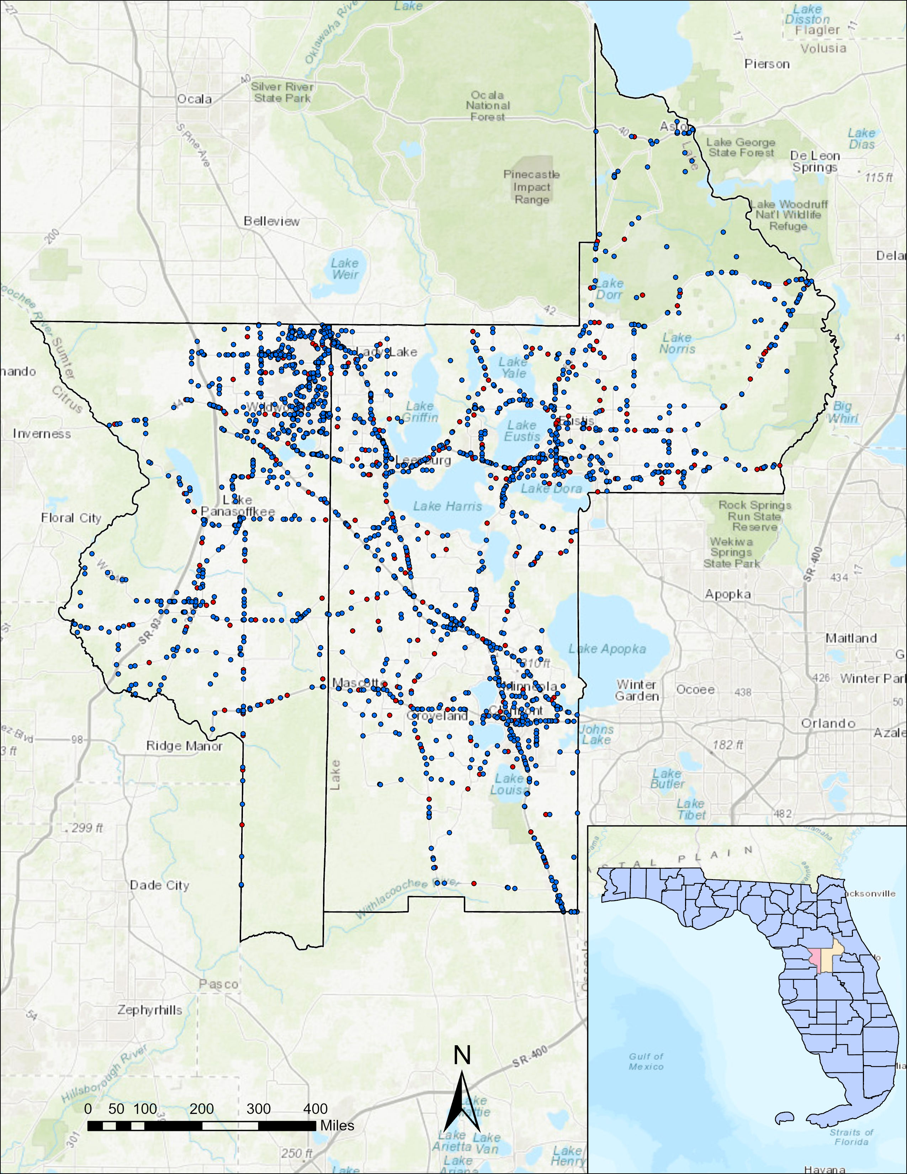
Crash Analysis 10 years (2015-2024)

Slide 8
Step 1 Raw crashes from S4A data
Step 2 Data Filter: KA + No toll/freeways (I-75, Florida’s Turnpike)
Step 3 4,539 KA crashes (fatal (K) and incapacitating injury (A)) crashes took place in Lake-Sumter Counties from 2015-2024.
CRASH ANALYSIS DATA SET
3 STEPS TO DETERMINE CRASHES FOR ANALYSIS:
Signal 4 Analytics (S4A) statewide crash database utilized for all crash analysis.
Focus on Killed (K) and Serious Injury Crashes (A) as they are most impactful.
Lake~Sumter MPO Vision Zero Safety Action Plan

Slide 9
Ten-years trend for KA crashes
TOTAL NUMBER OF KA CRASHES
Percentage of KA crashes
KA CRASHES / ALL CRASHES
Note:
State of Florida 10-year KA crash rate is 2.4%
Orange County 5-year KA crash rate is 3.1%
Lake~Sumter MPO Vision Zero Safety Action Plan
Notes:
For Orange County Average KA Crashes rate is 3.1% for the last 5 year.
For whole Florida Average KA Crashes rate is 2.4% for the last 10 year.

Slide 10
KA crashes: CRASH TYPE
CRASH TYPE
Key Takeaways
Four typical crash types that causing most of severe crashes (84.0%):
1
28.1% of the severe crashes are off road/roll over crashes
2
Left-turn/angle, rear-end, and pedestrian/ bicycle crashes account for 27.8%, 16.3%, and 10.5% of KA crashes, respectively.
Lake~Sumter MPO Vision Zero Safety Action Plan

Slide 11
KA crashes: DRIVER ATTRIBUTES
KA CRASH FREQUENCY PER 10,000 LICENSED DRIVERS BY AGE
Key Takeaways
1
The highest rates are observed among the youngest drivers specifically those aged 15–20 and 21–29. Males are twice as likely to be involved in KA crashes than females.
Lake~Sumter MPO Vision Zero Safety Action Plan

Slide 12
KA crashes: ROAD TYPE
KA CRASHES BY ROAD TYPE
Key Takeaway
Rural roads (37.4% of mileage) account for 54.4% of KA crashes, while urban roads (62.6%) account for 45.6%.
Lake~Sumter MPO Vision Zero Safety Action Plan

Slide 13
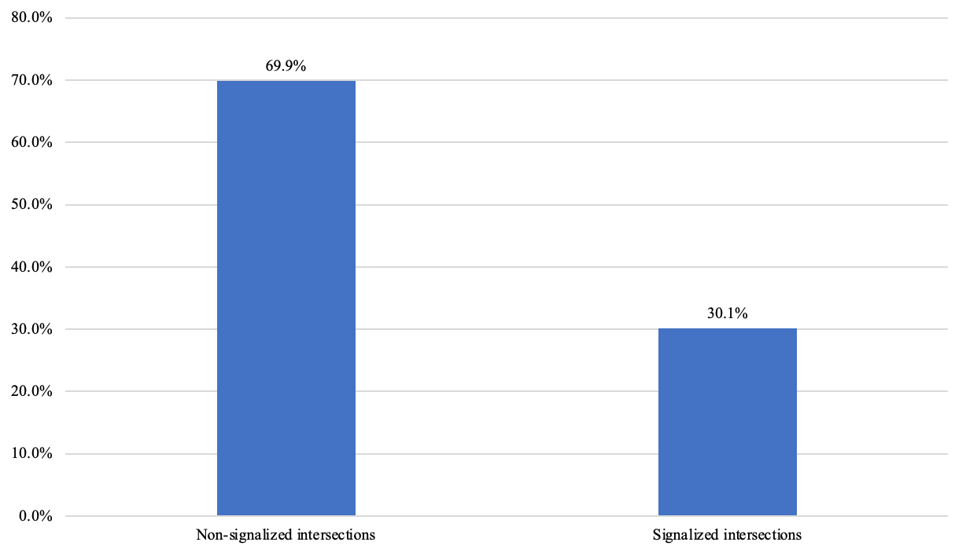
KA CRASHES: INTERSECTIONS
Intersections’ KA Crashes by Intersection Control
Key Takeaways
1
69.9% of KA crashes happened at Non-signalized intersections
Lake~Sumter MPO Vision Zero Safety Action Plan
Notes:
In Orange county 51.5% crashes occurred at non-signalized intersection and 48.5% at signalized intersections.

Slide 14
KA CRASHES: SEGMENTS
Segment KA Crashes by Road Types
Key Takeaways
1
62% of KA crashes happen on 2-way, 2-lane undivided
Note: 79.2% of roadway miles are 2-lane roads
Lake~Sumter MPO Vision Zero Safety Action Plan
Notes:
Approximately 79.2% miles of roadways are 2 lane roads in Lake and Sumter

Slide 15
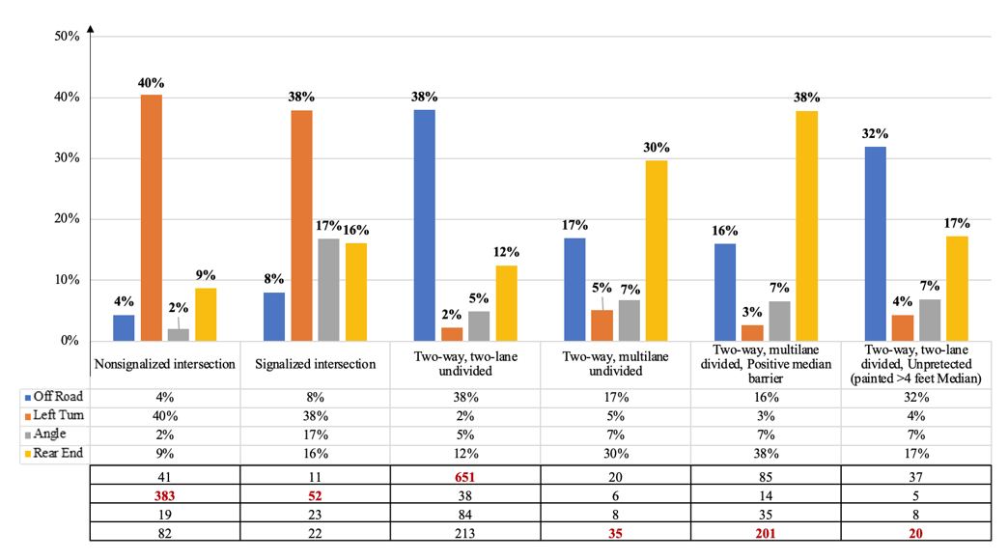
KA CRASHES: INTERSECTIONS & SEGMENTS
Road type vs. Crash type
Intersection Crashes
1
Non-Signalized:
40% Left-Turn
2
Signalized: 38% Left-Turn
Segment Crashes
1
2-Lane Undivided: 21% Rear-End, 17% Off-Road
2
4-Lane Divided: 38% Rear-End, 16% Off-Road
3
4-Lane Undivided: 32% Off-Road, 17% Rear-End
Lake~Sumter MPO Vision Zero Safety Action Plan

Slide 16
Crash COMPARISON 2015-2019 vs 2020-2024

Slide 17
Data Comparison: type of crash
Comparison in KA Crash Rate per Million Vehicle Miles Traveled (MVMT) by Type of Crash
Crash Type | 2015-2019 | 2020-2024 | Percentage Change | Key Observations
Off-road/Rollover | 55 | 51.2 | -6.9% | Decrease: Addition of RMS to two-lane roads likely contributed to the decline.
Left-Turn/Angle | 49.9 | 54.6 | 9.4% | Increase: Underscores persistent risks at intersections and high-conflict locations.
Rear-End | 34.8 | 27.1 | -22.1% | Decrease: Remains significant.
Pedestrian/Bicycle | 19.3 | 20.4 | 5.70% | Slight Increase: May reflect growing interaction complexity on shared roadways and multilane facilities.
Lake~Sumter MPO Vision Zero Safety Action Plan

Slide 18
Data Comparison: lighting conditions
Comparison in KA Crash Rate per Million Vehicle Miles Traveled (MVMT) by Lighting Conditions
Lighting Conditions | 2015-2019 | 2020-2024 | Percentage Change | Key Observations
Daylight | 108.5 | 115.6 | +6.6% | Increase: Indicates upward trend in crash severity or frequency during the most active traffic hours.
Dark-Lighted | 45.4 | 33.2 | −26.9% | Decrease: Suggests a potential improvement in nighttime roadway safety where artificial lighting is present.
Dark-Not Lighted | 18.5 | 14.9 | −19.5% | Decrease: Downward trend may result from rural road safety improvements, such as upgraded signage, delineation enhancements, and traffic calming efforts in unlit zones.
Dusk/Dusk | 14.4 | 15.8 | +9.7% | Increase: Transitional lighting and potential for visual misjudgment during these periods may contribute to this slight increase.
Lake~Sumter MPO Vision Zero Safety Action Plan

Slide 19
Data Comparison: Intersection types
Comparison in KA Crash Rate per Million Vehicle Miles Traveled (MVMT) by Intersection Types
Intersection Type | 2015-2019 | 2020-2024 | Percentage Change | Key Observations
Non-Signalized | 90.7 | 98.0 | 8.0% | Decrease: Increase in crash rate suggests persistent operational and safety challenges at non-signalized intersections.
Signalized Intersection | 44.9 | 38.0 | −15.4% | Decrease: Suggests potential safety gains through signal timing improvements, enforcement, or infrastructure upgrades.
Lake~Sumter MPO Vision Zero Safety Action Plan

Slide 20
In Depth Crash Analysis 5 years (2020-2024)

Slide 21




KA Crash Patterns: 5-YEAR DATA
Key Takeaways: Off-Road/Rollover Crashes
Off road/rollover KA crashes were overwhelmingly concentrated on roadway segments (84.3%)
1
Rural areas accounted for two-thirds (65.8%), of total off road/rollover crashes.
2
A notable portion of KA crashes occurred under dark–not lighted conditions (26.7%)
3
Higher crash frequencies among younger drivers (ages 15–29) and old drivers (age ≥70)
4
Lake~Sumter MPO Vision Zero Safety Action Plan

Slide 22

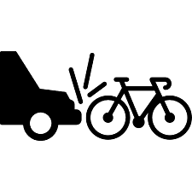

KA crashes: 5-year data by CRASH TYPE
Left-Turn/Angle Crashes:
83.4% of all LT/ANG KA occur at intersections
Stop sign control account for (40.2%)
Of segments LT/ANG, 53.8% occurred on 2-lane undivided roadways
Majority of left turn crashes are in urban (57.2%) vs. rural
Pedestrian/Bike Crashes:
71.2% occurred on segments vs. intersections: with a majority (58.4%) on 2-lane roads
Among intersection crashes (28.8%), most occurred at non-signalized (46.1%)
More frequent in urban areas (57.4%)
(20.1%) at urban intersections
A significant portion occurred in dark–not lighted conditions (26.1%)
Rear end crashes:
62.9% on roadway segments
Among intersection crashes (37.1%), 57% non-signalized and 43% signalized
RE Crashes were more frequent in urban areas (61.5%).
Lake~Sumter MPO Vision Zero Safety Action Plan

Slide 23
IDENTIFYING THE HIGH-INJURY Network

Slide 24
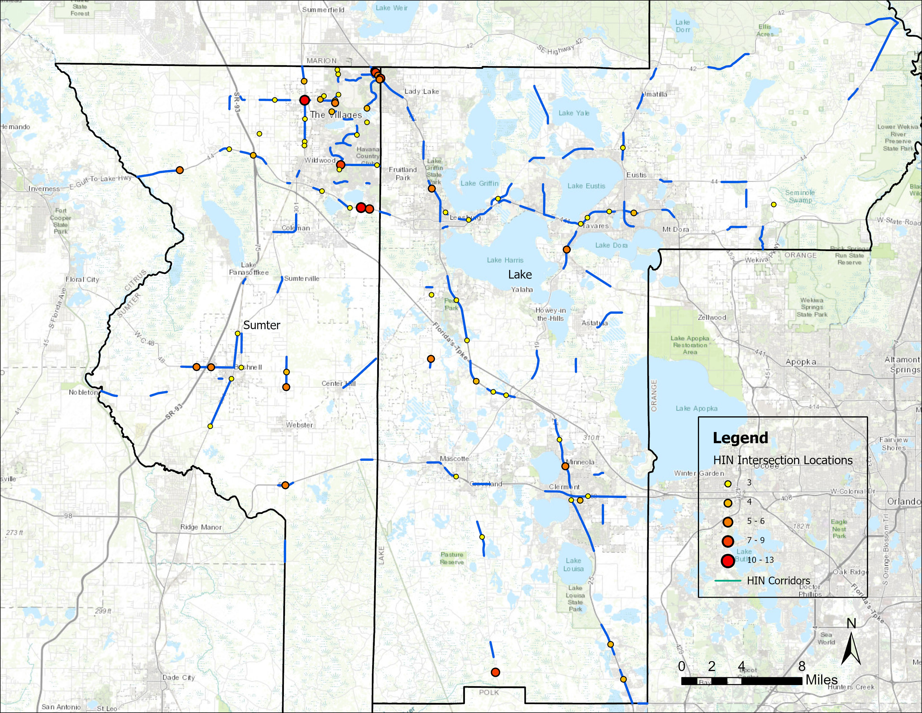
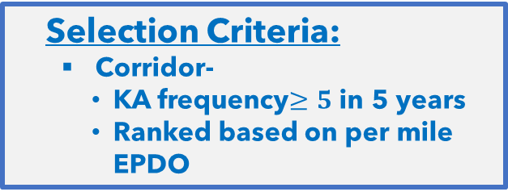
Overall high-injury network
108 corridors
70 intersections
Selection Criteria:
Corridor-
KA frequency$≥5$in 5 years
Ranked based on per mile EPDO

Slide 25
High Injury Network: crash Severity Factor
Each crash is then weighted based on Estimated Property Damage Only (EPDO) Factor
Crash Severity | Comprehensive Crash Cost | Crash Weighting Factor
Fatal (K) | $10,890,000 | 1414
Severe Injury (A) | $888,030 | 115
Moderate Injury (B) | $180,180 | 23
Minor Injury (C) | $103,950 | 14
Property Damage Only (O) | $7,700 | 1
Source: Florida Department of Transportation State Safety Office’s Crash Analysis Reporting (CARS) System, analysis years 2015 through 2019. Published by FDOT State Safety Office on 2/23/2022.
Lake~Sumter MPO Vision Zero Safety Action Plan

Slide 26
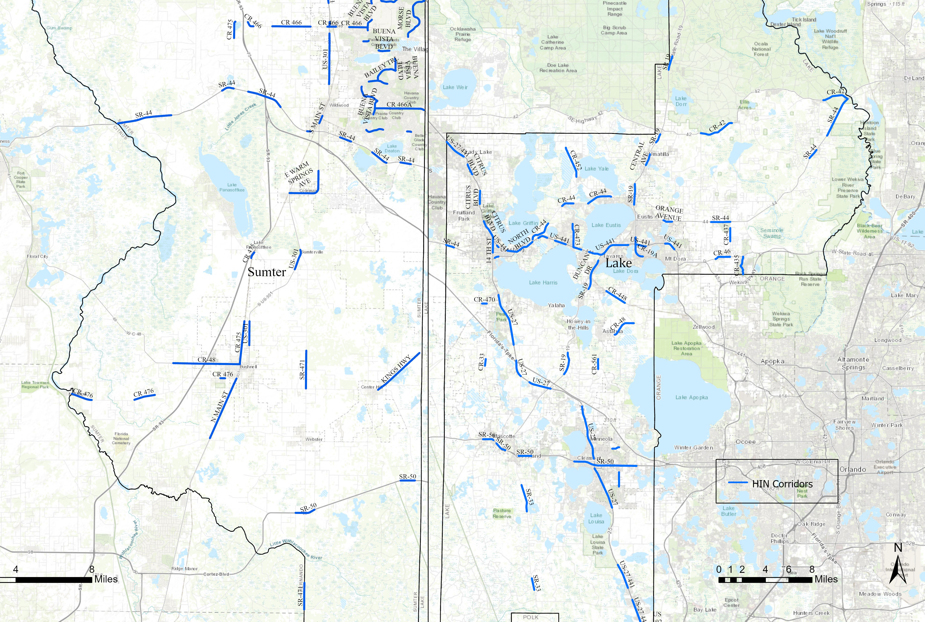
High Injury Network: MPO REGION
Key Takeaways
Total of 108 corridors
Lake County: 59 corridors accounting for 633 KA crashes within 99 miles
Sumter County: 49 corridors include 518 KA crashes over 59 miles
Critical corridors include:
US27/441, Marion County Line to Morse Blvd, 45 KA crashes (1.01 miles)
US301, CR 466 to NE 120 recorded 15 KA crashes (0.26 miles)
SR 44, Morse Blvd to Vivienne Dr, 23 KA crashes (0.56 miles)
Lake~Sumter MPO Vision Zero Safety Action Plan

Slide 27
High injury network statistics
1
The High Injury Network collectively accounts for 1186 KA crashes which is 50% of total KA crashes (2020-2024)
The cumulative length of the corridors is approximately 156.48 miles, which is 13.8% of the analyzed roadways, with an average corridor length of 1.48 miles
The average number of KA crashes per corridor is 10.8 with highest observed 45 KA and lowest 3 KA crashes
The High Injury Network also includes:
74 pedestrian-involved KA crashes (41.1% of all pedestrian KA)
52 bicycle-involved KA crashes (52% of all bicycle KA)
180 motorcycle-involved KA crashes (51.4% of all motorcycle KA)
2
3
4
Lake~Sumter MPO Vision Zero Safety Action Plan

Slide 28
High Injury Network: TOP 20 CORRIDORS
No | Name | County | From Intersecting Road | To Intersecting Road | All Crashes (KABCO) | Total Severe Crashes (KA) | Total Pedestrian Involved KA Crashes | Total Bicyclist Involved KA Crashes | Total motorcycle involved KA | Per mile EPDO | Length (mile)
1 | SR-44 | Sumter | MORSE BLVD | VIVIENNE DR | 177 | 24 | 0 | 0 | 3 | 13519 | 0.56
2 | US 192 | Lake | KERSEY ST | OUTDOOR RESORTS | 278 | 14 | 6 | 0 | 2 | 12482 | 0.60
3 | US-301 | Sumter | NE 120 XING | CR-466 | 200 | 15 | 0 | 0 | 0 | 10174 | 0.26
4 | CR 475 | Sumter | RAMP 18130016 | RAMP 18130020 | 50 | 6 | 0 | 0 | 0 | 10133 | 0.34
5 | DIXIE AVE | Lake | MCKENZIE ST | S 9TH ST | 80 | 5 | 1 | 0 | 4 | 9991 | 0.35
6 | US-27/441 | Sumter | MARION CNTY LINE | MORSE BLVD | 430 | 45 | 1 | 0 | 2 | 9443 | 1.01
7 | CR-33 | Lake | AUSTIN MERRITT RD | CHARTER LN | 60 | 7 | 0 | 0 | 0 | 9014 | 0.58
8 | SR-44 | Sumter | POWELL RD | BUENA VISTA BLVD | 123 | 6 | 1 | 0 | 0 | 8547 | 0.62
9 | SR-44 | Lake | SPRUCE DR | RORY LN | 35 | 7 | 1 | 1 | 1 | 8134 | 0.93
10 | 14 TH ST | Lake | CR-44A/GRIFFIN RD | W MAIN ST | 558 | 12 | 2 | 4 | 2 | 7863 | 1.19
11 | CITRUS BLVD | Lake | PALM ST | GRAFFIN RD | 677 | 21 | 4 | 1 | 2 | 7208 | 1.74
12 | US-441 | Lake | 11010005 WB OFF | SPRING HARBOR BLVD | 257 | 8 | 0 | 0 | 0 | 5702 | 0.81
13 | CR-19A | Lake | W CHARLOTTE AVE | OLD US-441 | 367 | 18 | 4 | 3 | 5 | 5701 | 2.03
14 | NORTH BLVD | Lake | N LAKE ST | CR-44 | 788 | 22 | 2 | 0 | 7 | 5490 | 2.45
15 | SR-44 | Sumter | CR-231 | CR-44A | 321 | 23 | 4 | 1 | 1 | 5407 | 1.95
16 | SR-50 | Lake | PEARL ST | VILLA CITY RD | 134 | 6 | 0 | 2 | 1 | 5335 | 0.99
17 | CR-470 | Lake | PALMETTO AVE | CR 33 | 36 | 5 | 0 | 0 | 2 | 4927 | 0.41
18 | BUENA VISTA BLVD | Sumter | SOUTHERN TRCE | PARR DR | 121 | 13 | 0 | 2 | 1 | 4912 | 0.66
19 | BUENA VISTA BLVD | Sumter | ST CHARLES PL | PINELLAS PL | 116 | 8 | 0 | 0 | 1 | 4782 | 0.80
20 | US-441 | Lake | PROFESSIONAL DR | TAVARES AVE | 89 | 5 | 1 | 0 | 2 | 4506 | 0.83
Note: The ranking is based on the per mile EPDO score
Lake~Sumter MPO Vision Zero Safety Action Plan

Slide 29
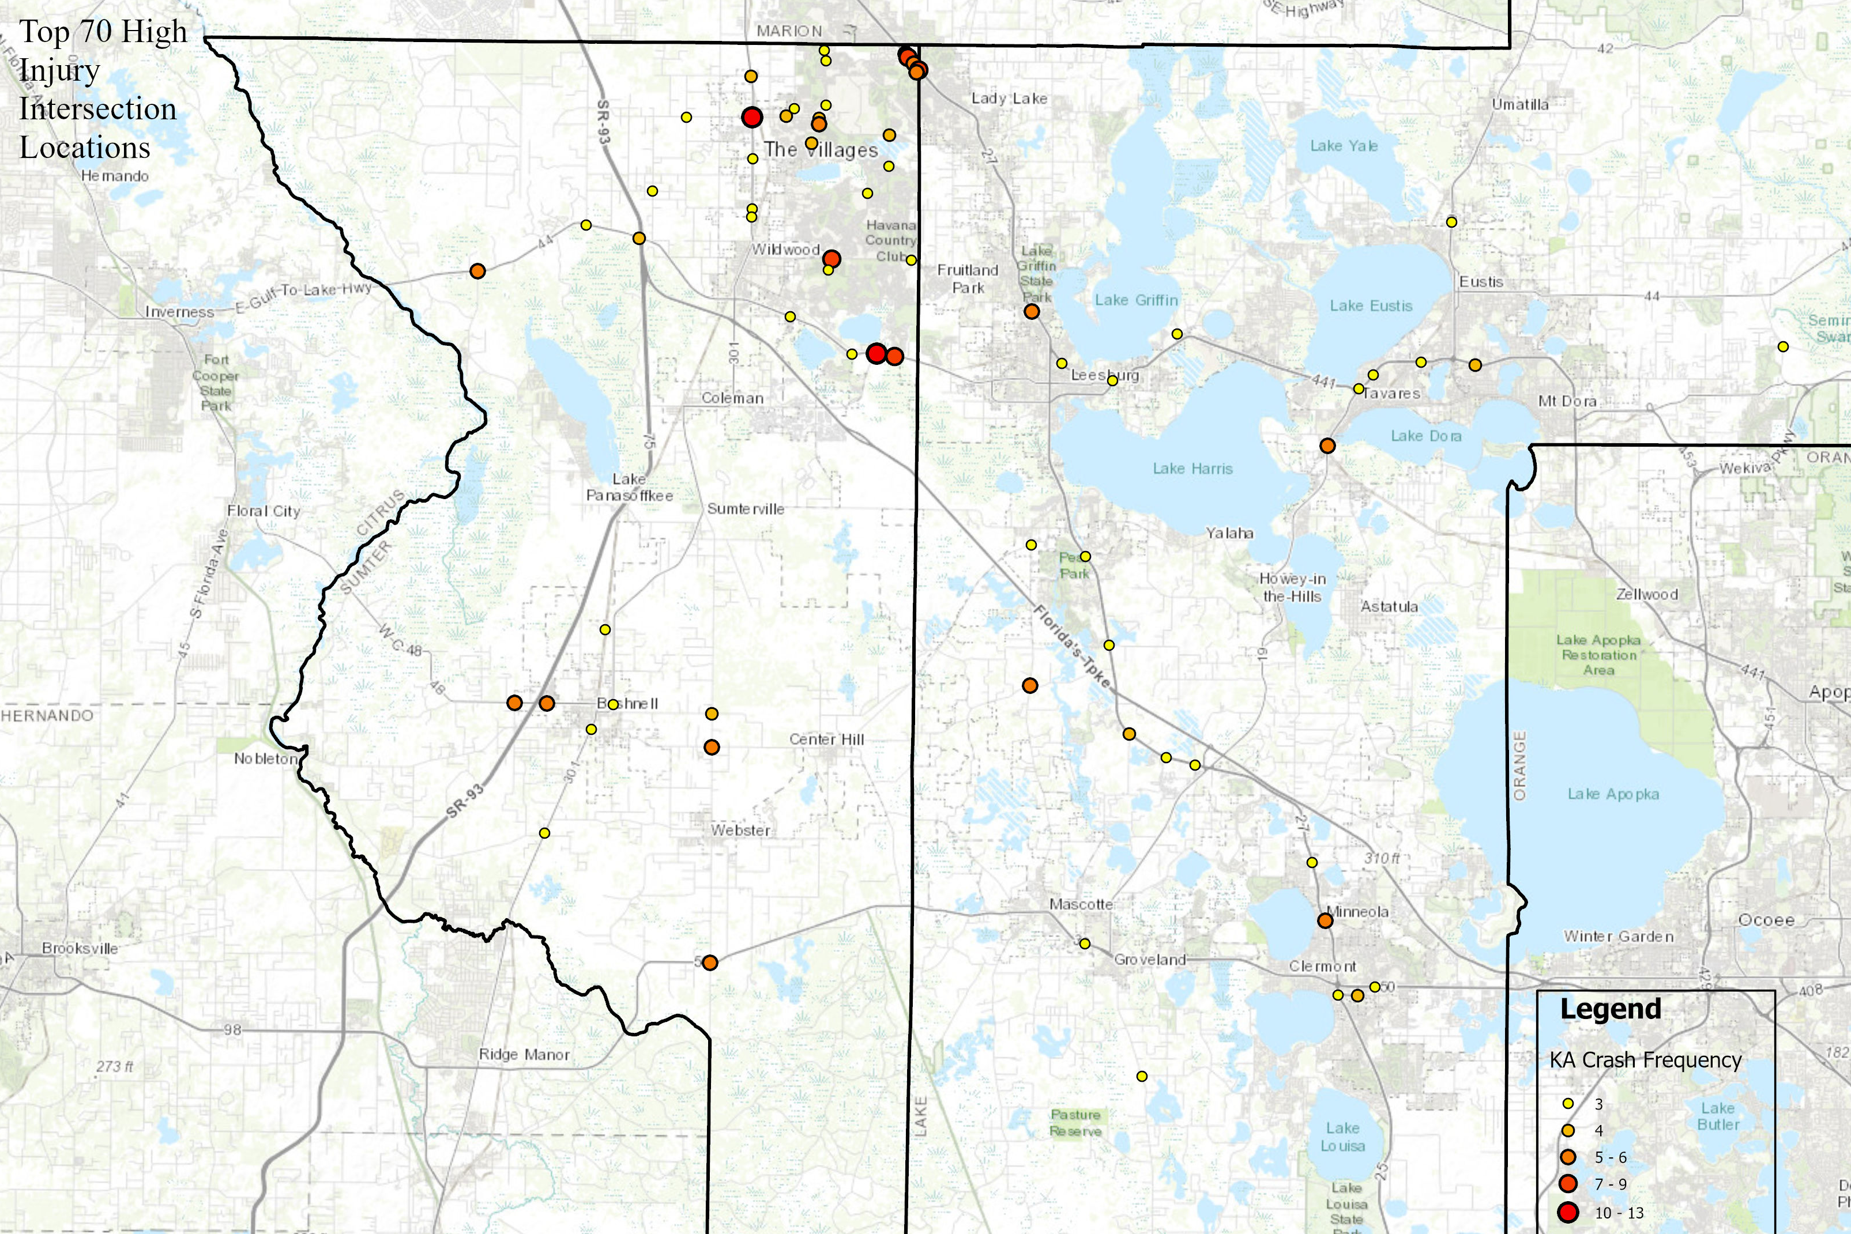
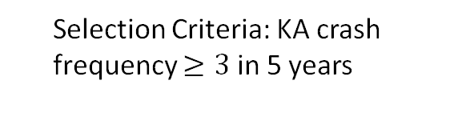
KA crashes: HIGH INJURY INTERSECTIONS
Key Takeaways
70 intersections as High Injury Intersections
27 are signalized
43 are unsignalized
1
2
Selection Criteria: KA crash frequency $≥3$ in 5 years
They were ranked by total KA frequency, fatal (K) frequency, and KA crash rate (calculated using total entering volume, TEV)
3
Lake~Sumter MPO Vision Zero Safety Action Plan

Slide 30
HIN INTERSECTIONS: SIGNALIZED & Unsignalized
SL | County | Intersection Type | Area | Major Roadway | Minor Roadway | KA | K | BCO | KA Crash Rate
1 | Sumter | Four Way Intersection | Urban | US 301 | CR 466 | 13 | 0 | 167 | 0.23
2 | Sumter | Four Way Intersection | Urban | SR 44 | MORSE BLVD | 11 | 1 | 96 | 0.17
3 | Sumter | Four Way Intersection | Urban | US 27/441 | MORSE BLVD | 8 | 0 | 75 | 0.08
4 | Sumter | Four Way Intersection | Urban | US 27/441 | NE 136TH AVE | 7 | 0 | 91 | 0.10
5 | Sumter | Four Way Intersection | Rural | SR 50 | SR 471 | 6 | 1 | 27 | 0.22
6 | Sumter | T Intersection | Rural | CR 48 | Lowery St | 6 | 0 | 30 | 0.59
7 | Sumter | Four Way Intersection | Urban | CITRUS BLVD | DR MLK JR BLVD | 5 | 1 | 44 | 0.06
8 | Sumter | Four Way Intersection | Rural | SR 471 | E SOUTHLAND AVE | 5 | 0 | 20 | 0.19
9 | Sumter | Four Way Intersection | Urban | US 27/441 | Bella Cruz Dr | 5 | 0 | 38 | 0.07
10 | Lake | Four Way Intersection | Urban | US 27 | WASHINGTON ST | 5 | 0 | 35 | 0.06
Top 10 HIN Signalized
SL | Location | Intersection Type | Area | Major Roadway | Minor Roadway | KA | K | BCO | KA Crash Rate
1 | Sumter | T Intersection | Rural | SR 33 | CR 474 | 9 | 1 | 35 | 0.29
2 | Sumter | T Intersection | Urban | SR 44 | Vivienne Dr | 8 | 1 | 27 | 0.19
3 | Sumter | Four Way Intersection | Urban | CR 466A | BUENA VISTA BLVD | 8 | 1 | 71 | 0.15
4 | Sumter | Four Way Intersection | Urban | CR 33 | BRIDGES RD | 6 | 2 | 46 | 0.41
5 | Sumter | Four Way Intersection | Urban | SR 19 | CR 561 | 6 | 2 | 24 | 0.10
6 | Sumter | T Intersection | Rural | SR 44 | CR 470 | 6 | 0 | 25 | 0.18
7 | Sumter | T Intersection | Rural | CR 48 | CR 616 | 5 | 2 | 11 | 0.49
8 | Sumter | Roundabout | Urban | MORSE BLVD | EL CAMINO REAL | 5 | 1 | 104 | 0.08
9 | Sumter | Four Way Intersection | Urban | BUENA VISTA BLVD | Parr Dr | 5 | 0 | 14 | 0.23
10 | Lake | T Intersection | Urban | US 27/441 | - | 5 | 0 | 16 | 0.07
Top 10 HIN Unsignalized
Lake~Sumter MPO Vision Zero Safety Action Plan

Slide 31
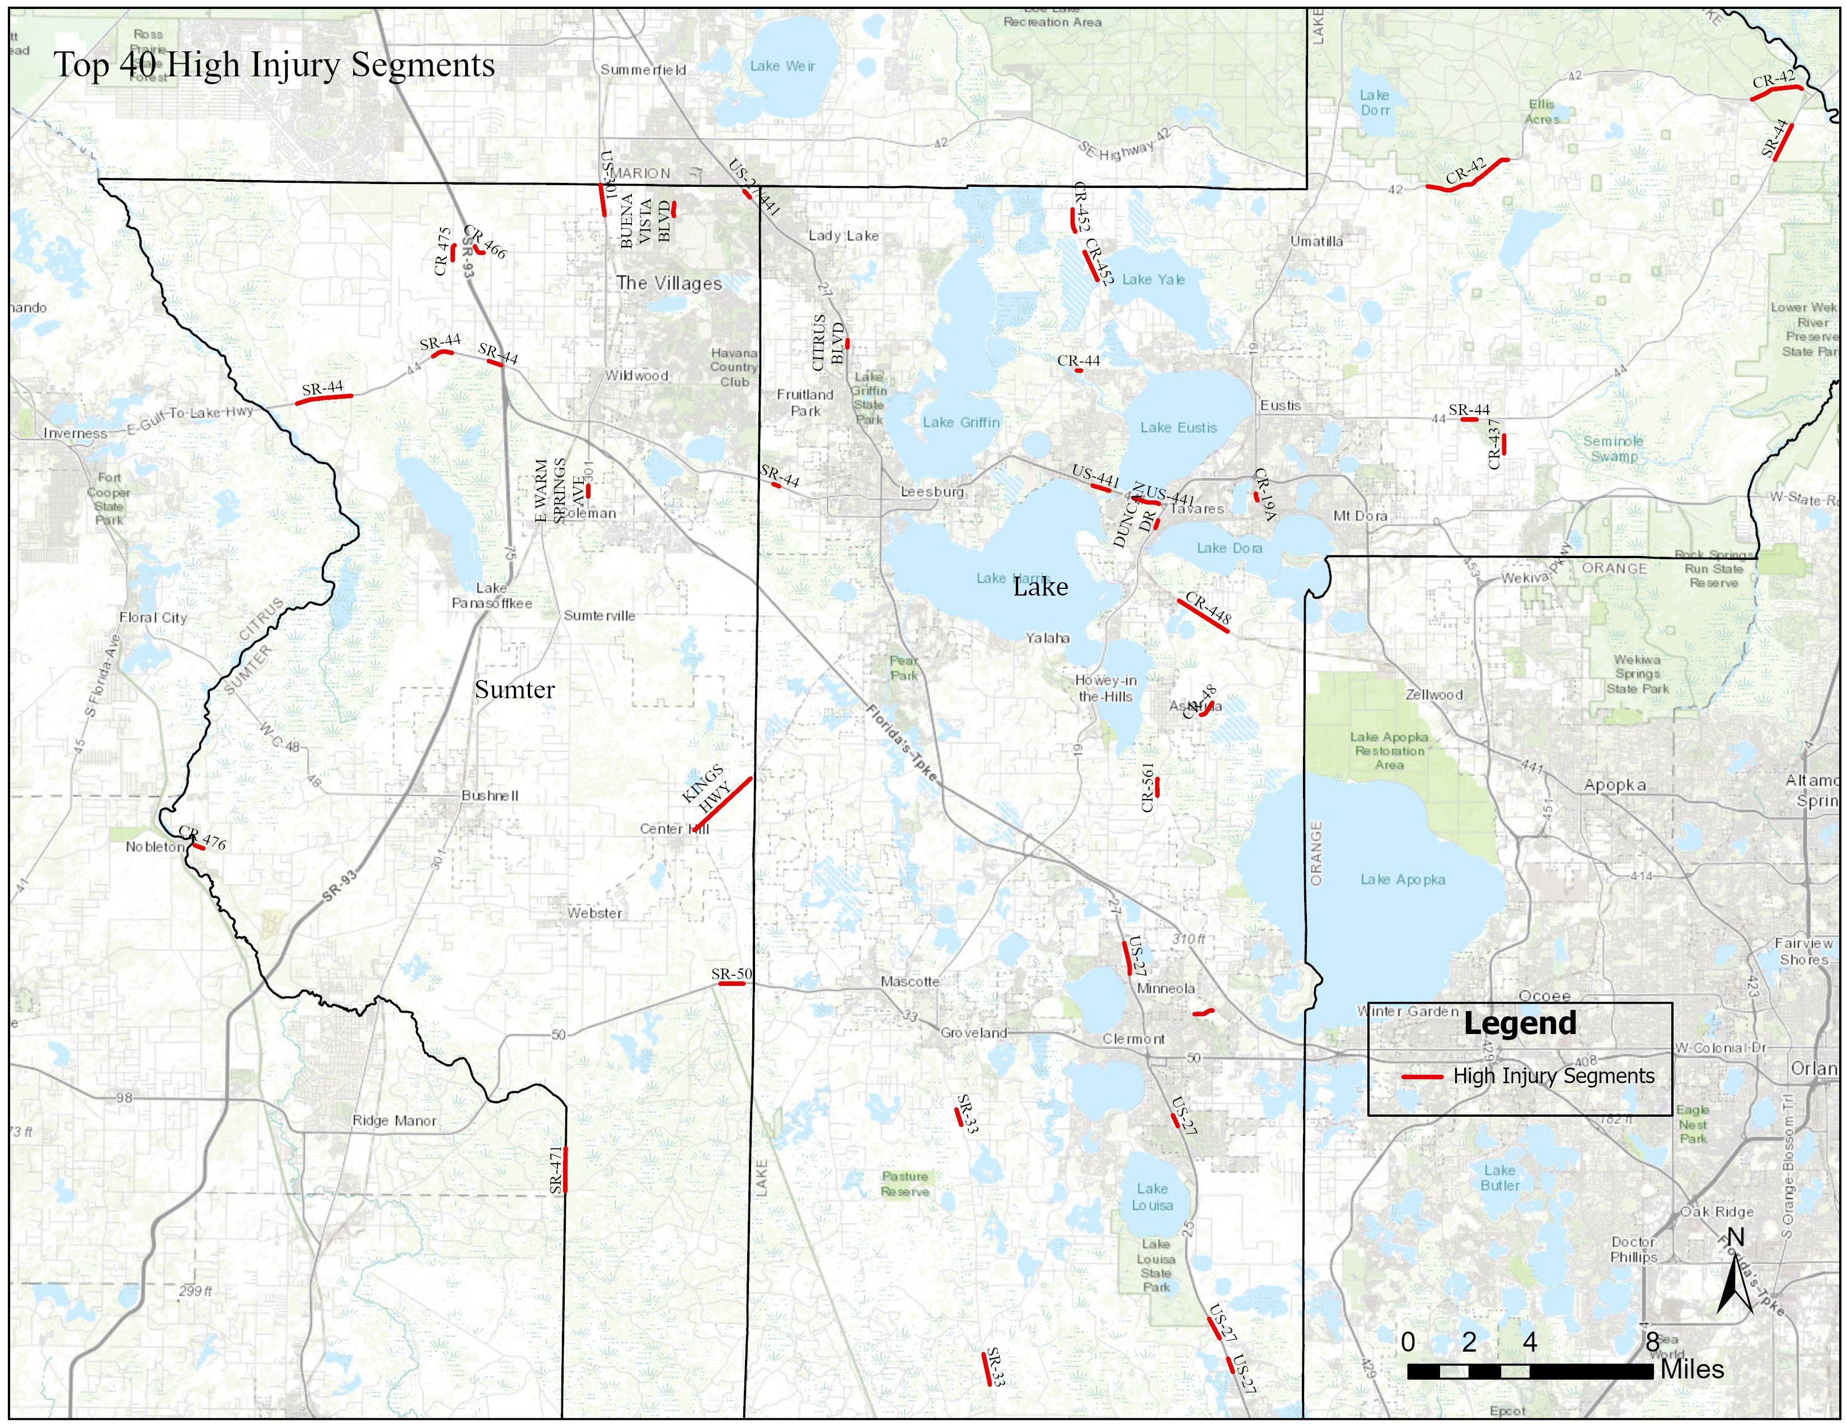
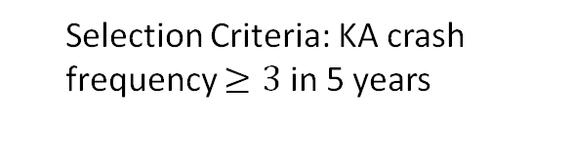
KA crashes: HIGH INJURY SEGMENTS
Key Takeaways
40 segments as High Injury Segments
1
Selection Criteria: KA crash frequency $≥3$ in 5 years
2
They were ranked by KA crash rate (calculated using Million Vehicle Miles , MVM), total KA frequency and K frequency.
3
Lake~Sumter MPO Vision Zero Safety Action Plan

Slide 32
High Injury Network: TOP 20 Segments
No | Roadway Name | County | From Intersecting Road | To Intersecting Road | Functional Class | Context Classification | Lane Per Direction | Speed (mph) | Total KA | Total BCO | KA Crash Rate | Length (mile)
1 | CR 476 | Sumter | CR 647 | CR 659 | Rural Major Collector | - | 1 | 45 | 3 | 16 | 1.274 | 0.31
2 | CR-44 | Lake | EMERALDA AVE | RHETT RD | Urban Major Collector | C3R | 1 | 40 | 3 | 12 | 1.062 | 0.14
3 | US-27/441 | Sumter | NE 138TH | LOWES | Urban Principal Arterial-Other | C3C | 3 | 45 | 8 | 43 | 0.782 | 0.14
4 | CR-42 | Lake | TENTH ST | RIVER FOREST BLVD | Rural Major Collector | - | 1 | 55 | 8 | 24 | 0.699 | 1.73
5 | CR-19A | Lake | BAY RD | DODSON CUTOFF | Urban Minor Arterial | C3C | 1 | 45 | 3 | 23 | 0.651 | 0.23
6 | CR 475 | Sumter | CR 245E | CR 246 S | Rural Major Collector | - | 1 | 45 | 3 | 6 | 0.626 | 0.52
7 | SR-44 | Sumter | CR-231 | 18120021 SB ON | Rural Principal Arterial-Other | C3C | 2 | 45 | 5 | 73 | 0.590 | 0.43
8 | CR-561 | Lake | DOUBLE RUN RD | WHITE CYPRESS RD | Rural Major Collector | C2 | 1 | 50 | 4 | 7 | 0.498 | 0.56
9 | CR-48 | Lake | LAYLAINE DR | RANCH RD | Rural Major Collector | - | 1 | 55 | 3 | 10 | 0.498 | 0.57
10 | E WARM SPRINGS AVE | Sumter | NE 41 LN | NE 37 PL | Urban Principal Arterial-Other | C2 | 1 | 55 | 5 | 13 | 0.478 | 0.35
11 | SR-44 | Lake | FOREST DR | TOMAHAWK TRL | Rural Principal Arterial-Other | C2 | 1 | 55 | 3 | 8 | 0.474 | 0.40
12 | CR 466 | Sumter | CR 475 | N MAIN ST | Rural Major Collector | - | 1 | 45 | 3 | 16 | 0.465 | 0.41
13 | CR-42 | Lake | CR 439 | CLEARWATER LAKE REC | Rural Major Collector | - | 1 | 55 | 7 | 40 | 0.357 | 2.97
14 | SR-44 | Lake | COUNTRYSIDE BLVD | UNSIGNED | Urban Principal Arterial-Other | C3R | 2 | 55 | 3 | 8 | 0.353 | 0.21
15 | OLD HIGHWAY 50 | Lake | N HANCOCK RD | BLACK STILL LAKE RD | Urban Major Collector | - | 1 | 35 | 3 | 16 | 0.314 | 0.63
16 | SR-33 | Lake | GROVENLAND FARMS RD | MCGILL RD | Urban Principal Arterial-Other | C2 | 1 | 60 | 3 | 10 | 0.310 | 0.53
17 | US-27/441 | Sumter | Lowe's | NE 136TH | Rural Minor Arterial | C3C | 3 | 45 | 3 | 52 | 0.310 | 0.14
18 | SR-44 | Sumter | CR 243 | CR 475 | Rural Principal Arterial-Other | C2 | 2 | 60 | 4 | 18 | 0.309 | 0.66
19 | KINGS HWY | Sumter | CR 702 | CR 558 | Rural Minor Collector | - | 1 | 45 | 5 | 22 | 0.300 | 2.51
20 | SR-471 | Sumter | S CARTER RD | N GRADE RD | Rural Minor Arterial | - | 1 | 60 | 3 | 6 | 0.273 | 1.41
Lake~Sumter MPO Vision Zero Safety Action Plan

Slide 33
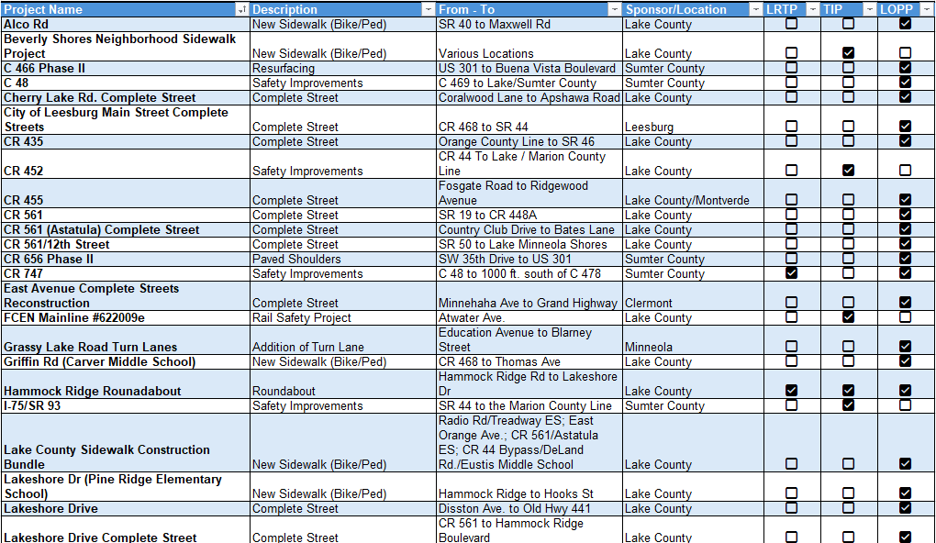
24 PROJECTS PLANNED
WHAT THE MPO and Local Jurisdictions ARE WORKING ON TO IMPROVE SAFETY…
Lake~Sumter MPO Vision Zero Safety Action Plan

Slide 34
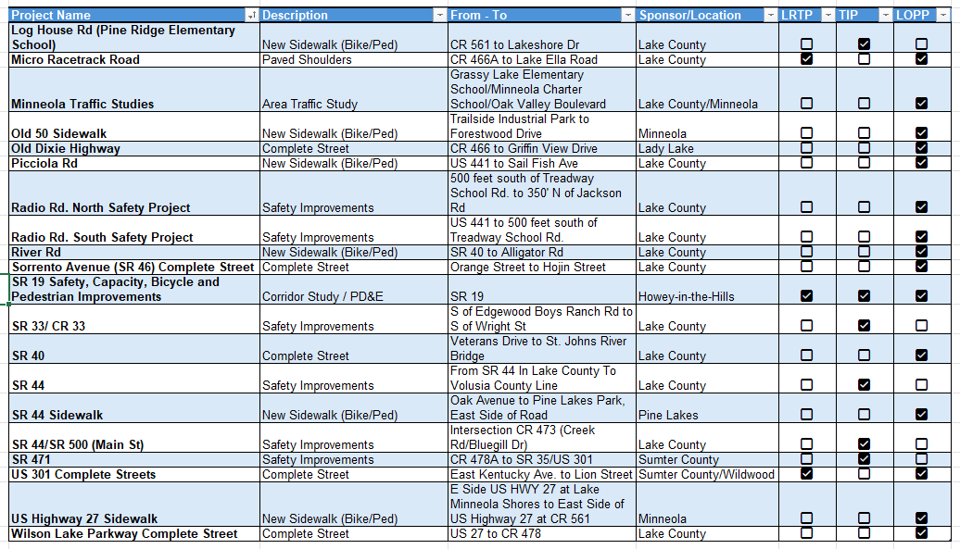
+ 20 PROJECTS PLANNED
WHAT THE MPO and Local Jurisdictions ARE WORKING ON TO IMPROVE SAFETY…
Lake~Sumter MPO Vision Zero Safety Action Plan

Slide 35
1
Public Safety Survey
Initiated October 2, 2025
Survey closes December 10, 2025
Survey – UCF Smart & Safe Transportation Lab
NEXT STEPS
2
LSMPO Board Presentation – Feb. 25, 2026
3
Final Vision Zero Action Plan (Spring 2026)
4
TAC/CAC Adoption (April 2026)
5
Board Adoption (April 2026)
Lake~Sumter MPO Vision Zero Safety Action Plan

Slide 36
Thank You
Dr. Mohamed Abdel-Aty and UCF SST team
https://smartsafe.ucf.edu/

