Slide 1
Lake~Sumter MPO April 12, 2023 Advisory Committee Meeting
Michael Woods, Executive Director

Slide 2
Call to Order by Chair
Invocation / Pledge of Allegiance
Proper Noticing
Roll Call – Determination of Quorum
Chair's Announcements
Motion to allow virtual voting by members
Update: Proposed revisions to Today’s Agenda

Slide 3
II.
OPPORTUNITY FOR PUBLIC COMMENT on Agenda or General Comments
At this point in the meeting, the Committee will hear citizens' questions, comments, and concerns. If the issue raised is not on today's Agenda, the Committee will not take action at this meeting. Questions may be answered by staff or referred for appropriate staff action. If further action is necessary, the item may be placed on a future committee agenda. Public comment shall be limited to three minutes per person.

Slide 4
ACTION ITEMS
Approval of TAC February 8, 2023, Meeting Minutes
Lake~Sumter MPO Transportation Improvement Program (TIP) 2023-2027 Amendment
Project # 443623-1 I-75 (SR 93) Turnpike to SR 200, 22.496 miles, Phase PLN, Fund Source HP, amount $2,500,000 in fiscal year 2023.

Slide 5
ACTION ITEMS
Approval of CAC February 8, 2023, Meeting Minutes
Lake~Sumter MPO Transportation Improvement Program (TIP) 2023-2027 Amendment
Project # 443623-1 I-75 (SR 93) Turnpike to SR 200, 22.496 miles, Phase PLN, Fund Source HP, amount $2,500,000 in fiscal year 2023.

Slide 6
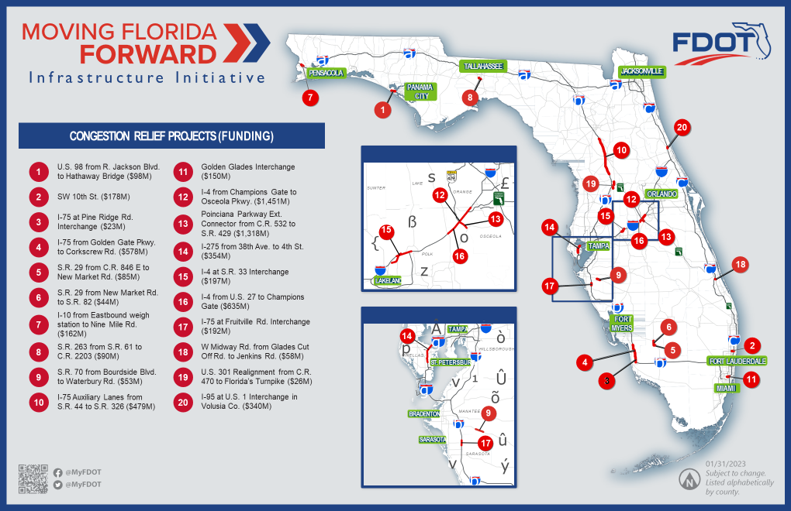

Slide 8
DISCUSSION ITEMS
2023 DRAFT List of Priority Projects (LOPP) – Preliminary DRAFT Review
B. FDOT Decennial Functional Classification Review
C. Lake~Sumter MPO WORKING DRAFT TIP FY 2024-2028

Slide 9
DISCUSSION ITEMS
2023 DRAFT List of Priority Projects (LOPP) – Preliminary DRAFT Review
B. Lake~Sumter MPO WORKING DRAFT TIP FY 2024-2028

Slide 10
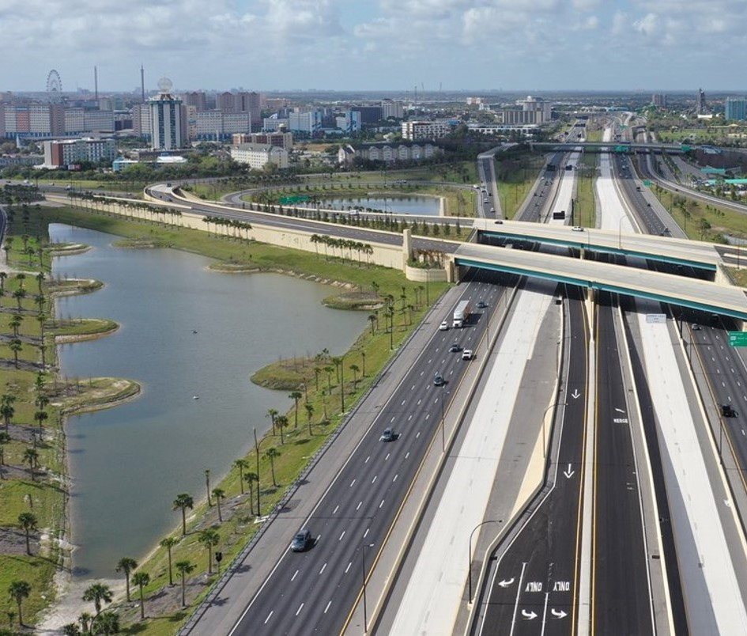
District Five Functional Classification Update Process Lake Sumter MPO
April 12, 2023

Slide 11
D5 Functional Classification Overview
Process to Date
Upcoming Schedule
D5 Functional Classification Online Application
Next Steps
Questions
AGENDA

Slide 12
Overview Presentation to D5 MPO/TPO Committees Aug to Sep 2022
Lake~Sumter MPO Technical & Community Advisory Committees
MetroPlan Orlando Technical, Citizens, and Municipal Advisory Committees
Ocala Marion TPO Technical and Citizens Advisory Committees
River to Sea TPO Technical Coordinating & Citizens Advisory Committees
Space Coast TPO Technical and Citizens Advisory Committees
PROCESS TO DATE

Slide 13
Conducted D5 Functional Classification Internal Review Aug to Dec 2022
D5 conducted comprehensive review and update to:
Address changes in the roadway system
Reevaluate roadway function districtwide
The result is the PROPOSED Functional Classification data layer
Completed Draft Functional Classification Online Application Jan 2023
MPO Staff Reviewed Online Application Feb 2023
Finalized Online Application March 2023
PROCESS TO DATE

Slide 14
Functional Classification Review Process
Begin Lake Sumter MPO/Local Agency Review Process – April 12
TPO and Local Agencies conduct review and provide comments; FDOT is available to provide technical assistance – Through May 26
FDOT will present Final Lake and Sumter County Functional Classification Maps to Lake Sumter MPO Committees (June 14) and Board (June 21) for Approval
UPCOMING SCHEDULE

Slide 15
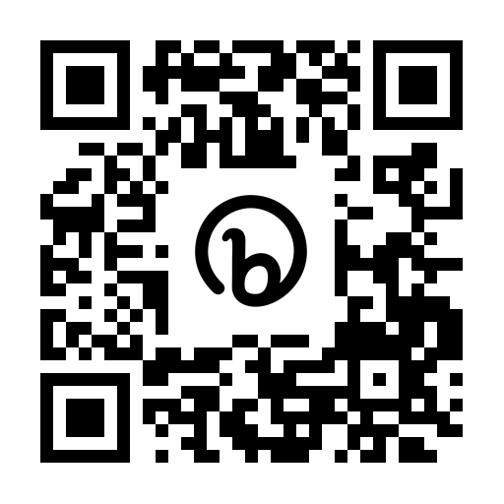
D5 APPLICATION
http://bit.ly/d5funclass

Slide 16
Begin Functional Classification Review Process
Local Agencies…
Identify lead for Functional Classification Review
Contact D5 if questions or to schedule specific discussion
Provide comments through online application
Complete all review and comments by May 26
NEXT STEPS

Slide 17
Questions
Notes:
Our team is happy to take any questions.

Slide 18
PRESENTATIONS, STATUS REPORTS
A. FDOT Report
B. FTE Report
C. Transit Reports-
D. County, City, MPO Updates

Slide 19
Committee member COMMENTS:
COMMITTEE MEMBER COMMENTS
Adjournment
Next Meeting: June 14, 2023 @ 1:30 PM

Slide 20
Committee member COMMENTS:
COMMITTEE MEMBER COMMENTS
Adjournment
Next Meeting: June 14, 2023 @ 3:00 PM

