Slide 1

Lake~Sumter MPO
February 8, 2023
Advisory Committee Meeting
Michael Woods, Executive Director

Slide 2
Call to Order by Chair
Invocation / Pledge of Allegiance
Proper Noticing
Roll Call – Determination of Quorum
Chair's Announcements
Motion to allow virtual voting by members
Update: Proposed revisions to Today’s Agenda

Slide 3
II.
OPPORTUNITY FOR PUBLIC COMMENT on Agenda or General Comments
At this point in the meeting, the Committee will hear citizens' questions, comments, and concerns. If the issue raised is not on today's Agenda, the Committee will not take action at this meeting. Questions may be answered by staff or referred for appropriate staff action. If further action is necessary, the item may be placed on a future committee agenda. Public comment shall be limited to three minutes per person.

Slide 4

CONSENT AGENDA ITEMS:
Approval of October 12, 2022, TAC Meeting Minutes
Review and approve the 2023 Committee Meeting Calendar: Apr 12, 2023 @ 1:30, Jun 14, 2023 @ 1:30, Oct 11, 2023 @ 1:30, Nov 8, 2023 @ 1:30
Approval of Amendment #2 for the Unified Planning Work Program, moving funds within Tasks. No new funding.

Slide 5
CONSENT AGENDA ITEMS:
Approval of October 12, 2022, CAC Meeting Minutes
Review and approve the 2023 Committee Meeting Calendar: Apr 12, 2023 @ 3:00, Jun 14, 2023 @ 3:00, Oct 11, 2023 @ 3:00, Nov 8, 2023 @ 3:00
Approval of Amendment #2 for the Unified Planning Work Program, moving funds within Tasks. No new funding.

Slide 6
UPWP Amendment moving funds to balance Task budgets. This funding adjustment requires MPO Board approval as it is over the threshold to be considered a modification.
Summary of moving funds:
PL 112 Funds (G2795)
Move 60,000 From Task 4 Consultants to Task 3 Consultants
Move 10,000 From Task 4 Personnel to Task 3 Consultants
5305 Funds (G2761) FDOT has requested the MPO spend the 5305 funds prior to PL funds
Move 30,229 Task 2 Consultant to Task 4 Consultant
5305 Funds (G1X23) FDOT has request the MPO spend the 5305 funds prior to the PL funds
Move 24,005 From Task 1 MPO Staff Salaries to Task 3 Consultants
Move 10,265.59 From Task 1 Consulting Services to Task 3 Consultants
Move 6,250 From Task 1 Accounting/Financial Analysis to Task 3 Consultants
Move 3,000 From Task 2 Personnel to Task 3 Consultants
Move 6,000 From Task 2 Consultant to Task 3 Consultants
Move 4,500 From Task 3 Personnel to Task 3 Consultants
Move 4,500 From Task 4 Personnel to Task 3 Consultants
Move 1,500 From Task 5 Personnel to Task 3 Consultants
Move 2,991.40 From Task 5 Consultant to Task 3 Consultants
Move 2,000 From Task 6 MPO Staff Salaries to Task 3 Consultants

Slide 7
ACTION ITEMS:
Election of Technical Advisory Committee (TAC) Officers Effective 2023
B. 2045 Long Range Transportation Plan (LRTP) Amendment.
C. 2023-2027 LSMPO Transportation Improvement Program (TIP) Amendment

Slide 8
ACTION ITEMS:
Election of Community Advisory Committee (CAC) Officers Effective 2023
B. 2045 Long Range Transportation Plan (LRTP) Amendment.
C. 2023-2027 LSMPO Transportation Improvement Program (TIP) Amendment

Slide 9
Action Item A: Election of Technical Advisory Committee (TAC) Officers Effective 2023
Chair and Vice-Chair shall be elected at the last scheduled meeting of each year and shall serve a term of one year, starting with the first meeting of the new year. Deborah Snyder, P.E , Director of Public Works, Sumter County, is the current Chair; the Vice-Chair position is vacant.

Slide 10
Action Item A: Election of Community Advisory Committee (TAC) Officers Effective 2023
A Chair and Vice-Chair shall be elected each year and shall serve a term of one year, starting with the first meeting of the new year. Jerry Prince is the current Chair, and Egor Emery is the current Vice-Chair.

Slide 11
ACTION ITEM B: 2045 Long Range Transportation Plan (LRTP) Amendment.
FDOT has requested that the Lake~Sumter MPO's 2045 LRTP be amended to add the Citrus Grove Rd Phase II Project to the Cost Feasible Plan. The Public review period for this LRTP amendment was opened on February 1, 2023, and will close on February 22, 2023, at the MPO Governing Board meeting. The Florida legislature awarded the City of Minneola an $8m appropriation for the project in the previous legislative session. Staff was also updating the text for the narrative for the Complete Streets section, updating the previously ongoing studies and augmenting to reference Complete Streets improvements that may be completed through FDOT's RRR program.
Staff recommends approval of the amendment as presented.
Attachments: LSMPO 2045 LRTP Amendment Packet

Slide 12

2045 LRTP Amendment #2
Technical Advisory Committee
&
Community Advisory Committee
February 8, 2023

Slide 13
LRTP Amendment Summary
LRTP amendment requested by FDOT to reflect the Department’s Five-Year Work Program
Citrus Grove Road Phase II received $8M legislative appropriation
  $11,558,896 programmed for construction in FY 2023 (includes $3,558,896 in local funds)
  Cost Feasible Projects tables/maps updated to reflect project is fully funded
  Project removed from Unfunded Needs table

Slide 14
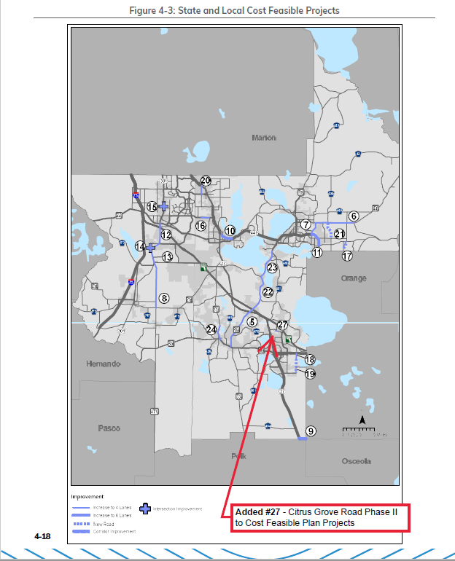
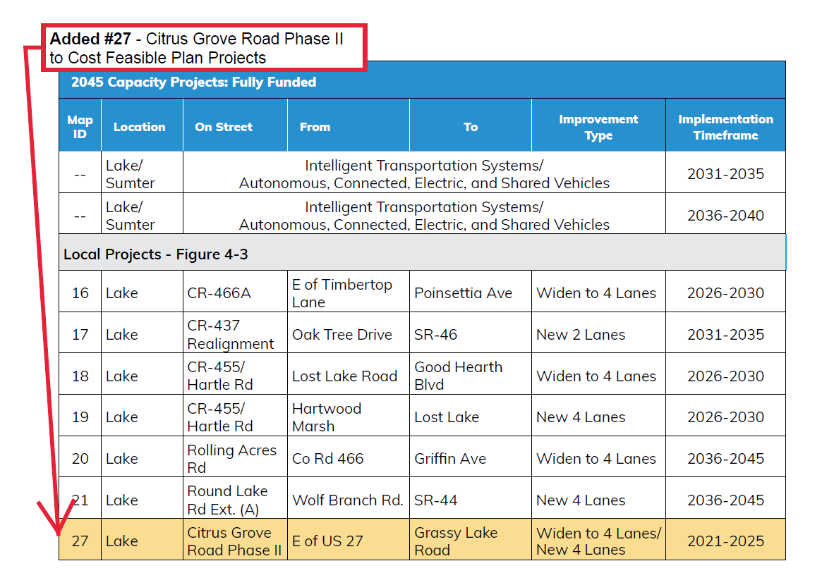

Slide 15
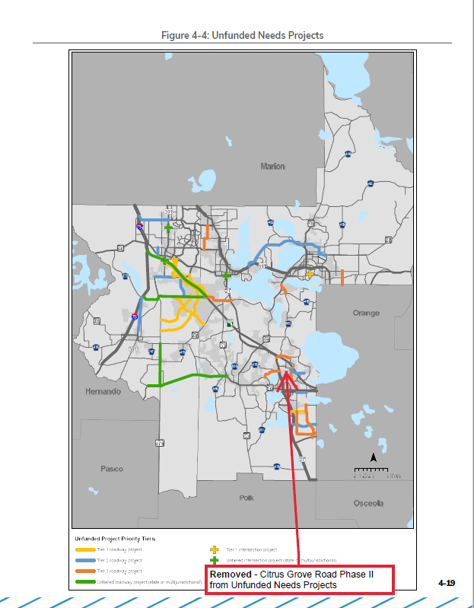
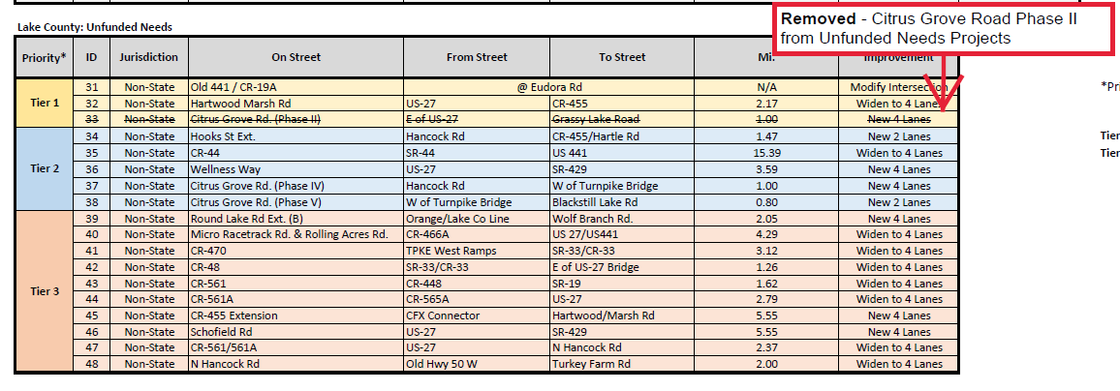

Slide 16
ACTION ITEM C: 2023-2027 LSMPO Transportation Improvement Program (TIP) Amendment
FDOT has requested that the MPO amend the TIP to include Citrus Grove Rd. Phase II project, Lake County Transit Funding, and an area-wide Safety Project to install rumble strips in the MPO planning area. The Public Review Period for this TIP amendment was opened on February 1, 2023, and will close on February 22, 2023, at the MPO Governing Board meeting
Staff recommends approval of the TIP Amendment as presented.
Attachments: LSMPO 2023-2027 TIP Amendment Packet.

Slide 17

Transportation Improvement Program FY 2023- 2027
Amendment # 2
Approved June 22, 2022 Amendment #1- September 23, 2022 Amendment #2- Pending
Prepared for the Lake – Sumter Metropolitan Planning Organization 1300 Citizens Blvd., Suite 175 Leesburg, FL 34748
-

Slide 18
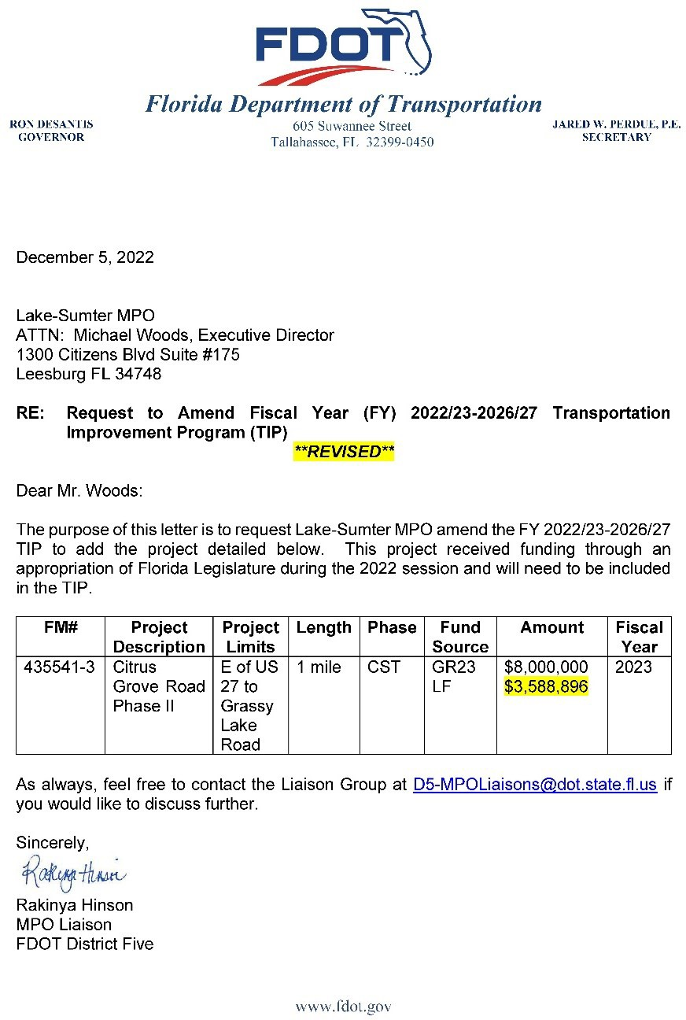


Slide 19
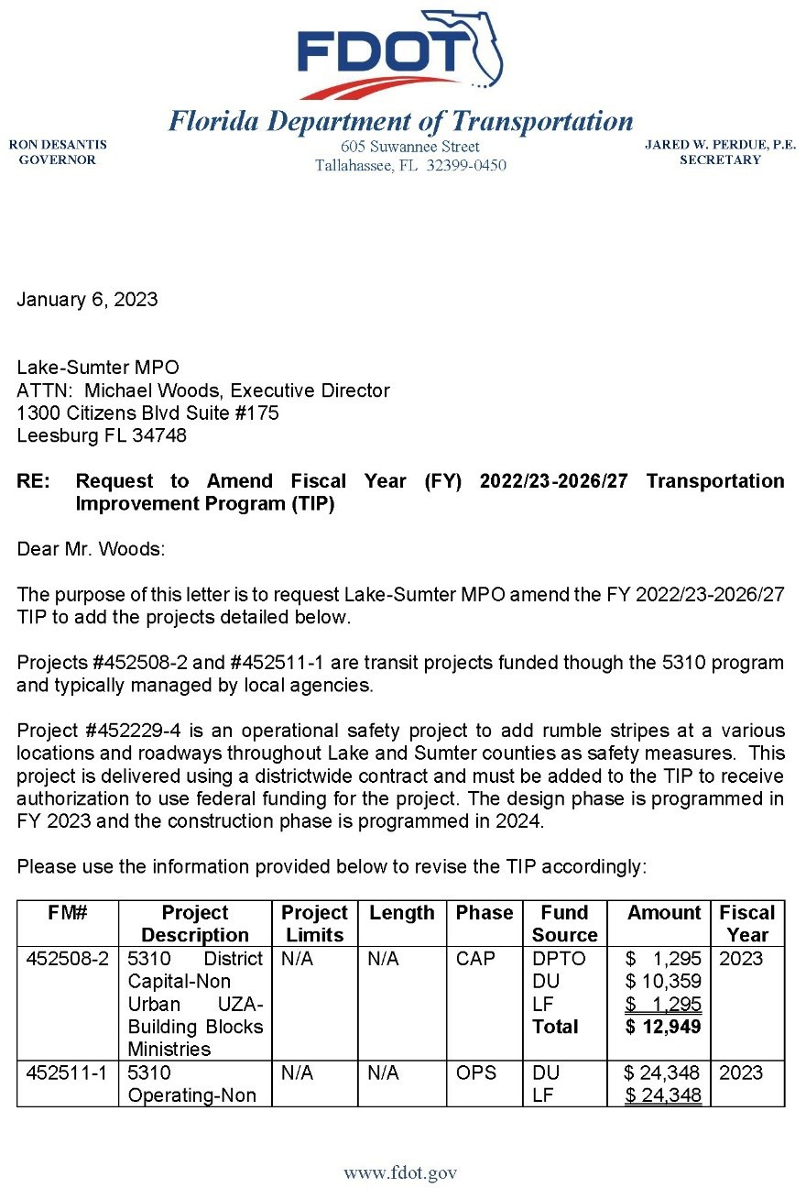
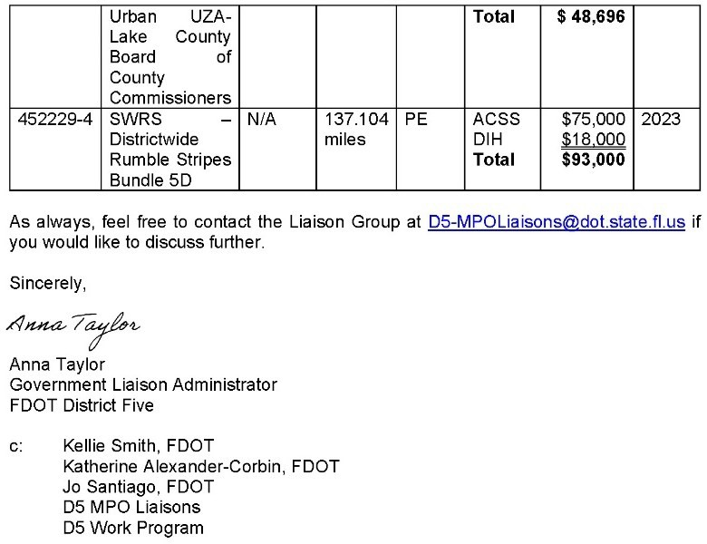

Slide 20
Project Sheets

Slide 21

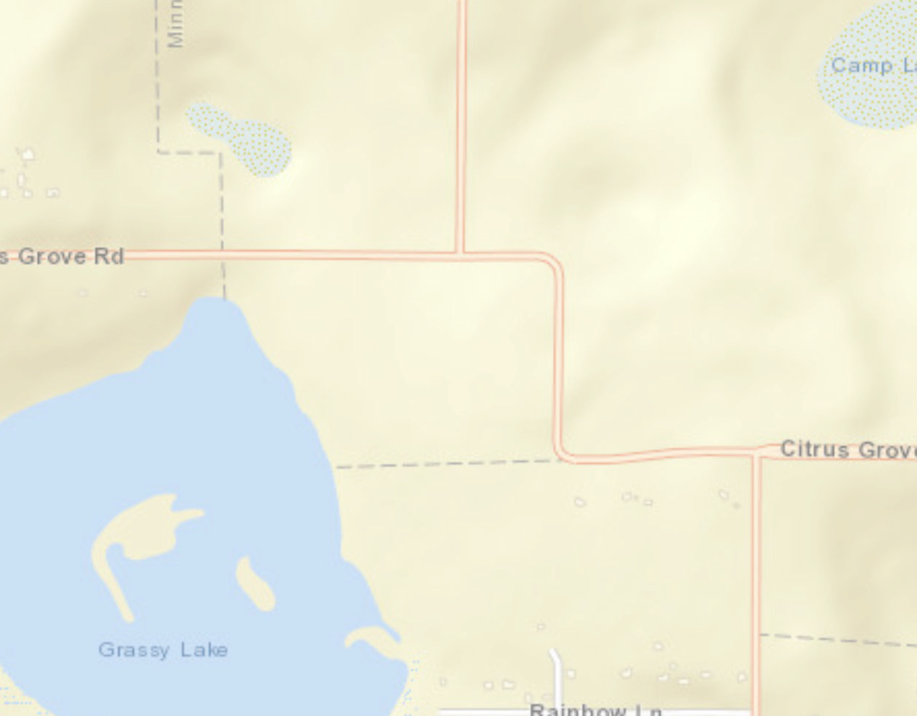
Lake-Sumter MPO
FM #: 4355413
5-Year Transportation Improvement Program (TIP) FY 2023 - 2027
DRAFT - Amendment #2
TIP Information
FM Number: Project Name: Project Segment:
From:
To: Begin Milepost: End Milepost:
Work Program Category:
County: LRTP Page: Project Length:
Amended: Work Description: Responsible Agency: Project Description: Historical Cost:
SIS Project: Non-SIS
http://maps.google.com/maps?q=28.5983597751298,-81.7383093589771
4355413
Citrus Grove Road Phase II
From E of US 27 to Grassy Lake Road E of US 27
Grassy Lake Road N/A
N/A N/A
LAKE
N/A
0.287 Miles
Yes - Amendment Packet: 2 Add Lanes And Reconstruct
FDOT
Citrus Grove Road Phase II
$N/A TIP Cost: $11,588,896
[
Roadway Capacity Projects (Non-SIS)
Cost by Year and Phase
Future Cost:
$N/A
Total Cost:
$11,588,896
PHASE | FUND CODE | FUNDING SOURCE | HISTORIC COST | 2023 | 2024 | 2025 | 2026 | 2027 | FUTURE COST | TOTAL
CST | LF | Local | $0.00 | $3,588,896.00 | $0.00 | $0.00 | $0.00 | $0.00 | $0.00 | $3,588,896.00
CST | GR23 | State 100% | $0.00 | $8,000,000.00 | $0.00 | $0.00 | $0.00 | $0.00 | $0.00 | $8,000,000.00
TIP FY 2023 - 2027 - Adopted: 6/22/2022
Amended: N/A
TIP Web App: https://hdr.maps.arcgis.com/apps/webappviewer/index.html?id=c0d4337b7b834cbdbe1e71d305b68fb0

Slide 22
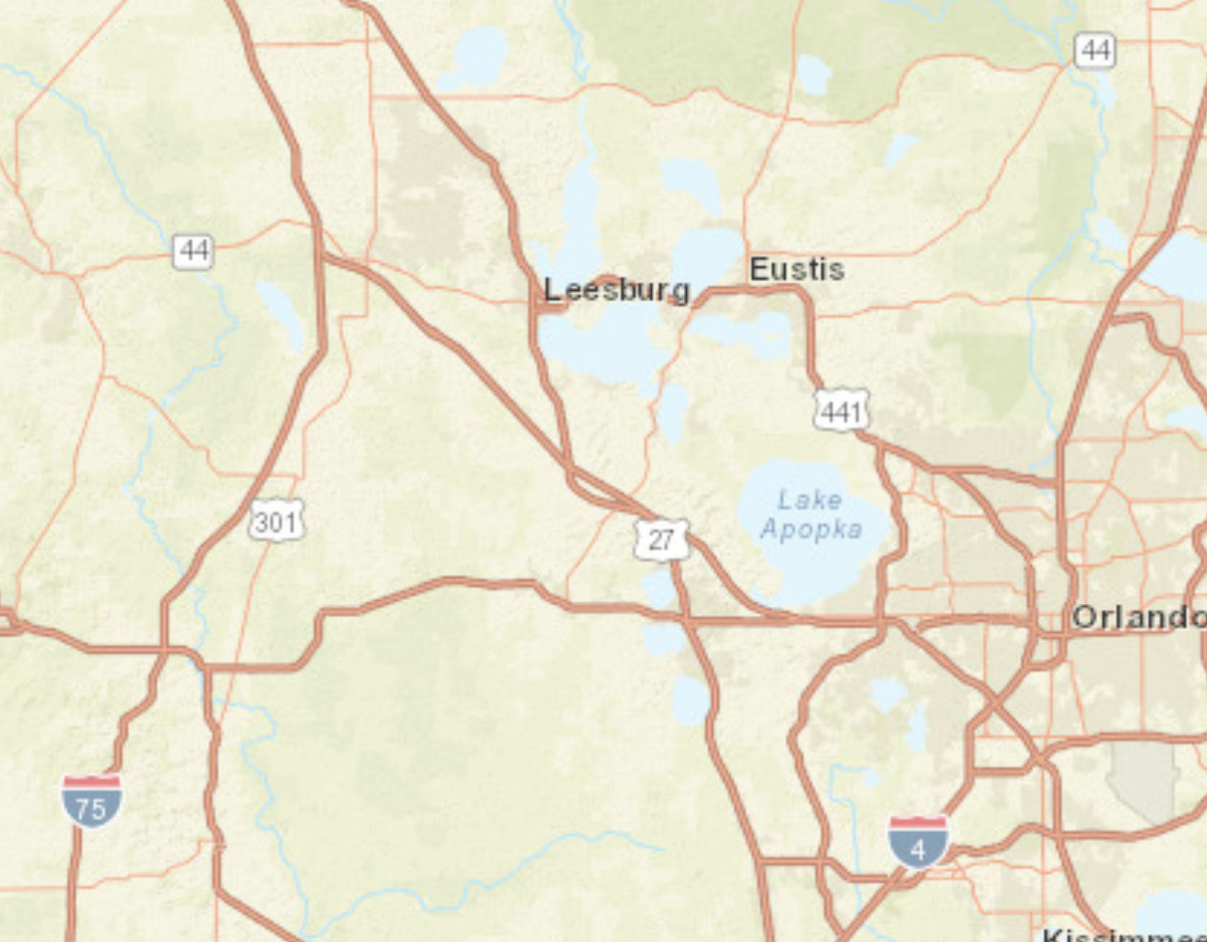
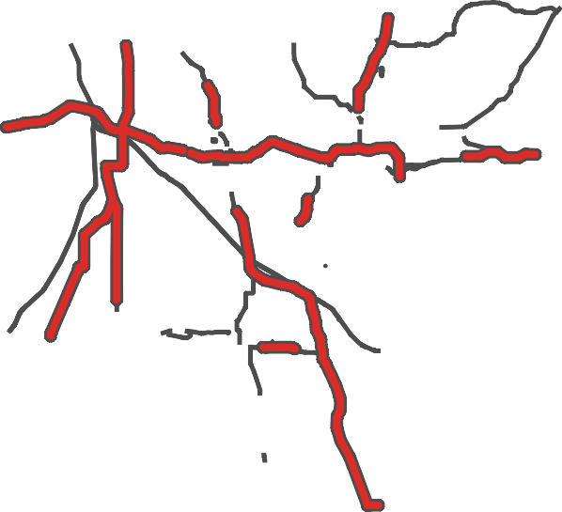
Lake-Sumter MPO
FM #: 4522294
5-Year Transportation Improvement Program (TIP) FY 2023 - 2027
DRAFT - Amendment #2
TIP Information
FM Number: Project Name: Project Segment:
From:
To: Begin Milepost: End Milepost:
Work Program Category:
County: LRTP Page: Project Length:
Amended: Work Description: Responsible Agency: Project Description: Historical Cost:
SIS Project: Non-SIS
http://maps.google.com/maps?q=28.7411045418019,-81.7661410053081
4522294
SWRS – Districtwide Rumble Stripes Bundle 5D
Various Locations and Roadways Thoughout Lake and Sumter Counties N/A
N/A N/A N/A N/A LSMPO
N/A
137.104 Miles
Yes - Amendment Packet: 2 Safety Project
FDOT
Districtwide Rumble Stripes Bundle
[
Safety/Operations/TSMO Projects Other Projects
Cost by Year and Phase
$N/A TIP Cost: $93,000 Future Cost:
$N/A
Total Cost:
$93,000
PHASE | FUND CODE | FUNDING SOURCE | HISTORIC COST | 2023 | 2024 | 2025 | 2026 | 2027 | FUTURE COST | TOTAL
PE | ACSS | Federal | $0.00 | $75,000.00 | $0.00 | $0.00 | $0.00 | $0.00 | $0.00 | $75,000.00
PE | DIH | State 100% | $0.00 | $18,000.00 | $0.00 | $0.00 | $0.00 | $0.00 | $0.00 | $18,000.00
TIP FY 2023 - 2027 - Adopted: 6/22/2022
Amended: N/A
TIP Web App: https://hdr.maps.arcgis.com/apps/webappviewer/index.html?id=c0d4337b7b834cbdbe1e71d305b68fb0

Slide 23

Lake-Sumter MPO
FM #: 4525082
5-Year Transportation Improvement Program (TIP) FY 2023 - 2027
DRAFT - Amendment #2
TIP Information
FM Number: Project Name: Project Segment:
From:
To: Begin Milepost: End Milepost:
Work Program Category:
County: LRTP Page: Project Length:
Amended: Work Description: Responsible Agency: Project Description: Historical Cost:
SIS Project: Non-SIS
http://maps.google.com/maps?q=28.8013297939463,-81.7307071247754
4525082
5310 District Capital-Non Urban UZA-Building Blocks Ministries N/A
N/A
N/A N/A N/A N/A LAKE
N/A
N/A Miles
Yes - Amendment Packet: 2 Capital For Fixed Route
Lake County Public Transportation
District Capital-Non Urban UZA-Building Blocks Ministries
$N/A TIP Cost: $12,949
[
Lake County Administration Building
Transit and Transportation Disadvantage Projects Other Projects
*Map shows location of responsible agency and does not represent the location of the actual project
Cost by Year and Phase
Future Cost:
$N/A
Total Cost:
$12,949
PHASE | FUND CODE | FUNDING SOURCE | HISTORIC COST | 2023 | 2024 | 2025 | 2026 | 2027 | FUTURE COST | TOTAL
CAP | DPTO | State 100% | $0.00 | $1,295.00 | $0.00 | $0.00 | $0.00 | $0.00 | $0.00 | $1,295.00
CAP | DU | Federal | $0.00 | $10,359.00 | $0.00 | $0.00 | $0.00 | $0.00 | $0.00 | $10,359.00
CAP | LF | Local | $0.00 | $1,295.00 | $0.00 | $0.00 | $0.00 | $0.00 | $0.00 | $1,295.00
TIP FY 2023 - 2027 - Adopted: 6/22/2022
Amended: N/A
TIP Web App: https://hdr.maps.arcgis.com/apps/webappviewer/index.html?id=c0d4337b7b834cbdbe1e71d305b68fb0

Slide 24

Lake-Sumter MPO
FM #: 4525111
5-Year Transportation Improvement Program (TIP) FY 2023 - 2027
DRAFT - Amendment #2
TIP Information
FM Number: Project Name: Project Segment:
From:
To: Begin Milepost: End Milepost:
Work Program Category:
County: LRTP Page: Project Length:
Amended: Work Description: Responsible Agency: Project Description: Historical Cost:
SIS Project: Non-SIS
http://maps.google.com/maps?q=28.8015818385812,-81.7294946999538
4525111
5310 Operating-Non Urban UZA-Lake Co. Board of County Commissioners N/A
N/A
N/A N/A N/A N/A LAKE
N/A
N/A Miles
Yes - Amendment Packet: 2 Operating for Fixed Route
Lake County Public Transportation
Operating-Non Urban UZA-Lake County Board of County Commissioners
[
Lake County Administration Building
Transit and Transportation Disadvantage Projects Other Projects
*Map shows location of responsible agency and does not represent the location of the actual project
Cost by Year and Phase
$N/A TIP Cost: $48,696 Future Cost:
$N/A
Total Cost:
$48,696
PHASE | FUND CODE | FUNDING SOURCE | HISTORIC COST | 2023 | 2024 | 2025 | 2026 | 2027 | FUTURE COST | TOTAL
OPS | DU | Federal | $0.00 | $24,348.00 | $0.00 | $0.00 | $0.00 | $0.00 | $0.00 | $24,348.00
OPS | LF | Local | $0.00 | $24,348.00 | $0.00 | $0.00 | $0.00 | $0.00 | $0.00 | $24,348.00
TIP FY 2023 - 2027 - Adopted: 6/22/2022
Amended: N/A
TIP Web App: https://hdr.maps.arcgis.com/apps/webappviewer/index.html?id=c0d4337b7b834cbdbe1e71d305b68fb0

Slide 25


Prepared for the Lake – Sumter Metropolitan Planning Organization
1300 Citizens Blvd., Suite 175
Leesburg, FL 34748
Prepared by

Slide 26
DISCUSSION ITEM A: 2023 List of Priority Projects (LOPP) Update
The List of Priority Projects (LOPP) is a document that all Metropolitan Planning Organizations (MPOs) are required to develop annually. The LOPP represents the unfunded transportation improvements that were not programmed for the following five-year period in order of priority. The Florida Department of Transportation (FDOT) uses each MPO's LOPP to aid in deciding which projects should be added to their Work Program each year. The Lake~Sumter MPO approves its LOPP annually. Staff will update the committee on the results of the Call for Projects.
Attachments: LOPP Presentation, 2022 LOPP

Slide 27
2023 List of Priority Projects (LOPP)
Technical Advisory Committee &
Community Advisory Committee
February 8, 2023

Slide 28
LOPP = Essential to Programming
LOPP defines priorities considered for development of Five-Year Work Program/TIP that begins on…
July 1 of the year following its approval
The 2023 LOPP will be used by FDOT to determine projects that might be added to the FY 2024/25 – 2028/29 Tentative Five-Year Work Program.
Consider Outer Years
Maintain Long-term View

Slide 29
2022 LOPP – Funding Recap
Based on the FDOT 2023/24 – 2027/28 Tentative Work Program:
Lake County
Top 20 #1: SR 50 Realignment (Groveland) - $14.7M for ROW in FY24 / $9.85M in FY25
Top 20 #17: Micro Racetrack Road - $450K for Design moved up to FY24 from FY26
Sumter County
Top 20 #2: US 301 Widening - $51M for ROW in FY24 / $71.1M for CST in FY 24 and
$45.8M for CST in FY26
Top 20 #6: US 301 Complete Streets (Wildwood) - $2M for Design in FY24
Top 20 #8: CR 48 Safety Project - $1.6M for Design in FY24
Bridges #1: Rehabilitation for Multiple Bridges - $717,289 for CST in FY24

Slide 30
2023 LOPP Development Schedule
Call for Projects – Project Information Application (PIA) Submitted | By October 27, 2022 – January 13, 2023
PIA Sufficiency Review | January 16 – March 16, 2023
Technical Assistance Meetings with Sponsors | February 20-24, 2023
Project Information Applications (PIA) Complete | March 17, 2023
Prioritization Process and Draft Ranking Complete | March 31, 2023
Draft LOPP Reviewed by Board/Committees | April 12 & April 26, 2023
Final LOPP Reviewed by Board/Committees | June 14 & June 28, 2023
MPO Submits Adopted LOPP to FDOT | By June 30, 2023

Slide 31
Questions?

Slide 32
Presentations and Reports
FDOT TENTATIVE WORK PROGRAM PRESENTATION
FTE TENTATIVE WORK PROGRAM PRESENTATION
MOVING FLORIDA AHEAD
STRATEGIC INTERMODAL SYSTEM (SIS) 10 YEAR PROGRAM
TRANSIT REPORT
County & City Reports

Slide 33


Florida’s Turnpike System
Tentative Five-Year Work Program
FY 2024 – FY 2028
Presentation to Lake-Sumter MPO

Slide 34














Florida’s Turnpike System
FIRST COAST EXPRESSWAY
Miles
WESTERN BELTWAY
SEMINOLE EXPRESSWAY
511
SUNCOAST PARKWAY
SUNCOAST PARKWAY
48*
BEACHLINE EAST EXPESSWAY
559
VETERANS EXPRESSWAY
BEACHLINE WEST EXPESSWAY
I-4 CONNECTOR
TURNPIKE MAINLINE /
SR 91
POLK PARKWAY
SAWGRASS
EXPRESSWAY
Florida’s Turnpike
CENTRAL POLK PARKWAY
Florida’s Turnpike (*Future)
SOUTHERN CONNECTOR
EXTENSION
Other FDOT Owned
Other FDOT Operated
Other Toll Agencies
TURNPIKE MAINLINE / SR 821

Slide 35


Department Vision
As one FDOT team, we serve the people of Florida by providing a transportation network that is well planned, supports economic growth, and has the goal of being congestion and fatality free.
Department Mission
The department will provide a safe transportation system that ensures the mobility of people and goods, enhances economic prosperity, and preserves the quality of our environment and communities.
Enterprise Vision
Helping to keep Florida on the
move through customer-oriented, environmentally sound,
user-financed facilities.
Enterprise Mission
To help meet the State's growing transportation needs, ensuring value to customers, protecting investors, and managing the Turnpike System in a business-like manner.

Slide 36
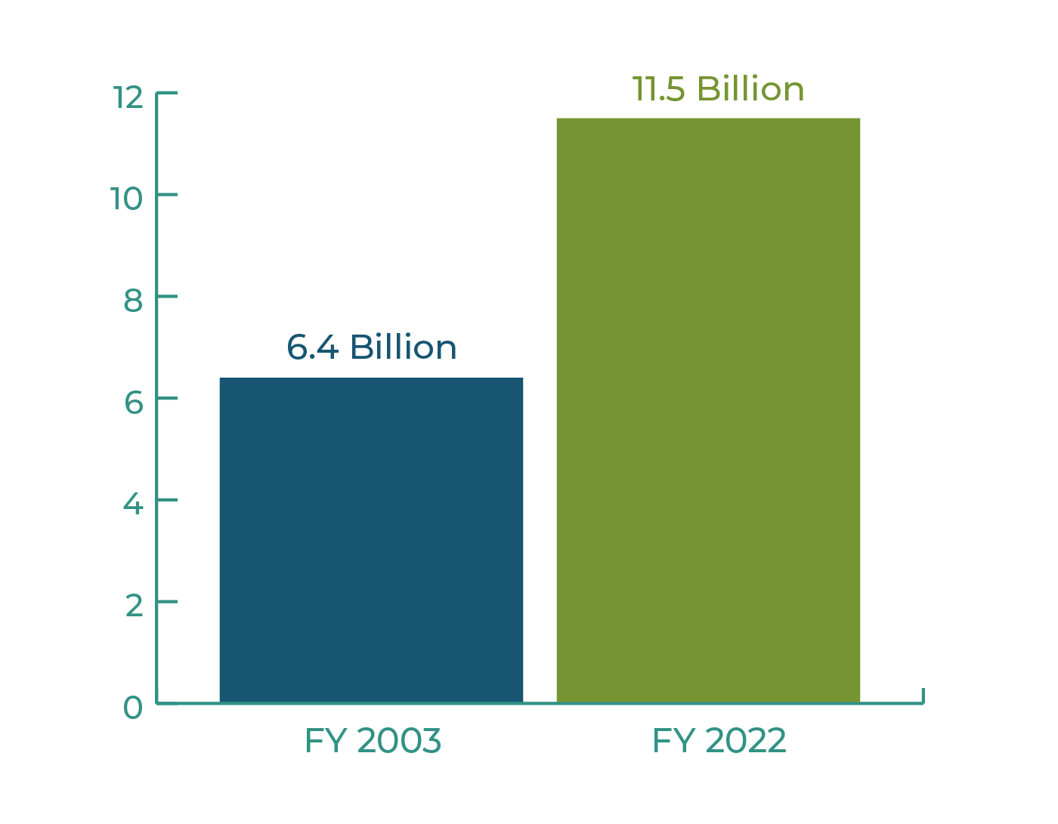

Growing Transportation Needs
Past 20 Years
TURNPIKE SYSTEM VEHICLE
MILES TRAVELED
FLORIDA POPULATION
REGISTERED
VEHICLES
31
37
%
%
80%
+
+
INCREASE

Slide 37






Revenues & Expenditures
Toll & Concession Revenue
Debt
Service
Renewal & Replacement
Operations & Maintenance *
System Capacity Improvements & Expansions
*FDOT Covenant for Operations and Maintenance expenses.

Slide 38

Turnpike Prioritization Process
Approach to Prioritizing
Resurfacing / Renewal
According to Pavement Condition Ratings & Lane-Mile Targets
Operations / Tolls / Miscellaneous
Systemwide Priorities
Stakeholder Input
Capacity
(Widening / Interchange)
Years of Need &
Systemwide Rankings
Expansion / Partnership
Environmental / Economic Feasibility

Slide 39
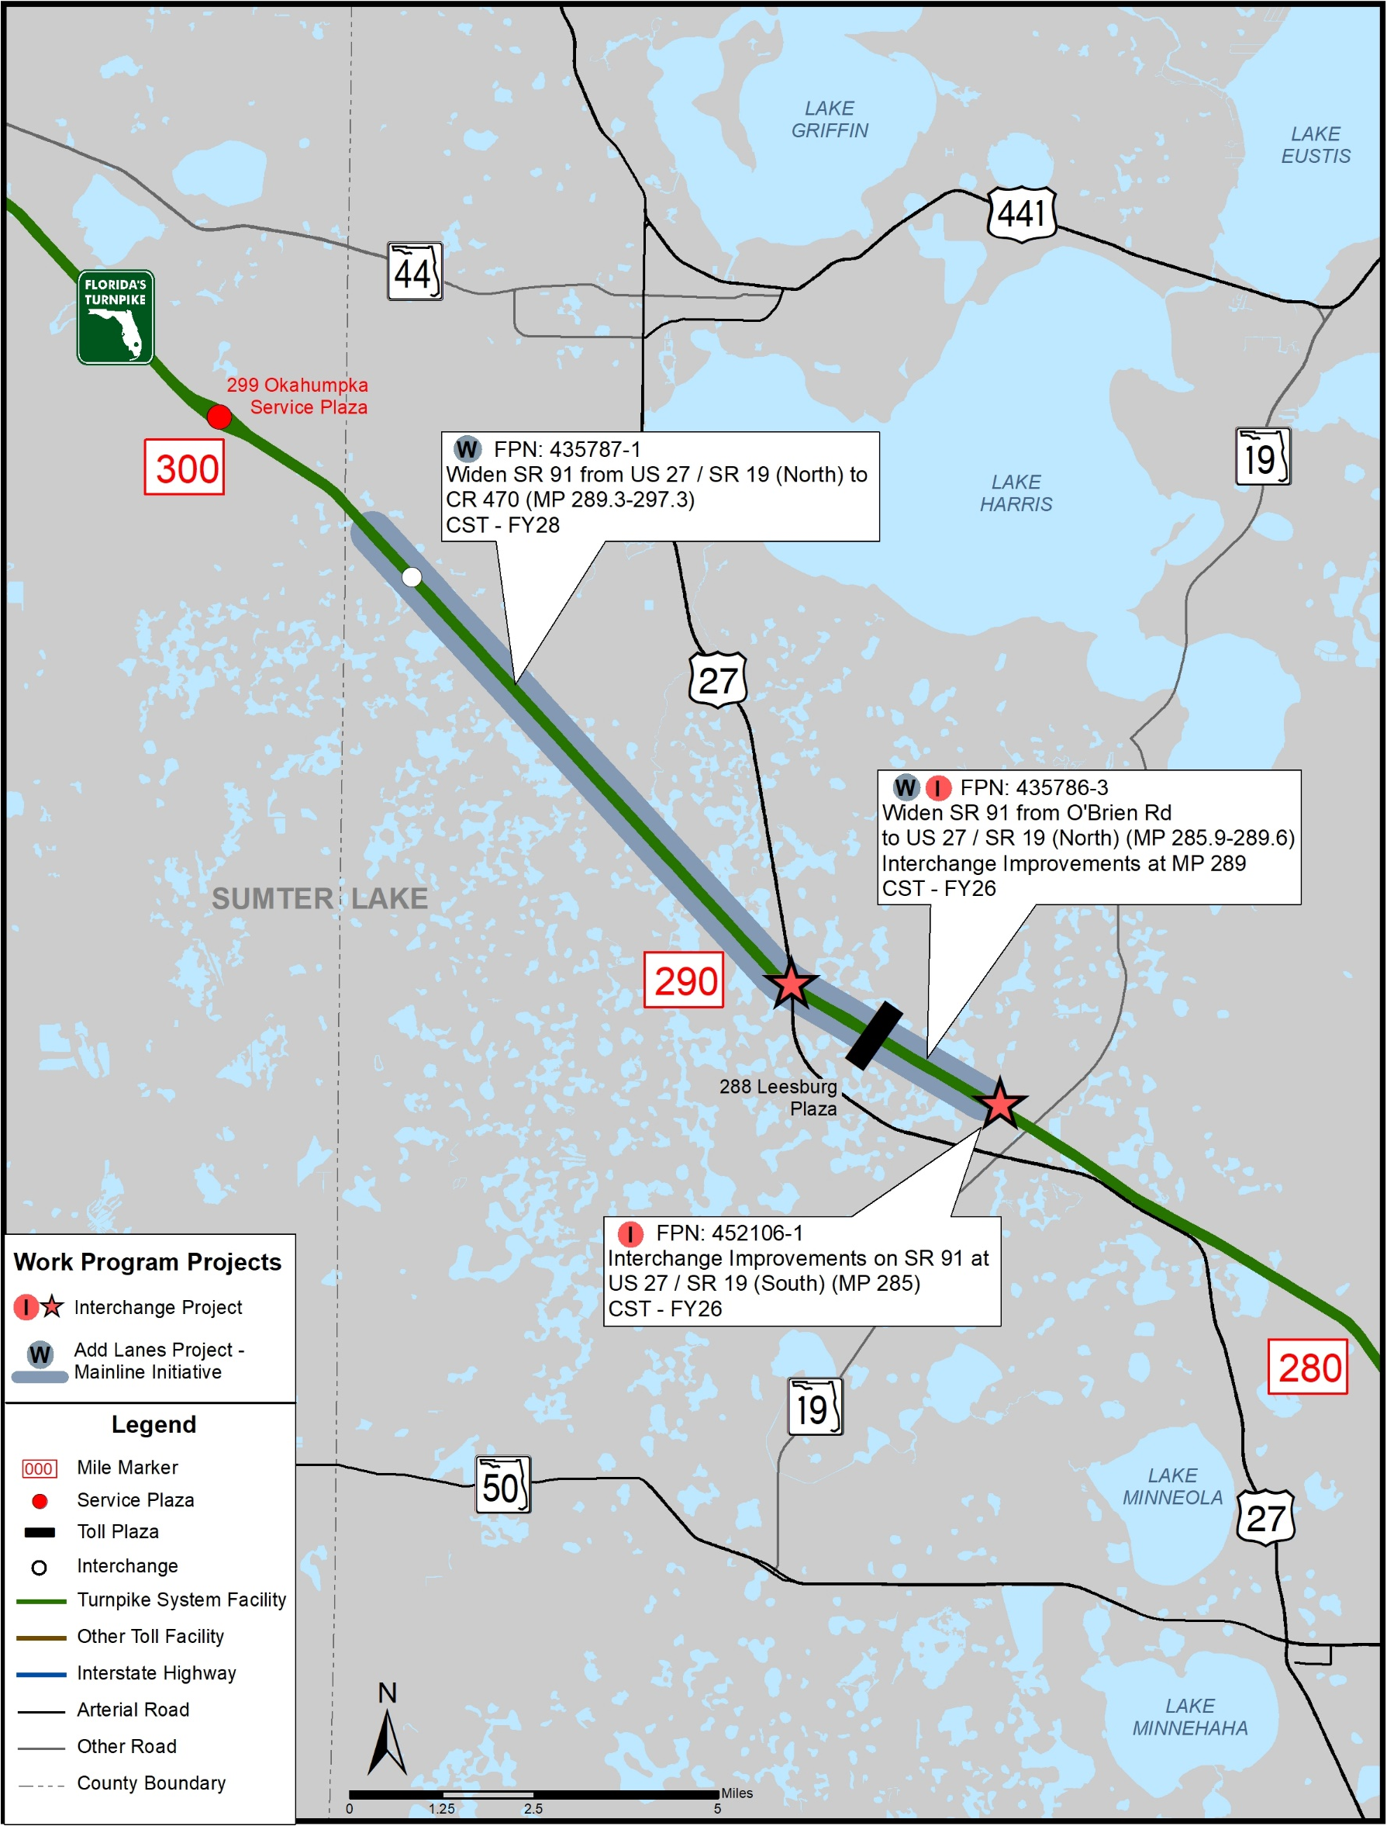
Lake County
Description | Phase | FY | Funds ($M)
Widen from US 27 / SR 19 (North) to Leesburg / CR 470 (MP 289.3 - MP 297.3) FPN: 435787-1 | ENV PE ROW RRU CST | 2028 2024, 27 2026 2027 2028 | $359.4
Widen from O’Brien Rd to US 27 / SR 19 (North) (MP 285.9 - MP 289.6) Interchange Improvements at MP 289 FPN: 435786-3 | PE ROW CST | 2025 2024-26 2026, 28 | $144.5
Interchange Improvements at US 27 / SR 19 (South) (MP 285) FPN: 452106-1 | ENV PE ROW CST | 2025 2024 2025 2026 | $9.5

Slide 40
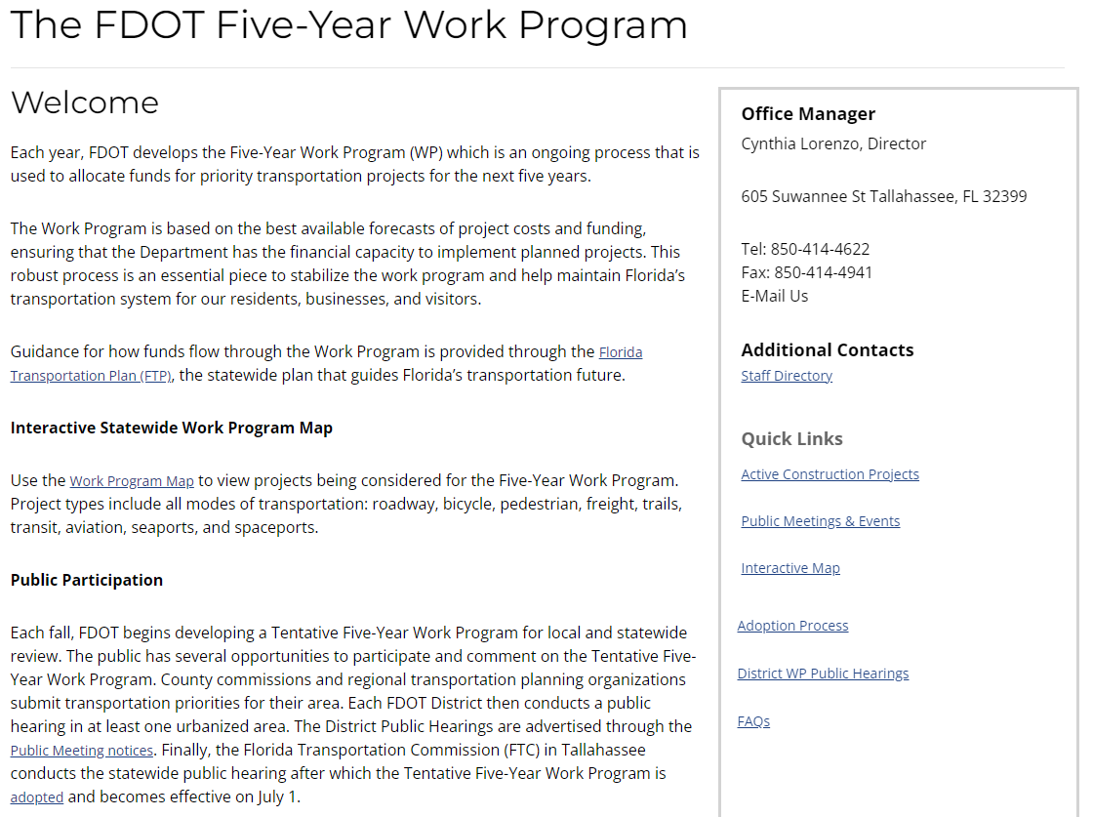
www.fdot.gov/wpph

Slide 41
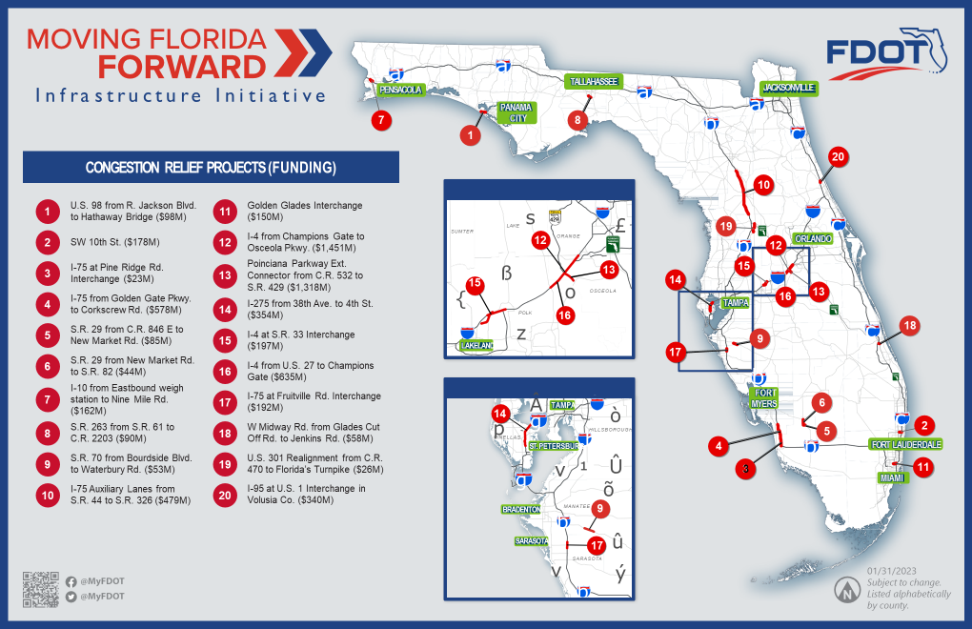

Slide 42
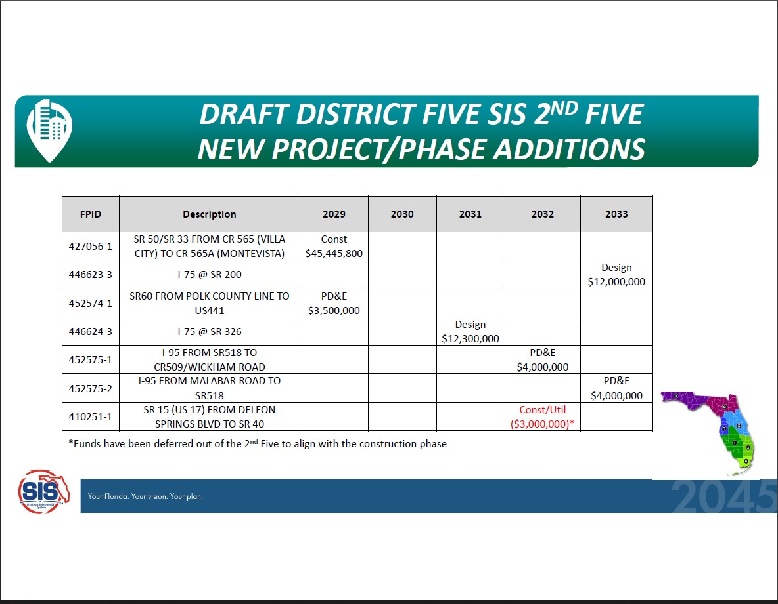

Slide 43
Committee member COMMENTS:
COMMITTEE MEMBER COMMENTS
Adjournment
Next Meeting: APRIL 12, 2023 @ 1:30 PM

Slide 44
Committee member COMMENTS:
Committee member COMMENTS:
Adjournment
Next Meeting: APRIL 12, 2023 @ 3:00 PM

