Slide 1
Wekiva & Neighborhood Lakes Trail
Conceptual Trailhead and Amenities
Wekiva &
Neighborhood Lakes Trail
DRAFT

Slide 2
Overview
Neighborhood Lakes Trail from Wekiva Trail to connect to Kelly Park (Orange County)
Major Trailhead at 46 / Wekiva Trail
Minor Trailhead at Baird Avenue (Neighborhood Access / Maintenance)
Bird Blind and Neighborhood Loop
Minor Trailhead at SR 435 (Orange County)
Neighborhood Lakes Trail
Trail Alignment and Amenities

Slide 3
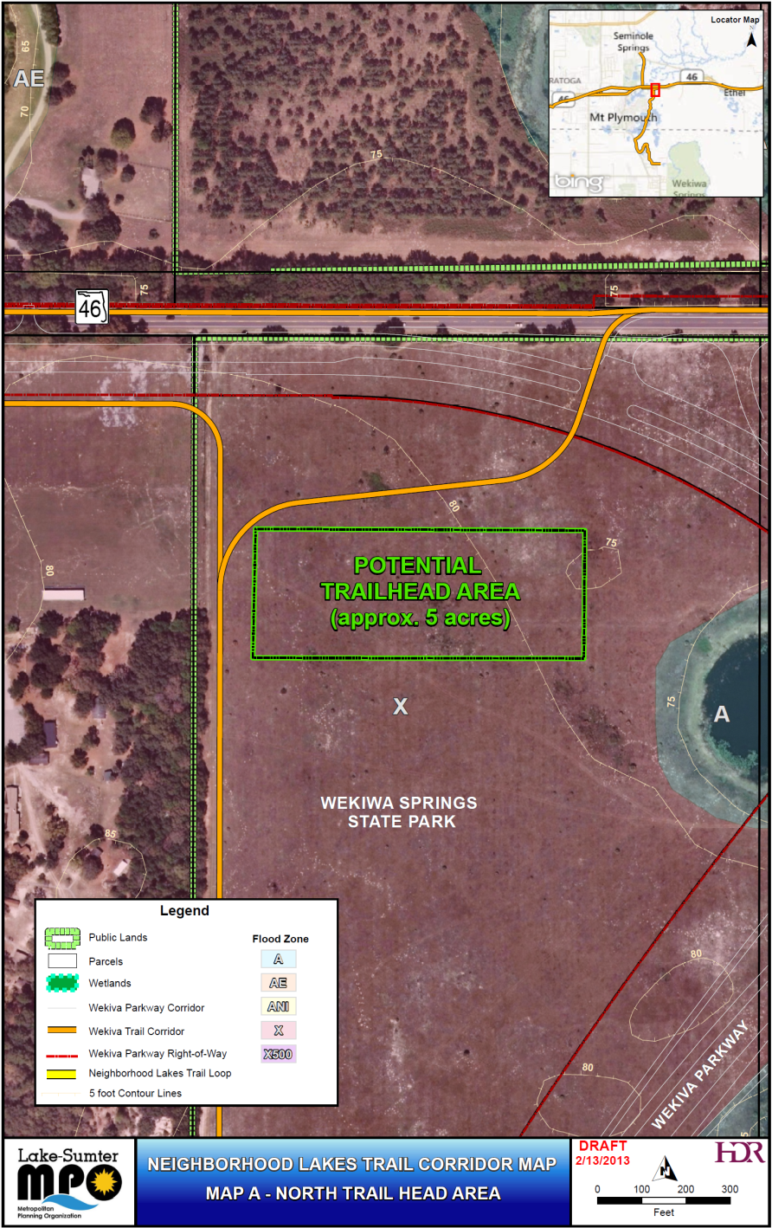
Major Trailhead
Wekiva Trail / Neighborhood Lakes Trail Connection
Equestrian and Park Amenities
Location may shift based on Final Road Alignment
WekivaTrail

Slide 4
WekivaTrail
Conceptual SR 46 Trailhead

Slide 5
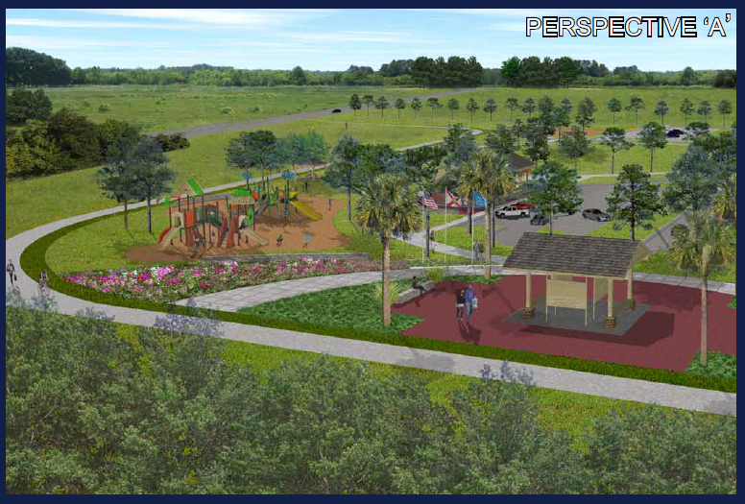
WekivaTrail
Conceptual SR 46 Trailhead

Slide 6
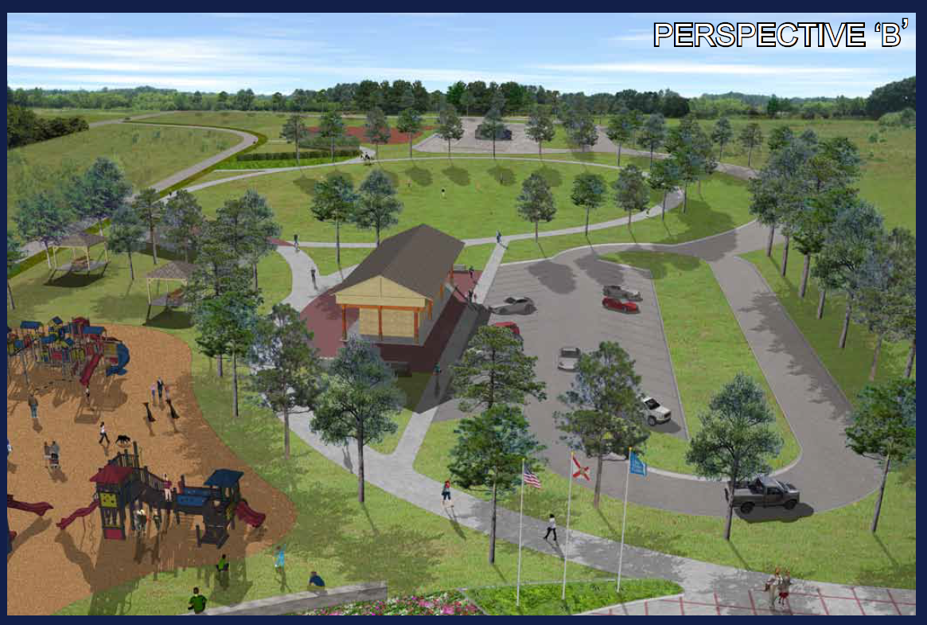
WekivaTrail
Conceptual SR 46 Trailhead

Slide 7
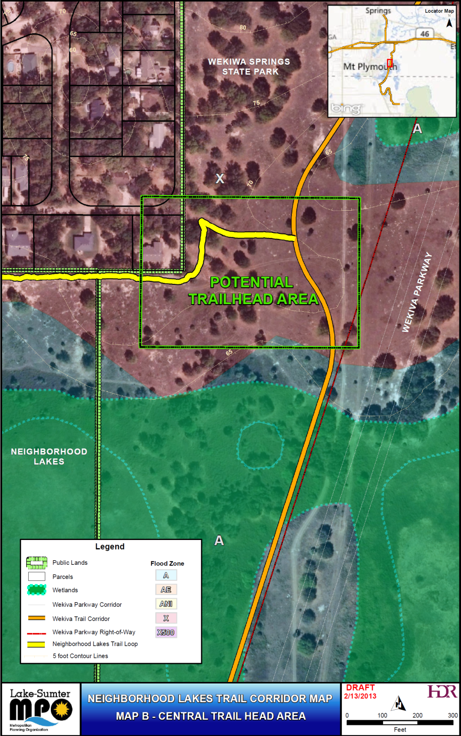
Minor Trailhead
Neighborhood Lakes Trail Connection
Minor Access
Maintenance Access
Neighborhood Lakes

Slide 8
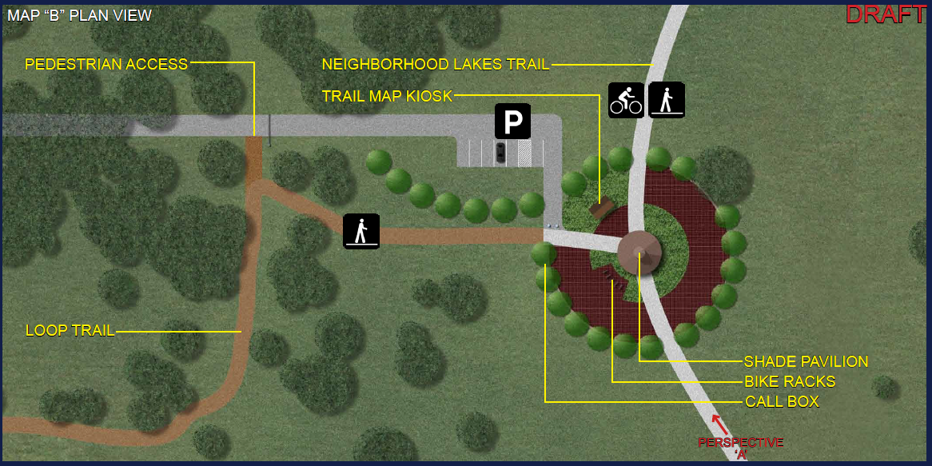
The Neighborhood Lakes Trailhead is consistent with the Lake County Parks & Trails Master Plan and Parks & Recreation Master Plan. Amenities will be consistent with those found at minor trailheads and passive area access points found through the county.
Minor trailhead with pavilion
Education panels similar to those at Ferndale Preserve
Kiosks identical to those along the South Lake Trail
Gate similar to North Shore Overlook and Trailhead
Area with be landscaped with native plants
Neighborhood Lakes
Conceptual Minor Trailhead

Slide 9
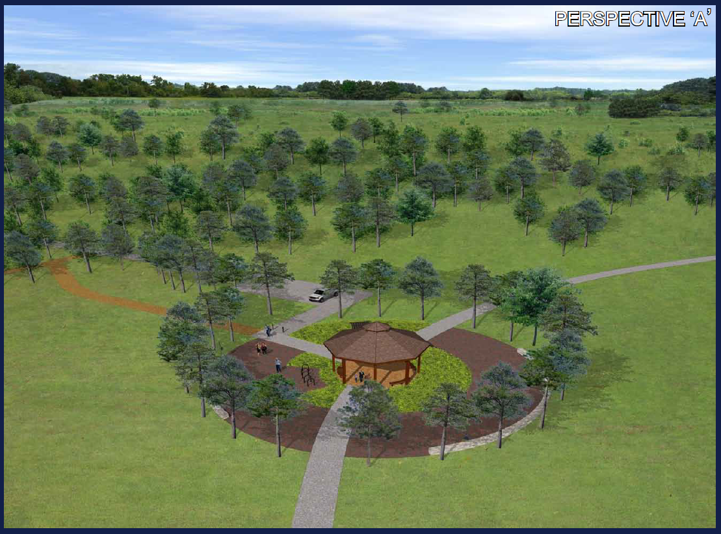
Neighborhood Lakes
Conceptual Minor Trailhead

Slide 10
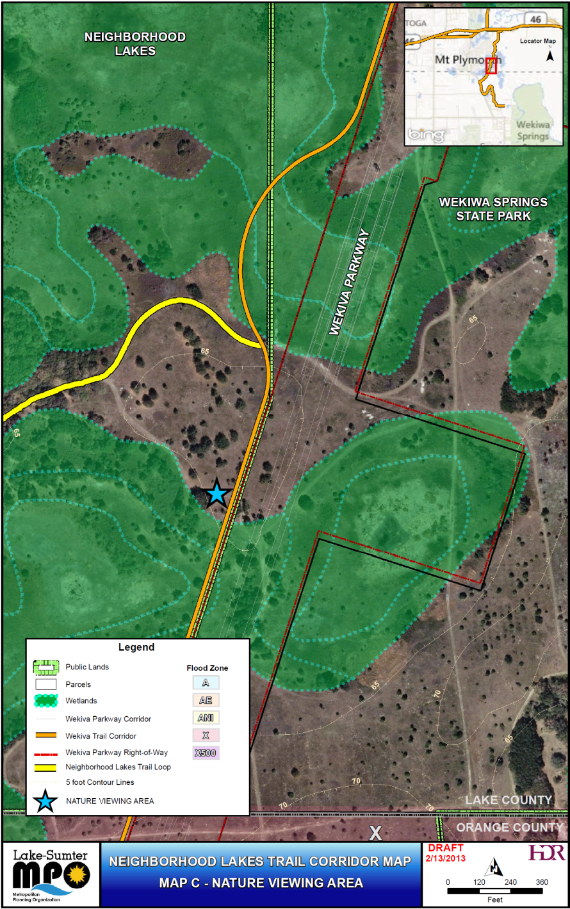
Observation Kiosk / Blind
Area to view birds / wildlife
Information Kiosks
Rest area
Neighborhood Lakes

Slide 11
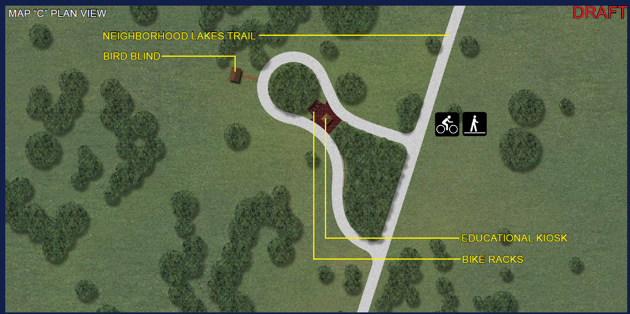
The Neighborhood Lakes Trail is consistent with the Lake County Parks & Trails Master Plan and Parks & Recreation Master Plan.
Bird and wildlife observation blind similar to P.E.A.R. Park’s
Education panels similar to those at Ferndale Preserve
Kiosks identical to those along the South Lake Trail
Shelter and bicycle amenities consistent with others along the Wekiva Trail in Lake County
Neighborhood Lakes
CONCEPTUAL BIRD AND WILDLIFE OBSERVATION BLIND

Slide 12
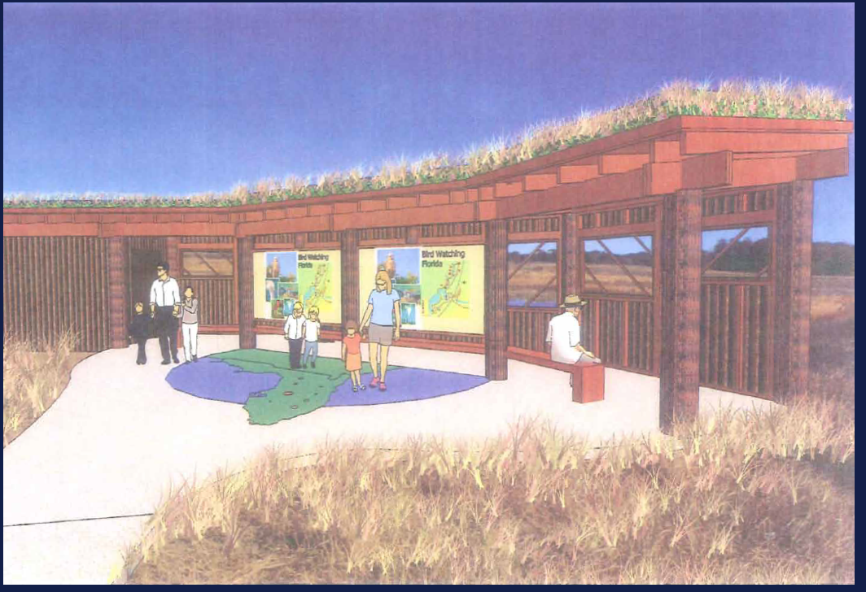
Neighborhood Lakes
CONCEPTUAL BIRD AND WILDLIFE OBSERVATION BLIND

Slide 13
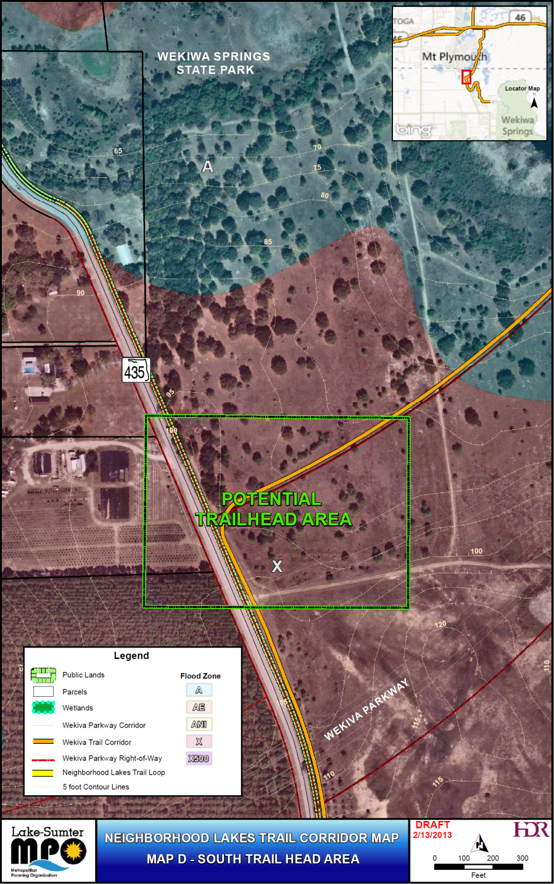
Conceptual Trailhead
Orange County
Very Conceptual
Minor Trailhead
Maintenance Access
Neighborhood Lakes

Slide 14
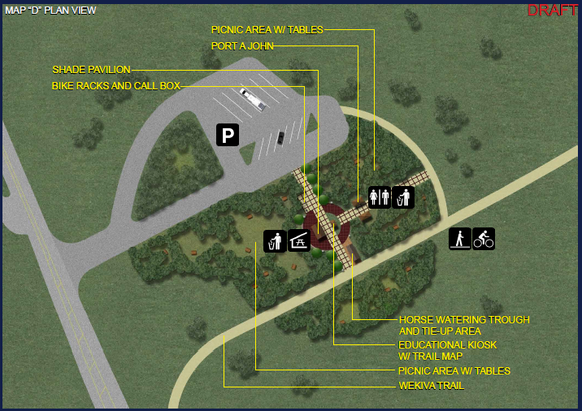
Neighborhood Lakes
Conceptual Trailhead

Slide 15
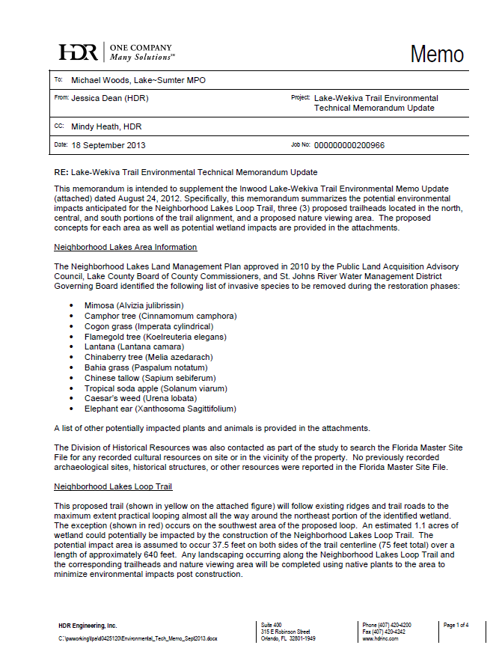
Environmental Review
Desktop Review
Relied on previous work for trail alignment:
Summary
Only one potential wetland impact is anticipated to occur on the southwest corner of the Neighborhood Lakes Trail Loop
Wetland impacts are not anticipated to occur at any of the trailhead sites or the natural viewing area
Formal surveys will be required for gopher tortoise, Florida scrub jay, and sand skink
Invasive species were observed in a number of places along the trail
Neighborhood Lakes Trail
Trail Alignment and Amenities

