Slide 1
Lake~Sumter MPO APRIL 26, 2023 executive committee Meeting
Michael Woods, Executive Director

Slide 2
Call to Order by Chair
Proper Noticing
Roll Call – Determination of Quorum
Chair's Announcements
Motion to allow virtual voting by members
Update: Proposed revisions to Today’s Agenda

Slide 3
II.
OPPORTUNITY FOR PUBLIC COMMENT on Agenda or General Comments
At this point in the meeting, the Board will hear citizens' questions, comments, and concerns. If the issue raised is not on today's Agenda, the Board will not take action at this meeting. Questions may be answered by staff or referred for appropriate staff action. If further action is necessary, the item may be placed on a future Board agenda. Public comment shall be limited to three minutes per person.

Slide 4
I.
Consent approval is requested for the following items:
Consideration to approve, December 7, 2022, MPO Executive Committee Meeting Minutes

Slide 5
DISCUSSION ITEMS:
Milestone Financial Report Review – Second Quarter
2020 Census – Urbanized Areas/MPO Apportionment Plan/MPA Boundary Maps – Early Look
C. 2020 Census - Transportation Management Area (TMA) Discussion

Slide 6
Quarterly Financial Report – 12/31/22
Revenues were $337,818 for fiscal year through 12/31/22
This included accrual of reimbursement requests thru Dec
Expenditures were $291,563 for fiscal year through 12/31/22
This did not include all expenditures for work thru Dec because Lake County does not accrue invoices received in Jan/Feb for work performed in December. (Accruals are only performed during LC’s FYE or MPO’s FYE.)
The reimbursement request does include these expenses so it makes revenues appear higher than expenditures; however, this is only caused because of timing issues in LC accounting. FDOT requires our reimbursement requests be made using accrual accounting.

Slide 7
Quarterly Financial Report – 12/31/22
All invoices submitted to agencies have been paid – all current.
The next invoice to FDOT will be submitted in May 2023 to cover Jan – March 2023 costs.
The cash balance has been under $200K for the last five months. Spending is minimal as we obtain new POs for our new 22-24 UPWP.

Slide 8
Quarterly Financial Report – 12/31/22

Slide 9
Census 2020 & Urbanize Area
April 26, 2023
Lake~Sumter MPO

Slide 10
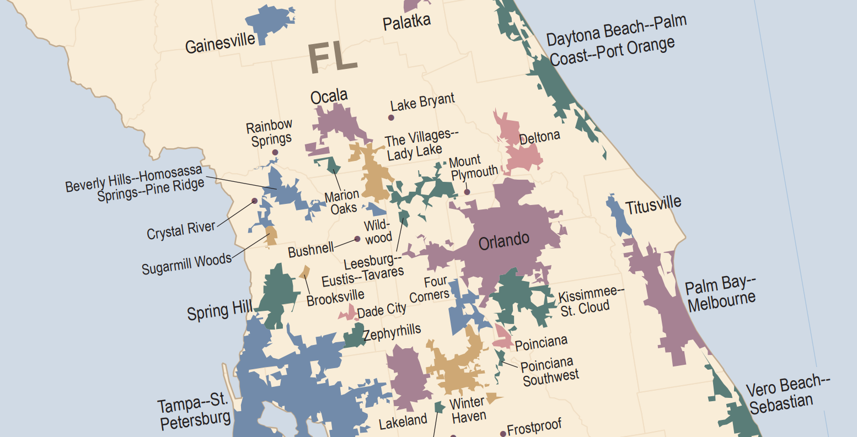
What is an Urbanized Area?
State
Agencies
Elected
Officials
Densely developed territory encompassing residential, commercial, and other non-residential urban land uses
Does not regard other legal boundaries, e.g.:
States
Counties
Cities
Made up of a collection of urban-qualified census blocks
Interest
Groups
Municipalities,
Counties,
Regional
Agencies
Private
Sector
Transit
Operators
Federal
Agencies
Public
Notes:
Establish a fair and impartial setting for effective regional decision making.
Identify and evaluate transportation improvement options related to mobility, system performance and preservation, and desired quality of life.
Develop long-range plans and short-range programs to achieve regional transportation goals.
Involve the public in the functions listed above.

Slide 11
Census 2020 Methodology Changes
Qualify census blocks as urban if they have ≥385 housing units per sq. mi.
Qualify urban areas if they have ≥4,000 housing units OR ≥10,000 persons
Cease distinguishing between types of urban areas
Reduce the maximum jump distance to 1.5 miles
No longer include low-density hop or jump corridors in urban areas
No longer include low-density indentations in urban areas
Split large urban agglomerations using worker flow data
Notes:
There are 27 MPOs in Florida, some represent the same area as the county they are in, with other representing more than one county, and even county in another state. The Census urban area determines the MPO, but the Governor for the state identifies the planning area the MPO represents.

Slide 12
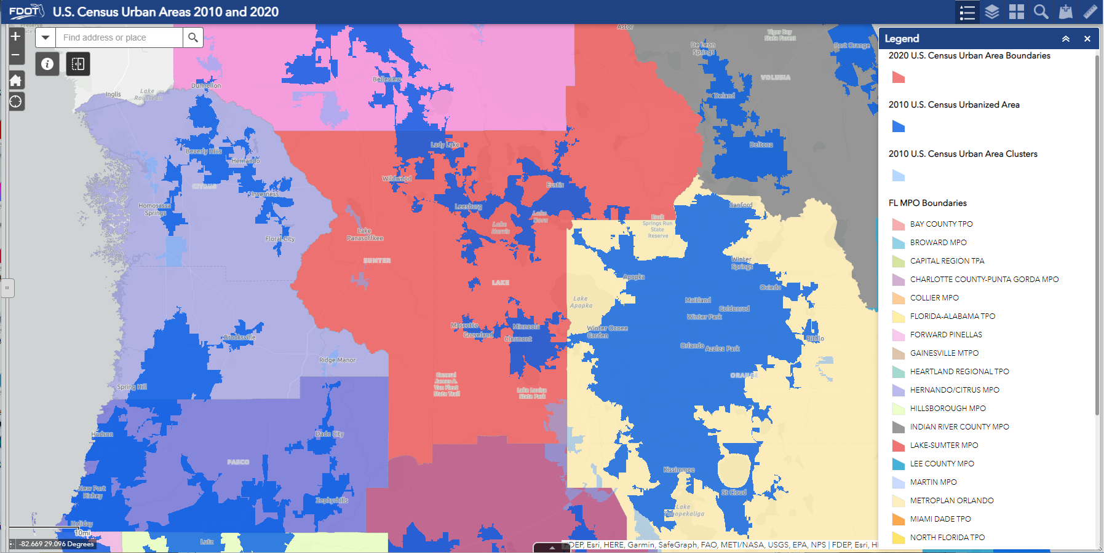
Notes:
Federal law is silent on staffing the MPO
State law identifies the make up of the board and need for committees – F.S. 339.175 - Statutes & Constitution :View Statutes : Online Sunshine (state.fl.us)
FHWA and FTA have funding programs to support MPO work; Florida has a Consolidated Planning Grant that will be explained later.
Required work may be performed by staff, member agencies, consultants
The Executive Director works for the Board, Staff work for the executive director. The Board or Executive director make the decisions for the MPO.

Slide 13
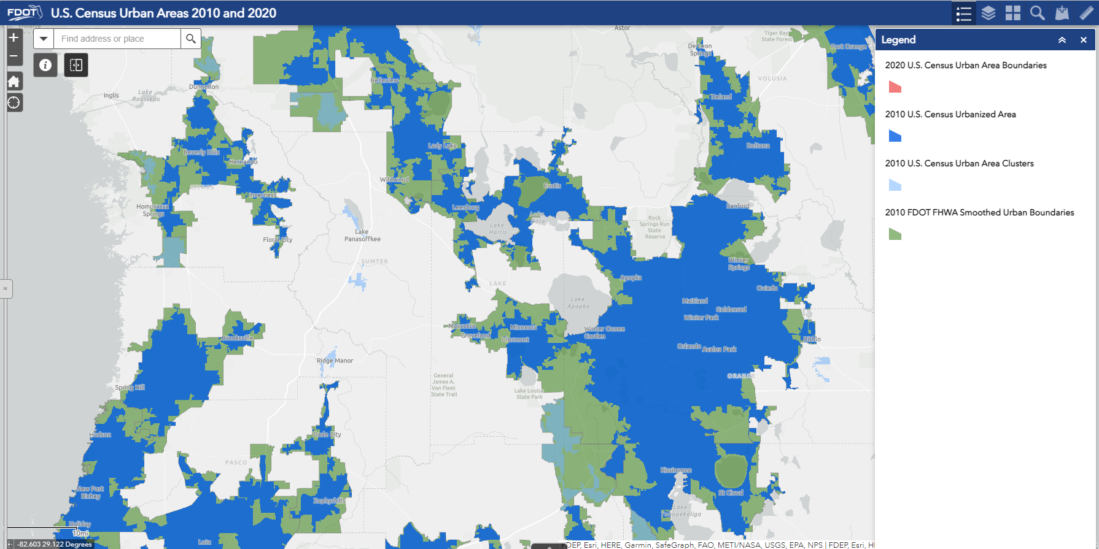
Notes:
Federal law is silent on staffing the MPO
State law identifies the make up of the board and need for committees – F.S. 339.175 - Statutes & Constitution :View Statutes : Online Sunshine (state.fl.us)
FHWA and FTA have funding programs to support MPO work; Florida has a Consolidated Planning Grant that will be explained later.
Required work may be performed by staff, member agencies, consultants
The Executive Director works for the Board, Staff work for the executive director. The Board or Executive director make the decisions for the MPO.

Slide 14
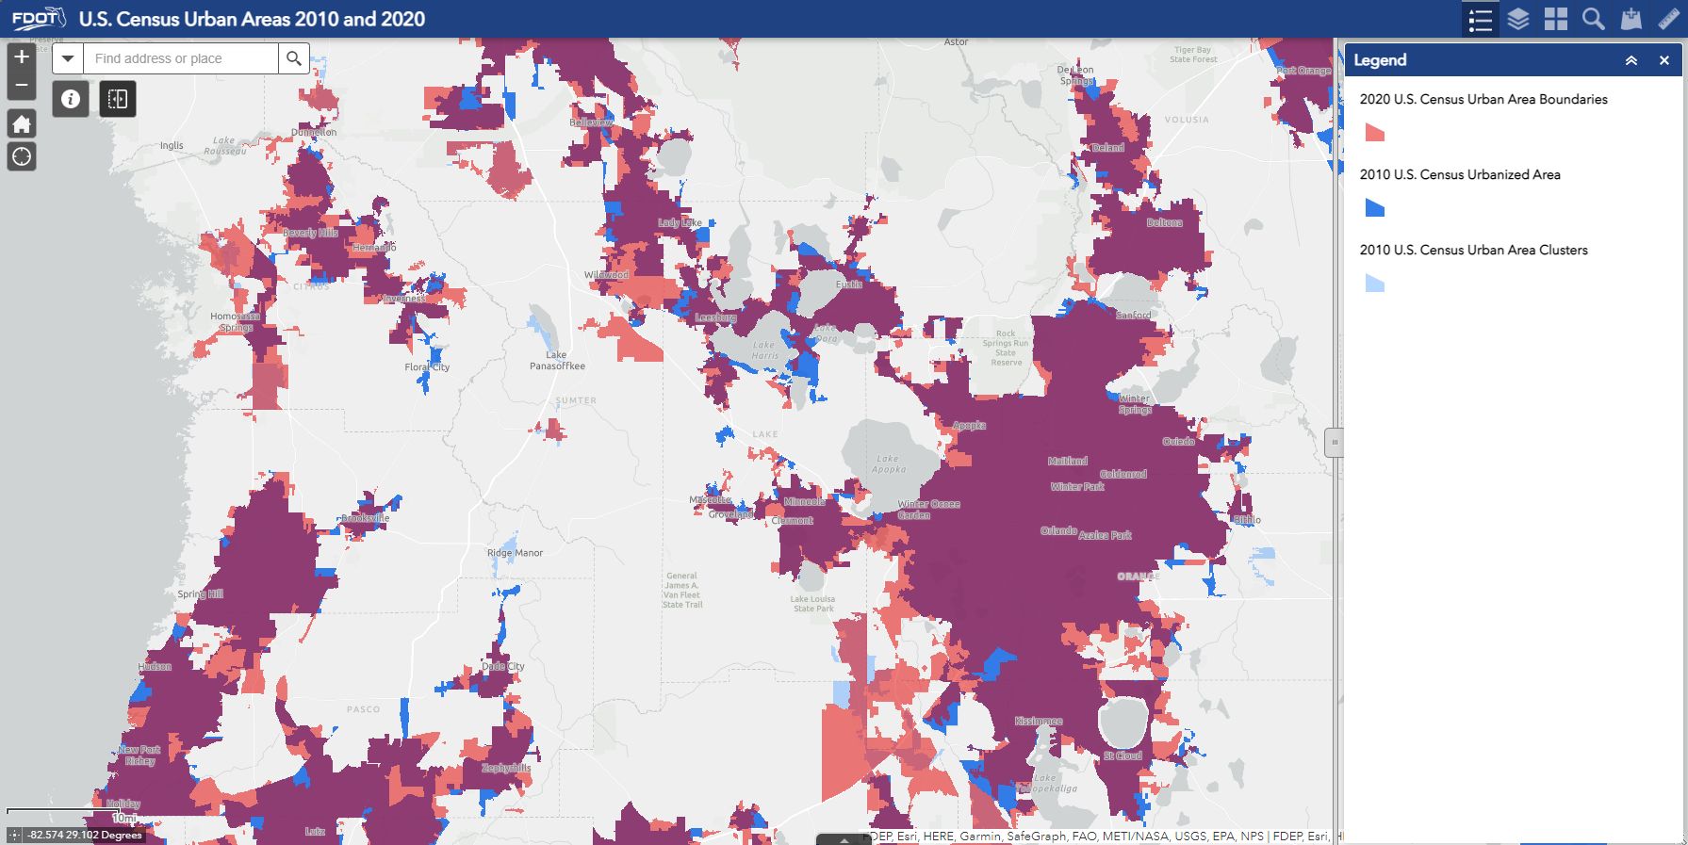
Notes:
Federal law is silent on staffing the MPO
State law identifies the make up of the board and need for committees – F.S. 339.175 - Statutes & Constitution :View Statutes : Online Sunshine (state.fl.us)
FHWA and FTA have funding programs to support MPO work; Florida has a Consolidated Planning Grant that will be explained later.
Required work may be performed by staff, member agencies, consultants
The Executive Director works for the Board, Staff work for the executive director. The Board or Executive director make the decisions for the MPO.

Slide 15
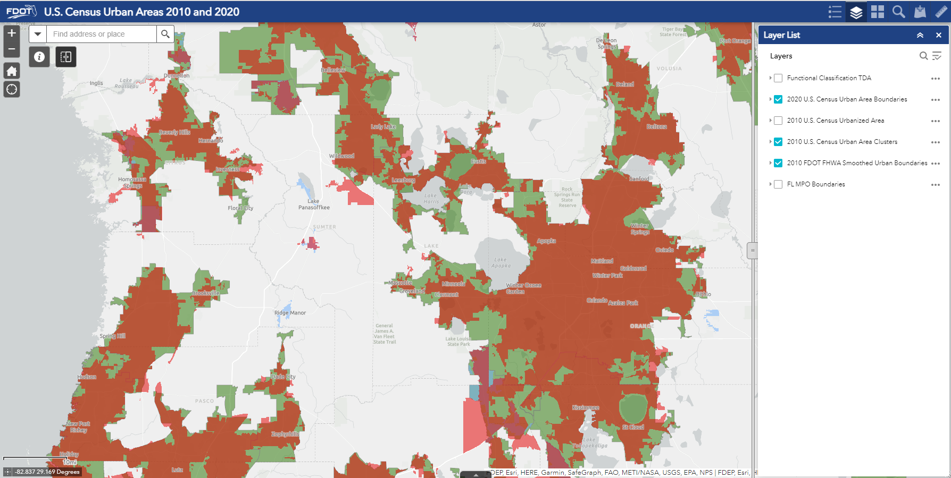
Notes:
Federal law is silent on staffing the MPO
State law identifies the make up of the board and need for committees – F.S. 339.175 - Statutes & Constitution :View Statutes : Online Sunshine (state.fl.us)
FHWA and FTA have funding programs to support MPO work; Florida has a Consolidated Planning Grant that will be explained later.
Required work may be performed by staff, member agencies, consultants
The Executive Director works for the Board, Staff work for the executive director. The Board or Executive director make the decisions for the MPO.

Slide 16
Notes:
Federal law is silent on staffing the MPO
State law identifies the make up of the board and need for committees – F.S. 339.175 - Statutes & Constitution :View Statutes : Online Sunshine (state.fl.us)
FHWA and FTA have funding programs to support MPO work; Florida has a Consolidated Planning Grant that will be explained later.
Required work may be performed by staff, member agencies, consultants
The Executive Director works for the Board, Staff work for the executive director. The Board or Executive director make the decisions for the MPO.

Slide 17
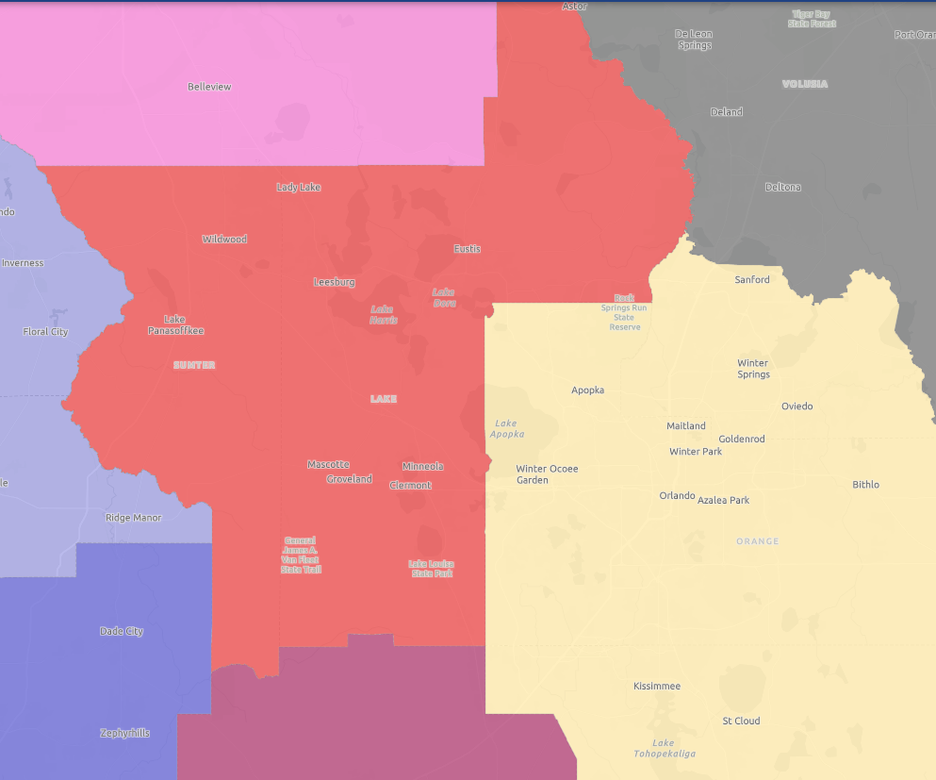
Lake~Sumter MPO Live Work Patterns
Notes:
Federal law is silent on staffing the MPO
State law identifies the make up of the board and need for committees – F.S. 339.175 - Statutes & Constitution :View Statutes : Online Sunshine (state.fl.us)
FHWA and FTA have funding programs to support MPO work; Florida has a Consolidated Planning Grant that will be explained later.
Required work may be performed by staff, member agencies, consultants
The Executive Director works for the Board, Staff work for the executive director. The Board or Executive director make the decisions for the MPO.

Slide 18
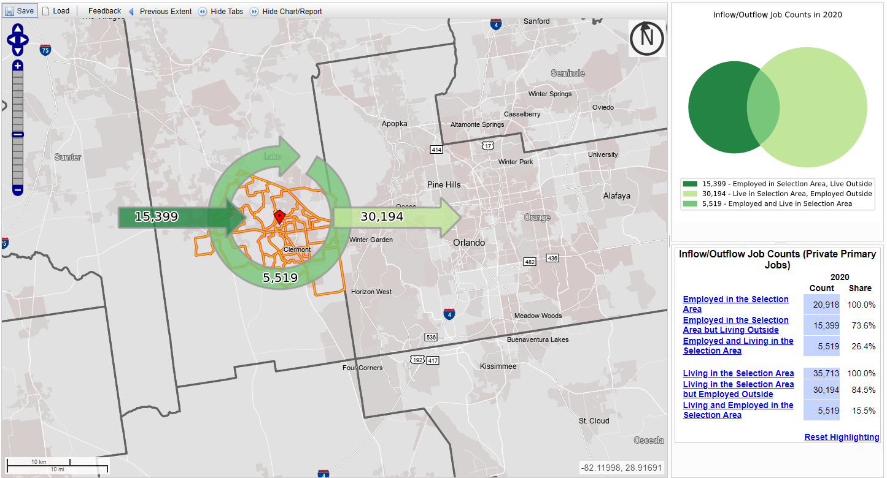
Notes:
Federal law is silent on staffing the MPO
State law identifies the make up of the board and need for committees – F.S. 339.175 - Statutes & Constitution :View Statutes : Online Sunshine (state.fl.us)
FHWA and FTA have funding programs to support MPO work; Florida has a Consolidated Planning Grant that will be explained later.
Required work may be performed by staff, member agencies, consultants
The Executive Director works for the Board, Staff work for the executive director. The Board or Executive director make the decisions for the MPO.

Slide 19
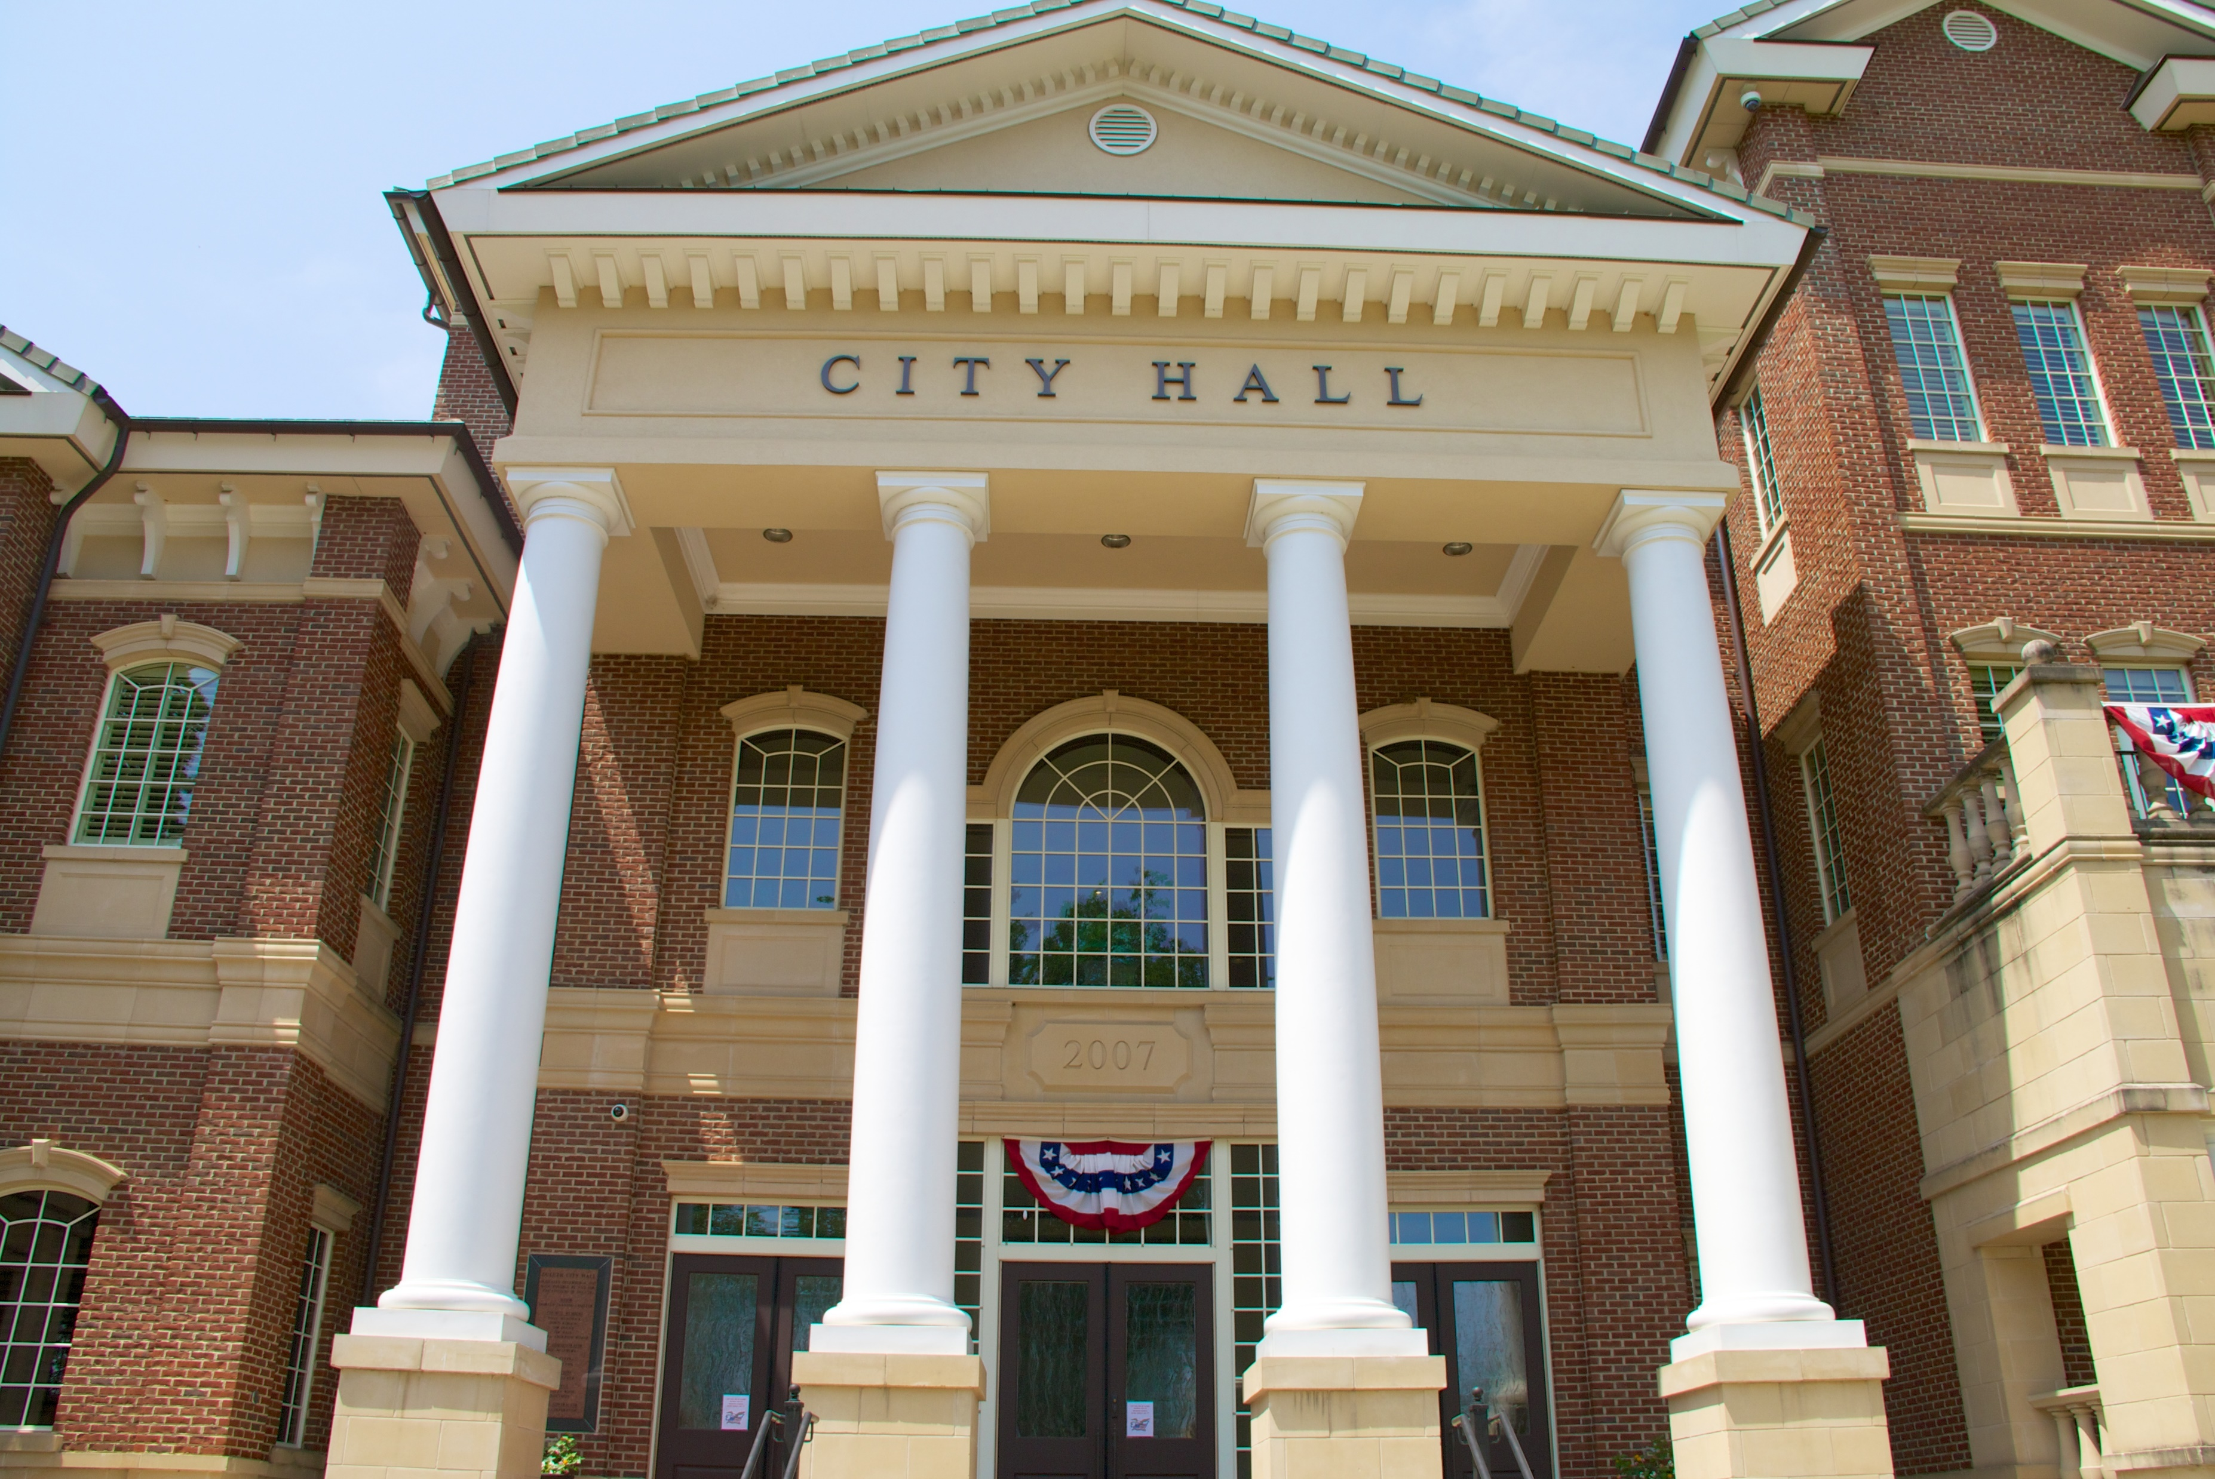
Next Steps
MPO needs to develop a Board Apportionment Plan and submit to FDOT & FHWA by October 2023
MPO will create new smoothed urbanized area boundaries (will not change population, TMA status or funding)
Work with MetroPlan on Unified Planning Documents for shared area of Clearmont
WebMap: U.S. Census Urban Areas 2010 and 2020 (arcgis.com)
2020 Urban Boundary Map

Slide 20
Questions?

Slide 21
Mike Woods
Executive Director
Lake~Sumter MPO
michael.woods@lakesumtermpo.com
2020 Urban Boundary Map

Slide 22
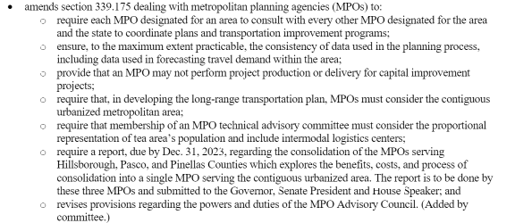
HB 425

Slide 23
Transportation Management Area (TMA) Briefing Executive Committee April 26, 2023

Slide 24
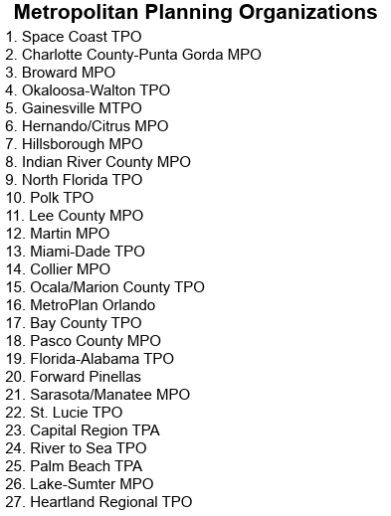
Florida’s 27 MPOs: TMA Status
Urbanized areas with population over 200,000
TMA
Non-TMA
Notes:
Gainseville MTPO is now a TMA, 4 or 17 is now a TMA

Slide 25
TMA Summary Points
Greater reporting and planning responsibilities
Additional funds for planning and project needs
Changes in transit funding

Slide 26
Key TMA Requirements
MPO Structure
Project Selection from TIP
Congestion Management Process
Florida Statutes also require CMP for all MPOs
Quadrennial Certification Review (FHWA/FTA)
Different than annual Joint Certification Review (FDOT)
Review MPO’s implementation of metropolitan planning requirements
Review and determine MPO’s compliance with broader requirements
“Corrective Actions” are the mechanism used to require changes
Effect of failure to certify – funds withheld – has not been an issue in FL

Slide 27
Non-TMA MPOs: Federal Review
Federal Program Accountability Review (PAR Reports)
Non-TMA MPOs can be included in PAR reviews
Prior PARs have focused on topics like:
Fiscal Constraint in LRTPs
Public Participation Plans

Slide 28
Examples of 2023 TMA Funding
SU Funds (Urban funds)
Winter Haven $3.6 million
Lakeland $4.6 million
Daytona Beach – Port Orange $6.2 million
Melbourne – Palm Bay $7.6 million
TALU Funds (Transportation Alternatives for TMAs)
Winter Haven $526 k
Lakeland $686 k
Daytona Beach – Port Orange $912 k
Melbourne – Palm Bay $1.18 million

Slide 29
TMA Funding – Key Point
SU funding allocation includes only urbanized areas that exceed 200,000 population
Petitioning to be a TMA will not change the allocation formula and 200,000 population threshold

Slide 30
Questions?

Slide 31
Executive committee member COMMENTS
Adjournment
Next Meeting: October 25, 2023 @ 1 PM

