Slide 1
Lake-Sumter MPO FY 2025 - 2029 Transportation Improvement Program (TIP)
Funded Projects through 2029
9/17/2024

Slide 2
TIP Overview
Purpose: A 5-year financially feasible program of multimodal transportation improvement projects.
Consistency with Other Plans:
All projects drawn from the 2045 Long Range Transportation Plan (LRTP)
Consistent with FDOT’s Five-Year Adopted Work Program
Consistent with Lake County’s Transit Development Plan (TDP)

Slide 3
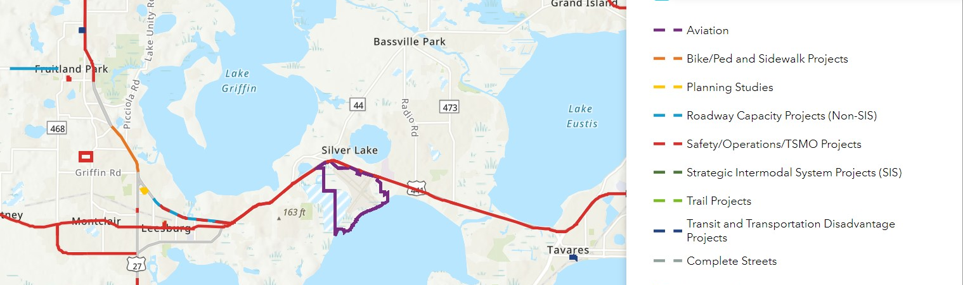
Web Application
TIP Interactive Map
Easy to Search Projects
Understand Context of Projects
Project Categories and Color Relate to TIP Report for Easy Reference
Notes:
Lake-Sumter MPO - TIP (arcgis.com)

Slide 4
Notes:
A decrease in number of projects from last year- of 57. but there’s an increase in funds.
Roadway Capacity Projects
Costs 250% increase
SIS Projects Costs
173% increase
Safety/Operations/TSMO Projects Costs
34% increase
Transit Projects Costs
55% increase

Slide 5
Funding Sources - FY25-29
Funding Source | 2025 | 2026 | 2027 | 2028 | 2029 | Total | FY 24/28 Difference
Federal | $57,528,133 | $122,096,500 | $20,288,481 | $7,337,675 | $870,808 | $ 208,121,597 | -$ 15,294,598
Local | $17,573,696 | $10,946,990 | $11,877,322 | $4,582,425 | $2,223,269 | $ 47,203,702 | -$ 29,050,805
R/W and Bridge Bonds | $24,565,096 | $19,253,170 | $- | $- | $- | $ 43,818,266 | $ 35,418,266
State 100% | $124,704,920 | $149,011,558 | $24,731,132 | $7,329,127 | $7,522,791 | $ 313,299,528 | -$ 201,718,702
Toll/Turnpike | $57,951,928 | $188,459,503 | $24,308,770 | $366,090,842 | $312,779,983 | $ 949,591,026 | $ 399,144,773
Total | $282,323,773 | $489,767,721 | $81,205,705 | $385,340,069 | $323,396,851 | $ 1,562,034,119 | $ 188,498,934

Slide 6
Project Category Cost FY 2025 - 2029
Project Category | 2025 | 2026 | 2027 | 2028 | 2029 | FY 24/28 Difference
Aviation | $ 4,050,000 | 1,375,000 | $ 3,300,000 | $ 3,200,000 | $ 3,750,000 | $ 15,675,000
Bike/Ped and Sidewalk Projects | $ 35,000 | $ - | $ 489,752 | $ - | $ - | $ 524,752
Complete Streets | $ - | $ - | $ - | $ - | $ - | $ -
Other | $ 900,000 | $ 1,500,000 | $ - | $ - | $ - | $ 2,400,000
Planning Studies | $ 859,669 | $ 870,808 | $ 870,808 | $ 870,808 | $ 870,808 | $ 4,342,901
Roadway Capacity Projects (Non-SIS) | $ 97,310,654 | $ 109,825,768 | $ 21,669,676 | $ - | $ 1,740,285 | $ 230,546,383
Safety/Operations/TSMO Projects | $ 67,204,208 | $ 100,174,276 | $ 16,762,395 | $ 4,104,069 | $ 2,198,281 | $ 190,443,229
Strategic Intermodal Systems Projects (SIS) | $ 91,093,125 | $ 257,763,200 | $ 24,464,750 | $ 366,071,942 | $ 312,761,083 | $ 1,052,154,100
Trail Projects | $ 6,994,087 | $ 5,430,387 | $ 707,280 | $ - | $ - | $ 13,131,754
Transit and Transportation Disadvantaged Projects | $ 13,877,030 | $ 12,828,282 | $ 12,941,044 | $ 11,093,250 | $ 2,076,394 | $ 52,816,000
Total | $ 282,323,773 | $ 489,767,721 | $ 81,205,705 | $ 385,340,069 | $ 323,396,851 | $ 1,562,034,119
Notes:
Prior: Change
Aviation- 6,673,000 reduced
Bike/Ped – 833,414 reduced
Planning Studies- 4,349,502
Other – 670,800 same
NON-SIS- 238,905,938 250% increased
Safety – 229,833,361 34% increase
SIS- 788,442,871 173% increase
Trail – 7,364,745 reduce
Transit- 94,444,400 55% increase
Total – 1,370,847,231

Slide 7
Project Category Percentages FY 2025-2029
Bike/Ped and Sidewalk Projects, Trail Projects and Planning Studies are less than 1% and are not shown.
There was no funding towards Complete Streets projects.

Slide 8
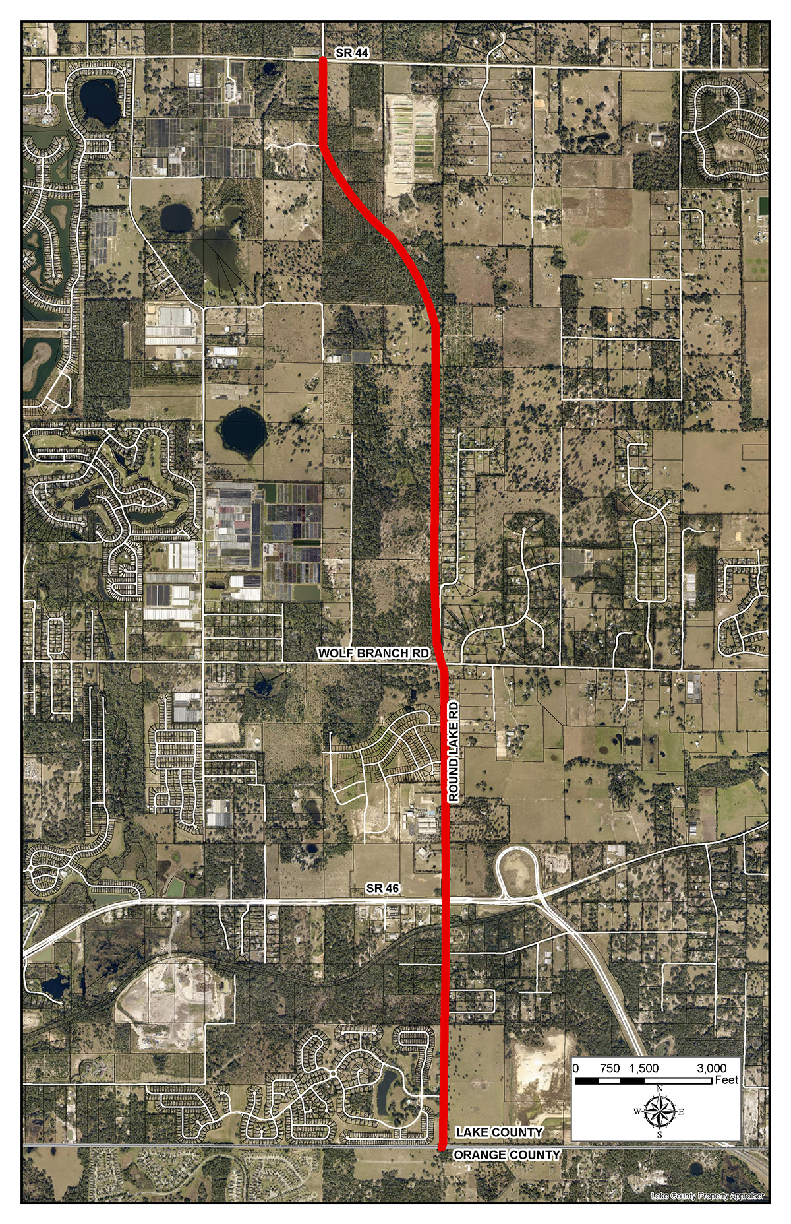
Round Lake Road 2-4 Lane Project $9M ROW Phase

Slide 9
CR 437 Realignment
ROW PHASE
FY 2024- $2.5m
CONSTRUCTION
NOT FUNDED

Slide 10
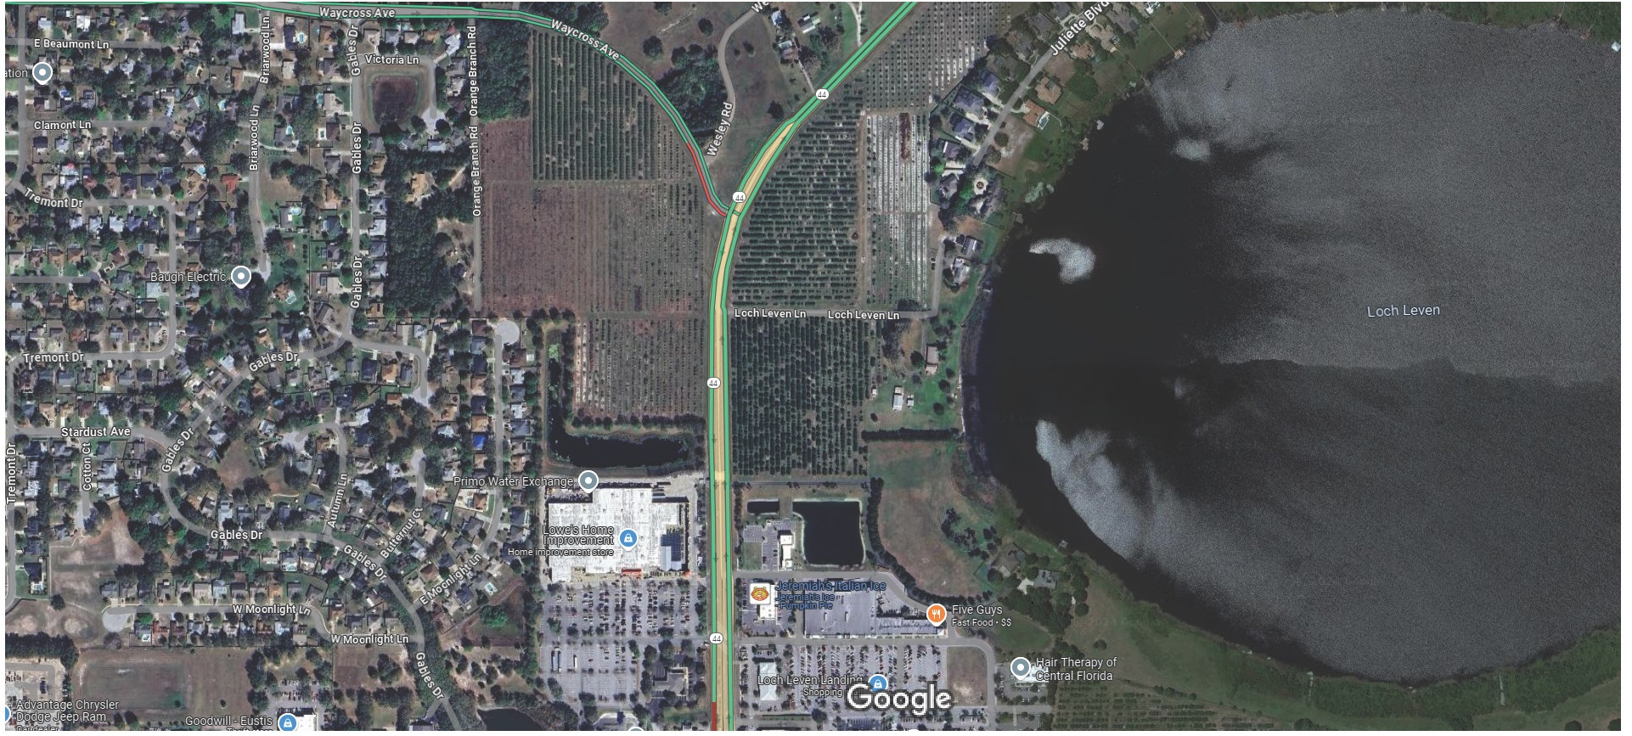
STATE ROAD 44
LOWES
PUBLIX

Slide 11
Segment 2 Funded for Construction FY 2025 $4m

Slide 12
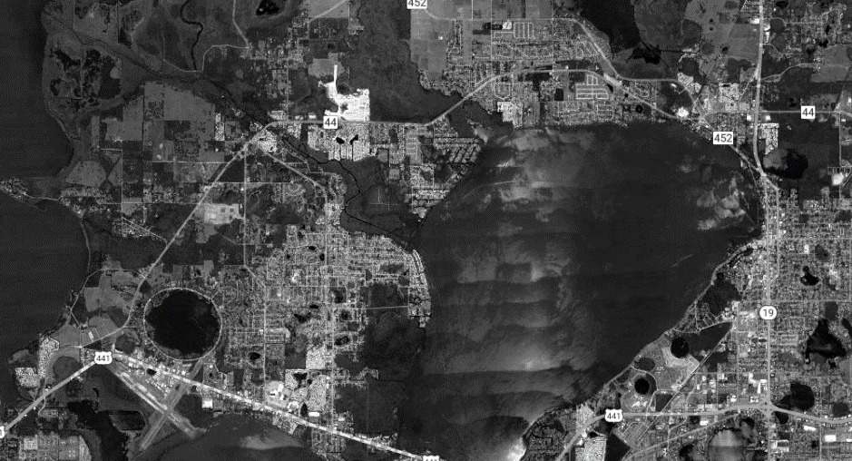
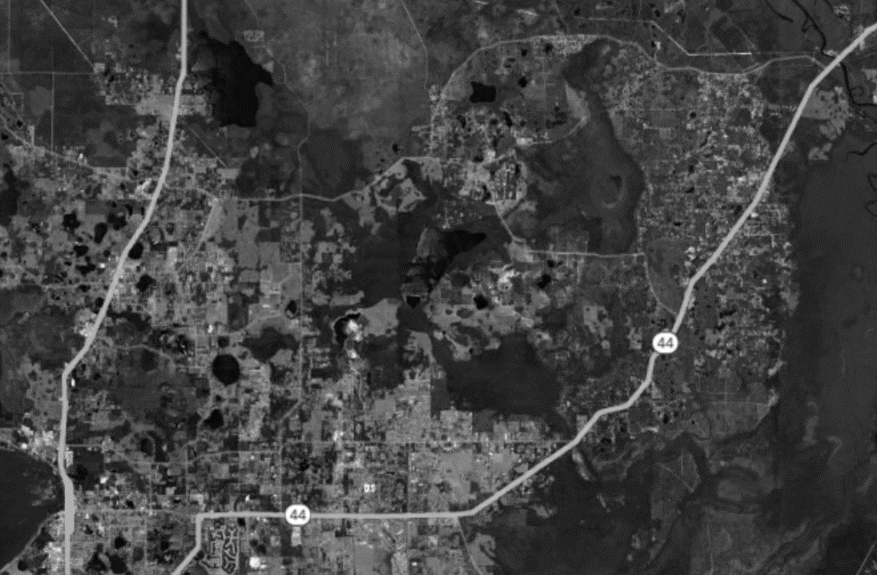
Key Projects – Lake County
FM# 453449-1:
C.R. 44, from U.S. 441 to S.R. 19
Add Left Turn Lanes
Design funded in FY 24/25 and Construction funded in FY 26/27
Funding in Tentative Work Program: $3,298,750
FM# 453086-1:
S.R. 44, from S.R. 44 in Lake County to Volusia County Line
Intersection Improvements
Design funded in FY 24/25 and Construction funded in FY 26/27
Funding in Tentative Work Program: $1,588,805
END PROJECT AT STATE ROAD 19
END PROJECT AT LAKE COUNTY LINE
BEGIN PROJECT AT S.R. 44
BEGIN PROJECT AT US 441

Slide 13
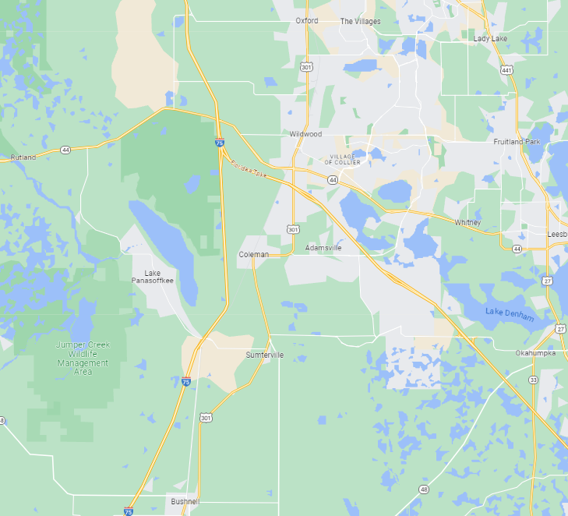
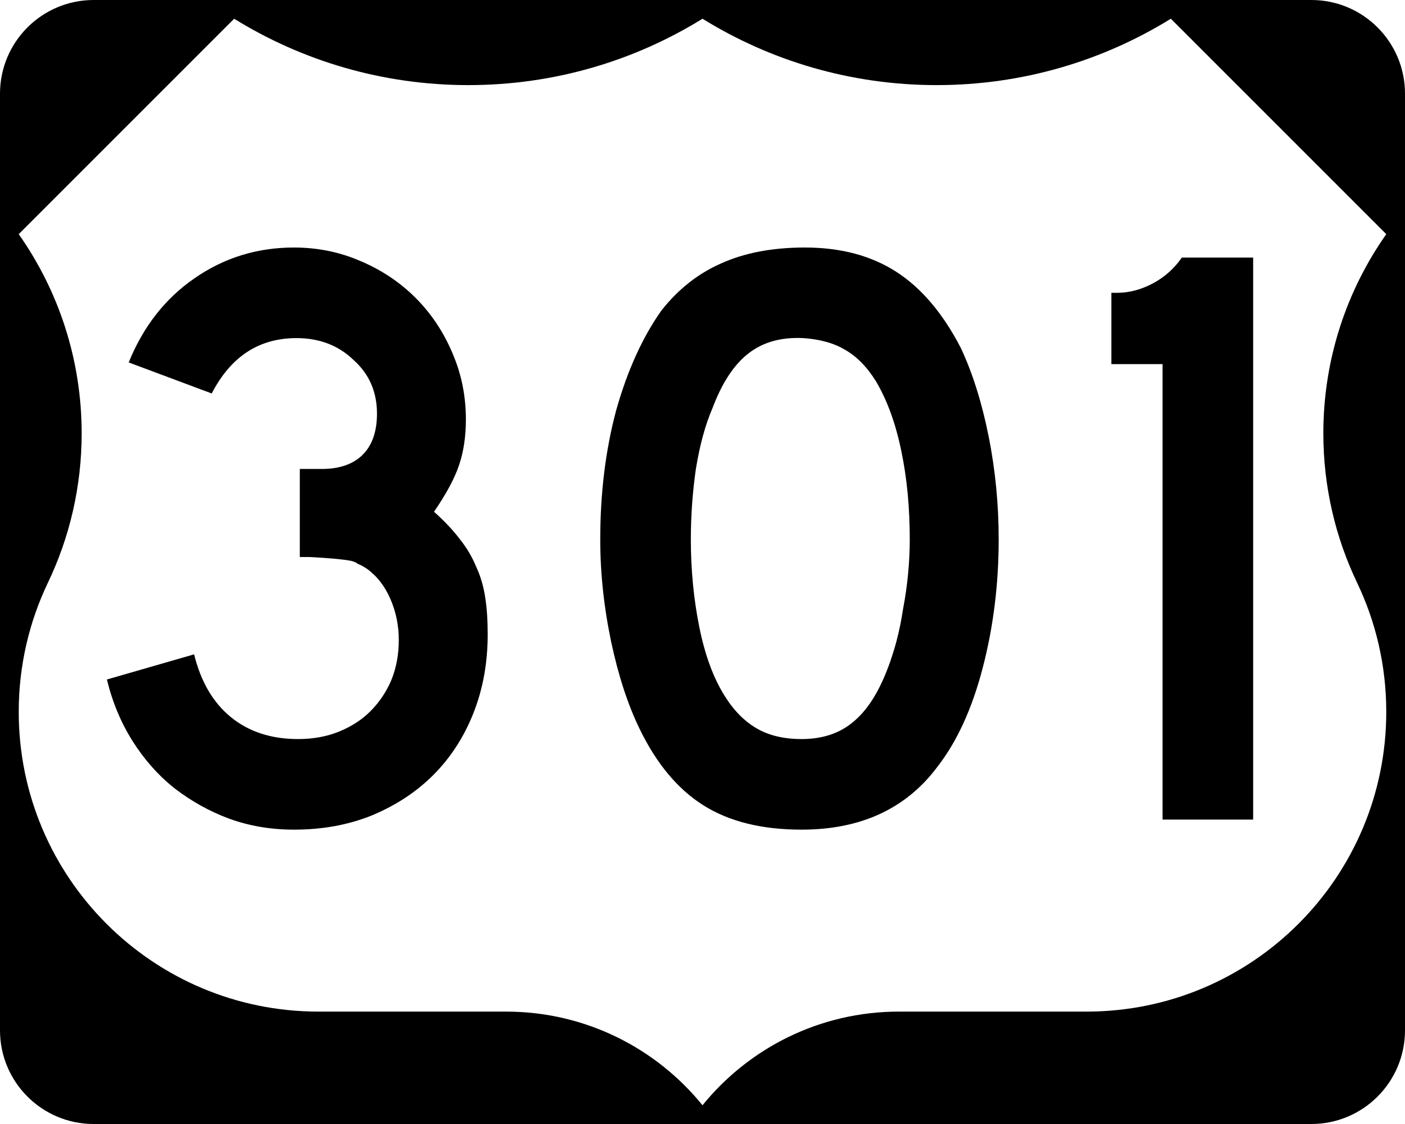
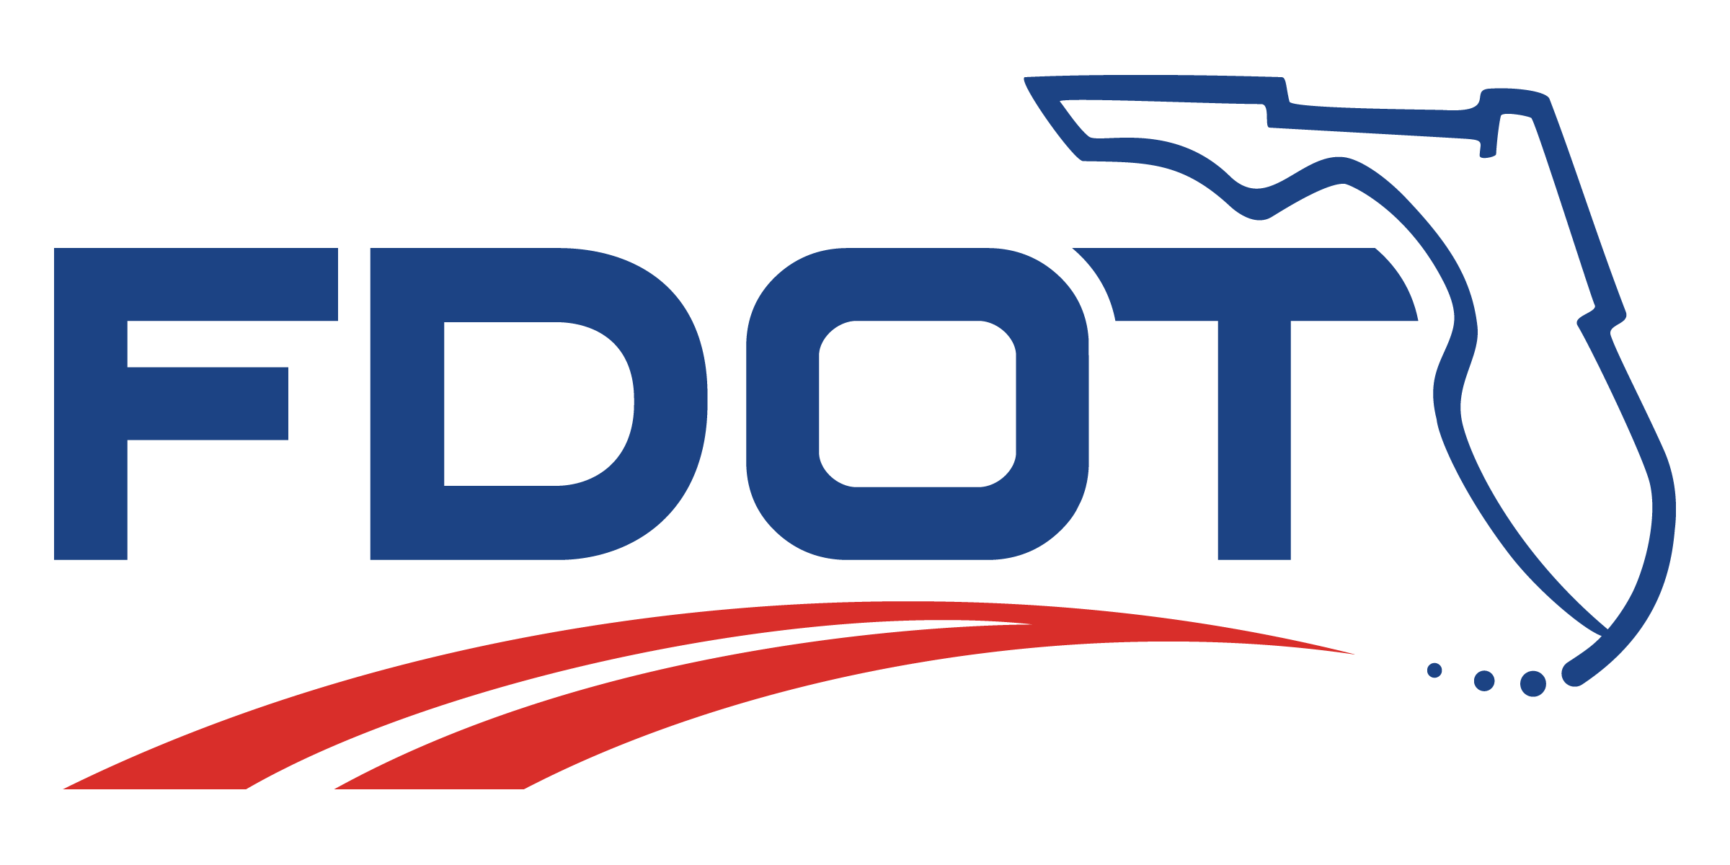
U.S 301 – Sumter County
Two focus projects:
430132-1 – Add Lanes, Realign, and Reconstruct
U.S. 301, from C.R. 525E to Florida’s Turnpike
Design-Build contract spring 2024
Construction phases to begin 2025
430132-2 – Add Lanes and Reconstruct
U.S. 301, from C.R. 470 to C.R. 525E
Design-Build contract spring 2024
Construction phases to begin 2025
Construction Phase FY 2025 $226 Million
Notes:
FM# 430132-1:
SR 35 (US 301) from County Road 525E to Florida Turnpike
Add Lanes & Reconstruct
Design-Build and Railroad/Utilities in FY 24/25 and Right of Way funded in FY 24/25 to 25/26
Funding in Tentative Work Program: $106,554,019
FM# 430132-2:
SR 35 (US 301) from County Road 470 to County Road 525E
Add Lanes & Reconstruct
Design-Build and Railroad/Utilities funded in FY 25/26
Funding in Tentative Work Program: $71,630,403

Slide 14
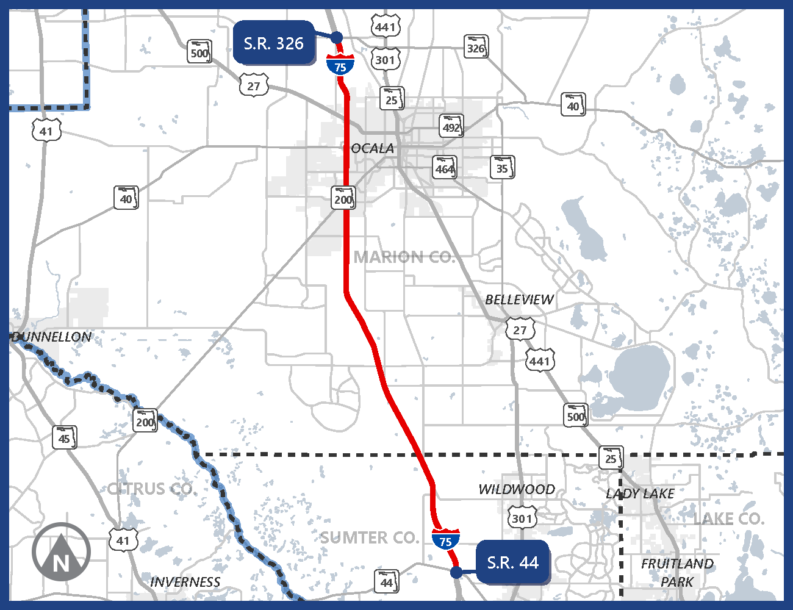
Interstate 75 from State Road (S.R.) 44 to S.R. 326 $479 million Construction Begins in 2025

Slide 15
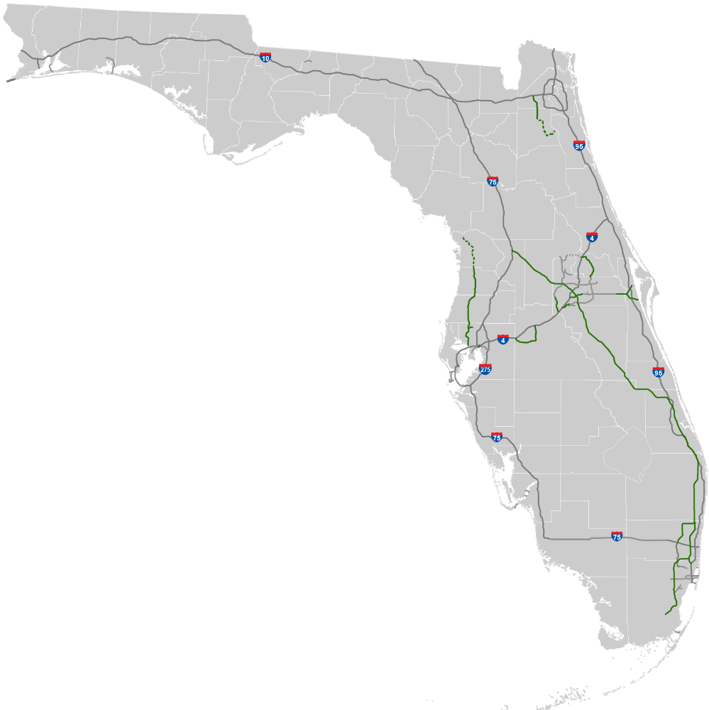
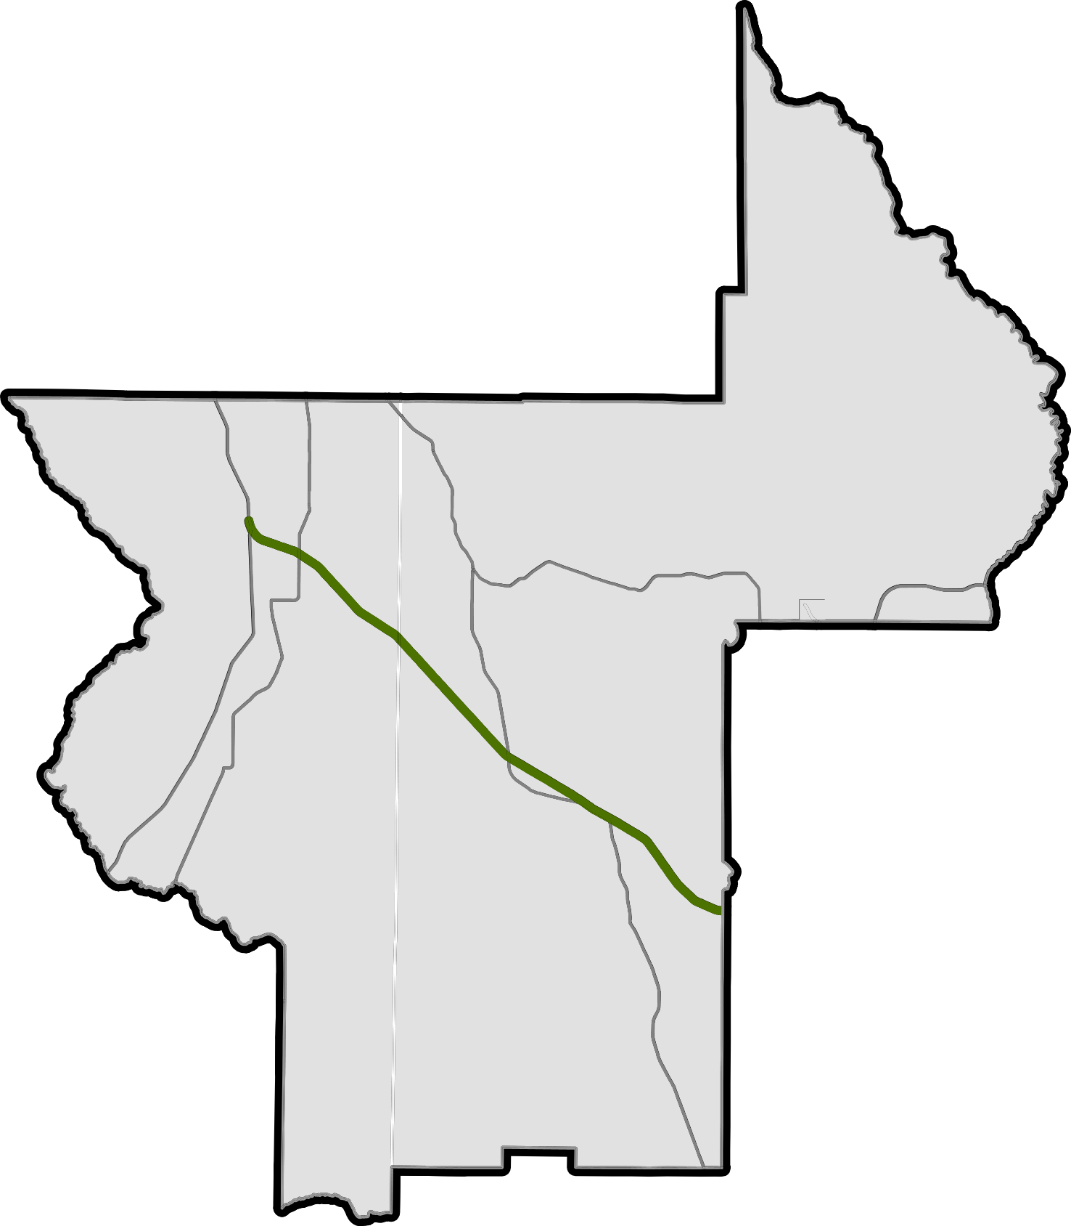
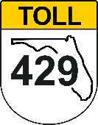
Facilities in Lake-Sumter Region
Turnpike Mainline (SR 91)
35 Miles
Notes:
Florida’s Turnpike Enterprise consists of a 511-mile statewide system of toll facilities in six of the seven FDOT Districts and 20 Florida counties.

Slide 16
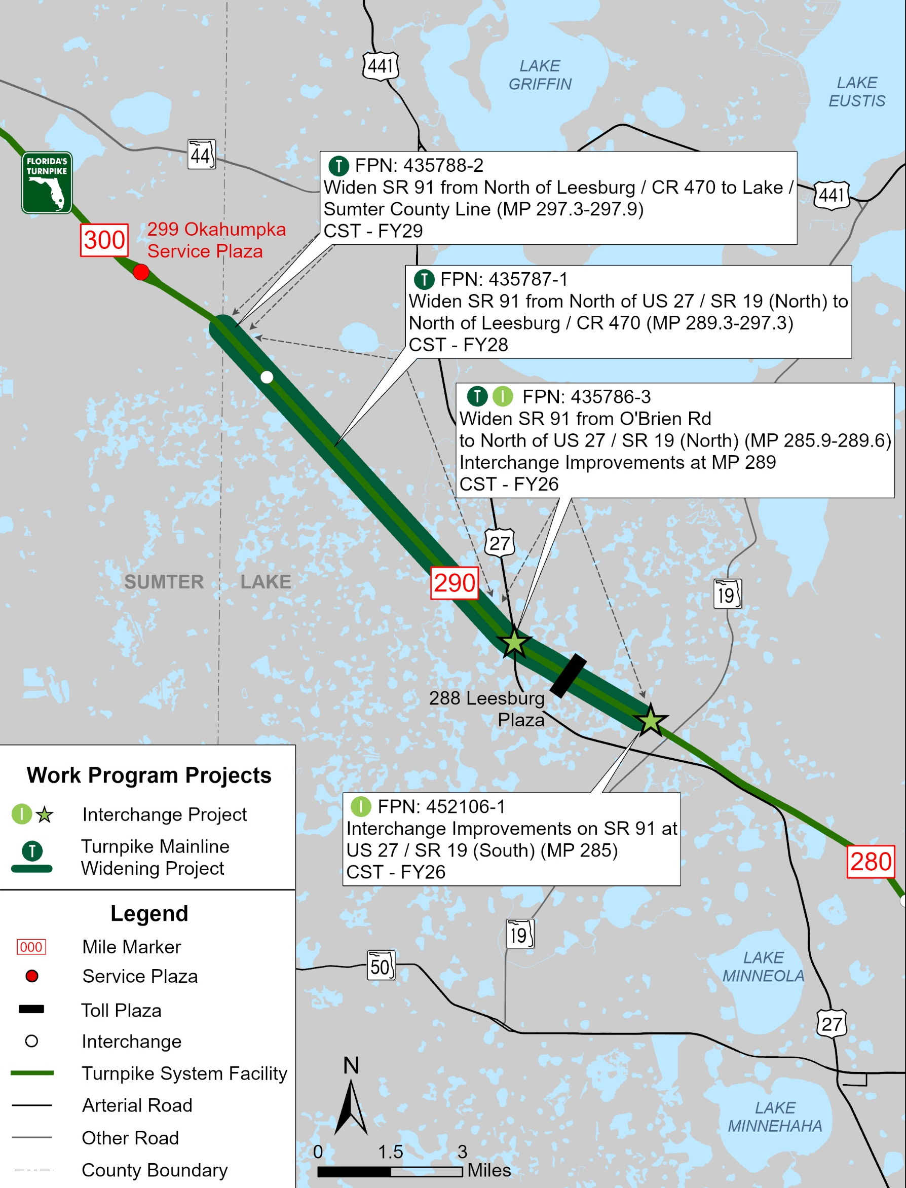
Lake County
Description | Phase | FY | Funds
Widen from Leesburg / CR 470 to Lake / Sumter County Line (MP 297.3 - MP 297.9) FPN: 435788-2 Construction funding has been added to the Tentative Five-Year Work Program | ENV PE ROW CST | 2026 2025-26 2026-27 2029 | $32.7M
Widen from North of US 27 / SR 19 (North) to North of Leesburg / CR 470 (MP 289.3 - MP 297.3) FPN: 435787-1 | ENV PE ROW RRU CST | 2028 2025, 27 2026-27 2028 2028 | $377.0M
Widen from Obrien Rd to North of US 27 / SR 19 (North) (MP 285.9 - MP 289.6) Interchange Improvements at MP 289 FPN: 435786-3 | ROW RRU CST | 2025-26 2025 2026, 29 | $167.4M
Interchange Improvements at US 27 / SR 19 (South) (MP 285) FPN: 452106-1 | ENV ROW CST | 2025 2025-26 2026 | $22.4M

Slide 17
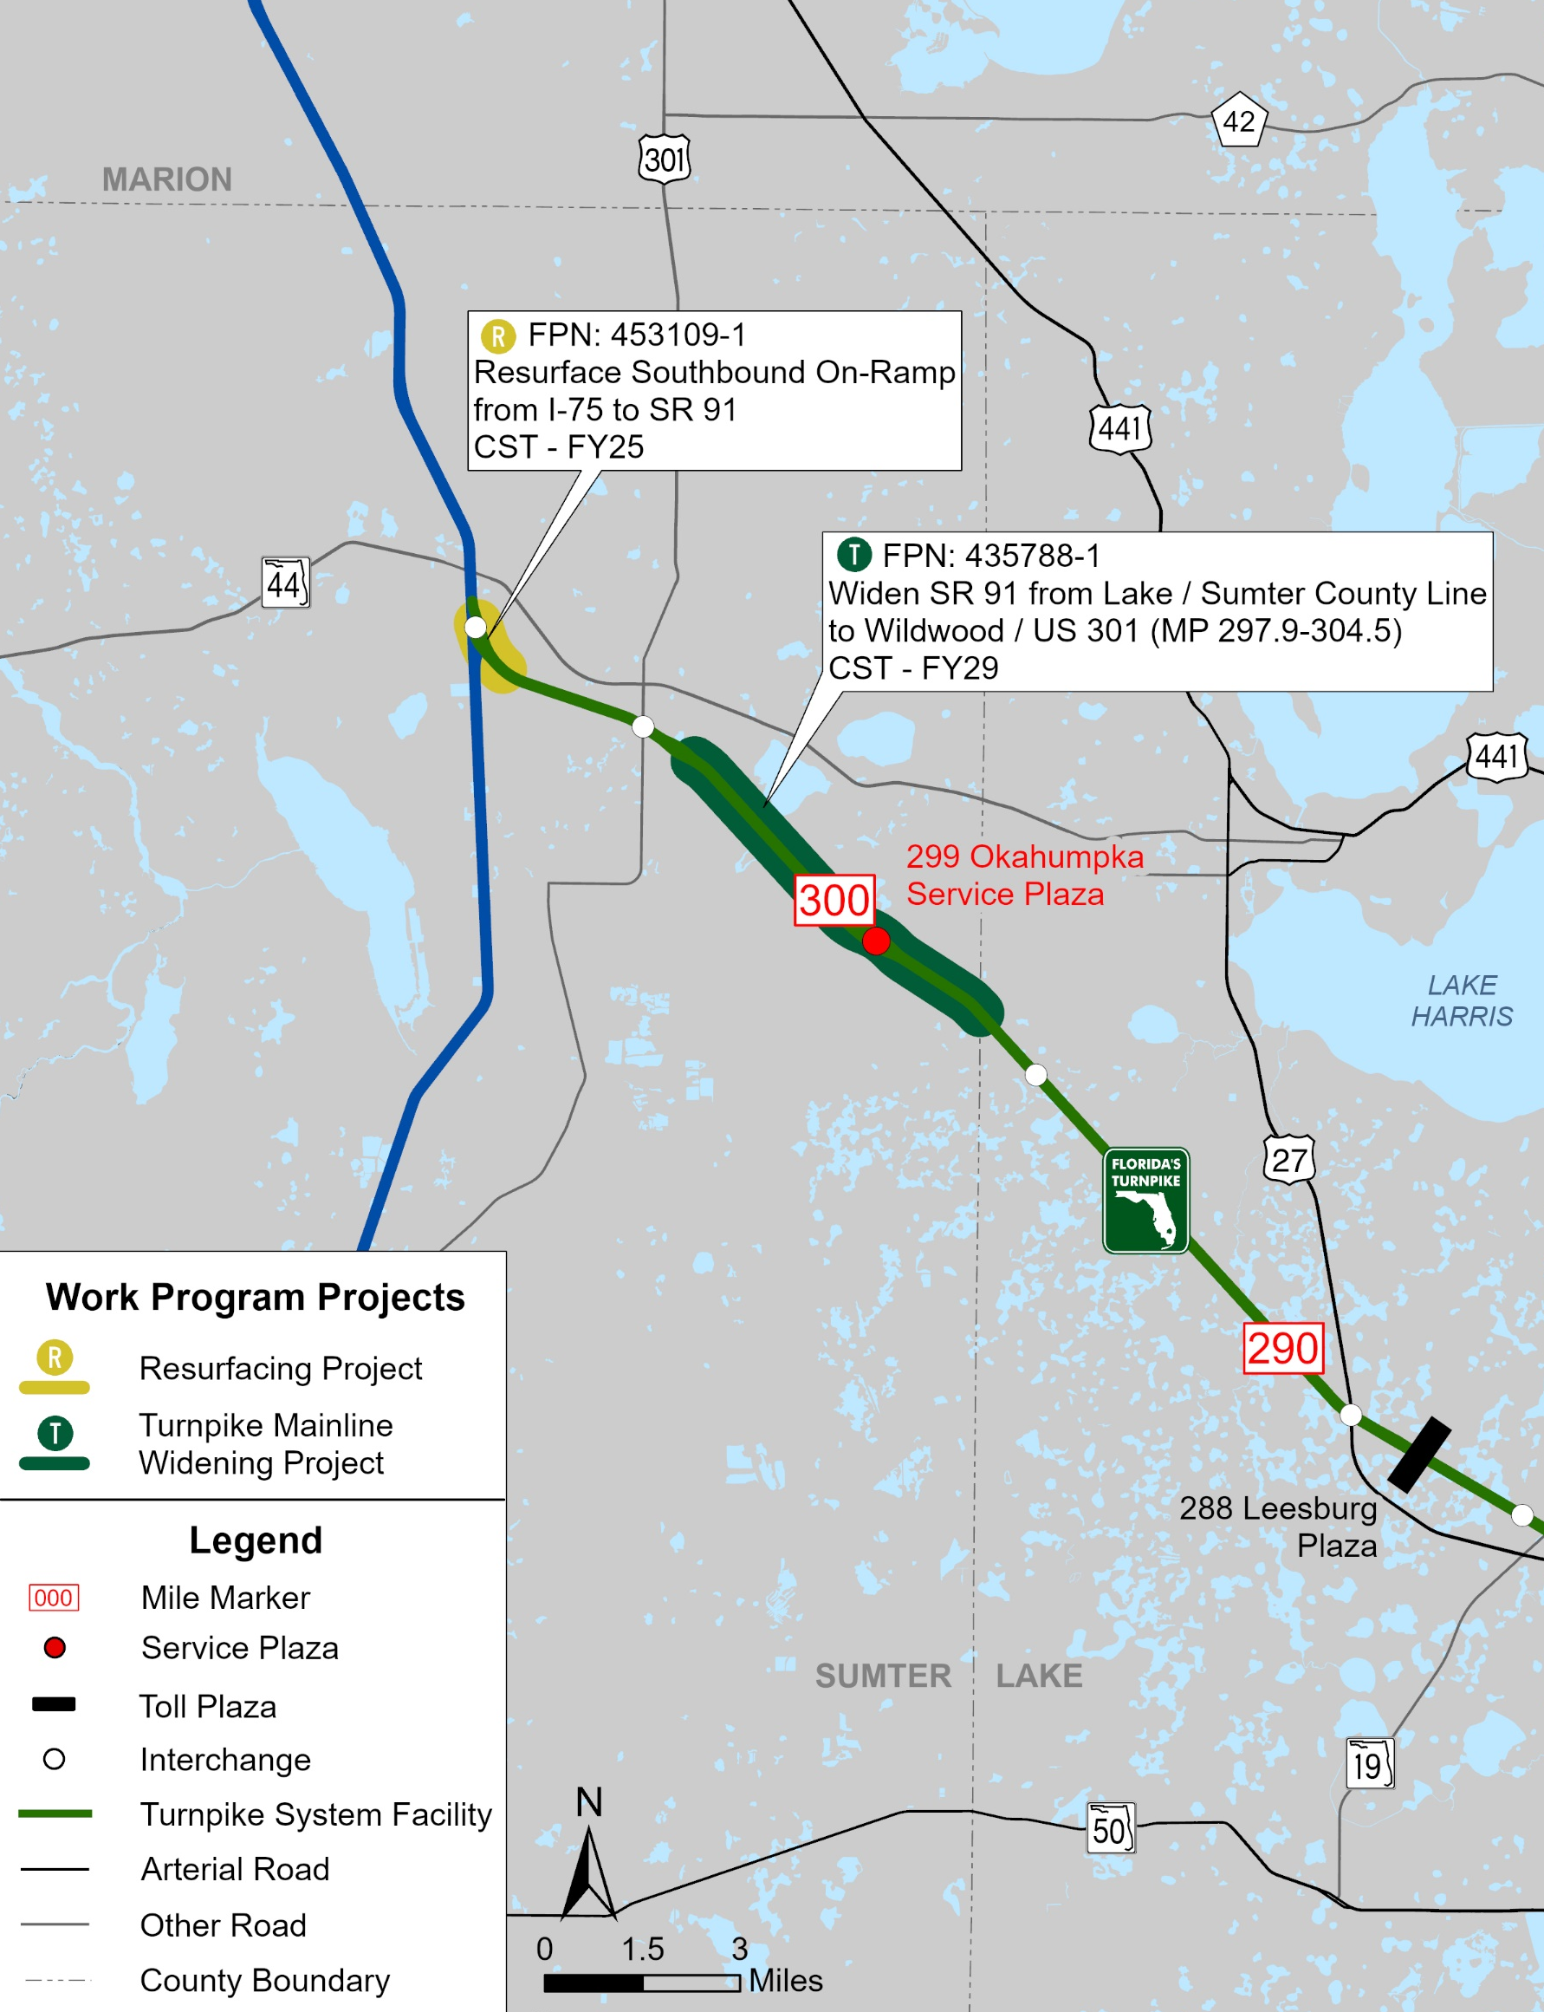
Sumter County
Description | Phase | FY | Funds
Resurface the Southbound On-Ramp from I-75 to the Turnpike Mainline / SR 91 at MP 309 FPN: 453109-1 Construction funding has been added to the Tentative Five-Year Work Program | CST | 2025 | $2.7M
Widen from Lake / Sumter County Line to Wildwood / US 301 (MP 297.9 - MP 304.5) FPN: 435788-1 Construction funding has been added to the Tentative Five-Year Work Program | ENV PE ROW RRU CST | 2029 2025 2026-27 2025, 29 2026-27, 29 | $300.5M

Slide 18
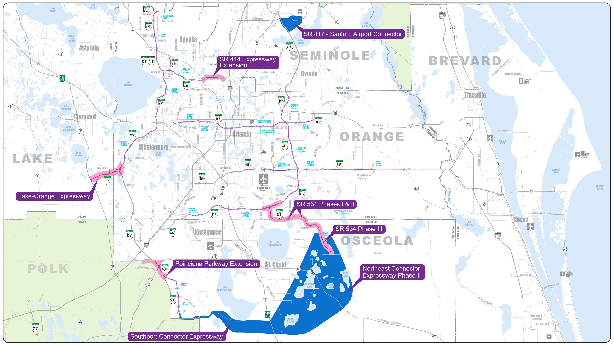
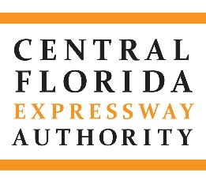
Expansion Projects

Slide 19
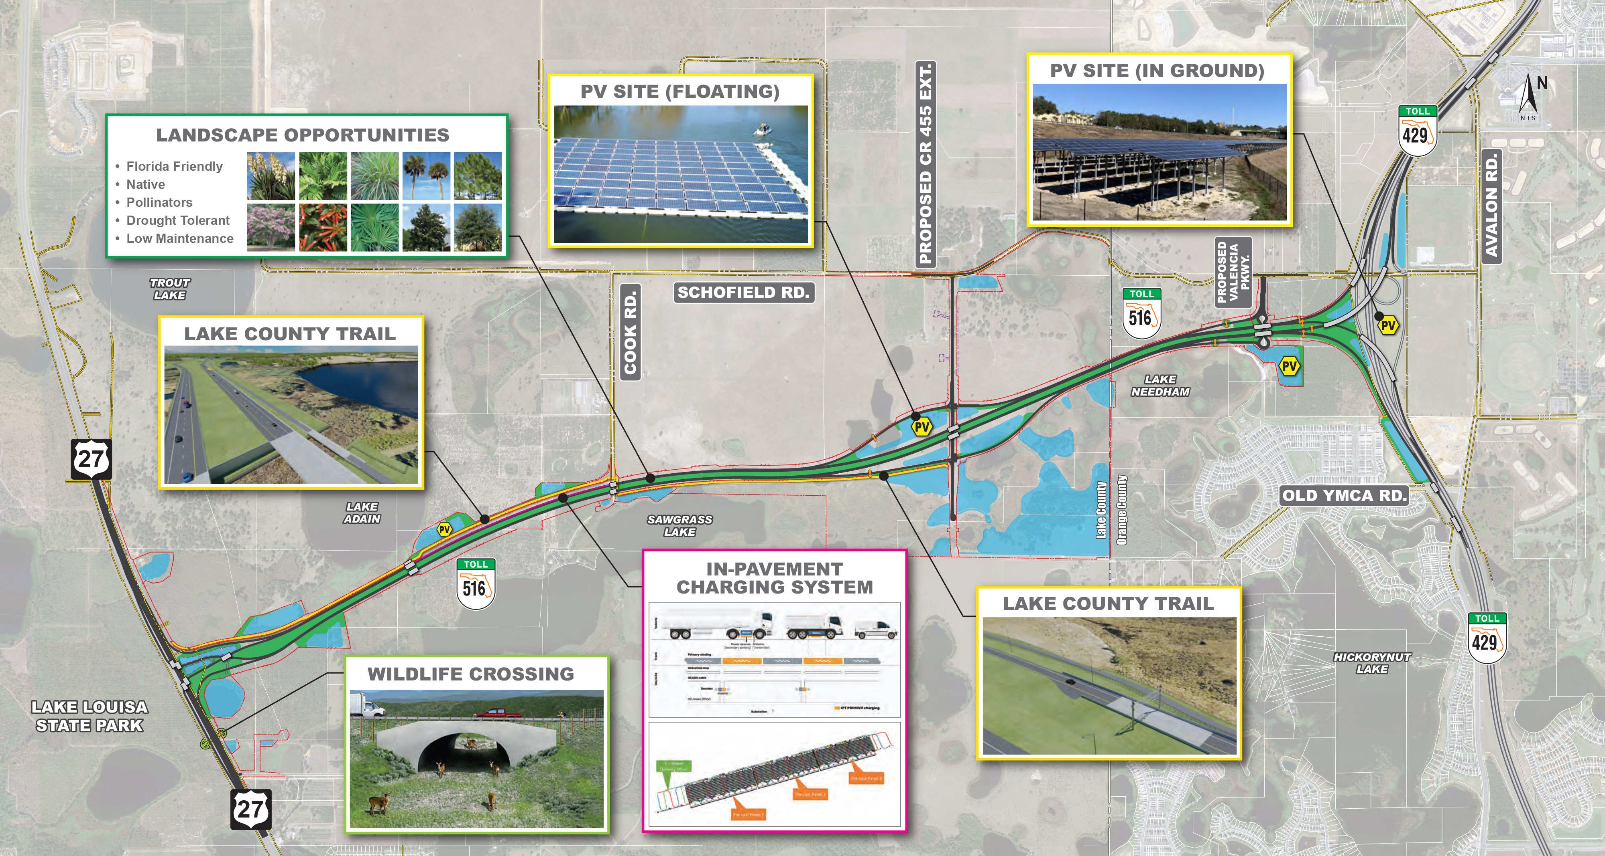
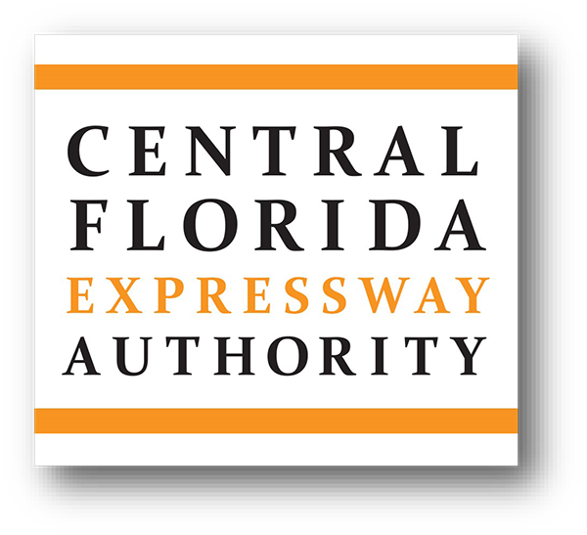

Slide 20
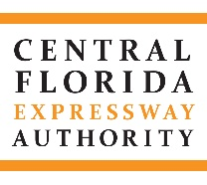
CFX Current FY 2025-2029 Work Plan
Project Cost Summary ($000’s) | Fiscal Year
Category | 2025 | 2026 | 2027 | 2028 | 2029 | Totals
Existing System Improvements | 157,955 | 59,705 | 39,725 | 117,195 | 251,926 | 626,506
System Expansion Projects | 401,301 | 438,127 | 700,132 | 710,591 | 621,209 | 2,871,540
Interchange Projects | 8,683 | 96,108 | 117,386 | 60,599 | 774 | 283,550
Facilities Projects | 12,204 | 5,029 | 3,708 | 4,234 | 7,956 | 33,131
Transportation Technology Projects | 14,384 | 24,838 | 2,133 | 3,127 | 5,995 | 50,477
Information Technology Projects | 16,440 | 15,327 | 2,488 | 2,186 | 2,186 | 38,627
Signing and Pavement Markings | 9,190 | 11,511 | 2,521 | 7,796 | 10,885 | 41,903
Renewal and Replacement Projects | 32,936 | 14,718 | 43,349 | 61,730 | 39,458 | 192,191
Landscape & Hardscape Projects | 1,958 | 9,609 | 10,964 | 744 | 1,684 | 24,959
Non-System Projects | 7,057 | 0 | 246 | 3,107 | 0 | 10,410
TOTALS | 662,108 | 674,972 | 922,832 | 971,309 | 942,073 | 4,173,294

Slide 21
QUESTIONS

