Slide 1
Lake~Sumter MPO APRIL 26, 2023 Governing Board Meeting
Michael Woods, Executive Director

Slide 2
Call to Order by Chair
Invocation / Pledge of Allegiance
Proper Noticing
Roll Call – Determination of Quorum
Chair's Announcements
Motion to allow virtual voting by members
Update: Proposed revisions to Today’s Agenda

Slide 3
II.
OPPORTUNITY FOR PUBLIC COMMENT on Agenda or General Comments
At this point in the meeting, the Board will hear citizens' questions, comments, and concerns. If the issue raised is not on today's Agenda, the Board will not take action at this meeting. Questions may be answered by staff or referred for appropriate staff action. If further action is necessary, the item may be placed on a future Board agenda. Public comment shall be limited to three minutes per person.

Slide 4
I.
Consent approval is requested for the following items:
Consideration to approve, February 22, 2023, MPO Governing Board Meeting Minutes
Approval of authorization for the Chair to sign the Executive Director’s timesheets and mileage reports for January – March 2023
Consideration to approve Financial Report as presented by Milestone Professional Services.
Approval for the Chair to sign the Letter of Support for the Governor’s Moving Florida Forward Initiative.

Slide 5
I. ACTION ITEM A.
Approval of Resolution 2023-3 Amending the Lake~Sumter MPO Transportation Improvement Program (TIP) for fiscal years 2023-2027.
Project # 443623-1 I-75 (SR 93) Turnpike to SR 200
22.496 miles
Phase PLN, Fund Source HP
$2,500,000 in fiscal year 2023
This funding supports the Moving Florida Forward Initiative for the I-75 project for additional lanes and interchange modification from the Florida Turnpike to CR 326 in Marion County.
MOTION TO CLOSE THE PUBLIC REVIEW PERIOD AND APPROVAL OF RESOLUTION 2023-3 ROLL CALL VOTE REQUIRED

Slide 6
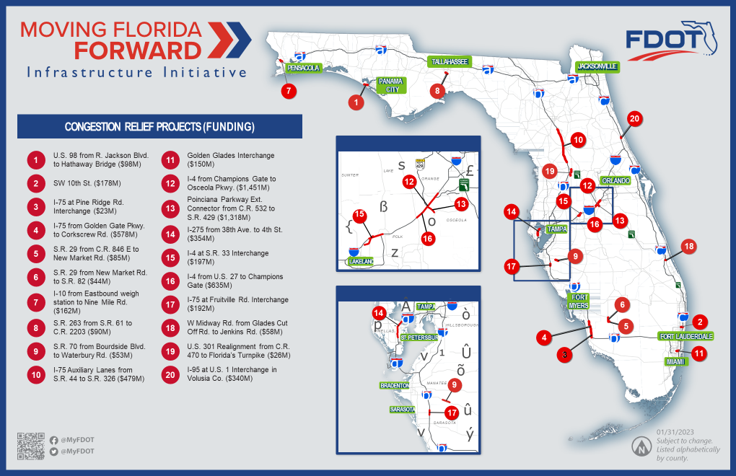

Slide 8
DISCUSSION ITEM A: 2023 List of Priority Projects (LOPP) Update
The LOPP represents the unfunded transportation improvements that were not programmed for the following five-year period in order of priority. The Florida Department of Transportation (FDOT) uses each MPO's LOPP to aid in deciding which projects should be added to their Work Program each year. The Lake~Sumter MPO approves its LOPP annually.
Staff will update the BOARD on the results FROM THE TENTATIVE WORK PROGRAM

Slide 9
List of Priority Projects (LOPP) Update Governing Board April 26, 2023

Slide 10
Key Points
2022 LOPP
FDOT Tentative Work Program
4 projects programmed for funding
1 project advanced
2023 LOPP
Anticipate significant carryover from 2022 LOPP

Slide 11
2022 LOPP – Proposed Funding
Based on FDOT 2023/24 – 2027/28 Tentative Work Program:
Lake County
#1: SR 50 Realignment (Groveland) - $14.7M for ROW in FY24 / $9.85M in FY25
#17: Micro Racetrack Road - $450K for Design advanced to FY24 from FY26
Sumter County
#2: US 301 Widening - $51M for ROW in FY24 / $71.1M for CST in FY 24 and $45.8M for CST in FY26
#6: US 301 Complete Streets (Wildwood) - $2M for Design in FY24
#8: CR 48 Safety Project - $1.6M for Design in FY24
Bridges #1: Rehabilitation for Multiple Bridges - $717,289 for CST in FY24

Slide 12
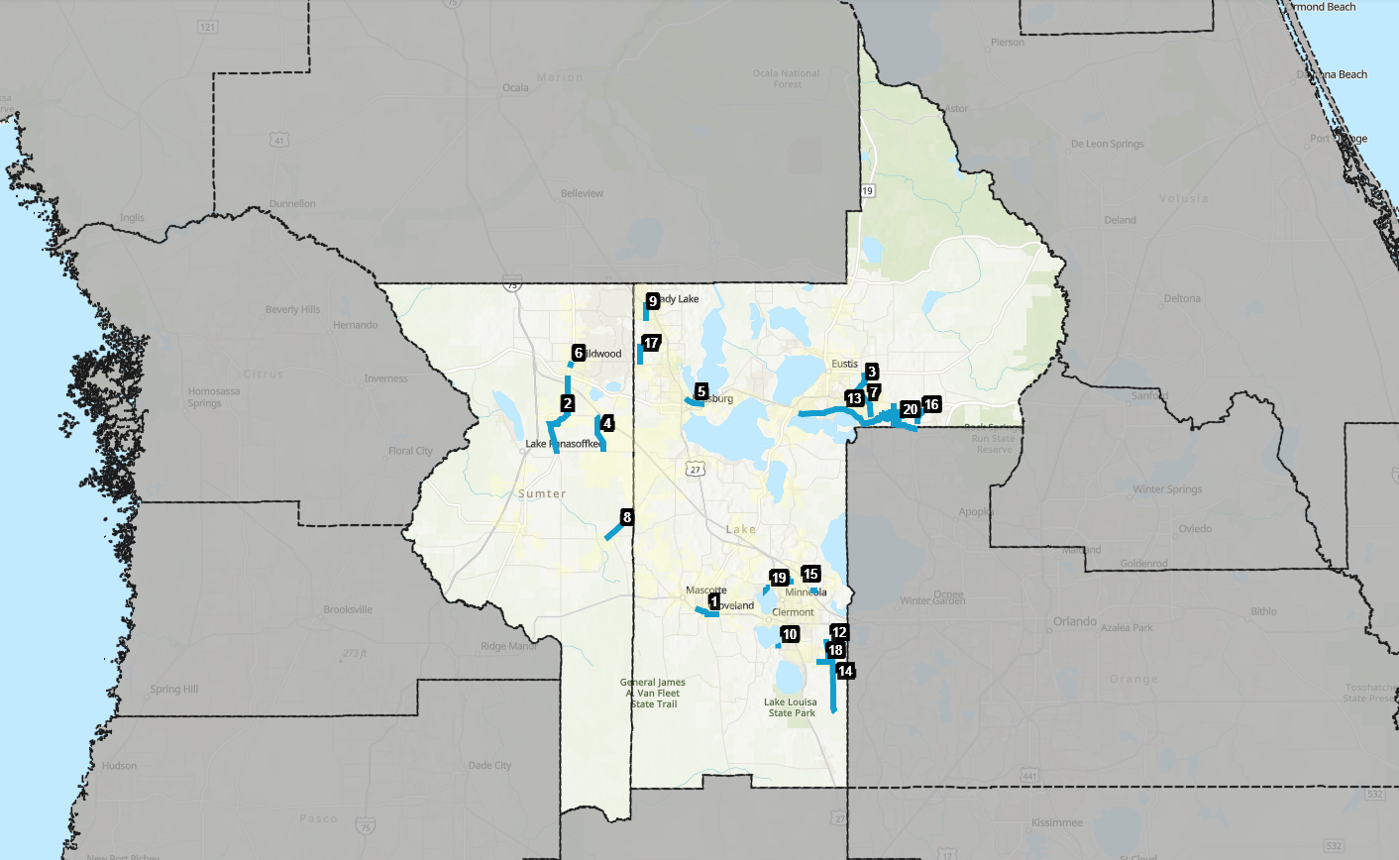
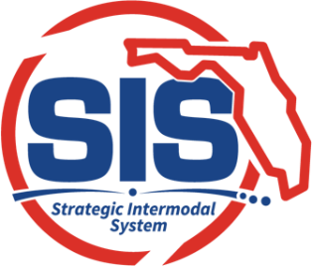
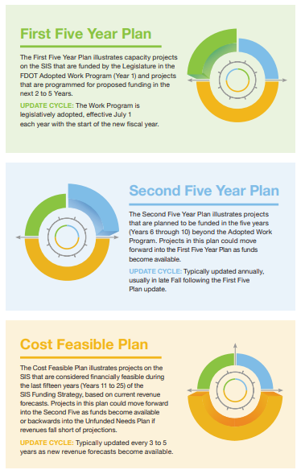
Strategic
Intermodal
System
Florida’s High Priority
High Capacity
Transportation
Network
#1: SR 50 Realignment (Groveland)
$14.7M for ROW in FY24 (Tentative WP)
$9.85M for ROW in FY25 (Tentative WP)
LSMPO’s #1 SIS Priority
$46M CST proposed in SIS 2nd Five-Year Plan

Slide 13
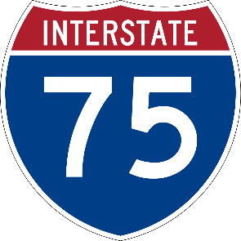
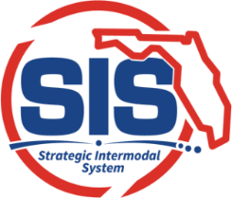
2022 LOPP SIS Priority
FDOT completing I-75 Master Plan from Sumter County (Turnpike) to CR 234 in Alachua
MOVING FLORIDA FORWARD proposes $479M in 2025 to begin construction of auxiliary lanes from SR 44 to SR 326 in Marion County

Slide 14
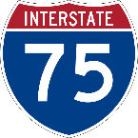
District Five DRAFT
2050 Cost Feasible Plan
I-75 – SR 44 to SR 326 (Marion)
Auxiliary Lanes
Design (FY 2032/33 – 2034/35)
ROW (FY 2040/41 – 2044/45)
CST (FY 2046/47 – 2049/50)
I-75 Truck Parking (Districtwide)
PD&E (FY 2035/36 – 2039/40)
I-75 – Turnpike to CR 484 (Marion)
Managed Lanes
Design (FY 2035/36 – 2039/40)
SR 50 – East of CR 478A to Sumter/Lake County Line
Widening
ROW (FY 2032/33 – 2034/35)
CST (FY 2046/47 – 2049/50)
US 27 – End of SR 19 to Turnpike North Ramps
Widening
PD&E (FY 2035/36 – 2039/40)
US 27 – CR 561A to End of SR 19
Widening
PD&E (FY 2035/36 – 2039/40)
SR 50 – East of Sumter/Lake County Line to CR 33
Widening
ROW (FY 2040/41 – 2044/45)
CST (FY 2046/47 – 2049/50)
SR 50 – US 27 to Montevista
Widening
PD&E (FY 2040/41 – 2044/45)

Slide 15
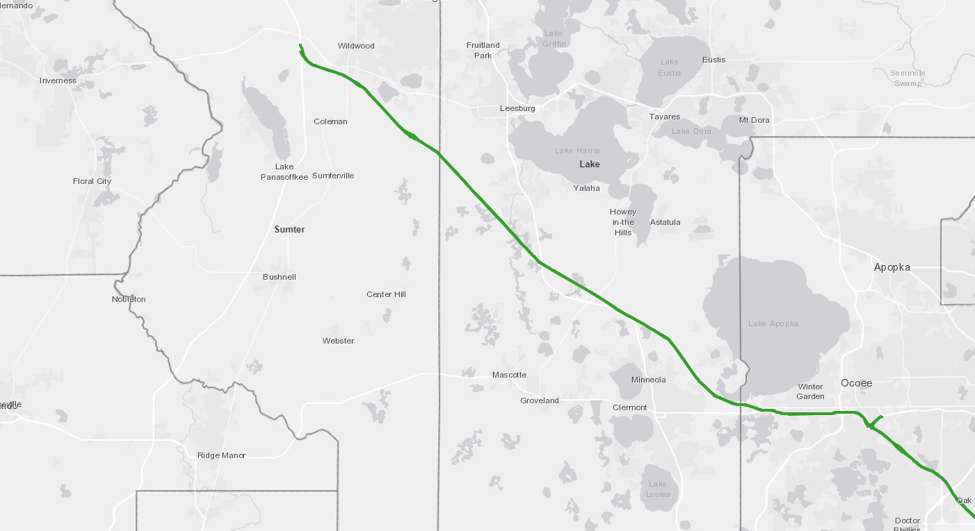
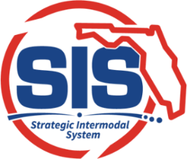
2022 LOPP SIS Priority:
Turnpike Widening from CR 470 to Lake/Sumter County Line
Design funded in FY 2025 (Tentative WP)
ROW funded in FY 2026 (Tentative WP)
Turnpike Widening from US 301 to I-75
Design funded in FY 2026 (Tentative WP)
ROW funded in FY 2028 (Tentative WP)
Turnpike Widening from O’Brien to US 27 includes Interchange Improvements at US 27/ SR 19 (North) (MP 289)
Construction funded in FY 2026 (Tentative WP)
2022 LOPP SIS Priority:
Turnpike Widening from County Line to US 301
Design funded in FY 2025 (Tentative WP)
ROW funded in FY 2026 (Tentative WP)
Interchange Improvements at US 27/ SR 19 (South) (MP 285)
Construction funded in FY 2026
2022 LOPP SIS Priority:
Turnpike Widening from US 27 to CR 470
Construction funded in FY 2028 (Tentative WP)
UNDER CONSTRUCTION
Turnpike Widening from Clermont to O’Brien

Slide 16
#2: US 301 Widening/Realignment
$51M for ROW in FY24 (Tentative WP)
$71.1M for CST in FY 24 (Tentative WP)
$45.8M for CST in FY26 (Tentative WP)
$26M proposed in MOVING FLORIDA FORWARD
Funded Through Construction

Slide 17
#17: Micro Racetrack Road
$5M CST request in 2022 LOPP
No new funding
Design advanced from 2026 to 2024
#6: US 301 Complete Street (Wildwood)
$2M for Design in FY24 (Tentative WP)
#15: Citrus Grove Rd. Phases II & V
Phase II funded through construction (legislative appropriation/local funding)
#8: CR 48 Safety Project
$1.6M for Design in FY24 (Tentative WP)

Slide 18
2022 LOPP Proposed Funding
2022 Top 20 Rank | Sponsor/ Location | Project Name | From | To | Proposed Funding
1 | FDOT/ Lake County | SR 50 | CR 565 (Villa City) | CR 565A (Montevista) | $24.6M for ROW in Tentative WP + $46M for CST proposed in SIS 2nd Five-Year Plan
2 | FDOT/ Sumter County | SR 35 (US 301) | SR 44 | CR 470 | $51M for ROW in Tentative WP $117M for CST in Tentative WP + $26M proposed in MOVING FLORIDA FORWARD
3 | FDOT | SR 44 (CR44B) | US 441 | SR 44
4 | Sumter County | Marsh Bend Trail (CR 501) | Corbin Trail | Central Parkway
5 | FDOT | SR 500 (US 441) | Perkins Street | SR 44
6 | Sumter/ Wildwood | US 301 Complete Streets | C-466A | C-44A | $2M for Design in Tentative WP
7 | FDOT | SR 500 (US 441) | SR 44 | N of SR 46
8 | Sumter County | C 48 | C 469 | Lake/Sumter County Line | $1.6M for Design in FY24 (Tentative WP)
9 | Lake County/ Lady Lake | Rolling Acres Road | West Lady Lake Avenue | Griffin Avenue
10 | Lake County | Hammock Ridge Roundabout | Hammock Ridge Rd | Lakeshore Dr

Slide 19
2022 LOPP Proposed Funding
2022 Top 20 Rank | Sponsor/ Location | Project Name | From | To | Proposed Funding
11 | Lake County | Round Lake Road | Lake/Orange County Line | SR 44
12 | Lake County | CR 455 (Ray Goodgame Parkway) | Lost Lake Road | Hartwood Marsh Road
13 | Lake County | Wekiva Trail (Segments 1&5) | Disston Avenue | Sorrento
14 | Lake County | CR 455 Extension | Hartwood Marsh Rd | CFX Lake-Orange Connector
15 | Lake County | Citrus Grove Phase II & V | W. of Scrub Jay Lane (Phase II) / Florida's Turnpike (Phase V) | Grassy Lake Road (Phase II) / Blackstill Lake Drive (Phase V) | Phase II funded through construction (legislative appropriation/local funding)
16 | Lake County | CR 437 Realignment | Oak Tree Dr | SR 46
17 | Lake County | Micro Racetrack Road | CR 466A | Lake Ella Road | Design advanced from 2026 to 2024
18 | Lake County | Hartwood Marsh Road | Regency Hills Drive | CR 455/Ray Goodgame Parkway
19 | Lake County | Lake Minneola Shores & Jalarmy Rd Roundabout | Lake Minneola Shores | Jalarmy Road
20 | Lake County/ Mount Dora | Vista Ridge Drive/Wolf Branch Innovation Blvd | Niles Road | CR 437

Slide 20
2023 Prioritization Concept
2023 PROPOSED Top 20 Rank | 2022 Top 20 Rank | Sponsor/ Location | Project Name | From | To | 2023 Proposed Phase | 2023 Proposed Phase FY | 2023 Proposed Phase Cost | CMP Congested Corridors 2022 Analysis (for informational purposes) | Prior Year Top 20 Rank | Project Phase Requested | Crash Density (for informational purposes)
 | 1 | FDOT/ Lake County | SR 50 | CR 565 (Villa City) | CR 565A (Montevista) | CST | 2024/25 | $45,445,800 | Operating at Acceptable Level of Service | 1-5 | Construction | Medium (51-100)
Funded | 2 | FDOT/ Sumter County | SR 35 (US 301) | SR 44 | CR 470 |  |  |  | Extremely Congested (2027) | 1-5 | Funded | Medium-Low (1-50)
 | 3 | FDOT | SR 44 (CR44B) | US 441 | SR 44 | CST | 2024/25 | $26,500,000 | Extremely Congested (2022) | 1-5 | Construction | Medium (51-100)
 | 4 | Sumter County | Marsh Bend Trail (CR 501) | Corbin Trail | Central Parkway | CST | 2024/25 | $1,462,300 | Operating at Acceptable Level of Service | 1-5 | Construction | Medium-Low (1-50)
 | 5 | FDOT | SR 500 (US 441) | Perkins Street | SR 44 | CST | 2024/25 | $13,794,537 | Approaching Congestion | 1-5 | Construction | High (101-200)
Funded | 6 | Sumter/ Wildwood | US 301 Complete Streets | C-466A | C-44A | CST | 2024/25 | $10,039,169 | Operating at Acceptable Level of Service | 6-10 | Funded | Medium-Low (1-50)
 | 7 | FDOT | SR 500 (US 441) | SR 44 | N of SR 46 | CST | 2024/25 | $25,800,000 | Operating at Acceptable Level of Service | 6-10 | Construction | Medium (51-100)
 | 8 | Sumter County | C 48 | C 469 | Lake/Sumter County Line | CST | 2025/26 | $6,475,426 | Operating at Acceptable Level of Service | 6-10 | Construction | Medium-Low (1-50)
 | 9 | Lake County/ Lady Lake | Rolling Acres Road | West Lady Lake Avenue | Griffin Avenue | ROW | 2026/27 | $4,000,000 | Congested (2022) | 6-10 | ROW | Medium-Low (1-50)
 | 10 | Lake County | Hammock Ridge Roundabout | Hammock Ridge Rd | Lakeshore Dr | CST | 2027/28 | $1,500,000 | Extremely Congested (2022) | 6-10 | Construction | Medium-Low (1-50)

Slide 21
2023 Prioritization Concept
2023 PROPOSED Top 20 Rank | 2022 Top 20 Rank | Sponsor/ Location | Project Name | From | To | 2023 Proposed Phase | 2023 Proposed Phase FY | 2023 Proposed Phase Cost | CMP Congested Corridors 2022 Analysis (for informational purposes) | Prior Year Top 20 Rank | Project Phase Requested | Crash Density (for informational purposes)
 | 11 | Lake County | Round Lake Road | Lake/Orange County Line | SR 44 | CST | 2027/28 | $30,000,000 | Operating at Acceptable Level of Service | 11-15 | Construction | Medium-Low (1-50)
 | 12 | Lake County | CR 455 (Ray Goodgame Parkway) | Lost Lake Road | Hartwood Marsh Road | CST | 2024/25 | $19,800,000 | New Roadway, Not on CMP Network | 11-15 | Construction | New Roadway
TA App. Required | 13 | Lake County | Wekiva Trail (Segments 1&5) | Disston Avenue | Sorrento | ROW | 2024/25 | $19,000,000 | Trail | 11-15 | ROW | Medium-Low (1-50)
 | 14 | Lake County | CR 455 Extension | Hartwood Marsh Rd | CFX Lake-Orange Connector | Design | 2024/25 | $3,000,000 | New Roadway, Not on CMP Network | 11-15 | Design | New Roadway
 | 15 | Lake County | Citrus Grove Phase V | Florida's Turnpike | Blackstill Lake Dr. | CST | 2024/25 | $6,126,039 | New Roadway, Not on CMP Network | 11-15 | Construction | New Roadway
 | 16 | Lake County | CR 437 Realignment | Oak Tree Dr | SR 46 | CST | 2024/25 | $4,000,000 | New Roadway, Not on CMP Network | 16-20 | Construction | New Roadway
 | 17 | Lake County | Micro Racetrack Road | CR 466A | Lake Ella Road | ROW | 2024/25 | $5,000,000 | Congested (2022) | 16-20 | ROW | Medium-Low (1-50)
 | 18 | Lake County | Hartwood Marsh Road | Regency Hills Drive | CR 455/Ray Goodgame Parkway | ROW | 2024/25 | $3,000,000 | Operating at Acceptable Level of Service | 16-20 | ROW | Medium-Low (1-50)
 | 19 | Lake County | Lake Minneola Shores & Jalarmy Rd Roundabout | Lake Minneola Shores | Jalarmy Road | CST | 2024/25 | $1,200,000 | Operating at Acceptable Level of Service | 16-20 | Construction | Medium (51-100)
 | 20 | Lake County/ Mount Dora | Vista Ridge Drive/Wolf Branch Innovation Blvd | Niles Road | CR 437 | Planning/ Preliminary Design | 2023/24 | $1,500,000 | New Roadway, Not on CMP Network | 16-20 | Planning | New Roadway

Slide 22
Proposed Top 20 Candidates
CR 466 Phase I & II
CR 656 Phase II
Sumter County Safe Streets for All – Phase I
SR 19 Planning Study – SR 50 to CR 455
2050 Long Range Transportation Plan – Preliminary Planning

Slide 23
Next Steps
Preliminary LOPP Options Reviewed by Board/Committees | April 12 & April 26
Final LOPP Reviewed & Approved by Board/Committees | June 14 & June 28
MPO Submits Adopted LOPP to FDOT | By June 30

Slide 24
Questions?

Slide 25
Discussion Item B: Lake~Sumter MPO DRAFT Transportation Improvement Program FY 2024-2028
The Transportation Improvement Program (TIP) lists each transportation project to be implemented over the next five years.
The TIP identifies projects for maintaining and improving the transportation system funded by federal and state sources.
The list of funded transportation projects is developed annually with input from the community and updated throughout the year.
The final Draft TIP will be on the June Committee and Board meeting agendas for approval.

Slide 26
DISCUSSION ITEM C: FDOT Decennial Functional Classification Review Process
Functional Classification is a method to assign public roadways into classifications according to the character of service they provide in relation to the total roadway network.
The deadline for local agencies to provide comments is
May 26, 2023, information is in the agenda packet.

Slide 27
Reports, PRESENTATIONS, STUDIES
FDOT Construction Report
Florida Turnpike Enterprise (FTE)
Lake County Transit Report
Informational Items:
CFMPOA 2045 Regional LRTP
Urban Area Boundary Data Hub

Slide 28
Board MEMBER COMMENTS
Adjournment
Next Meeting: JUNE 21, 2023 @ 2 PM

