Slide 1

Lake~Sumter MPO
October 11, 2023
Advisory Committee Meeting
Michael Woods, Executive Director

Slide 2

Call to Order by Chair
Invocation / Pledge of Allegiance
Proper Noticing
Roll Call – Determination of Quorum
Chair's Announcements
Motion to allow virtual voting by members
Update: Proposed revisions to Today’s Agenda

Slide 3
II.
OPPORTUNITY FOR PUBLIC COMMENT on Agenda or General Comments
At this point in the meeting, the Committee will hear citizens' questions, comments, and concerns. If the issue raised is not on today's Agenda, the Committee will not take action at this meeting. Questions may be answered by staff or referred for appropriate staff action. If further action is necessary, the item may be placed on a future committee agenda. Public comment shall be limited to three minutes per person.

Slide 4
CONSENT AGENDA ITEMS for APPROVAL
Items A-E
Approval of June 14, 2023, Meeting Minutes
Transportation Improvement Program (TIP)
  Retroactive Approval of Resolution 2023-11 Amending the 2024-2028 Transportation Improvement Program (TIP). The MPO processed an Emergency TIP Amendment as per the MPO Bylaws.
  Retroactive Approval of Resolution 2023-12 Amending the 2024-2028 TIP. The MPO processed an Emergency TIP Amendment as per MPO Bylaws to include the Roll Forward projects from the FDOT Work Program for fiscal year 2024.
Unified Planning Work Program (UPWP)
  Retroactive Approval of Resolution 2023-13 Amending the 2023-2024 UPWP Amendment. The MPO processed non-financial text amendment for a consultant Work Task Order (WTO) for the MPO Freight Assessment and Summary Report. See Attached
Approval to Amend the 2023-2024 Unified Planning Work Program (UPWP). See description below.
    (1)Amendment 8 moving FY 2023 $124,005 FTA Funds (G1X23) to FY 2024
    (2)Amendment 9 moving FY 2023 $120,915 FTA Funds (G2761) to FY 2024

Slide 5
CONSENT AGENDA ITEMS for APPROVAL
D. List of Priority Projects (LOPP)
Approval of Resolution 2023-14 Amending the 2023 List of Priority Projects (LOPP) to include the C 470 Outlet River Bridge Replacement Project for submittal to the Rural Surface Transportation Grant Program.
E. Lake~Sumter MPO Transportation Performance Measures and Targets for Safety PM1
Approval of Resolution 2023-15 Adopting the statewide performance measure targets for Safety. Biannual approval of the PM1 Safety targets as set by FDOT on August 31, 2023. As in prior years the statewide target for all five measures are set at zero. The 2023 Highway Safety Implementation Program Annual Report and the 2023 Highway Safety Implementation Program Implementation Plan are attached for your reference. MPOs must either support the statewide targets or establish targets for their planning area.

Slide 6
DISCUSSION ITEM A.
A. Lake~Sumter MPO Adjusted Urban Area Boundary – Posted for agency review.
Urban Areas are defined by the US Census represent densely developed areas and Metropolitan Planning Organizations. The Census revises these urban areas every 10 years, and the 2020 decennial census up.
Once the Census Bureau has designated urbanized areas (based on housing density now), the Federal Highway Administration (FHWA) gives state DOTs in cooperation with MPOs, the opportunity to adjust and revise these boundaries to be more consistent with local transportation planning needs.
MPO staff and consultants have developed a proposed Adjusted Urban Area Boundary for Local Government Partner Agency review, and the Urban Boundary Dashboard created by FDOT

Slide 7
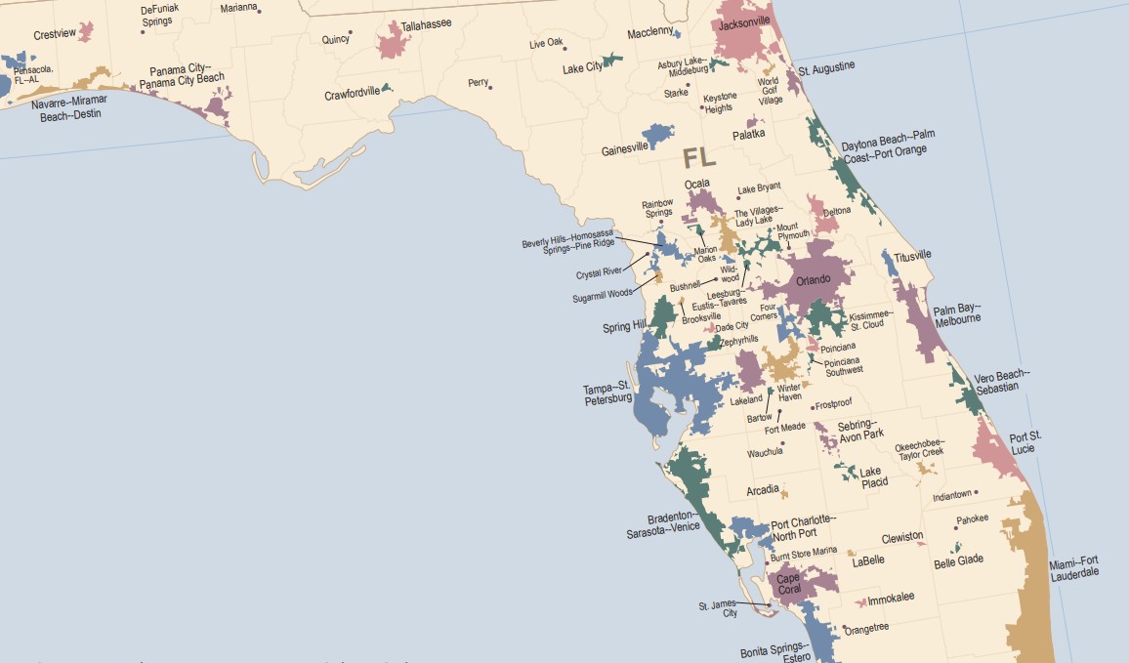



October 11, 2023
RFP #2022-03

Slide 8
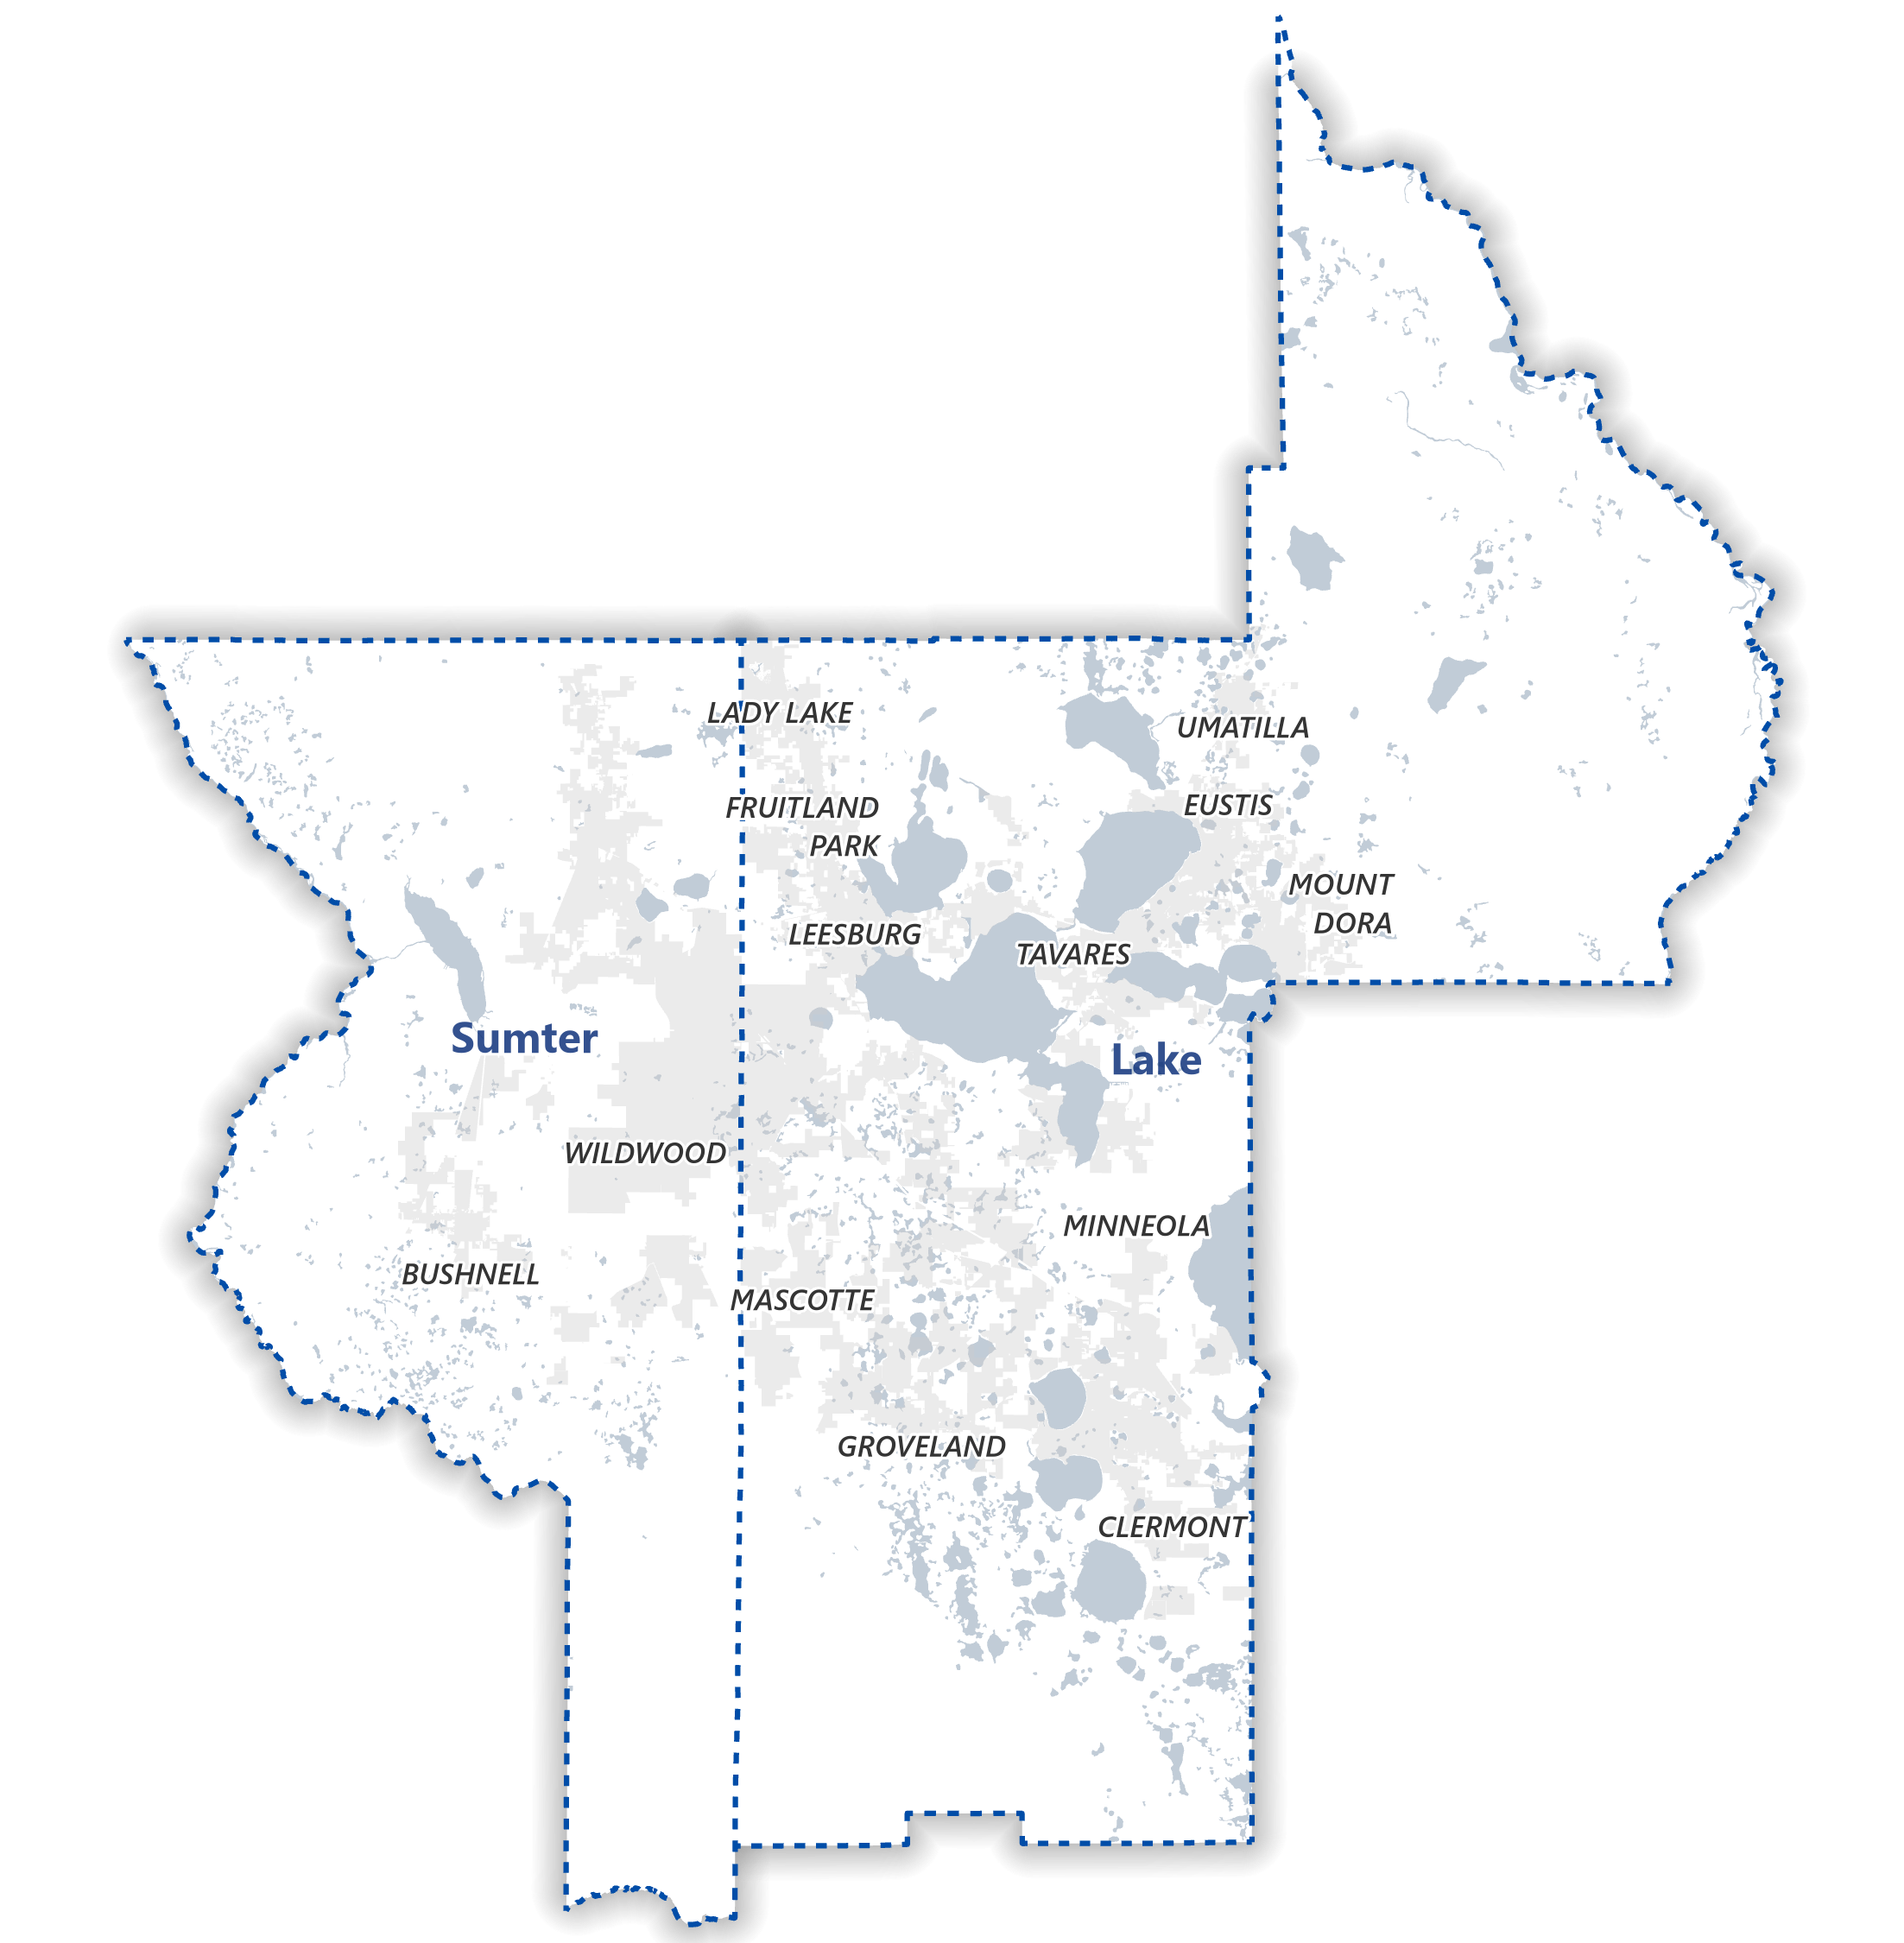
Adjusted Urban Area Boundary
Why adjust the original Census Urban Area Boundary?

Slide 9
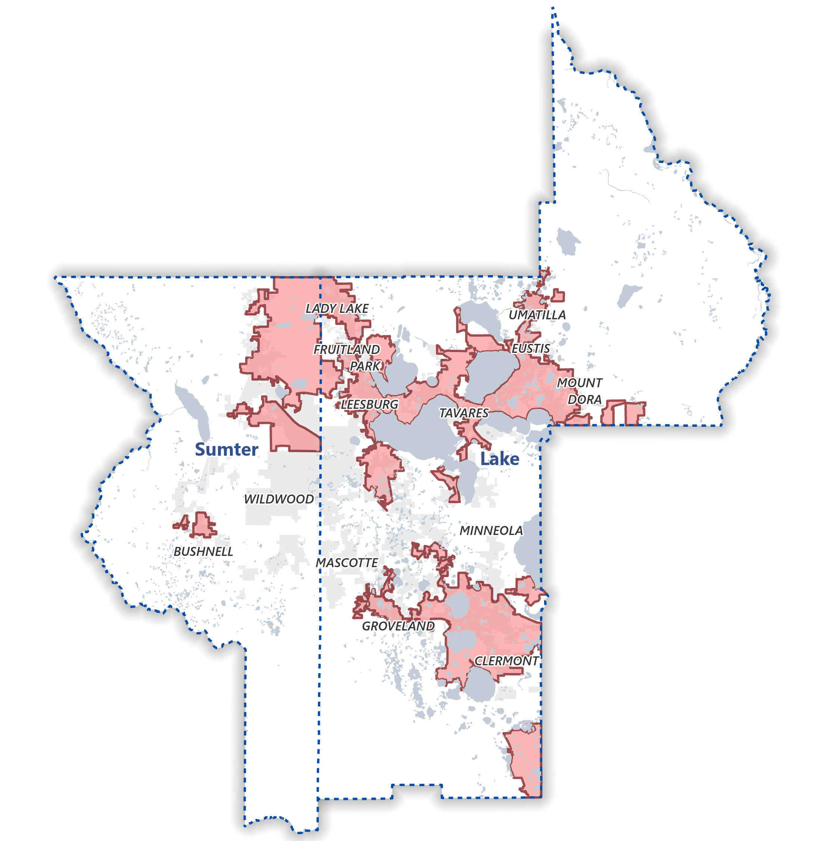
Adjusted Urban Area Boundary
Why adjust the original Census Urban Area Boundary?
Boundaries can consider transportation terminals, transit routes
Boundary should follow municipal limits or physical features
Boundary should be easy to discern
Boundaries should be simple, without irregularities
Boundaries should not split roadways or ramps

Slide 10
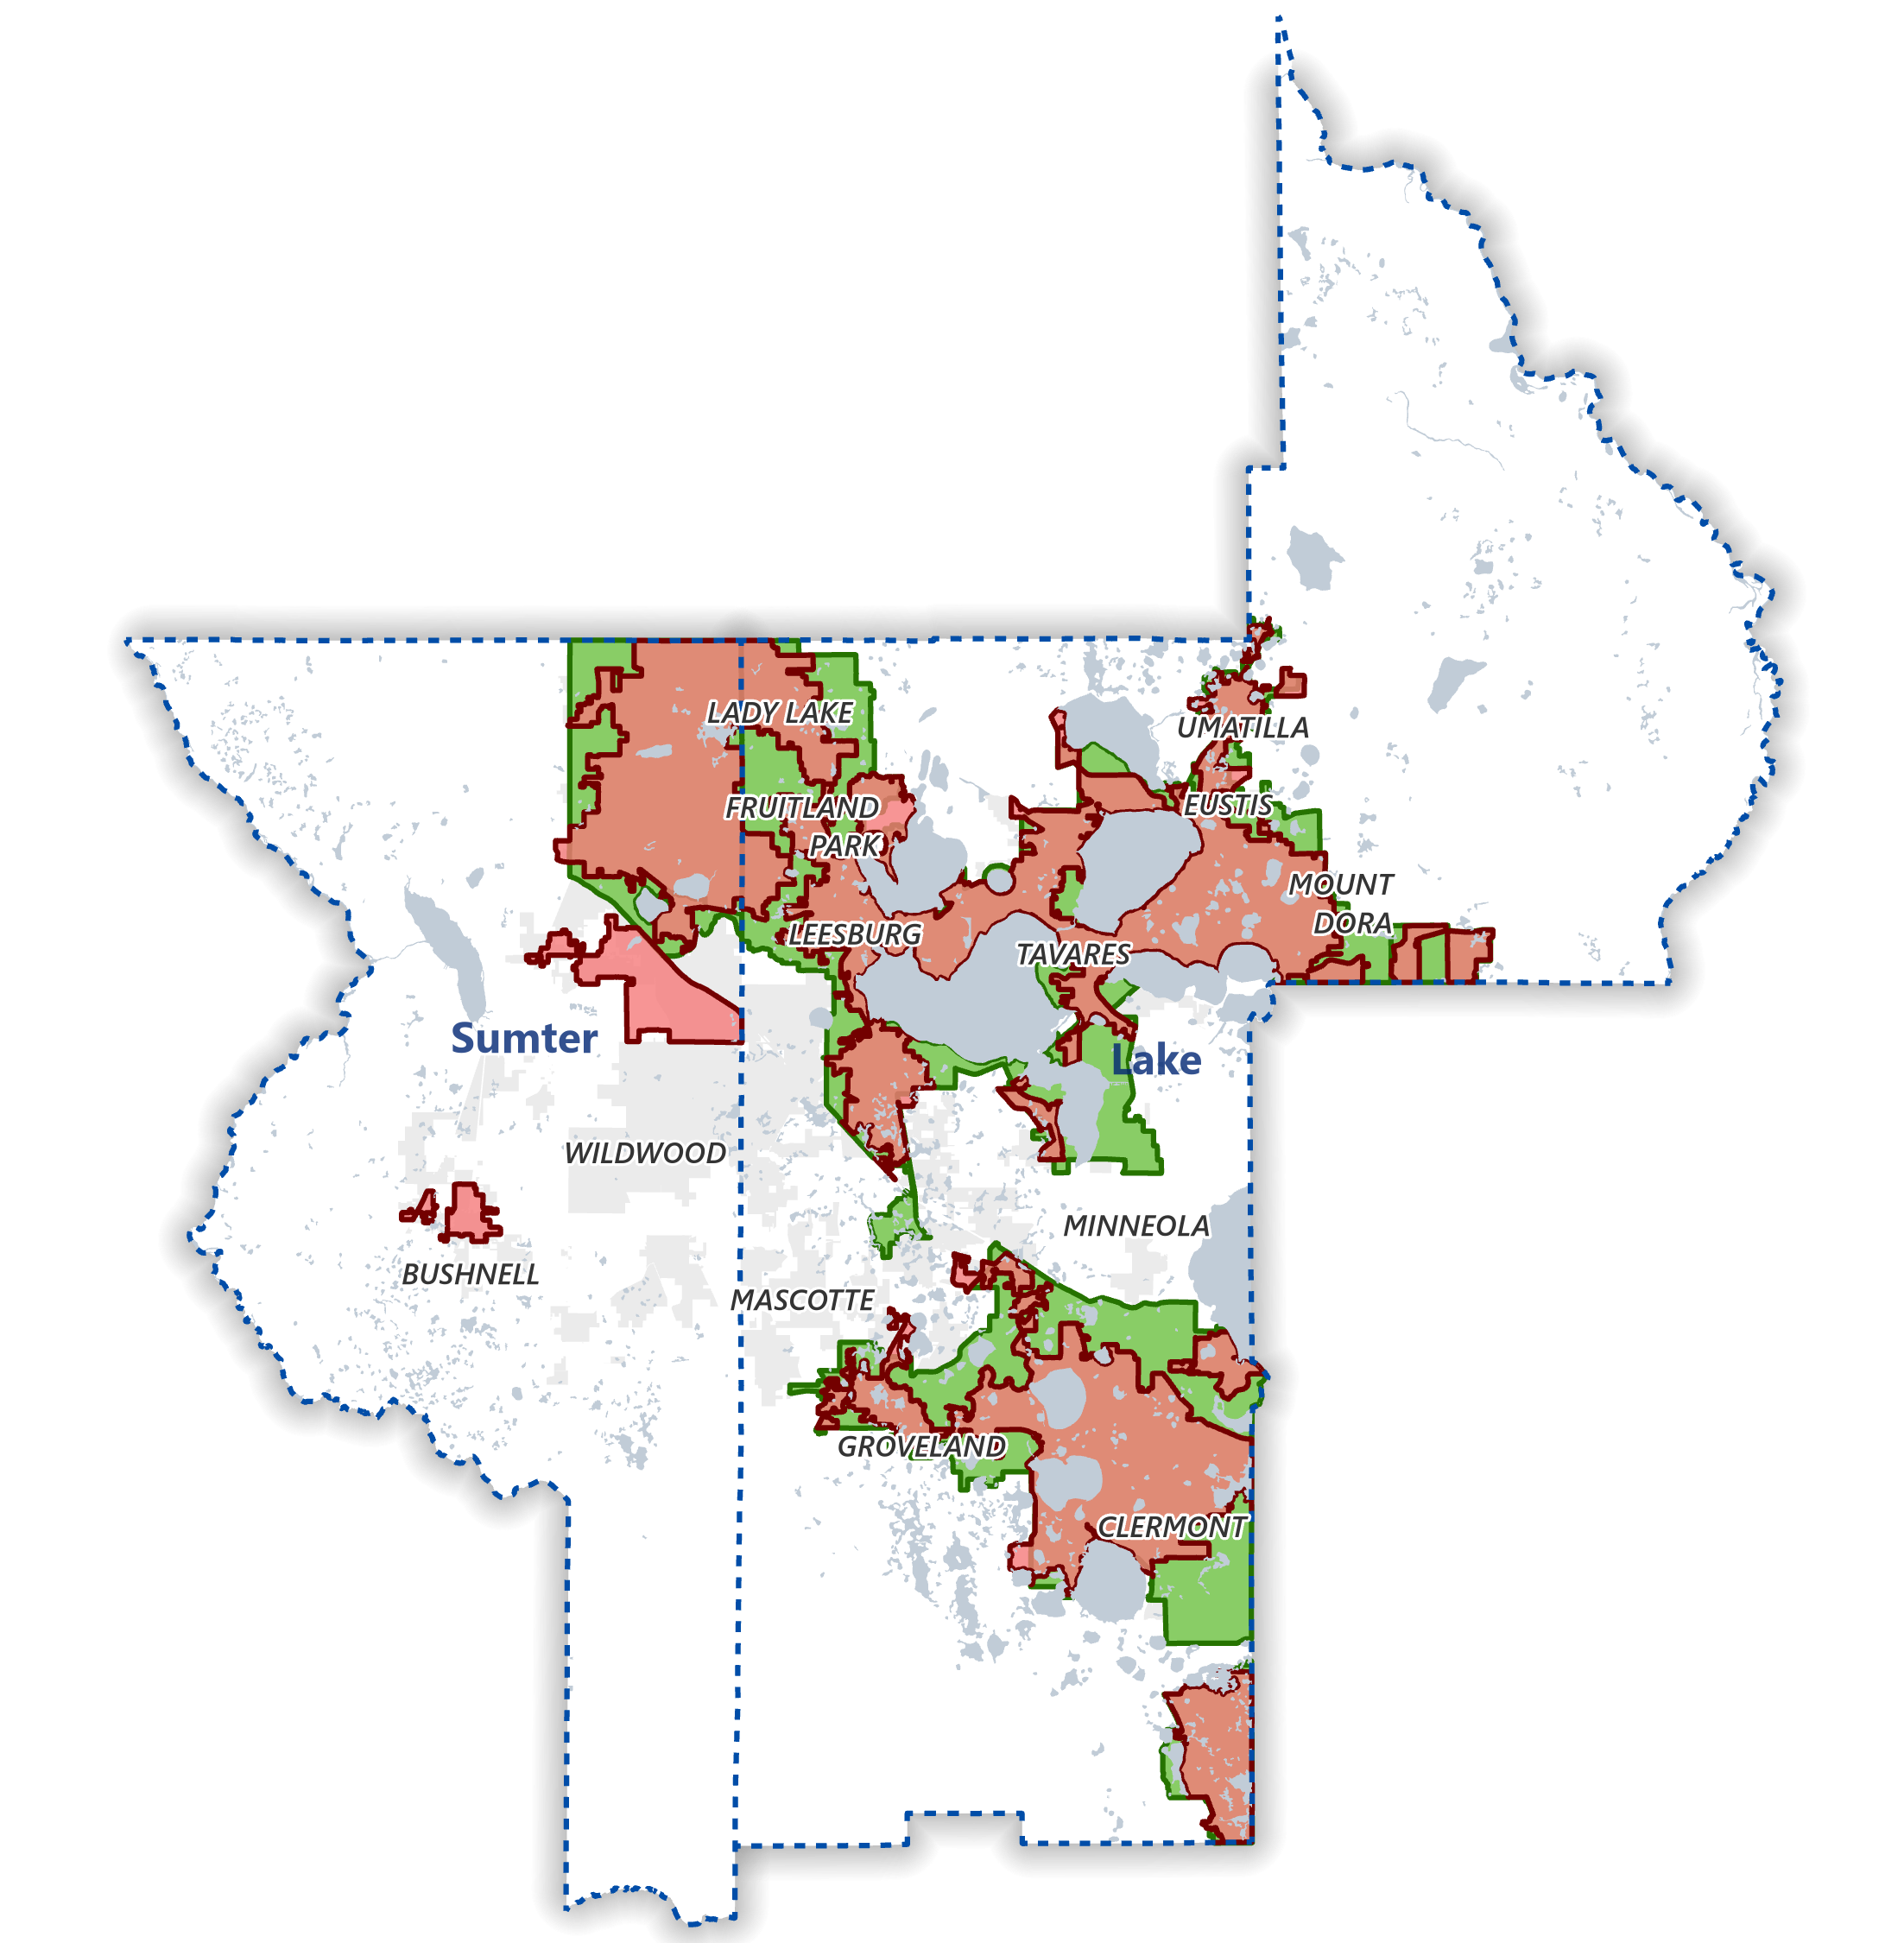
Adjusted Urban Area Boundary
DRAFT –
Methodology for Adjusted Urbanized Area or Smoothing
If Urbanized block in 2010, Urbanized in 2020

Slide 11
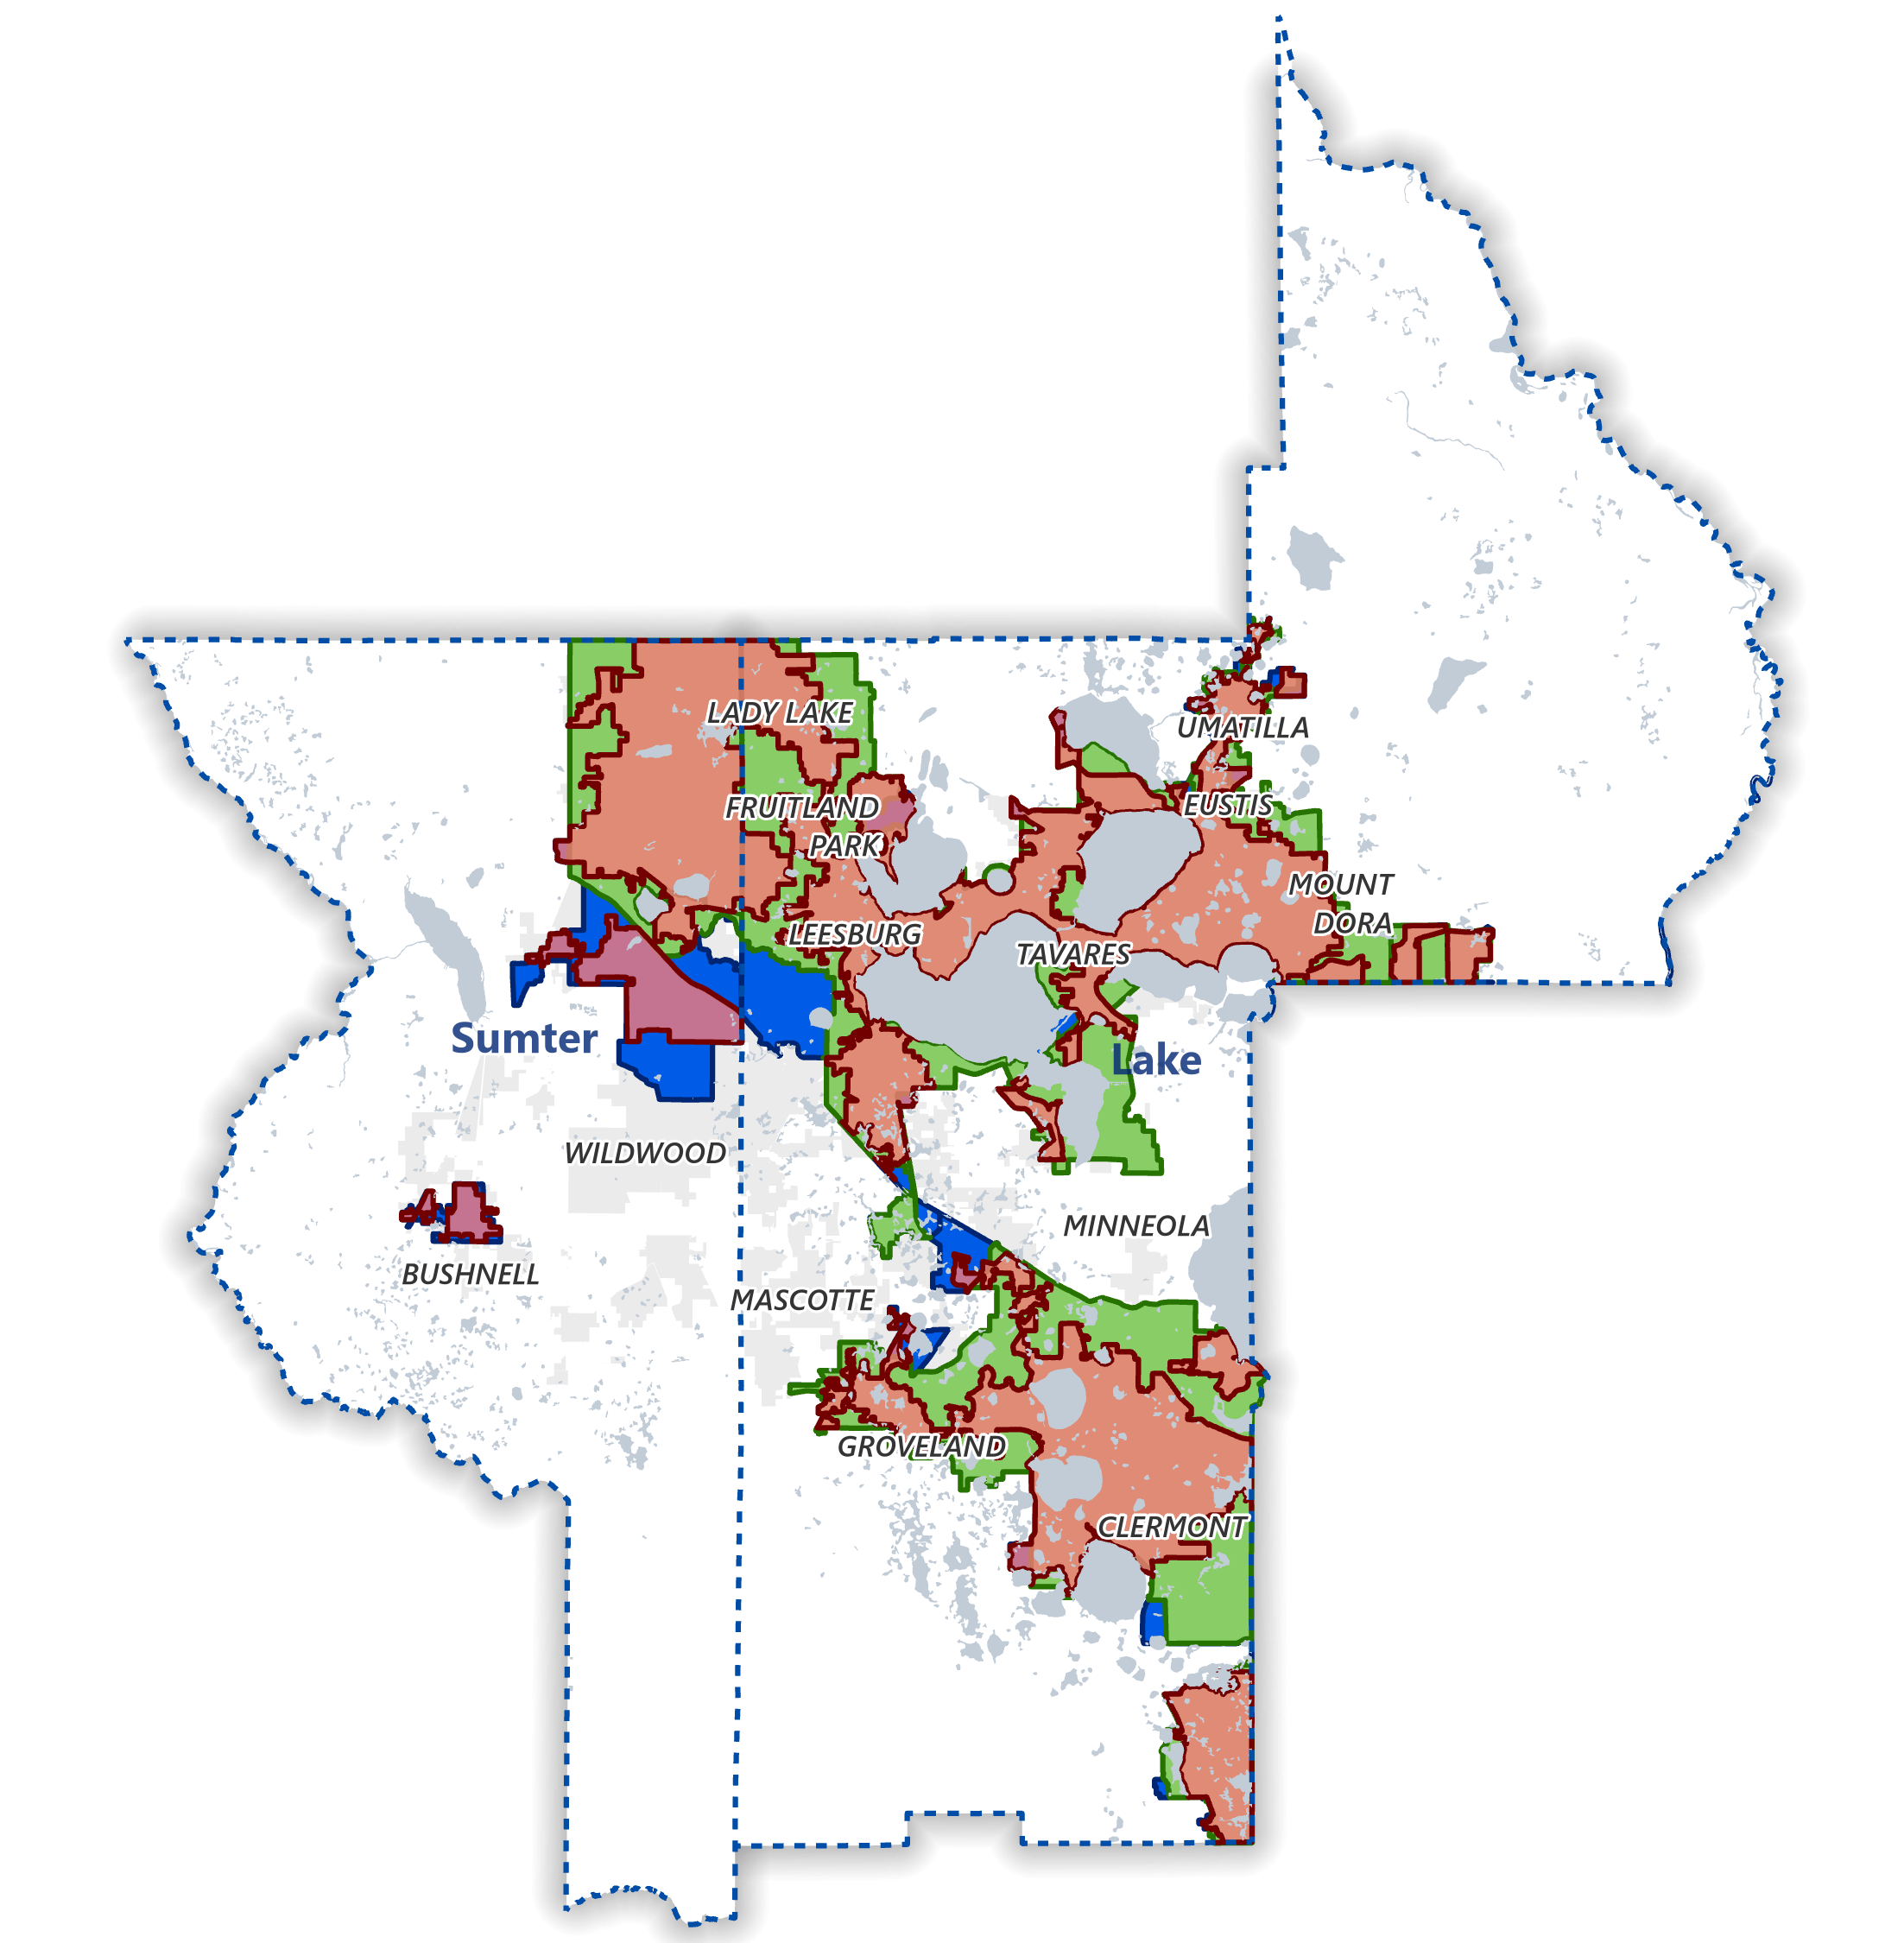
Adjusted Urban Area Boundary
DRAFT –
Methodology for Adjusted Urbanized Area or Smoothing
If Urbanized block in 2010, Urbanized in 2020
Uses Census Block Geography
Joint Planning Areas & Municipal Boundary
Does not change TMA designation, boundary is for planning and implementation of federal transportation funds withing the Lake~Sumter Metropolitan Planning Area (Lake & Sumter County)

Slide 12
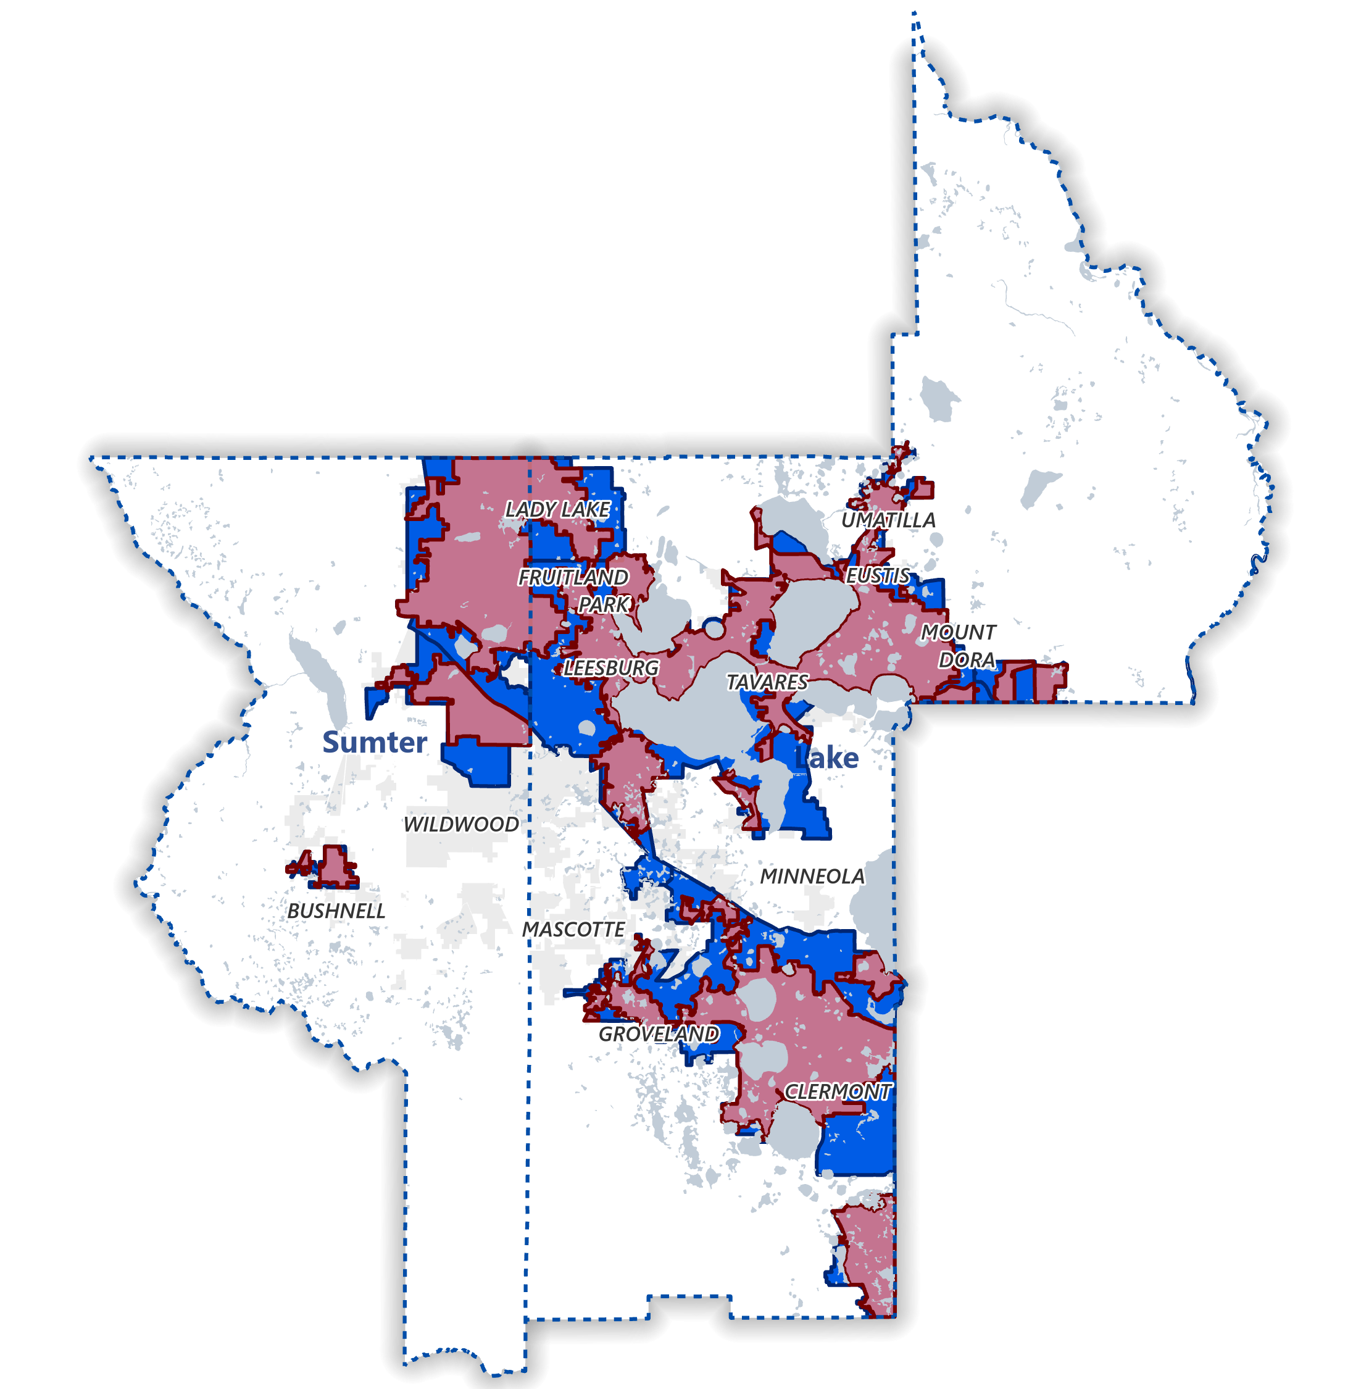
Adjusted Urban Area Boundary
DRAFT –
Methodology for Adjusted Urbanized Area or Smoothing
GIS tool for Local Government Partners to review and confirm DRAFT Adjusted Urban Area Boundary
FDOT Urban Boundary Dashboard - District Five Urban Boundary Dashboard (arcgis.com)
Lake~Sumter Urban Boundary Dashboard – Lake~Sumter MPO(arcgis.com)

Slide 13
Contact Information
Nick Lepp, AICP CTP, Metropolitan Planning Practice Lead
D 407.420.4171 M 321.274.7865
nick.lepp@hdrinc.com
Michael Woods, Executive Director
407-314-4499
Michael.Woods@lakesumtermpo.com

Slide 14
DISCUSSION ITEM B.
2024 List of Priority Projects
Call for new projects, and review of projects for resubmission.
The LOPP represents the unfunded transportation improvements that were not programmed for the following five-year period, in order of priority. The Florida Department of Transportation (FDOT) uses each MPO's LOPP to aid in their decisions as to which projects should be added to their Work Program each year. The Lake~Sumter MPO approves its LOPP annually.

Slide 15
2024 List of Priority Projects (LOPP)
Technical Advisory Committee
& Community Advisory Committee
October 11, 2023

Slide 16
LOPP Process – 2024 Considerations
Comprehensive project descriptions – Tell the story of the project, not only the requested phase
MPO Trail Workshop – Build consensus on trail priorities/requests
Identify potential TRIP projects – State match for regionally-significant projects
Identify grant-eligible projects

Slide 17
Proposed LOPP Development Schedule
Call for New Projects / Review List of Resubmittals | By October 27, 2023 – January 12, 2024
Technical Assistance Meetings with Sponsors | Early December
PIA Sufficiency Review | January 16 – March 16, 2024
Complete New Project Information Applications (PIA) and Updates for Resubmittals | March 15, 2024
Prioritization Process and Draft Rankings Complete | March 29, 2024
Draft LOPP Reviewed by Board/Committees | April 10 & April 24, 2024
Final LOPP Reviewed by Board/Committees | June 12 & June 26, 2024
MPO Submits Adopted LOPP to FDOT | By June 30, 2024

Slide 18
Questions?

Slide 19
DISCUSSION ITEM C.
TRANSPORTATION 2045 Long Range Transportation Plan (LRTP)
  In July 2023, the MPO received a request from FTE to amend the 2045 LRTP, updating FTE projects to reflect the departments Work Program. At this time, the MPO is requesting that the submission of any new or revised state, county or municipal projects using federal funds be included in this LRTP amendment process, which will begin in November 2023
.

Slide 20

Florida Department of Transportation
Turkey Lake Service Plaza Mile Post 263 | Bldg. #5315
P.O. Box 613069, Ocoee, Florida 34761
RON DESANTIS GOVERNOR
JARED W. PERDUE, P.E. SECRETARY
June 14, 2023
Mr. Michael Woods Executive Director Lake~Sumter MPO
1300 Citizens Blvd., Suite 175
Leesburg, FL 34748
Dear Mr. Woods:
Subject: REQUEST FOR UPDATE TO LAKE~SUMTER MPO 2045 LRTP
The Florida Department of Transportation (FDOT), Florida’s Turnpike Enterprise requests the following changes to be made to the Lake~Sumter Metropolitan Planning Organization’s Adopted 2045 Long Range Transportation Plan (LRTP) to reflect the Department’s Work Program.
Update Table 4-7: 2045 Final Roadway Needs Projects (page 4-11). Please remove project T5 (Widen Florida’s Turnpike from CR 470 Interchange to US 301) from this table. Please replace...... reflect the following information.
Update Figure 4-1: 2045 Final Roadway Needs Projects (page 4-13). Please amend this map to reflect the information in the table below.
Facility | From | To | Improvement
Florida’s Turnpike | CR 470 Interchange | Lake/Sumter County Line | Widen to 8 Lanes
Florida’s Turnpike | Lake/Sumter County Line | US 301 | Widen to 8 Lanes
Update Table 4-10: 2045 Cost Feasible Plan Projects (page 4-15 to 4-16). Please amend this table to reflect the information in the table below.
Update Figure 4-2: Strategic Intermodal System (SIS) Cost Feasible Projects (page 4-17).
Please amend this map to reflect the information in the table below.
Update Appendix C: Cost Feasible Projects Year of Expenditure (YOE), 2045 Capacity Projects: Fully Funded, 2045 Capacity Projects: Partially Funded. Please include all four projects below into the document as described in the table.
Update Appendix D: Cost Feasible Projects Present Day Cost (PDC), 2045 Capacity Projects: Fully Funded, 2045 Capacity Projects: Partially Funded. Please include all four projects below into the document as described in the table.
www.fdot.gov | www.floridasturnpike.com

Slide 21
Facility Name | Project Description | Length (Miles) | Phase | Present Day Cost | Time | Funding Source | Funded Level
Lake County
SR 91 / Florida’s Turnpike from US 27 to CR 470 Interchange | Widening to 8 Lanes | 8.00 | CST | $305,704,590 | 2026-2030 | PKBD | Fully Funded
 |  |  | CEI | $24,918,154 | 2026-2030 | PKBD
SR 91 / Florida’s Turnpike from CR 470 Interchange to Lake/Sumter County Line | Widening to 8 Lanes | 0.54 | PD&E¹ | $3,700,000 | COMPLETE | PKYI | Partially Funded
 |  |  | PE | $925,204 | 2026-2030 | PKYI
 |  |  | ROW | $520,910 | 2026-2030 | PKYI
 |  |  | CST | N/A | N/A | N/A
 |  |  | CEI | N/A | N/A | N/A
Sumter County
SR 91 / Florida’s Turnpike from Lake/Sumter County Line to US 301 | Widening to 8 Lanes | 6.29 | PD&E¹ | $3,700,000 | COMPLETE | PKYI | Partially Funded
 |  |  | PE | $15,029,605 | 2025 | PKYI
 |  |  | ROW | $4,986,148 | 2026-2030 | PKYI
 |  |  | CST | N/A | N/A | N/A
 |  |  | CEI | N/A | N/A | N/A
SR 91 / Florida’s Turnpike from US 301 to I-75 | Widening to 8 Lanes | 4.38 | PD&E¹ | $3,700,000 | COMPLETE | PKYI | Partially Funded
 |  |  | PE | $4,538,759 | 2026-2030 | PKYI
 |  |  | ROW | $1,693,950 | 2026-2030 | PKYI
 |  |  | CST | N/A | N/A | N/A
 |  |  | CEI | N/A | N/A | N/A
c
Page 2 of 2

Slide 22
DISCUSSION ITEM D.
Lake County 2023 Transit Development Plan Major Update
The Transit Development Plan (TDP) Major Update is a 10-year planning, policy, and service development tool required by the Florida Department of Transportation (FDOT) to qualify for State of Florida Public Transit Block Grant (PTBG) Program funding. The 2023 TDP Major Update represents LakeXpress' strategic vision for public transportation and enhanced connectivity across Lake County for residents and visitors.

Slide 23
Lake County
Transit Development Plan
MPO Technical & Community Advisory Committees
October 11, 2023

Slide 24
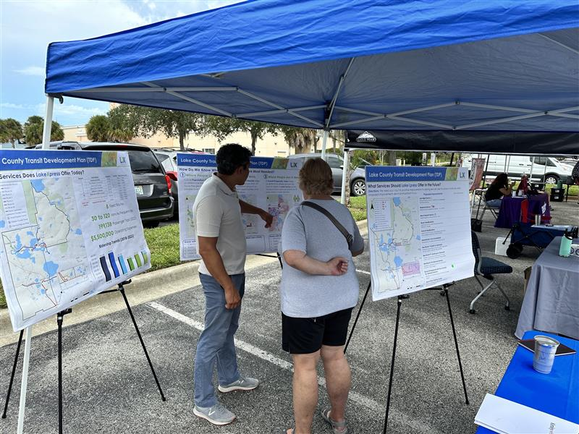
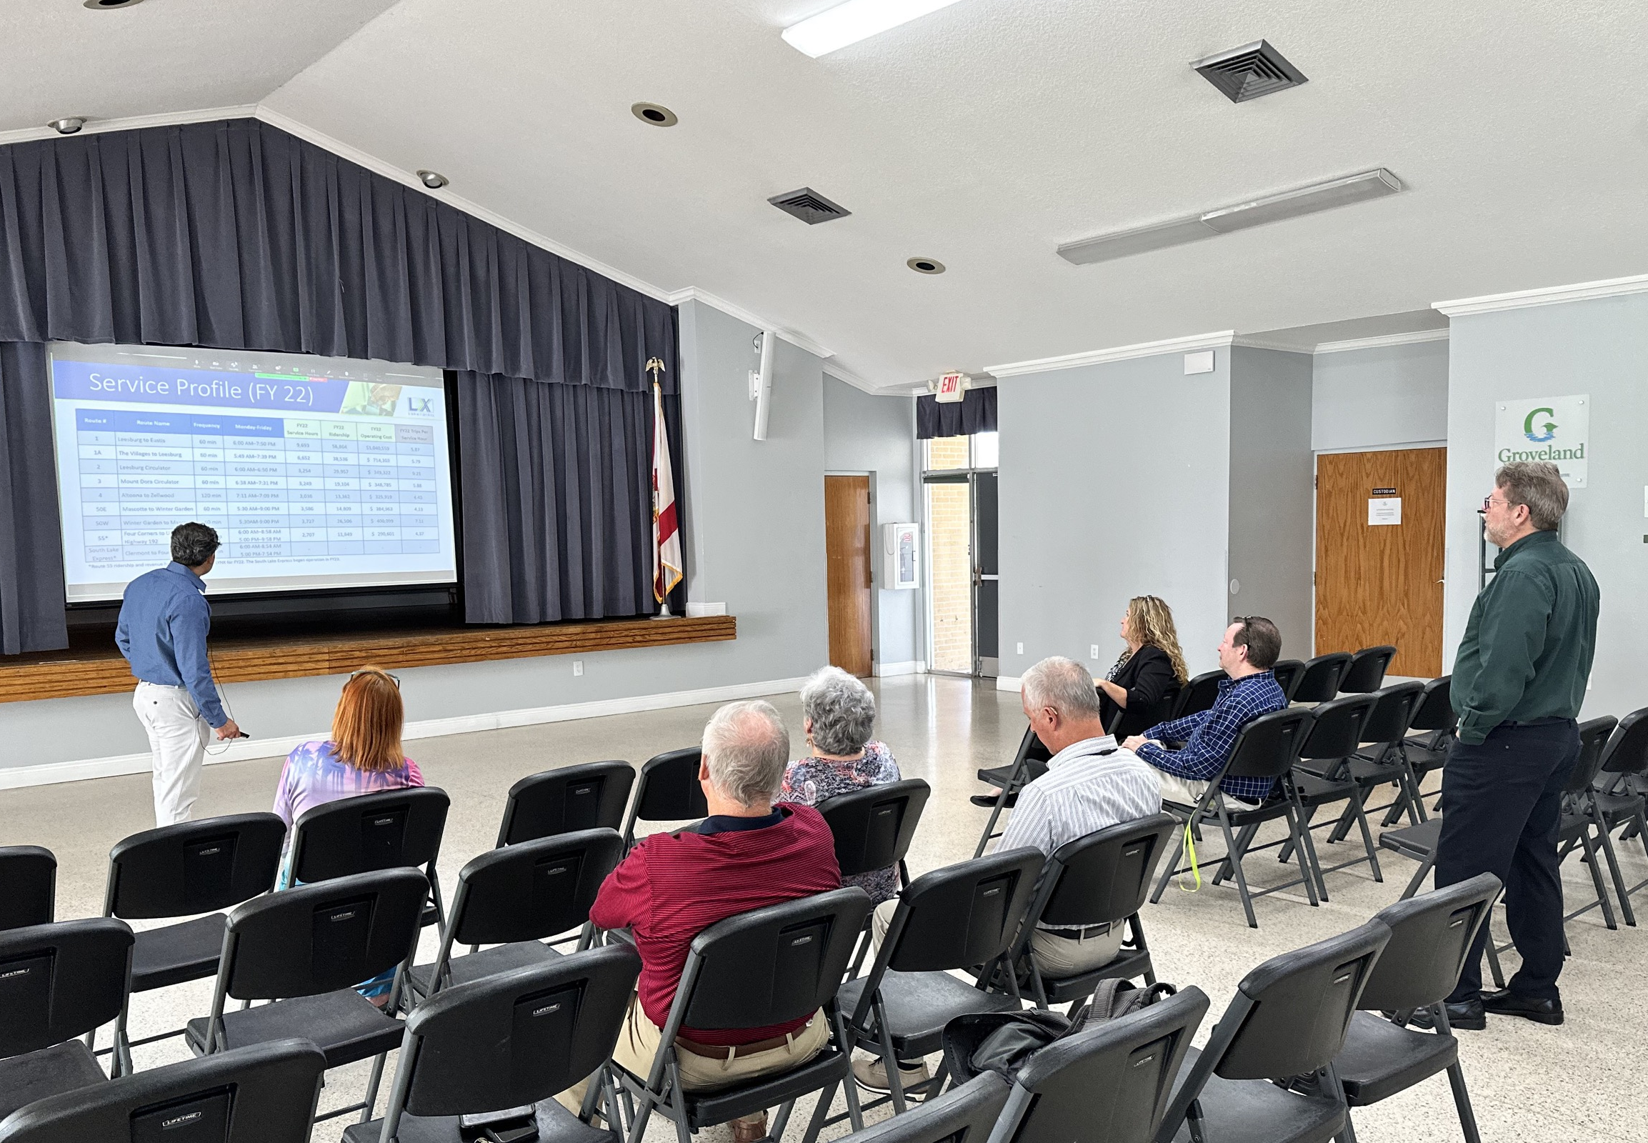
Today
Project Status
Existing Services Evaluation
Public Outreach Summary
Service and Capital Needs
Preliminary Financial Summary
Next Steps

Slide 25
Project Status

Slide 26
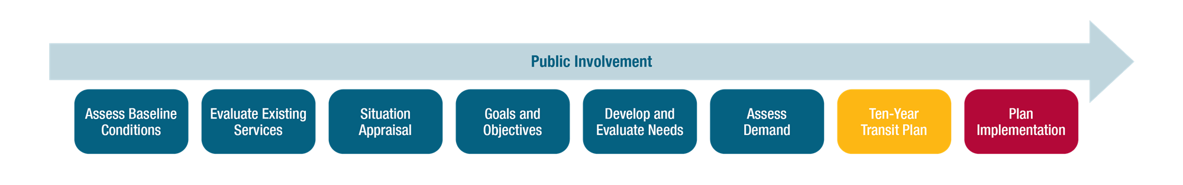
What is a TDP?
10-Year Planning, Policy, and Service Development Guide
FDOT Rule - Florida Administrative Code (FAC) 14-73
Public Transportation Block Grant (PTBG)
Major Updates vs. Annual Progress Reports

Slide 27
Project Status

Slide 28
What Services Are Available Today?

Slide 29
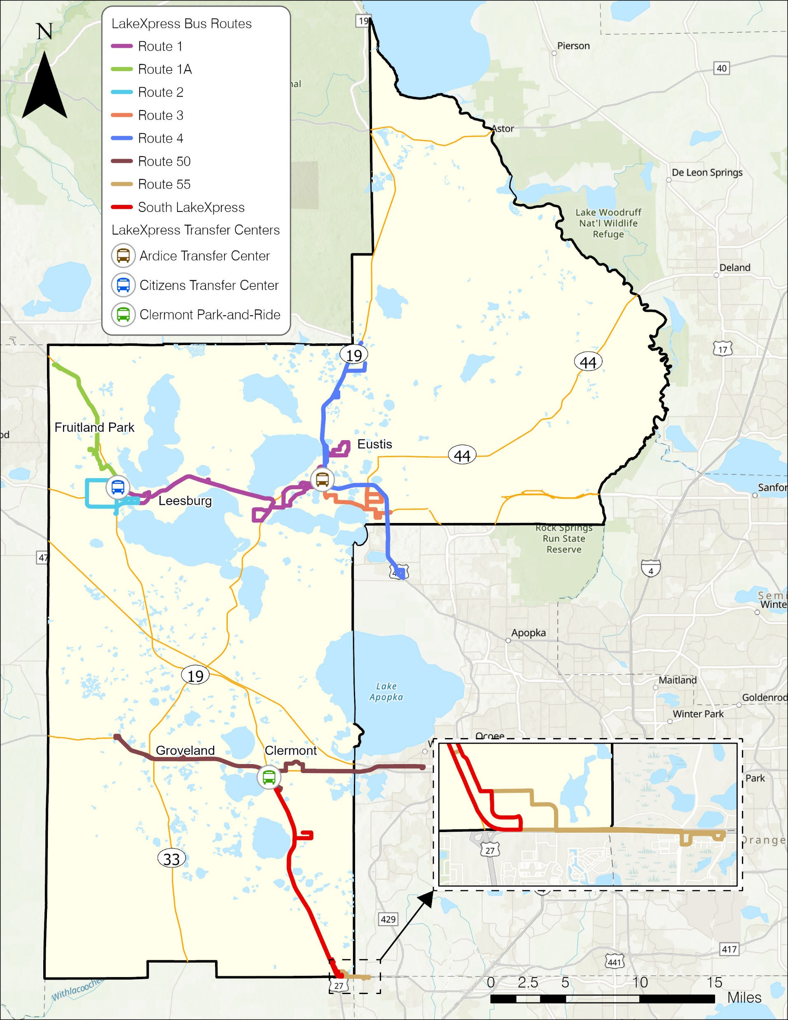
LakeXpress Service
  8 Fixed Routes (FR)
  Frequency: 30 and 60 minutes
    Except Altoona Route
  ADA Complementary Service
  Weekday Service Only
  FY 2022 General Performance
    Passenger Trips – 199,138
    Passenger Miles – 1,280,457
    Revenue Hours – 33,196
https://ridelakexpress.com/schedules
Notes:
In addition to TD operation/CTC role

Slide 30
Ridership Trend

Slide 31
What have we heard so far?

Slide 32
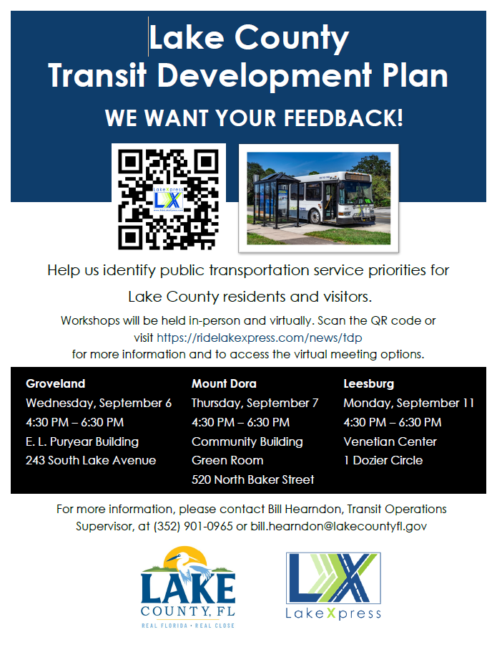
Outreach
Activities Completed To Date
  Public Workshops
  Grassroots Outreach
    Four Corners Farmers Market (Cagans Crossing)
  On-Board Survey
  Board Presentations
    TD Coordinating Board – September 18th
    BCC – September 26th
  Career Fairs
    Leesburg – September 12th
    Clermont – September 20th

Slide 33
Outreach
How would you rate your bus service experience in the past year?
85%
Good or Very Good

Slide 34
Outreach
What three service improvements would make LakeXpress better for you to use?

Slide 35
Outreach
What is the most important reason you use the bus?
77%
Cannot drive themselves

Slide 36
Service and Capital Needs

Slide 37
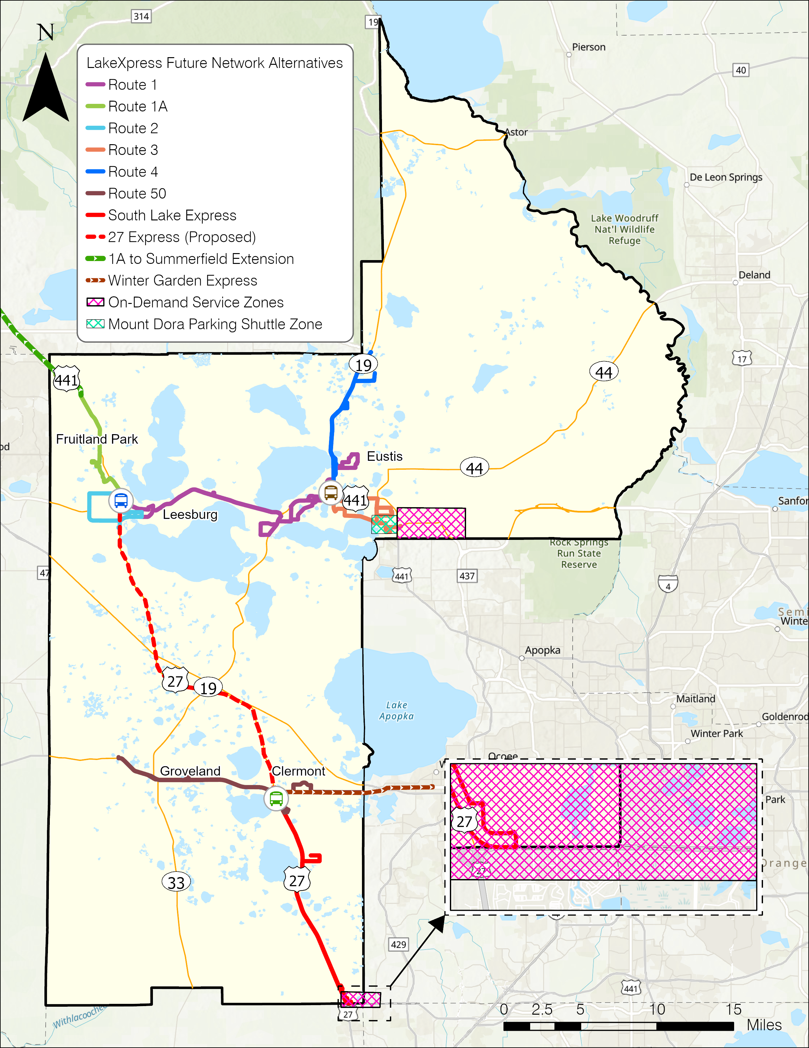



Service Proposals
More Frequent Service
Later Evening Service
Weekend Service
Route Modifications
New Routes
New On-Demand Service

Slide 38
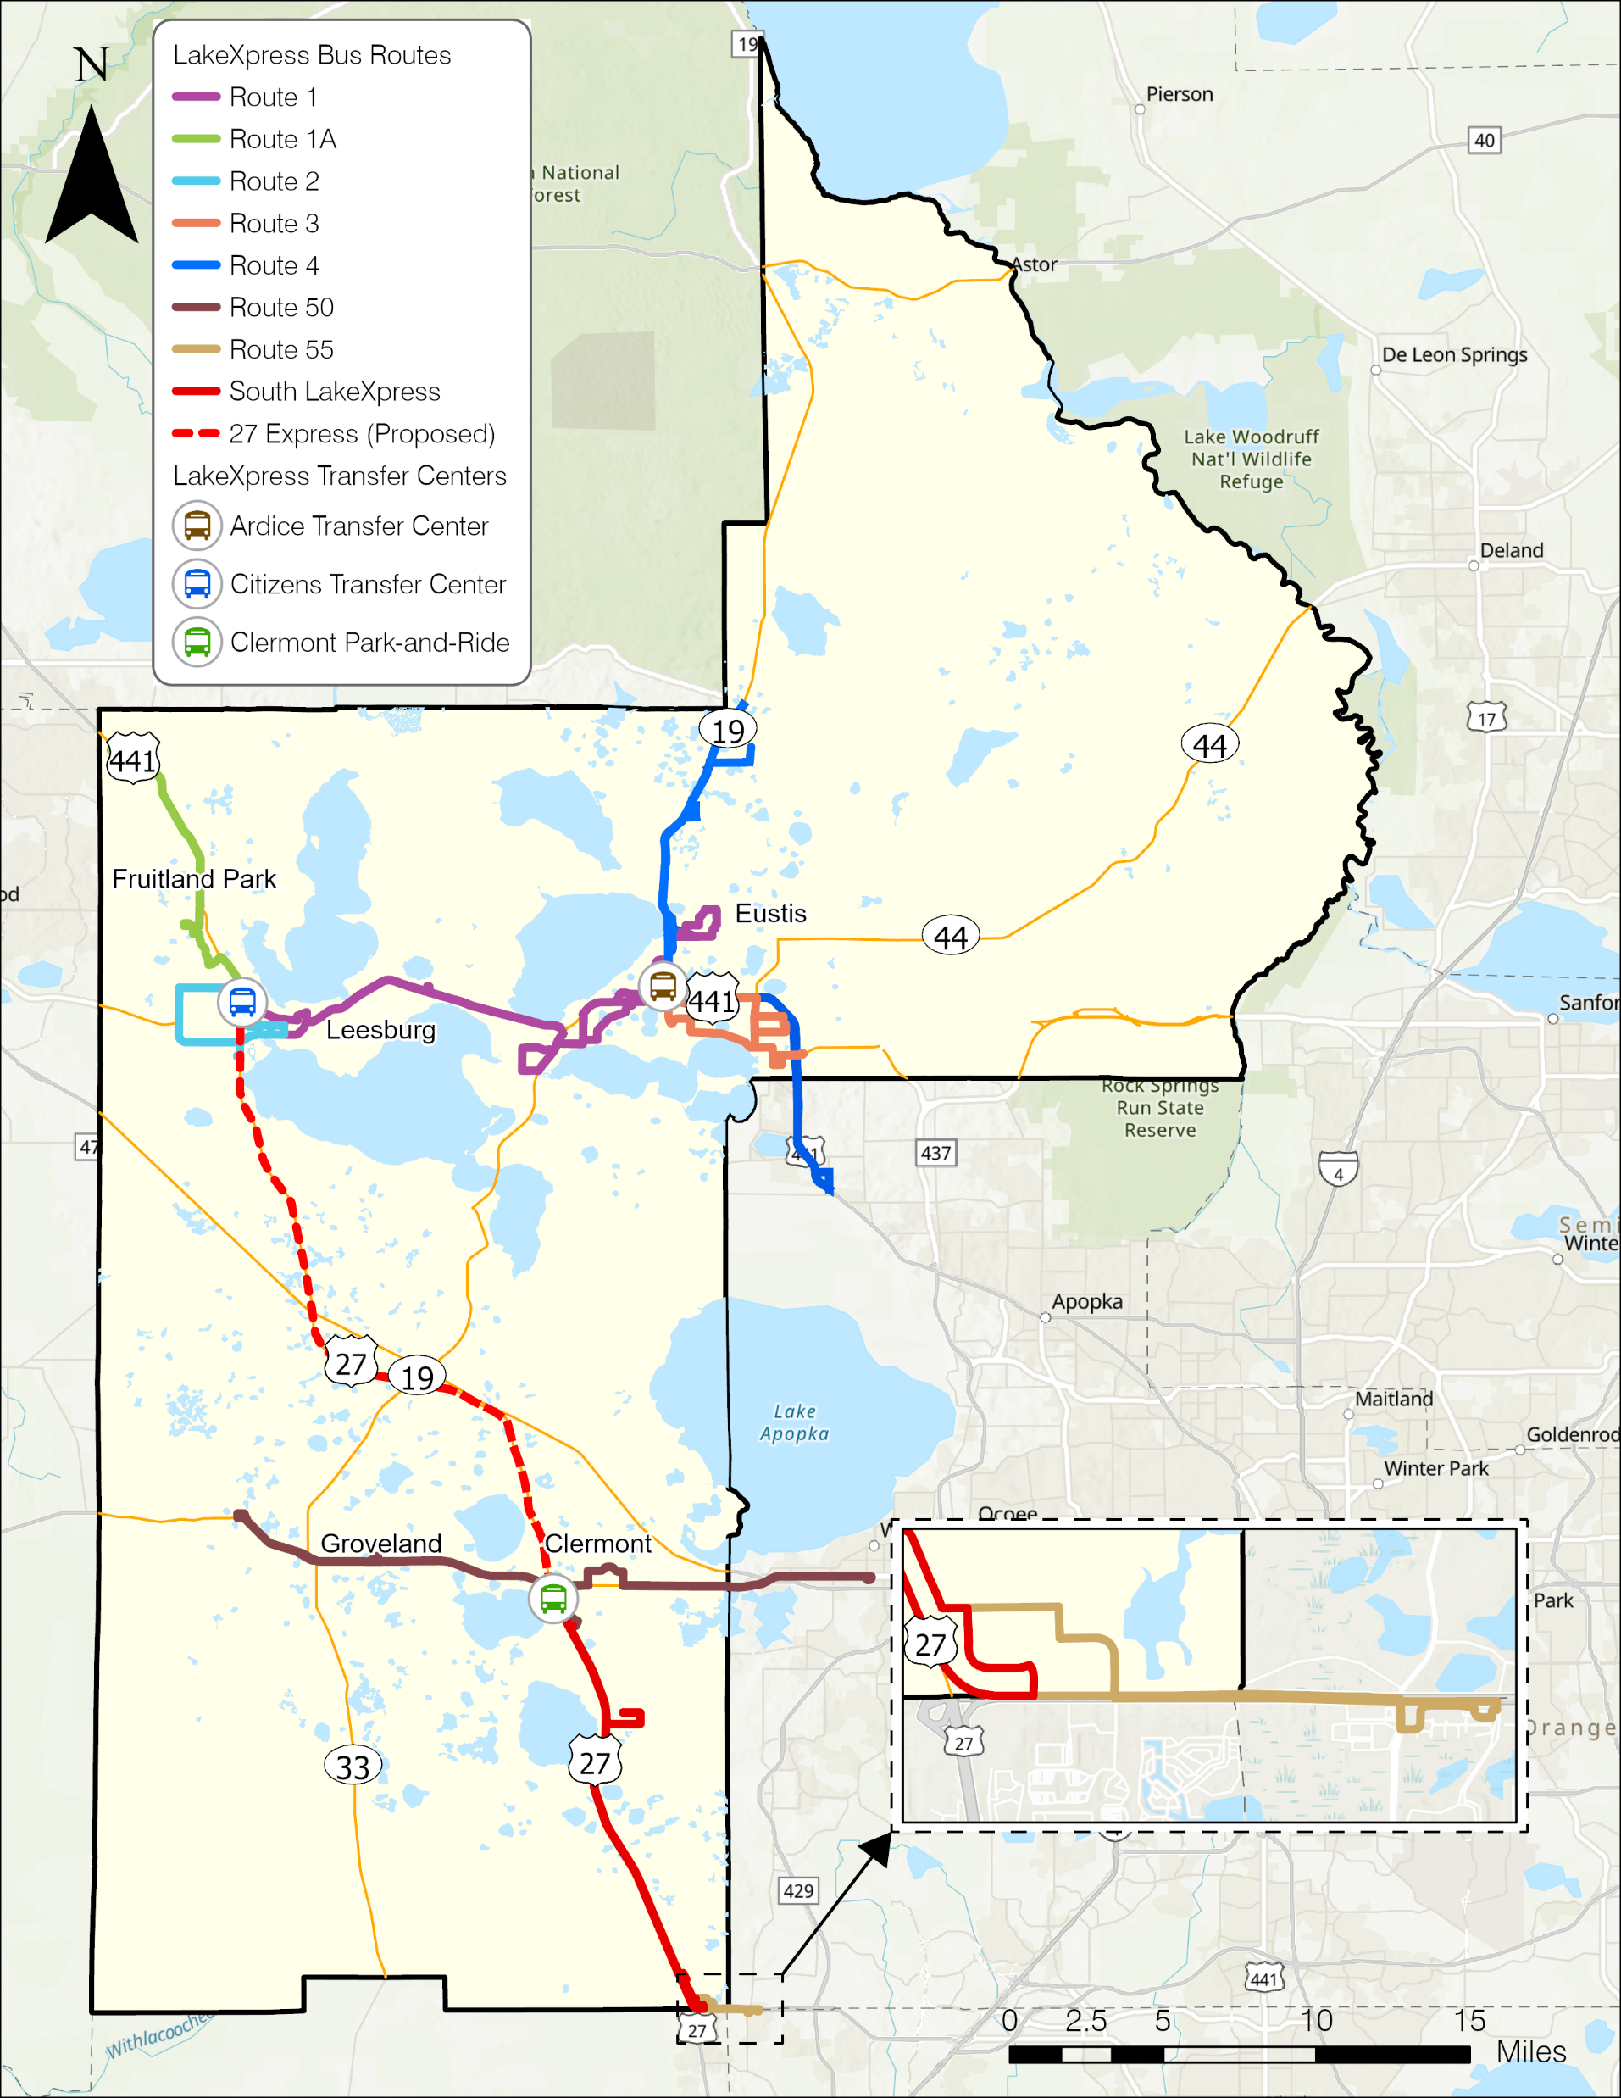
27 Express
  Operating Characteristics
  Leesburg to Clermont via US 27
  Peak Hour Service
  Weekdays
  Clermont Park and Ride Connection
  Connection to Ford Commerce Park
  Funding
  Service Development Grant Application submitted to FDOT for FY 2025 funding

Slide 39
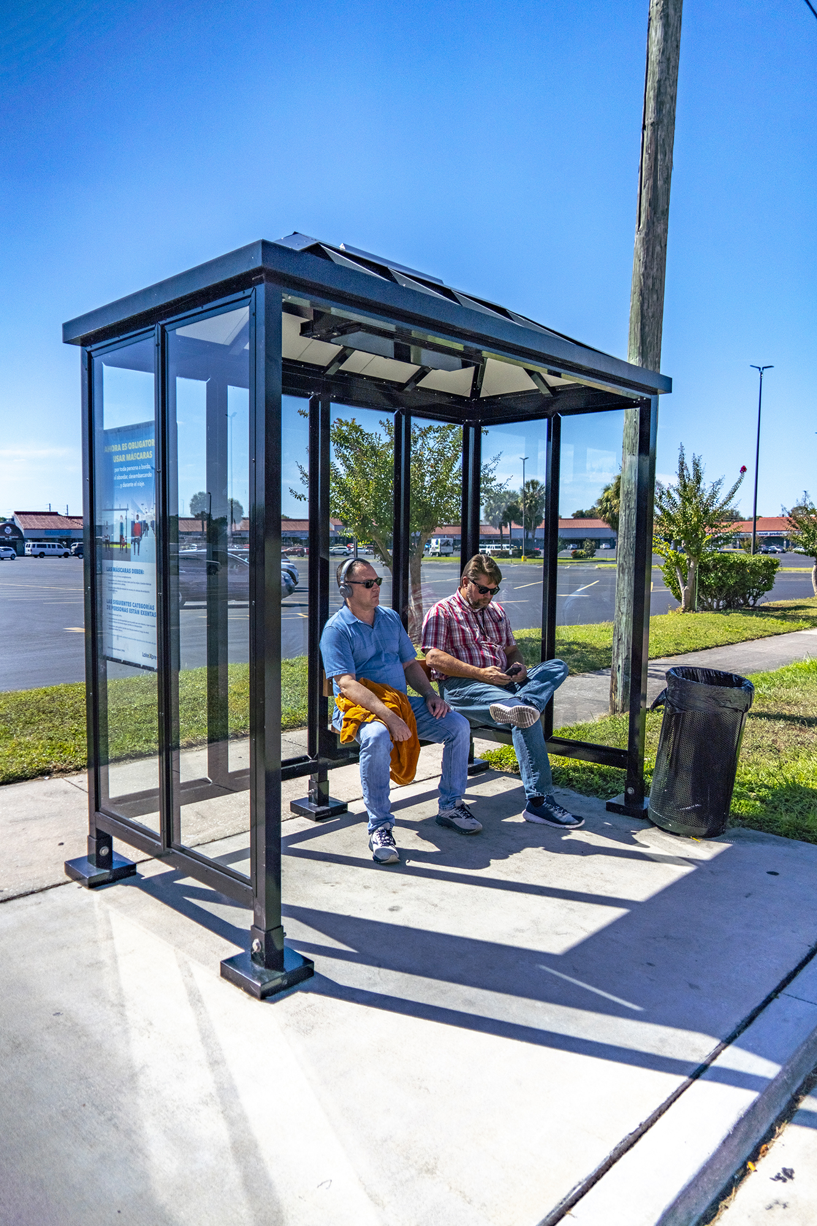
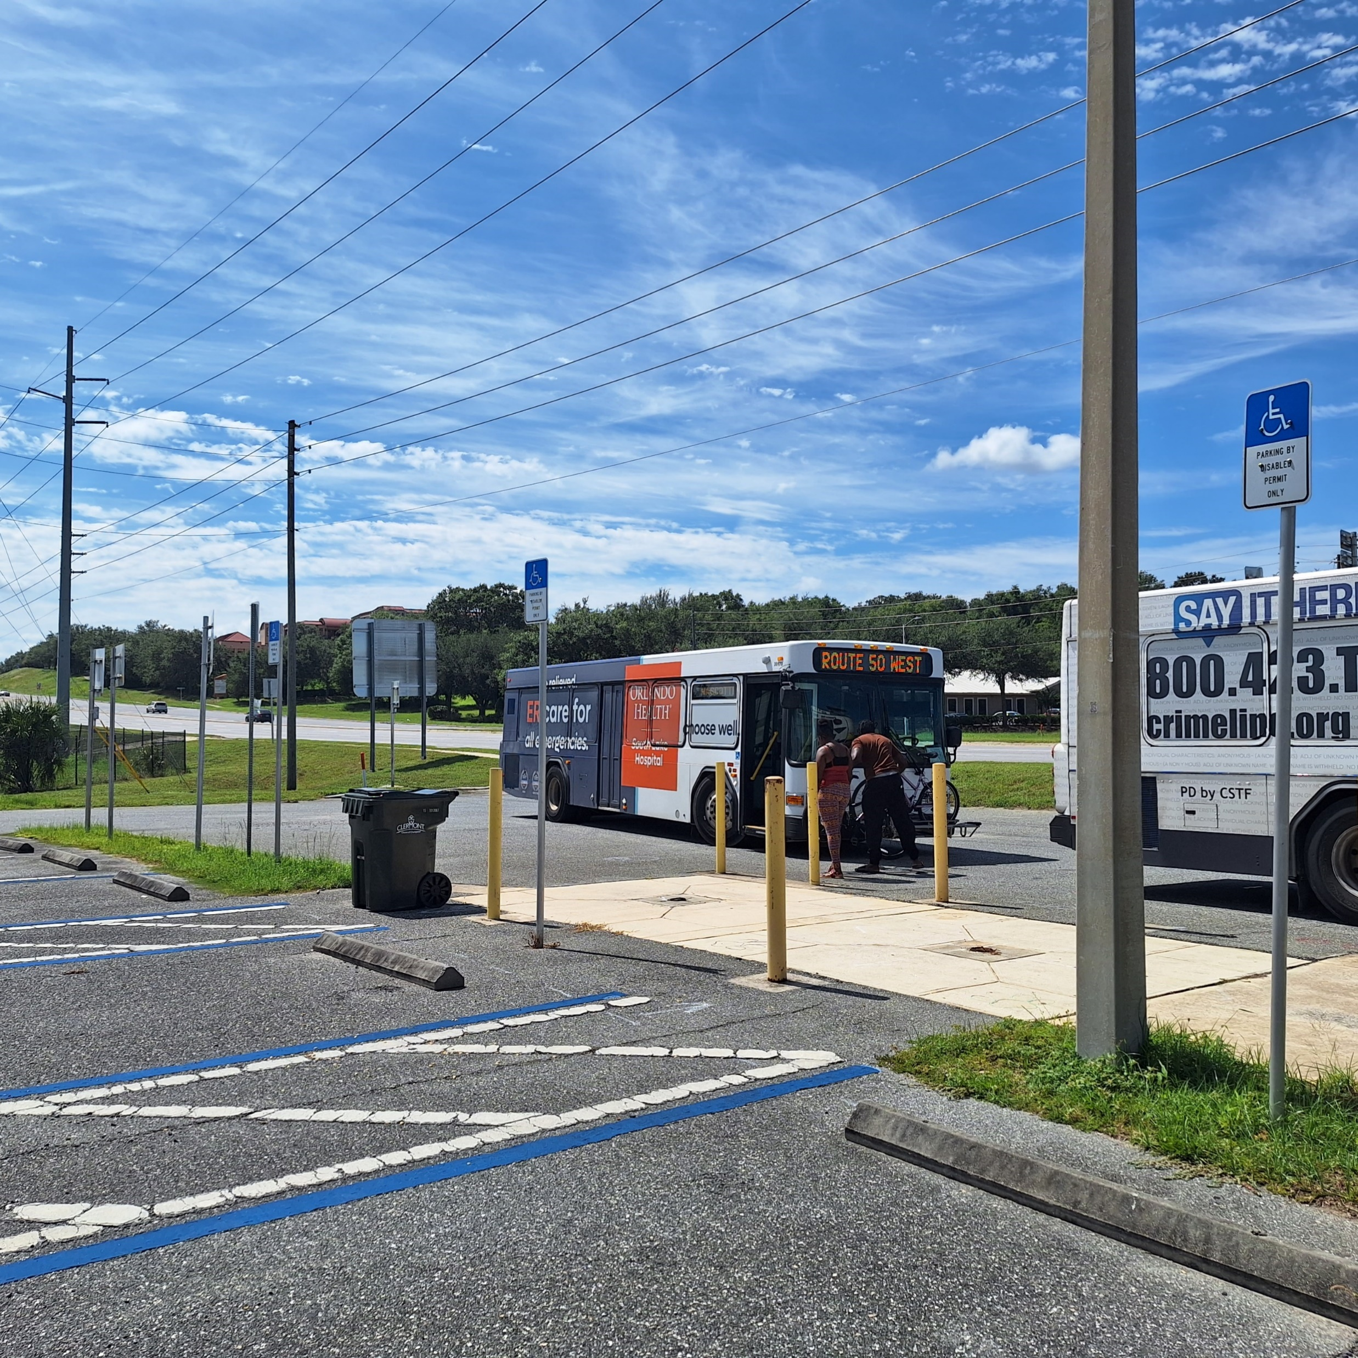
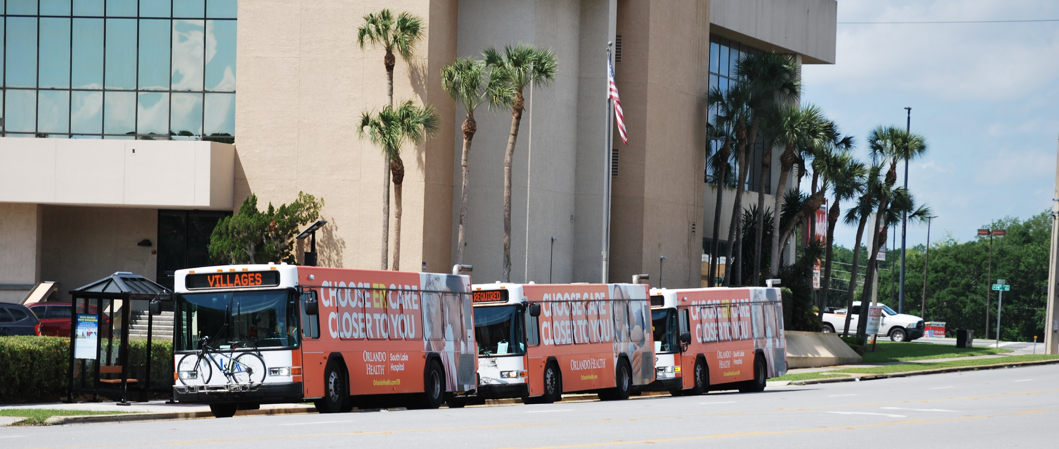
Capital/Technology
Vehicle Replacement
Mobile Ticketing
Real Time Bus Arrival Information
Stop Amenities (Shelters and benches)
More Sidewalks
Customer Service Booths
New Administrative/Operations Facility
Clermont Park and Ride
Ardice Transfer Center

Slide 40
Preliminary Financial Summary

Slide 41
Operating Budget (FY 24)
Total Operating Budget $12.4M
County General Fund $1.25M
Notes:
$1.9 – Local
1.2M interfund transfer
300k other transportation fees
110k advertising fees
110k Mid-Fla Community
90k Medicaid Waiv Sv Ag

Slide 42
Capital Needs
10-Year Capital Needs
$79.0M
Notes:
2025 and 2026 – fleet expansion
2027 and 2028 – design and construction for new admin and ops facility
2032 – fleet replacement

Slide 43
Next Steps
Finalize 10-Year Financial and Implementation Plan
Plan Adoption
  Board of County Commissioners – November 28, 2023
  FDOT Submittal
    November 30, 2023

Slide 44
Contact Information
Bill Hearndon
  Transit Operations Supervisor
  Office of Transit Services
  Ph: 352.901.0965
  Bill.Hearndon@lakecountyfl.gov
Ryan Suarez
  Project Manager
  Kimley-Horn and Associates
  Ph: 727.328.4299
  Ryan.Suarez@kimley-horn.com

Slide 45
DISCUSSION ITEM E.
SUN Trail Notice of Funding
FDOT to solicit REQUESTS FOR FUNDING Regional and Individual Trail projects through the Shared-Use Nonmotorized (SUN) Trail program for inclusion in the work program development cycle.
Projects programmed this cycle will be funded as early as Fiscal Years 2029/30. To be eligible for consideration to receive TLWR, applicants must submit a separate, complete “Request for Funding”, with all applicable project information, including required signatures for each eligible unfunded Regional or Individual Trail project through the Grant Application Process online system (GAP) during the open solicitation.
As of today, the solicitation period is open from September 27, 2023, and close at 2:00 p.m., Eastern Standard Time (EST), December 20, 2023, Hard deadline.

Slide 46
PRESENTATIONS, STATUS REPORTS
FDOT Report –
Jonathan Scarfe, MPO Liaison Administrator
Chuck Koppernolle, MPO Liaison, FDOT-5 Planning & Environmental Management
The FDOT Work Program Public hearing week (virtually online at www.fdot.gov/WPPH/District5) will be from Oct 16th-20^{th.}, 2023. And the in-person meeting date will be Tuesday, Oct 17th, 2023, from 3:00-5:30 PM at the FDOT D5 district office at 719 S. Woodland Blvd, DeLand, FL 32720.
FDOT D5 WORK PROGRAM PUBLIC HEARING

Slide 47
PRESENTATIONS, STATUS REPORTS
B. FTE Report
C. Transit Reports-
D. County, City, MPO Updates

Slide 48
Committee member COMMENTS:
COMMITTEE MEMBER COMMENTS
Adjournment
Next Meeting: November 8, 2023 @ 1:30 PM

Slide 49
Committee member COMMENTS:
COMMITTEE MEMBER COMMENTS
Adjournment
Next Meeting: November 8, 2023 @ 3:00 PM

