Slide 1
CITY OF MOUNT DORA TRANSPORTATION UPDATE MARCH 7, 2023
MICHAEL WOODS,
EXECUTIVE DIRECTOR
Notes:
Thanks you for inviting me tonight.
Growth
Funding
Next steps

Slide 2
Florida’s Population Trend
Notes:
Current population is 22.2 million, projected to be 25m in 2030.
Second fastest growing state
Added 2.7 million people
300,00 people per year
Third in total population

Slide 3
2023 LOCAL GROWTH TRENDS
Lake County Census data:
2020 - 383,956 2010 – 297,047
Change – 86,909 29.3%
MOUNT DORA Census Data
2020 – 16,665 2010 – 12,139
Change – 4,526 27%
Notes:
9 counties in the Florida had growth rates of 20-30%
4 counties had growth rates of over 30% including Sumter

Slide 4
TRANSPORTATION FUNDING
STATE TRANSPORTATION TRUST FUND
MOVING FLORIDA FORWARD
SENATE BILL 100 - MCORES
STRATEGIC INTERMODAL SYSTEM (SIS)
Notes:
STTF – Federal and State Gas Tax revenues – normal funding revenues for FDOT, legislature and Governor signs and becomes law July 1st 2023.
MFF – 7 billion in funding for 20 projects throughout Florida , I75 got $479m
MCORES – Northern Turnpike Extension, Suncoast Parkway Extension and the Heartland Parkway Project, Legislature rescinded the bill last year and the Governor reallocated the funds, we got US301 at $200m
SIS – The Florida Legislature established the SIS in 2003 to enhance Florida’s economic prosperity and competitiveness. The system encompasses transportation facilities of statewide and interregional significance and is focused on the efficient movement og passengers and freight.

Slide 5
FDOT Annual Appropriation History
Notes:
The FY 22/23 FDOT budget is a record $12.7 Billion. Mostly because of our state commitment to investing in our infrastructure, Florida’s transportation system is consistently ranked as one of the best in the country. Only 25% of FDOT’s budget comes from Federal funds.
It seems like everywhere you go in Florida; the transportation system is under construction.

Slide 6
What Sets Florida Apart?
State Fuel Tax Indexed to CPI
Extensive Tolling Systems
Maximum Use of Innovative Financing
Population Growth
Record Tourism
Notes:
Florida is in a much better financial position for funding its infrastructure than almost all of the other states in the country. Why is this?
We have been adjusting our state fuel taxes based on the CPI since 1992.
This indexing of the State Fuel Taxes has resulted in approximately $8 Billion in additional revenue since the indexing began.
We have the most toll-road mileage in the country.
We have taken advantage of every innovative finance option available.
We are growing again. Over 300,000 people are moving to the state each year. Over 100 million tourist visit the state each year. (double edged sword)
All of these variables have produced our record transportation budgets.

Slide 7
200 MILLION Visitors to Florida BY 2030
Notes:
We have surpassed the number of annual tourist to Florida from the pre-Covid numbers. On track for 133 million in 2022. and close to 200 million by 2030. Brings in gas tax revenues and congestion.

Slide 8
Fuel Consumption in Florida (Millions of Gallons Annually)
Forecast
Notes:
Unlike many other states in the country, fuel consumption and, therefore, fuel tax receipts have been growing again in Florida. You can see the drop in consumption during the recession and Covid years. But you can also see what the future has in store for us. Leveling off in future years, due to fuel efficient cars and truck, hybrid vehicle and trend of working remotely.

Slide 9
Electric Vehicle Impacts to Transportation Revenue
2040 Net Revenue Loss Projections
Conservative Growth Scenario = -5.6%
Aggressive Growth Scenario = -20.0%
Moderate Growth Scenario = -11.1%
For every 1% increase in EV market adoption, estimated 0.5% reduction in STTF revenue
Notes:
Electric vehicles account for less than one & of the market but growing uickly.
Note that this is ONLY EV impacts to revenue, not the impact of hybrids or improved fuel efficiency of ICE vehicles.
Again, the impact of the rising cost of fuel may accelerate the move towards electric vehicles.
In the private sector, when the current business model is no longer working, they revise the business model, or they go out of business. The MPOs in Florida have taken the lead and are exploring a pilot project in Florida.

Slide 10
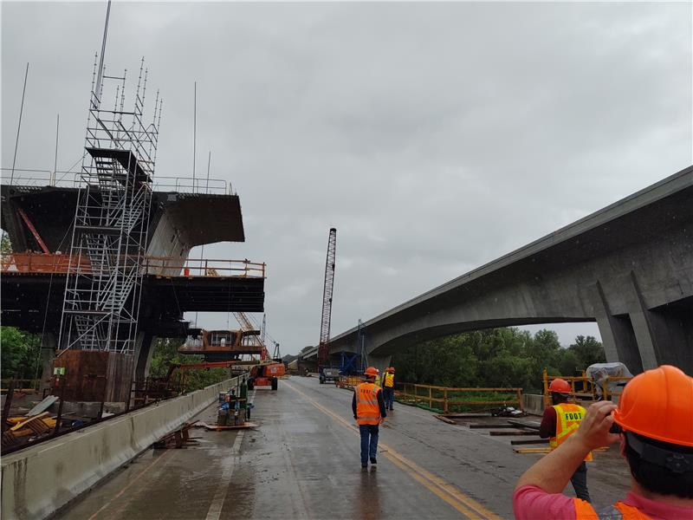
The year 2022 in review… What were the effects of inflation on the Work Program?
Project Impacts:
Cost Increases; material and labor shortages, premium pricing for certain materials (i.e. electrical, steel) and augmented project unknowns
Limited competition; single bids at significant high costs, selective pursuits
Dynamic cost estimation and predictions; forecasting of ongoing/future projects in the pipeline
ROW Impacts:
Approximately 15% increase on land prices
Higher severance damage and appraisal costs
approx. 24%+ Project Cost Increases
Notes:
Increased project costs due to premium pricing for certain materials (ie. electrical, steel)
Limited competition; single bids at significant high costs/ bid rejections
Substantial monitoring of contingency usage and projections
Dynamic cost estimation and predictions for ongoing/future projects in the pipeline; short term trend considerations/long term adjustments
ROW – waiting to hear back from unit

Slide 11
The Five-Year Outlook
FIVE-YEAR TENTATIVE WORK PROGRAM FUNDING
County | FY 2023/24 | FY 2024/25 | FY 2025/26 | FY 2026/27 | FY 2027/28 | TOTAL
Lake | $111,252,228 | $76,864,141 | $58,041,686 | $30,980,247 | $15,949,566 | $293,087,868
Sumter | $82,209,890 | $86,035,514 | $77,841,443 | $3,637,899 | $416,403 | $250,141,149
TOTAL | $193,462,118 | $162,899,655 | $135,883,129 | $34,618,146 | $16,365,969 | $543,229,017
* Excludes projects from Florida Turnpike Enterprise (FTE)
Notes:
No New Projects and No Defferals
Project Impacts:
Cost Increases; material and labor shortages, premium pricing for certain materials (i.e. electrical, steel) and augmented project unknowns
Limited competition; single bids at significant high costs, selective pursuits
Dynamic cost estimation and predictions; forecasting of ongoing/future projects in the pipeline
Programs and Allocations:
Resurfacing program allocations increased due to statewide needs – adjustment impacted allocations
Changes in revenue and surcharge projections - adjustment to more conservative growth factors
2021 Bipartisan Infrastructure Law (BIL) / Infrastructure Investment and Jobs Act (IIJA):
Extends and increases formula funding for transportation – FDOT received additional $3.5B/35% increase
New formula programs - Resiliency (PROTECT), Carbon Reduction (CARB/L/M/N/U), Bridge, and Electric Vehicle (EV)
More federal funds available through competitive grant applications

Slide 12
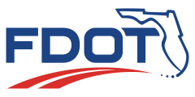
Lake-Sumter MPO Region – Funding Breakdown
Project Type | Five-Year Estimated (Lake) | Five-Year Estimated (Sumter) | Total
Safety | $12,812,873 | $3,784,344 | $16,597,217
Capacity | $95,394,747 | $186,716,210 | $282,110,957
Preservation | $73,446,212 | $26,932,500 | $100,378,712
Multi-modal | $68,600,661 | $2,928,838 | $71,529,499
Operations | $8,215,293 | $0 | $8,215,293
Bike/Ped | $7,726,114 | $0 | $7,726,114
Misc. | $26,891,968 | $29,779,257 | $56,671,225
Priority Projects
11
$205,237,688
$543,229,017
$543,229,017
Notes:
Safety – roundabouts, safety projects, paved shoulders, and miscellaneous construction
Capacity – widening and new roads
Preservation – Resurfacing and bridge rehabilitation
$16,135,293 (Lake) – SR 19, from north of SR 40 to north of Lakeview Avenue
$14,181,439 (Lake) – SR 25 from SR 50 to CR 561A / Southern Breeze Drive
$11,806,945 (Sumter) – SR 471 from CR 478A to US 301/SR 35
Multimodal – transit, aviation
Some major projects under Multimodal:
Transit
414331-2 ($25,238,786 --- capital grant section 5307)
444285-1 ($20M – FTA Section 5307 Operating Funds)
442461-1 (($2,928,838 – Section 5311 Rural Transportation)
Airports
Umatilla Municipal Airport Hangar - $1.923M
Leesburg International Fuel Farm Construction - $1.75M
Operations – signal upgrades, ITS improvements, ATMS, and traffic control
Bike/Ped – sidewalks and bike/trails
Misc. – fixed capital, landscaping, maintenance, planning, studies, toll plazas, and EV charging
Priority Projects: 11 projects (6 capacity, 3 Bike/Ped, 1 Safety, 1 Operations) – Lake 8 / Sumter 3

Slide 13
2022 LOPP – Proposed Funding
Based on FDOT 2023/24 – 2027/28 Tentative Work Program:
Lake County
#1: SR 50 Realignment (Groveland) - $14.7M for ROW in FY24 / $9.85M in FY25
#17: Micro Racetrack Road - $450K for Design moved up to FY24 from FY26
Sumter County
#2: US 301 Widening - $51M for ROW in FY24 / $71.1M for CST in FY 24 and $45.8M for CST in FY26
#6: US 301 Complete Streets (Wildwood) - $2M for Design in FY24
#8: CR 48 Safety Project - $1.6M for Design in FY24
Bridges #1: Rehabilitation for Multiple Bridges - $717,289 for CST in FY24

Slide 14
Lake~Sumter MPO #1 Priority and #1 SIS Priority for last two years $14.7 M for ROW in FY 2024 – Tentative Work Program $9.8 M for ROW in FY 2025 – Tentative Work Program $46 M for CST proposed in FY 2029 in the SIS Cost Feasible Program (2nd Five Year Plan)
Notes:
The only new project phase for a capacity project

Slide 15
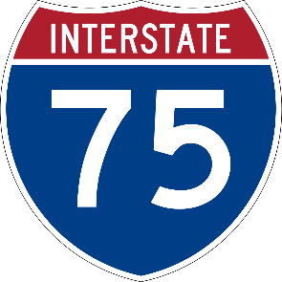
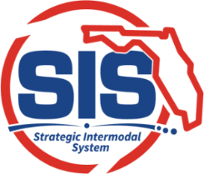
2022 LOPP SIS Priority
FDOT completing I-75 Master Plan from Sumter County (Turnpike) to CR 234 in Alachua
MOVING FLORIDA FORWARD proposes $479M in 2025 to begin construction of auxiliary lanes from SR 44 to SR 326 in Marion County
Notes:
Moving Florida Forward – I75 construction $479m

Slide 16
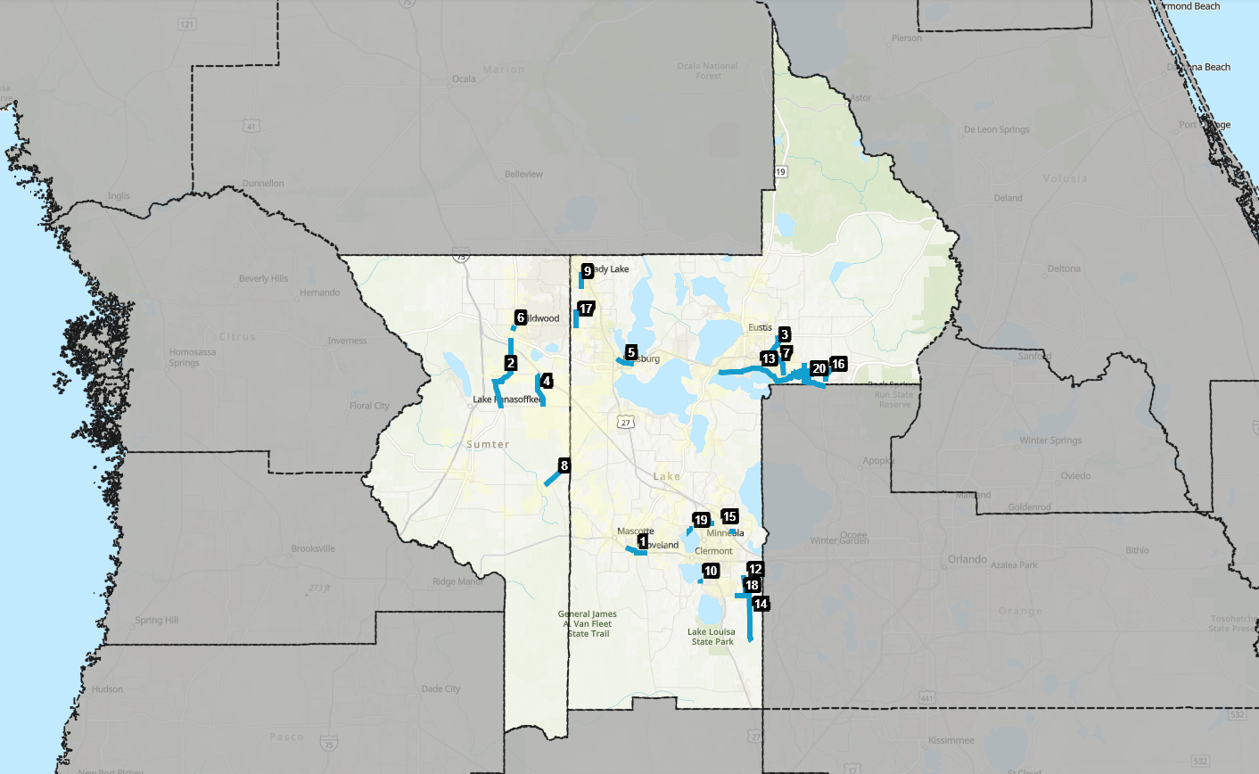
#2: US 301 Widening/Realignment
$51M for ROW in FY24 (Tentative WP)
$71.1M for CST in FY 24 (Tentative WP)
$45.8M for CST in FY26 (Tentative WP)
$26M proposed in MOVING FLORIDA FORWARD
Funded Through Construction

Slide 17
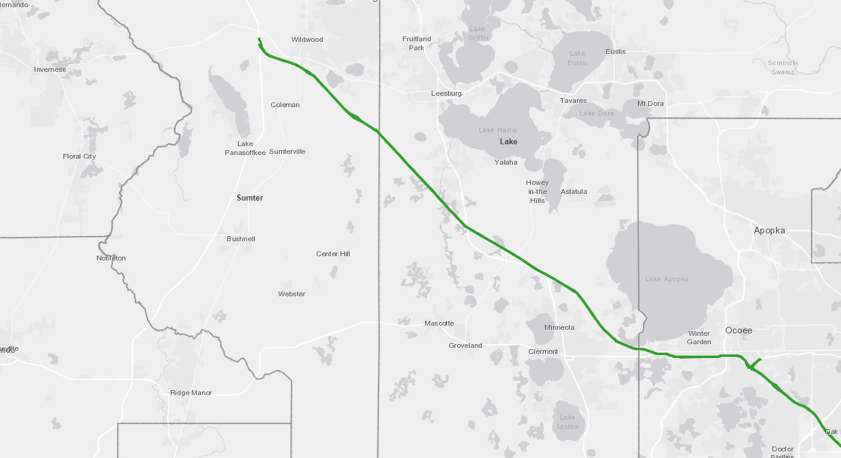
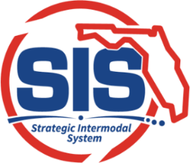
2022 LOPP SIS Priority:
Turnpike Widening from CR 470 to Lake/Sumter County Line
Design funded in FY 2025 (Tentative WP)
ROW funded in FY 2026 (Tentative WP)
Turnpike Widening from US 301 to I-75
Design funded in FY 2026 (Tentative WP)
ROW funded in FY 2028 (Tentative WP)
Turnpike Widening from O’Brien to US 27 includes Interchange Improvements at US 27/ SR 19 (North) (MP 289)
Construction funded in FY 2026 (Tentative WP)
2022 LOPP SIS Priority:
Turnpike Widening from County Line to US 301
Design funded in FY 2025 (Tentative WP)
ROW funded in FY 2026 (Tentative WP)
Interchange Improvements at US 27/ SR 19 (South) (MP 285)
Construction funded in FY 2026
2022 LOPP SIS Priority:
Turnpike Widening from US 27 to CR 470
Construction funded in FY 2028 (Tentative WP)
UNDER CONSTRUCTION
Turnpike Widening from Clermont to O’Brien
Notes:
Fully funded for construction through Lake County
Deign and ROW funded in Sumter to US 301/ I75

Slide 18
Construction planned 2024 Eudora road roundabout
$1.75 million from FDOT
$1.75 million County match
City Relocate Utilities
Scheduled Construction Start FY 2024
CR 19A and Eudora Road, Mount Dora
7

Slide 19
CR 437 Realignment
Sorrento Avenue /SR 46

Slide 20
Round Lake Road

Slide 21
Round Lake Road Proposed Typical Section

Slide 22
Wekiva trail
SEGMENT STATUS: 5-PD&E ON-GOING 1-DESIGN ON-GOING 2-RIGHT-OF-WAY ON-GOING 3 & 4-COMPLETE (Construction 2025-26)
15

