Slide 1
Lake county trails Update Current Projects
Gallus Quigley – Recreation Coordinator – Trails
February 2023

Slide 2
OVERVIEW
Trails Master Plan
2008 Created & Adopted
2018 Updated & Adopted
June 2022 Physical Map Updated
Interactive Map Updated Regularly

Slide 3
OVERVIEW
Regional Trail Network
River to the Hills Trail
Wekiva Regional Trail
Coast to Coast Trail
Lake Ridge Trail

Slide 4
Current projects
Hancock Trail –Segment 5
2.0 Miles Under Construction
Completion 2024
Completes Lake Apopka Loop (Lake)
Lake Apopka Loop Trail
Green Mountain Scenic Overlook & Trailhead
County Road 561A

Slide 5
Current projects
Wekiva Trail –Segment 2
ROW In-progress
2.5 Miles
0.4 Miles Built with ELSCC
Construction Funded in 2024
Hojin St.
East Lake Sports & Community Complex
Sorrento Ave.

Slide 6
Current projects
Wekiva Trail –Segment 1
Design-Engineering In-progress
5.4 Miles
Sorrento Ave.
Tremain St.

Slide 7
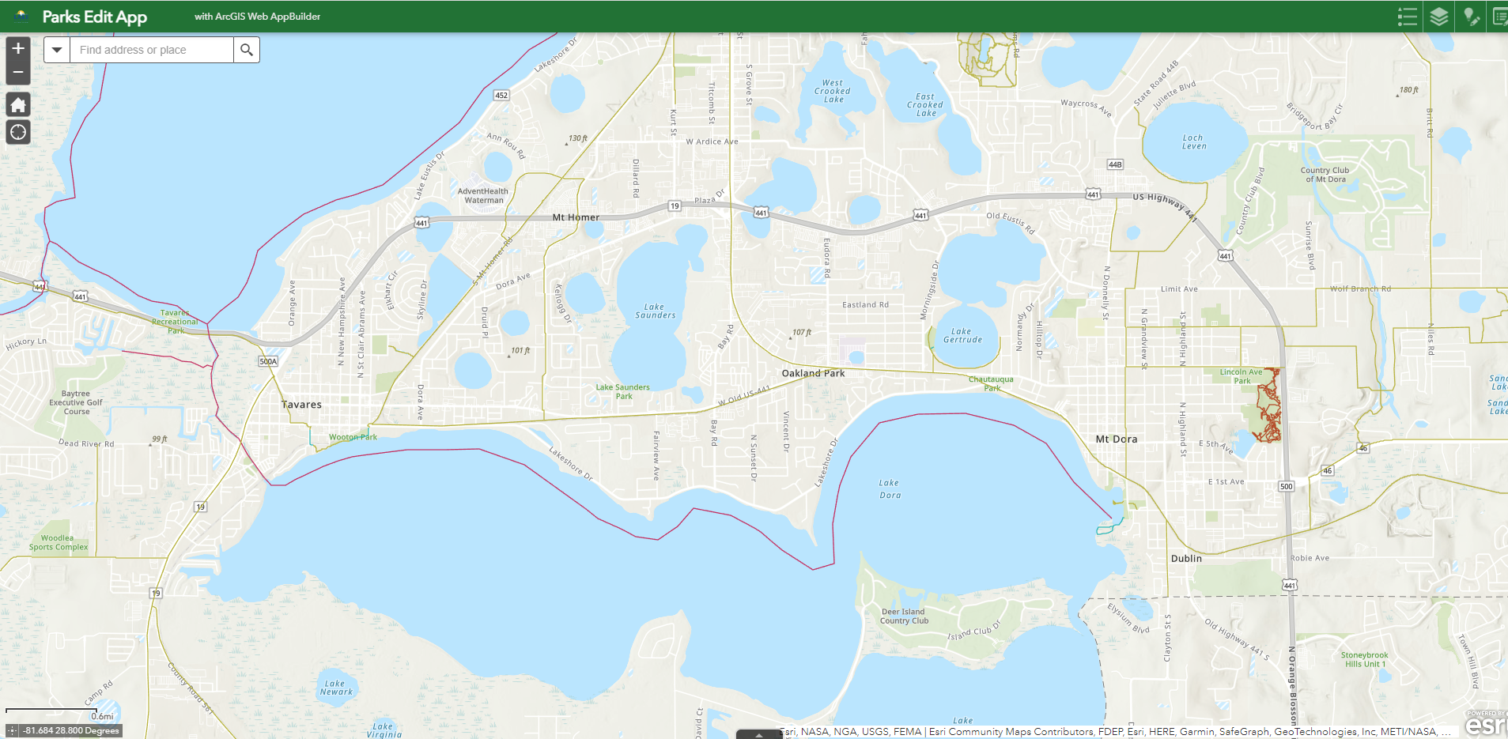
Current projects
Wekiva Trail –Segment 5
PD&E In-progress
5.3 Miles
Tav-Lee Trail
(Existing)
Tremain St.
Wooton Park
Wekiva Segment 1

Slide 8
Current projects
South Lake Trail Segment 3B
ROW in progress - FDOT
1.8 Miles
Coast to Coast
South Lake Trail Segment 3A
(Existing)
Silver Eagle Rd.
South Lake Trail Segment 3C
2nd Ave.

Slide 9
Current projects
South Lake Trail Segment 4
Design -Engineering Complete (FDOT)
FDOT Funding for ROW and Construction
5.6 Miles
Coast to Coast
Segment 3C
Van Fleet State Trail
Villa City Rd.

Slide 10
Current projects
Wellness Way Sector Plan
Multiple Trails
Bike-Ped Friendly Development
Flat Lake Trail (CR 455) – Design-Engineering
Lake Ridge Trail (US 27) - Various
Wellness Way Trail – Design- Engineering
5 Mile Running Trail - Planned
Lake Needham Trail (SR 516) - Engineering

Slide 11
Current projects
North Lake Trail–Segment 3
PD&E In-progress
16 Miles
Collins St. to CR 42 Design
2.0 Miles
A
Black Bear Scenic Trail – Heart of Florida Loop
B
C
SR 40
E. Collin St./CR 450
CR 42

Slide 12
Current projects
Citrus Grove Trail–Segment 2
Awaiting Construction 2023
0.7 Miles
Citrus Grove Trail Segment 3 (Existing)
Citrus Grove Trail Segment 1 (Existing)
Grass Lake Rd.

Slide 13
Current projects
Citrus Grove Trail–Segment 4B-C
Construction Underway 4B
Engineer Complete 4C
1.5 Miles
Citrus Grove Trail Segment 3 & 4A (Existing)
Citrus Grove Trail Segment 4B &C

Slide 14
Current Projects
Blackstill Lake Trail–Segment 1
Construction Underway
0.8 Miles
Citrus Grove Trail 4C
Existing Old Blackstill Lake Trail
Realigned Blackstill Lake Trail Segment 1 – Developer Built

Slide 15
QUESTIONS
Gallus Quigley – Recreation Coordinator – Trails
gallus.quigley@lakecountyfl.gov

