Slide 1
Florida’s Population Trend
Notes:
Current population is 22.2 million, projected to be 24.4 in 2030.

Slide 2
Florida continues to be one of the most rapidly growing states in the nation. According to the 2020 Census, Florida’s population was 22,000,000
The 2010–2020 period was the fifth consecutive decade in which the Florida population grew by more than 2.7 million residents.
The population of the United States was 331,449,281 on April 1, 2020, an increase of 22.7 million (7.4%) since 2010. Most of this increase occurred in the South and West.

Slide 3
Four counties grew by more than 30%
Osceola, St. Johns, Sumter, and Walton
while another nine grew by 20%–30%
Lake, Orange, Santa Rosa, Manatee, Nassau, Lee, Pasco, Flagler, and Polk.
Lake County Census data:
2020 - 383,956 2010 – 297,047 Change – 86,909 29.3%
Groveland Census Data
2020 – 18,505 2010 – 8,729 Change – 9,776 112.0%

Slide 4
FDOT Annual Appropriation History
Notes:
So, in Florida, we have a perception problem.
The FY 22/23 FDOT budget is a record $12.7 Billion. Mostly because of our state commitment to investing in our infrastructure, Florida’s transportation system is consistently ranked as one of the best in the country. Only 25% of FDOT’s budget comes from Federal funds.
It seems like everywhere you go in Florida; the transportation system is under construction.

Slide 5
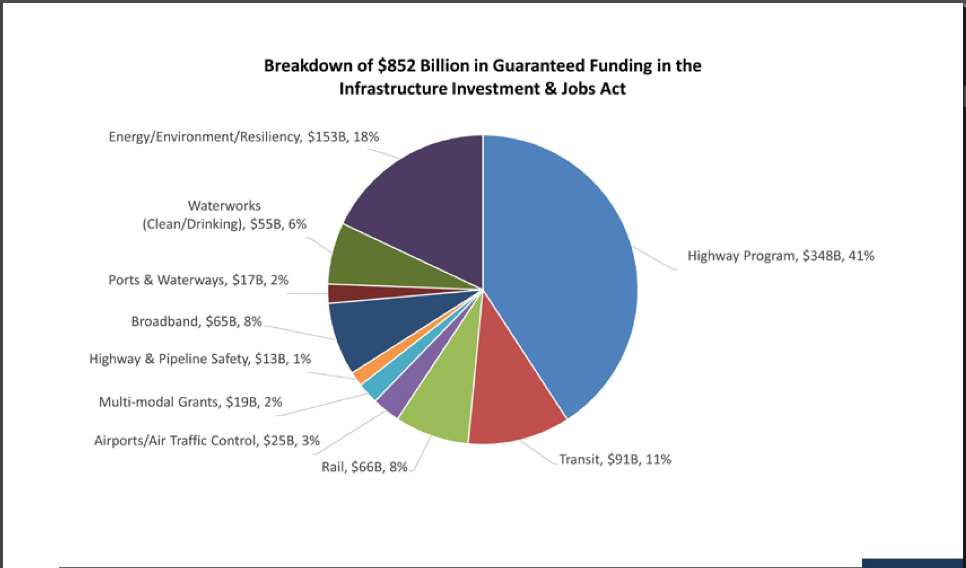

Slide 6
What Sets Florida Apart?
State Fuel Tax Indexed to CPI
Extensive Tolling Systems
Maximum Use of Innovative Financing
Population Growth
Record Tourism
Notes:
Florida is in a much better financial position for funding its infrastructure than almost all of the other states in the country. Why is this?
We have been adjusting our state fuel taxes based on the CPI since 1992.
This indexing of the State Fuel Taxes has resulted in approximately $8 Billion in additional revenue since the indexing began.
We have the most toll-road mileage in the country.
We have taken advantage of every innovative finance option available.
We are growing again. Over 300,000 people are moving to the state each year. Over 100 million tourist visit the state each year. (double edged sword)
All of these variables have produced our record transportation budgets.

Slide 7
Visitors to Florida
Notes:
We have surpassed the number of annual tourist to Florida from the pre-Covid numbers. On track for 133 million in 2022.

Slide 8
Fuel Consumption in Florida (Millions of Gallons Annually)
Forecast
Notes:
Unlike many other states in the country, fuel consumption and, therefore, fuel tax receipts have been growing again in Florida. You can see the drop in consumption during the recession and Covid years. But you can also see what the future has in store for us.

Slide 9
Electric Vehicle Impacts to Transportation Revenue
2040 Net Revenue Loss Projections
Conservative Growth Scenario = -5.6%
Aggressive Growth Scenario = -20.0%
Moderate Growth Scenario = -11.1%
For every 1% increase in EV market adoption, estimated 0.5% reduction in STTF revenue
Notes:
Note that this is ONLY EV impacts to revenue, not the impact of hybrids or improved fuel efficiency of ICE vehicles.
Again, the impact of the rising cost of fuel may accelerate the move towards electric vehicles.

Slide 10
Approved Transportation Improvement Program FY 2023- 2027
Project Categories
Project Category | 2023 | 2024 | 2025 | 2026 | 2027 | Total
Aviation Projects | $1,625,000 | $2,050,000 | $1,650,000 | $1,125,000 | $625,000 | $7,075,000
Bike/Ped and Sidewalk Projects | $0 | $539,823 | $35,000 | $0 | $489,752 | $1,064,575
Planning Studies | $941,128 | $853,430 | $864,351 | $875,490 | $875,490 | $4,409,889
Roadway Capacity Projects (Non-SIS) | $22,368,816 | $12,405,400 | $0 | $17,100,000 | $12,540,000 | $64,414,216
Safety/Operations/TSMO Projects | $51,965,336 | $61,997,738 | $33,338,746 | $11,486,174 | $5,095,749 | $163,883,743
Strategic Intermodal System Projects (SIS) | $86,524,479 | $7,836,917 | $3,525,120 | $123,966,992 | $0 | $221,853,508
Trail Projects | $10,332,412 | $2,456,774 | $4,163,344 | $0 | $0 | $16,952,530
Transit and Transportation Disadvantage Projects | $6,560,901 | $8,502,244 | $8,757,310 | $8,867,710 | $8,981,654 | $41,669,819
TOTALS | $180,318,072 | $96,642,326 | $52,333,871 | $163,421,366 | $28,607,645 | $521,323,280
Total Project Category Costs*
$7,075,000
$1,069,575
$4,409,889
$75,607,294
$246,785,931
$587,977,624
$25,010,556
$56,455,488
$1,004,391,357
*Total Project Costs include historic (<2023) and future costs (>2027)

Slide 11
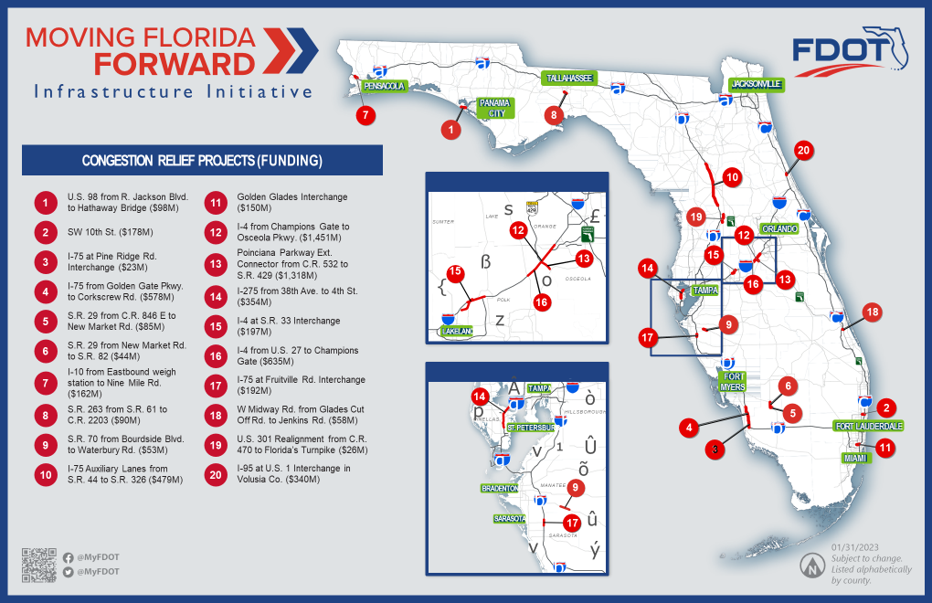

Slide 13
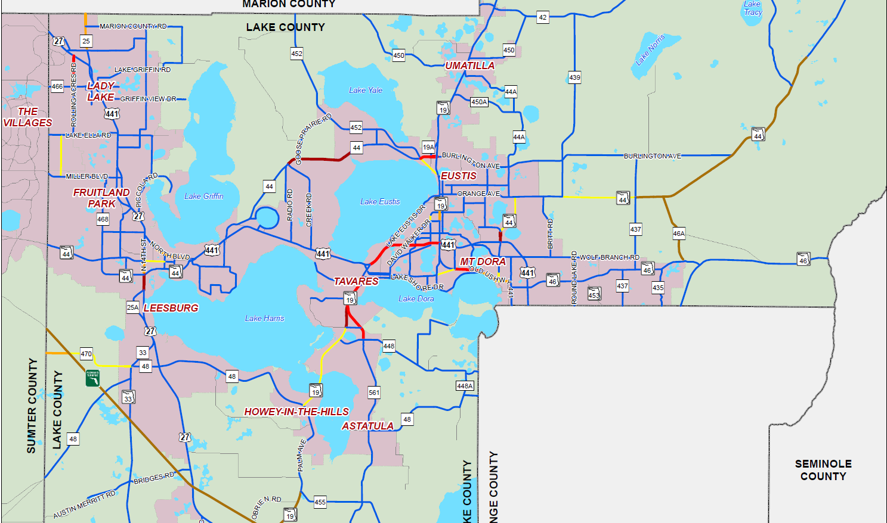
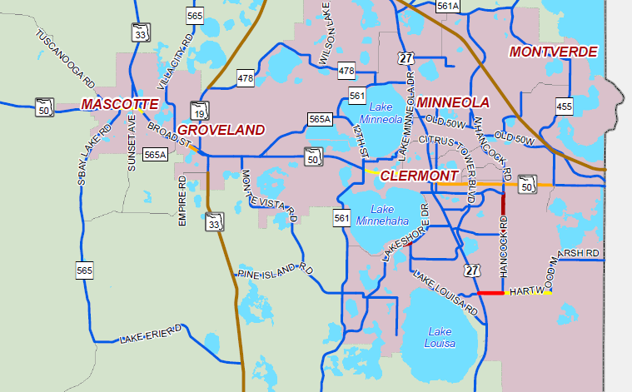
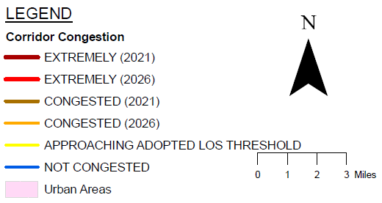
Lake County Roadway Performance
LOS Standard
D in Urban Area
C outside Urban Area
Systems Evaluation

Slide 14
Switch to funded roadway project map
Big Regional Projects: feel free to rearrange the order)
Groveland SR 50 Realignment
Turnpike projects
US 27 resurfacing (2 projects)
I75
US 301
SR 50 projects west of Groveland
Other State Funded projects in and around Groveland:
SR 50 Landscaping, SR 50 Resurfacing
SR 19 Resurfacing
SR 33 Resurfacing and Safety project
CR 565 Villa City Rd – safety project Paved Shoulders

Slide 15
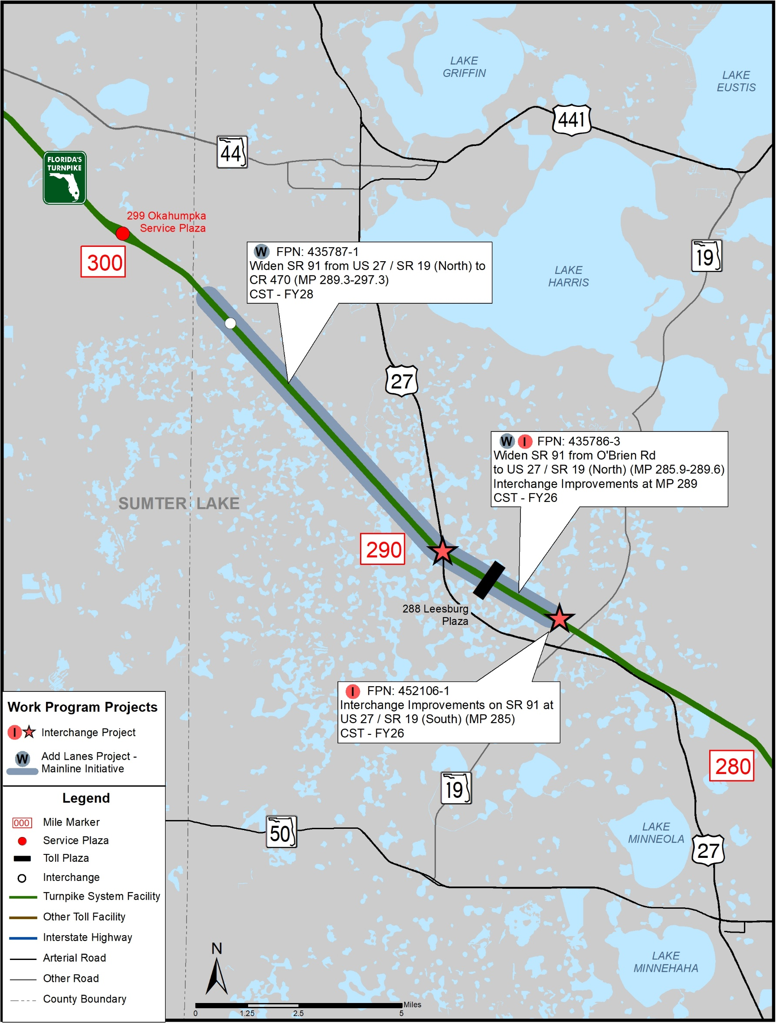
Lake County
Description | Phase | FY | Funds ($M)
Widen from US 27 / SR 19 (North) to Leesburg / CR 470 (MP 289.3 - MP 297.3) FPN: 435787-1 | ENV PE ROW RRU CST | 2028 2024, 27 2026 2027 2028 | $359.4
Widen from O’Brien Rd to US 27 / SR 19 (North) (MP 285.9 - MP 289.6) Interchange Improvements at MP 289 FPN: 435786-3 | PE ROW CST | 2025 2024-26 2026, 28 | $144.5
Interchange Improvements at US 27 / SR 19 (South) (MP 285) FPN: 452106-1 | ENV PE ROW CST | 2025 2024 2025 2026 | $9.5

