Slide 1
Lake~Sumter MPO June 14, 2023 Advisory Committee Meeting
Michael Woods, Executive Director

Slide 2
Call to Order by Chair
Invocation / Pledge of Allegiance
Proper Noticing
Roll Call – Determination of Quorum
Chair's Announcements
Motion to allow virtual voting by members
Update: Proposed revisions to Today’s Agenda

Slide 3
II.
OPPORTUNITY FOR PUBLIC COMMENT on Agenda or General Comments
At this point in the meeting, the Committee will hear citizens' questions, comments, and concerns. If the issue raised is not on today's Agenda, the Committee will not take action at this meeting. Questions may be answered by staff or referred for appropriate staff action. If further action is necessary, the item may be placed on a future committee agenda. Public comment shall be limited to three minutes per person.

Slide 4
CONSENT AGENDA ITEMS for APPROVAL
Approval of TAC April 12, 2023, Meeting Minutes
2023-2024 Unified Planning Work Program (UPWP) Amendment
This amendment moves funds and adds text into Task 1 Administration, for the Update and Development of the new MPO Apportionment Plan, Metropolitan Planning Area, and the Urbanized Area based on the 2020 Census data. This update also includes development and coordination of unified planning documents and process for shared urbanized areas with the Lake~Sumter MPO Planning Area Boundary.
This amendment adds funds into Task 3 Long Range Planning for preliminary work on the 2050 LRTP.
This amendment adds funds and text to Task 4 Special Studies, for the assessment of projects in the TIP and LOPP for IIJA funding opportunities and other implementation strategies.

Slide 5
CONSENT AGENDA ITEMS for APPROVAL
Approval of CAC April 12, 2023, Meeting Minutes
2023-2024 Unified Planning Work Program (UPWP) Amendment
This amendment moves funds and add text into Task 1 Administration, for the Update and Development of the new MPO Apportionment Plan, Metropolitan Planning Area, and the Urbanized Area based on the 2020 Census data. This update also includes development and coordination of unified planning documents and process for shared urbanized areas with the Lake~Sumter MPO Planning Area Boundary.
This amendment adds funds into Task 3 Long Range Planning for preliminary work on the 2050 LRTP.
This amendment adds funds and text to Task 4 Special Studies, for the assessment of projects in the TIP and LOPP for IIJA funding opportunities and other implementation strategies.

Slide 6
ACTION ITEM A.
Consideration of Resolution 2023-6 Approving the
2023 List of Priority Projects (LOPP).
Priority Projects (LOPP) document that all Metropolitan Planning Organizations (MPOs) are required to develop annually. The LOPP represents the unfunded transportation improvements that were not programmed for the following five years in order of priority. The Florida Department of Transportation (FDOT) uses each MPO's LOPP to aid in their decisions about which projects should be added to their Work Program each year. The Lake~Sumter MPO approves its LOPP annually. Approval of the 2023 LOPP will include an update to the CFMPOA Regional LOPP for SIS, Regional Trails, Regional Transit, and TRIP projects, the CFMPOA Regional LOPP is summary of regional project in District Five and not a prioritized list of projects.
Attachments: 2023 DRAFT List of Priority Projects
Staff recommends approval the 2023 LOPP as presented.

Slide 7
List of Priority Projects (LOPP) Update Technical Advisory Committee & Community Advisory Committee June 14, 2023

Slide 8
Schedule Overview
Preliminary LOPP Options Reviewed by Board/Committees | April 12 & April 26
Final LOPP Reviewed & Approved by Board/Committees | June 14 & June 21
MPO Submits Adopted LOPP to FDOT | By June 30

Slide 9
2023 LOPP – Key Points
Fifteen (15) projects carry over from 2022 Top 20
Five (5) projects removed
Five (5) projects added to 2023 Top 20
Includes three (3) major Planning projects
Factors provided to inform Board review of proposed Top 20 priorities

Slide 10
2022 Top 20 – Projects in TWP
Based on FDOT 2023/24 – 2027/28 Tentative Work Program:
Lake County
#1: SR 50 Realignment (Groveland) - $14.7M for ROW in FY24 / $9.85M in FY25
#17: Micro Racetrack Road - $450K for Design advanced to FY24 from FY26
Sumter County
#2: US 301 Widening - $51M for ROW in FY24 / $71.1M for CST in FY 24 and $45.8M for CST in FY26
#6: US 301 Complete Streets (Wildwood) - $2M for Design in FY24
#8: CR 48 Safety Project - $1.6M for Design in FY24
Bridges #1: Rehabilitation for Multiple Bridges - $717,289 for CST in FY24
Items in Green: Added to Funded Top 20 Projects List

Slide 11
Projects Leaving 2022 Top 20
#2: US 301 Widening
#4: Marsh Bend Trail (CR 501)
#6: US 301 Complete Streets (Wildwood)
#13 Wekiva Trail (Segs 1 & 5)
#15 Citrus Grove Phase II & V
Notes:
#2: US 301 Widening – TWP and Moving Florida Forward
#4: Marsh Bend Trail (CR 501) – Work Program (previous TWP), going to construction
#6: US 301 Complete Streets (Wildwood) – TWP funded
#13 Wekiva Trail (Segs 1 & 5) – Turn over to Mike
#15 Citrus Grove Phase II & V – Legislative funding for Phase II, Locally funded Phase V

Slide 12
Projects Added to 2023 Top 20
#6 - Wellness Way (2 to 4 Lanes)
#8 - Sumter County Safe Streets for All – Phase I
#16 - SR 19 Planning Study – SR 50 to CR 455
#17 - 2050 Long Range Transportation Plan – Preliminary Planning Activities and Studies
#19 - CR 44 Corridor Feasibility Study – US 441 to Eustis Bypass/Deland Road
Notes:
#6 - Wellness Way (2 to 4 Lanes) – Important corridor S Lake, developers funded 2 lane section, request to fund the widening
#8 - Sumter County Safe Streets for All – Phase I – Supporting Sumter’s grant efforts
#16 - SR 19 Planning Study – SR 50 to CR 455 – Failing now, CMP identified, funded for const (early) in 2045 LRTP
#17 - 2050 Long Range Transportation Plan – Preliminary Planning Activities and Studies
#19 - CR 44 Corridor Feasibility Study – US 441 to Eustis Bypass/Deland Road – Request from Lake, want to review and determine short term solutions, not in the CFP, prepare for it to be included in the 2050

Slide 13
2023 Top 20 Projects
2023 PROPOSED Top 20 Rank | 2022 Top 20 Rank | Sponsor/ Location | Project Name | From | To | Description | 2023 Proposed Phase | 2023 Proposed Phase FY | 2023 Proposed Phase Cost | CMP Congested Corridors 2022 Analysis (for informational purposes) | Prior Year Top 20 Rank | Project Phase Requested | Crash Density (for informational purposes)
1 | 1 | FDOT/ Lake County | SR 50 | CR 565 (Villa City) | CR 565A (Montevista) | Realignment | CST | 2024/25 | $45,445,800 | Operating at Acceptable Level of Service | 1-5 | Construction | Medium (51-100)
2 | 3 | FDOT | SR 44 (CR44B) | US 441 | SR 44 | Road Widening | CST | 2024/25 | $26,500,000 | Extremely Congested (2022) | 1-5 | Construction | Medium (51-100)
3 | 8 | Sumter County | C 48 | C 469 | Lake/Sumter County Line | Safety Project | CST | 2025/26 | $6,475,426 | Operating at Acceptable Level of Service | 6-10 | Construction | Medium-Low (1-50)
4 | 5 | FDOT | SR 500 (US 441) | Perkins Street | SR 44 | Road Widening | CST | 2024/25 | $13,794,537 | Approaching Congestion | 1-5 | Construction | High (101-200)
5 | 11 | Lake County | Round Lake Road | Wolf Branch Road | SR 44 | Road Widening/ Extension | CST | 2027/28 | $30,000,000 | Operating at Acceptable Level of Service | 11-15 | Construction | Medium-Low (1-50)
6 | - | Lake County | Wellness Way (2 to 4 Lanes) | Hancock Road Extension | Orange County Line | Widening | CST | 2025/26 | $8,633,484 | New Roadway, Not on CMP Network | Not Ranked in Top 20 | Construction | New Roadway
7 | 7 | FDOT | SR 500 (US 441) | SR 44 | N of SR 46 | Road Widening | CST | 2024/25 | $25,800,000 | Operating at Acceptable Level of Service | 6-10 | Construction | Medium (51-100)
8 | - | Sumter County | Safe Streets For All Phase I | Sidewalk repairs and ADA compliance along St Charles Place, Bailey Trail, Canal Street, Odell Circle, and Bonita Boulevard |  | Sidewalk Repairs/ ADA Compliance | Design | 2024/25 | $393,455 | Sidewalk Project | Not Ranked in Top 20 | Design | Sidewalk Project
9 | 9 | Lake County/ Lady Lake | Rolling Acres Road | West Lady Lake Avenue | Griffin Avenue | Road Widening | Design | 2026/27 | $1,500,000 | Congested (2022) | 6-10 | Design | Medium-Low (1-50)
10 | 10 | Lake County | Hammock Ridge Roundabout | Hammock Ridge Rd | Lakeshore Dr | Roundabout | CST | 2027/28 | $2,000,000 | Extremely Congested (2022) | 6-10 | Construction | Medium-Low (1-50)

Slide 14
2023 Top 20 Projects
2023 PROPOSED Top 20 Rank | 2022 Top 20 Rank | Sponsor/ Location | Project Name | From | To | Description | 2023 Proposed Phase | 2023 Proposed Phase FY | 2023 Proposed Phase Cost | CMP Congested Corridors 2022 Analysis (for informational purposes) | Prior Year Top 20 Rank | Project Phase Requested | Crash Density (for informational purposes)
11 | 12 | Lake County | CR 455 (Ray Goodgame Parkway) | Lost Lake Road | Hartwood Marsh Road | Roadway Extension/ Widening | CST | 2024/25 | $19,800,000 | New Roadway, Not on CMP Network | 11-15 | Construction | New Roadway
12 | 14 | Lake County | CR 455 Extension | Wellness Way | Schofield Road | Roadway Extension | Design | 2026/27 | $1,500,000 | New Roadway, Not on CMP Network | 11-15 | Design | New Roadway
13 | 16 | Lake County | CR 437 Realignment | Oak Tree Dr | SR 46 | New Corridor/ Road Widening | CST | 2025/26 | $4,000,000 | New Roadway, Not on CMP Network | 16-20 | Construction | New Roadway
14 | 18 | Lake County | Hartwood Marsh Road | Regency Hills Drive | CR 455/Ray Goodgame Parkway | Road Widening | Design | 2025/26 | $3,000,000 | Operating at Acceptable Level of Service | 16-20 | ROW | Medium-Low (1-50)
15 | 19 | Lake County | Lake Minneola Shores & Jalarmy Rd Roundabout | Lake Minneola Shores | Jalarmy Road | Roundabout | CST | 2024/25 | $2,000,000 | Operating at Acceptable Level of Service | 16-20 | Construction | Medium (51-100)
16 | - | FDOT/ Lake County | SR 19 Corridor Coalition | SR 50 | CR 455 | Corridor Study | Planning | 2024/25 | $600,000 | Ranges from Congested (2022) to Extremely Congested (2022/2027) | Not Ranked in Top 20 | Planning | Medium-Low (1-50)
17 | - | Lake~Sumter MPO | 2050 Long Range Transportation Plan - Preliminary Planning Activities and Studies |  |  | Long Range Planning | Planning | 2024/25 | $200,000 | N/A | Not Ranked in Top 20 | Planning | N/A
18 | 17 | Lake County | Micro Racetrack Road | CR 466A | Lake Ella Road | Paved Shoulders | ROW | 2025/26 | $5,000,000 | Congested (2022) | 16-20 | ROW | Medium-Low (1-50)
19 | - | Lake County | CR 44 Corridor Feasibility Study | US 441 | Eustis Bypass/ Deland Road | Corridor Study | Planning | 2024/25 | $750,000 | Extremely Congested (2022) | Not Ranked in Top 20 | Planning
20 | 20 | Lake County/ Mount Dora | Vista Ridge Drive/Wolf Branch Innovation Blvd | Niles Road | CR 437 | Corridor Study/ Preliminary Design | Design | 2025/26 | $1,500,000 | New Roadway, Not on CMP Network | 16-20 | Planning | New Roadway

Slide 15
2023 Top 20 Projects
2023 PROPOSED Top 20 Rank | 2022 Top 20 Rank | Sponsor/ Location | Project Name | From | To | Description | 2023 Proposed Phase | 2023 Proposed Phase FY | 2023 Proposed Phase Cost
1 | 1 | FDOT/ Lake County | SR 50 | CR 565 (Villa City) | CR 565A (Montevista) | Realignment | CST | 2024/25 | $45,445,800
2 | 3 | FDOT | SR 44 (CR44B) | US 441 | SR 44 | Road Widening | CST | 2024/25 | $26,500,000
3 | 8 | Sumter County | C 48 | C 469 | Lake/Sumter County Line | Safety Project | CST | 2025/26 | $6,475,426
4 | 5 | FDOT | SR 500 (US 441) | Perkins Street | SR 44 | Road Widening | CST | 2024/25 | $13,794,537
5 | 11 | Lake County | Round Lake Road | Wolf Branch Road | SR 44 | Road Widening/ Extension | CST | 2027/28 | $30,000,000
6 | - | Lake County | Wellness Way (2 to 4 Lanes) | Hancock Road Extension | Orange County Line | Widening | CST | 2025/26 | $8,633,484
7 | 7 | FDOT | SR 500 (US 441) | SR 44 | N of SR 46 | Road Widening | CST | 2024/25 | $25,800,000
8 | - | Sumter County | Safe Streets For All Phase I | Sidewalk repairs and ADA compliance along St Charles Place, Bailey Trail, Canal Street, Odell Circle, and Bonita Boulevard |  | Sidewalk Repairs/ ADA Compliance | Design | 2024/25 | $393,455
9 | 9 | Lake County/ Lady Lake | Rolling Acres Road | West Lady Lake Avenue | Griffin Avenue | Road Widening | Design | 2026/27 | $1,500,000
10 | 10 | Lake County | Hammock Ridge Roundabout | Hammock Ridge Rd | Lakeshore Dr | Roundabout | CST | 2027/28 | $2,000,000

Slide 16
2023 Top 20 Projects
2023 PROPOSED Top 20 Rank | 2022 Top 20 Rank | Sponsor/ Location | Project Name | From | To | Description | 2023 Proposed Phase | 2023 Proposed Phase FY | 2023 Proposed Phase Cost
11 | 12 | Lake County | CR 455 (Ray Goodgame Parkway) | Lost Lake Road | Hartwood Marsh Road | Roadway Extension/ Widening | CST | 2024/25 | $19,800,000
12 | 14 | Lake County | CR 455 Extension | Wellness Way | Schofield Road | Roadway Extension | Design | 2026/27 | $1,500,000
13 | 16 | Lake County | CR 437 Realignment | Oak Tree Dr | SR 46 | New Corridor/ Road Widening | CST | 2025/26 | $4,000,000
14 | 18 | Lake County | Hartwood Marsh Road | Regency Hills Drive | CR 455/Ray Goodgame Parkway | Road Widening | Design | 2025/26 | $3,000,000
15 | 19 | Lake County | Lake Minneola Shores & Jalarmy Rd Roundabout | Lake Minneola Shores | Jalarmy Road | Roundabout | CST | 2024/25 | $2,000,000
16 | - | FDOT/ Lake County | SR 19 Corridor Coalition | SR 50 | CR 455 | Corridor Study | Planning | 2024/25 | $600,000
17 | - | Lake~Sumter MPO | 2050 Long Range Transportation Plan - Preliminary Planning Activities and Studies |  |  | Long Range Planning | Planning | 2024/25 | $200,000
18 | 17 | Lake County | Micro Racetrack Road | CR 466A | Lake Ella Road | Paved Shoulders | ROW | 2025/26 | $5,000,000
19 | - | Lake County | CR 44 Corridor Feasibility Study | US 441 | Eustis Bypass/ Deland Road | Corridor Study | Planning | 2024/25 | $750,000
20 | 20 | Lake County/ Mount Dora | Vista Ridge Drive/Wolf Branch Innovation Blvd | Niles Road | CR 437 | Corridor Study/ Preliminary Design | Design | 2025/26 | $1,500,000

Slide 17
2023 LOPP – Tables 2 to 11
Strategic Intermodal System (SIS)
Roadway Capacity (Non-SIS)
Safety/Operations/TSM&O
Complete Streets
Trails
Bicycle/Pedestrian & Sidewalk
Transit
Planning Studies
Bridge Projects
Small County Outreach Program (SCOP)
Notes:
Strategic Intermodal System (SIS)
Roadway Capacity (Non-SIS)
Safety/Operations/TSM&O
Complete Streets
Trails (PIA, TA, SUN Trail)
Bicycle/Pedestrian & Sidewalk (PIA, TA)
Transit
Planning Studies
Bridge Projects
Small County Outreach Program (SCOP)
Applications

Slide 18
2023 LOPP – Preparing for Submission
Application Reminder…
FDOT requires new applications for all projects
Please have all prepared and submitted to LSMPO by June 21st
Also include any critical projects from Tables 2 to 11

Slide 19
2024 LOPP – Looking Ahead
Anticipated process refinements …
Enhance year-to-year predictability of lists/priorities
Continue Funded Top 20 Projects list
Prioritize key projects from sub-lists to develop Top 20

Slide 20
Discussion
Action

Slide 21
2022 LOPP Proposed Funding
2022 Top 20 Rank | Sponsor/ Location | Project Name | From | To | Proposed Funding
1 | FDOT/ Lake County | SR 50 | CR 565 (Villa City) | CR 565A (Montevista) | $24.6M for ROW in Tentative WP + $46M for CST proposed in SIS 2nd Five-Year Plan
2 | FDOT/ Sumter County | SR 35 (US 301) | SR 44 | CR 470 | $51M for ROW in Tentative WP $117M for CST in Tentative WP + $26M proposed in MOVING FLORIDA FORWARD
3 | FDOT | SR 44 (CR44B) | US 441 | SR 44
4 | Sumter County | Marsh Bend Trail (CR 501) | Corbin Trail | Central Parkway
5 | FDOT | SR 500 (US 441) | Perkins Street | SR 44
6 | Sumter/ Wildwood | US 301 Complete Streets | C-466A | C-44A | $2M for Design in Tentative WP
7 | FDOT | SR 500 (US 441) | SR 44 | N of SR 46
8 | Sumter County | C 48 | C 469 | Lake/Sumter County Line | $1.6M for Design in FY24 (Tentative WP)
9 | Lake County/ Lady Lake | Rolling Acres Road | West Lady Lake Avenue | Griffin Avenue
10 | Lake County | Hammock Ridge Roundabout | Hammock Ridge Rd | Lakeshore Dr
Notes:
Only use if needed

Slide 22
2022 LOPP Proposed Funding
2022 Top 20 Rank | Sponsor/ Location | Project Name | From | To | Proposed Funding
11 | Lake County | Round Lake Road | Lake/Orange County Line | SR 44
12 | Lake County | CR 455 (Ray Goodgame Parkway) | Lost Lake Road | Hartwood Marsh Road
13 | Lake County | Wekiva Trail (Segments 1&5) | Disston Avenue | Sorrento
14 | Lake County | CR 455 Extension | Hartwood Marsh Rd | CFX Lake-Orange Connector
15 | Lake County | Citrus Grove Phase II & V | W. of Scrub Jay Lane (Phase II) / Florida's Turnpike (Phase V) | Grassy Lake Road (Phase II) / Blackstill Lake Drive (Phase V) | Phase II funded through construction (legislative appropriation/local funding)
16 | Lake County | CR 437 Realignment | Oak Tree Dr | SR 46
17 | Lake County | Micro Racetrack Road | CR 466A | Lake Ella Road | Design advanced from 2026 to 2024
18 | Lake County | Hartwood Marsh Road | Regency Hills Drive | CR 455/Ray Goodgame Parkway
19 | Lake County | Lake Minneola Shores & Jalarmy Rd Roundabout | Lake Minneola Shores | Jalarmy Road
20 | Lake County/ Mount Dora | Vista Ridge Drive/Wolf Branch Innovation Blvd | Niles Road | CR 437
Notes:
Only use if needed

Slide 23
ACTION ITEM B.
Consideration of Resolution 2023-11 Approving the
FY2024 – 2028 Transportation Improvement Program (TIP).
The five-year Transportation Improvement Program (TIP) document is based on several funding sources, including the FDOT Tentative Work Program and the Florida Turnpike Enterprise Work Program. The DRAFT TIP for FY 2024 -2028 will be presented for adopted at the MPO Governing Board Public Hearing on June 21, 2023
Attachment: 2024-2028 TIP
Staff recommends approving Resolution 2023-5 adopting the Transportation Improvement Program for FY2024-2028 as presented.

Slide 24
Lake-Sumter MPO 2024- 2028 TIP
CAC and TAC Meetings
06/14/2023

Slide 25
TIP Overview
Purpose: A 5-year financially feasible program of multimodal transportation improvement projects.
Consistency with Other Plans:
All projects drawn from the 2045 Long Range Transportation Plan (LRTP)
Consistent with FDOT’s Five-Year Adopted Work Program
Consistent with Lake County’s Transit Development Plan (TDP)

Slide 26
TIP Overview : Project Selection
The Lake-Sumter MPO adopted its List of Priority Projects (LOPP) in June 2022
The 2022 LOPP was then submitted to FDOT to develop the FY 2024- 2028 Tentative Five-Year Work Program based on the priority projects
The Five-Year Work Program is used to develop the draft TIP

Slide 27
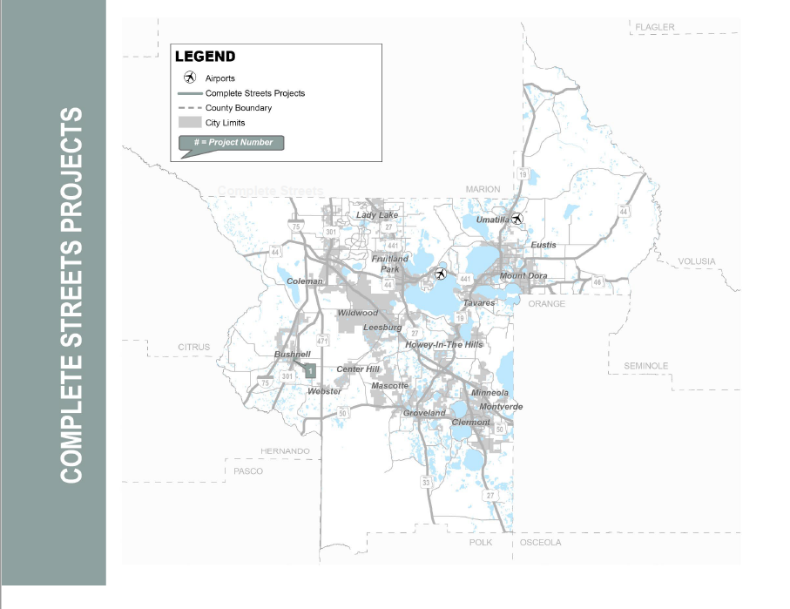
TIP Report : Minor Improvements
New Project Category to be consistent with LOPP 2022

Slide 28
TIP Report - Improvements
Table Updated to show Top 20 vs. Project Category Priorities
Table updated to show CMP Status

Slide 29
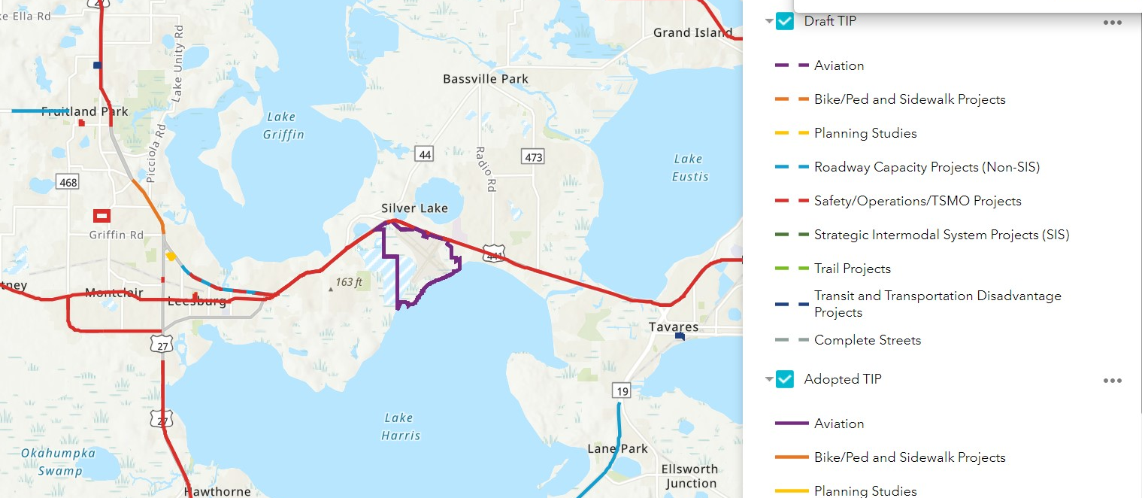
Web Application
Easy to Search Projects
Compare Draft vs Adopted TIP Projects
Understand Context of Projects
Project Categories and Color Relate to TIP Report for Easy Reference

Slide 30
02
2024-2028 TIP by the Numbers

Slide 31
Executive Summary

Slide 32
Project Costs and Revenue FY 2024-2028
Funding Source | 2024 | 2025 | 2026 | 2027 | 2028 | TIP Total
Federal | $ 57,027,142 | $ 50,181,151 | $ 64,674,273 | $ 8,380,364 | $ 7,342,357 | $ 187,605,287
Local | $ 17,963,673 | $ 9,724,287 | $ 10,911,362 | $ 11,437,125 | $ 4,047,672 | $ 54,084,119
R/W and Bridge Bonds | $ 7,750,000 | $ - | $ - | $ - | $ - | $ 7,750,000
State 100% | $ 116,385,547 | $ 103,818,193 | $ 100,233,649 | $ 14,795,641 | $ 5,450,924 | $ 340,683,954
Toll/Turnpike | $ 26,574,454 | $ 20,358,078 | $ 159,518,660 | $ 5,231,516 | $ 337,207,930 | $ 548,890,638
Total | $ 225,700,816 | $ 184,081,709 | $ 335,337,944 | $ 39,844,646 | $ 354,048,883 | $ 1,139,013,998.00
Total Project Costs*
$ 223,127,019
$ 63,465,416
$ 7,750,000
$ 449,107,621
$ 668,865,229
$ 1,412,315,285
*Total Project Costs include historic (<2024) and future costs (>2028)

Slide 33
Project Category Cost FY 2024- 2028
Project Category | 2024 | 2025 | 2026 | 2027 | 2028 | Total
Safety/Operations/TSMO Projects | $ 83,765,010 | $ 51,243,878 | $ 74,909,403 | $ 6,718,754 | $ 4,398,235 | $ 221,035,280.00
Transit and Transportation Disadvantage Projects | $ 15,158,141 | $ 12,746,938 | $ 12,857,026 | $ 12,970,650 | $ 11,123,744 | $ 64,856,499.00
Trail Projects | $ 298,900 | $ 4,386,985 | $ 2,515,477 | $ - | $ - | $ 7,201,362.00
Strategic Intermodal System Projects (SIS) | $ 55,159,137 | $ 39,372,021 | $ 169,353,315 | $ 5,225,000 | $ 337,201,414 | $ 606,310,887.00
Roadway Capacity Projects (Non-SIS) | $ 65,731,441 | $ 73,782,536 | $ 73,702,233 | $ 12,540,000 | $ - | $ 225,756,210.00
Aviation | $ 2,423,000 | $ 1,650,000 | $ 1,125,000 | $ 1,025,000 | $ 450,000 | $ 6,673,000.00
Planning Studies | $ 855,990 | $ 864,351 | $ 875,490 | $ 875,490 | $ 875,490 | $ 4,346,811.00
Bike/Ped and Sidewalk Projects | $ 292,043 | $ 35,000 | $ - | $ 489,752 | $ - | $ 816,795.00
Complete Streets | $ 2,017,154 | $ - | $ - | $ - | $ - | $ 2,017,154.00
Total | $ 225,700,816 | $ 184,081,709 | $ 335,337,944 | $ 39,844,646 | $ 354,048,883 | $ 1,139,013,998.00
Total Project Category Costs*
$ 306,110,600
$ 97,660,915
$ 12,731,492
$ 752,989,791
$ 228,027,599
$ 6,673,000
$ 5,287,939
$ 816,795
$ 2,017,154
$ 1,412,315,285
*Total Project Costs include historic (<2024) and future costs (>2028)

Slide 34
Project Category Percentages FY 2024-2028
*Complete Streets, Bike/Ped, Trail and Planning Projects are
less than 1% and are not shown

Slide 35
ACTION ITEM C.
Consideration of Resolution 2023-12 Amending the
TRANSPORTATION 2045 Long Range Transportation Plan (LRTP)
The Florida Department of Transportation (FDOT) request changes to be made to the Lake~Sumter Metropolitan Planning Organization's Adopted 2045 Long Range Transportation Plan (LRTP) to reflect the Department's Work Program. The Long Range Transportation Plan (LRTP) is revised and adopted every five years by the Lake-Sumter MPO. This amendment has been developed to update the 2045 LRTP.
Attachments: 2045 LRTP Amendment Packet
Staff recommends approval of Resolution 2023-6 amending the 2045 LRTP as presented.
.

Slide 36
2045 LRTP Amendment #3 Technical Advisory Committee & Community Advisory Committee June 14, 2023

Slide 37
LRTP Amendment Summary
LRTP amendment requested by FDOT for planning consistency:
SR 50 (from E of 478A to CR 33) received federal funding for FY 2023
$14,239,174 for design phase; $18,709,055 for right-of-way phase
$136.4 M for construction is unfunded; funding is anticipated by FY 2030
Includes a segment of Coast to Coast Trail (SUN Trail Regional System)
This is new funding allocated to this project and does not affect other projects in the LRTP.

Slide 38
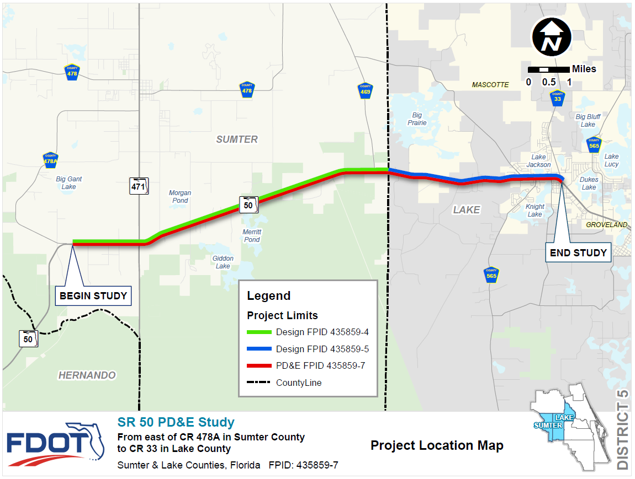

Slide 39
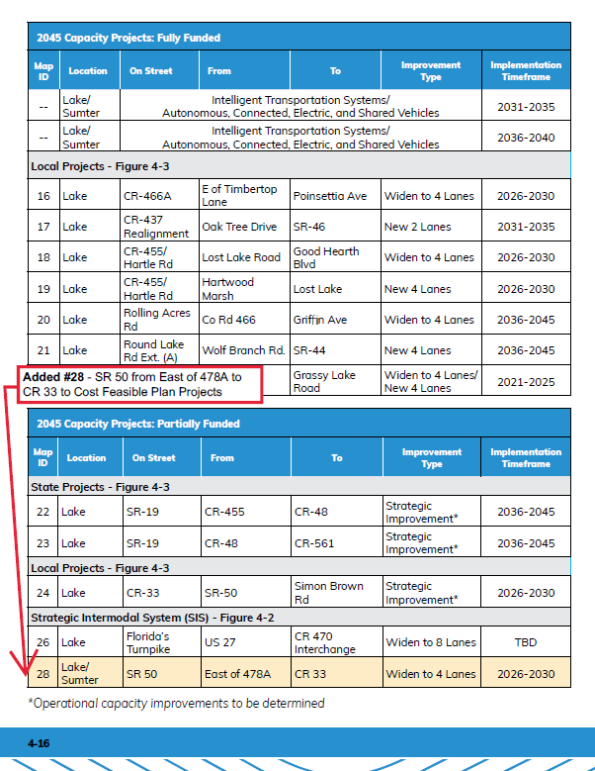
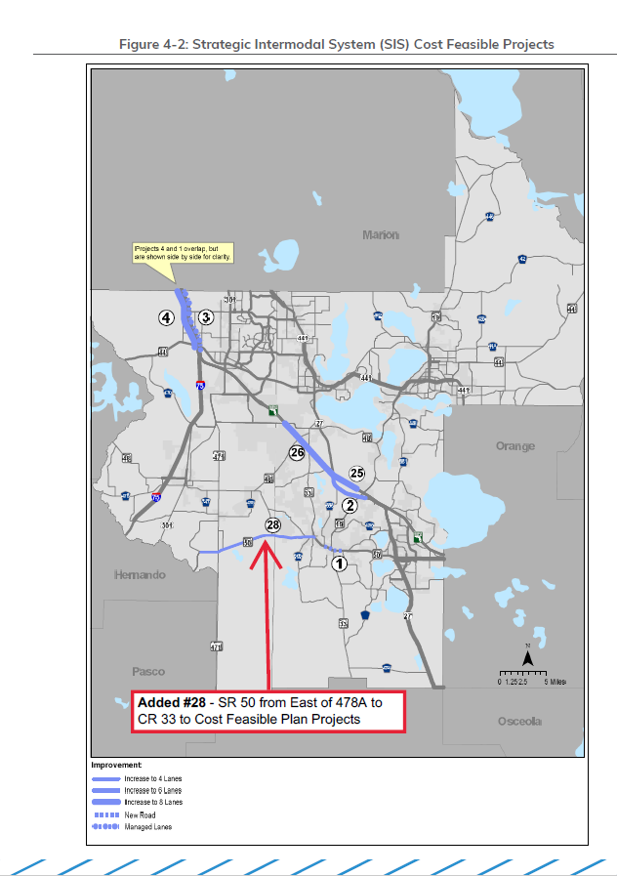

Slide 40
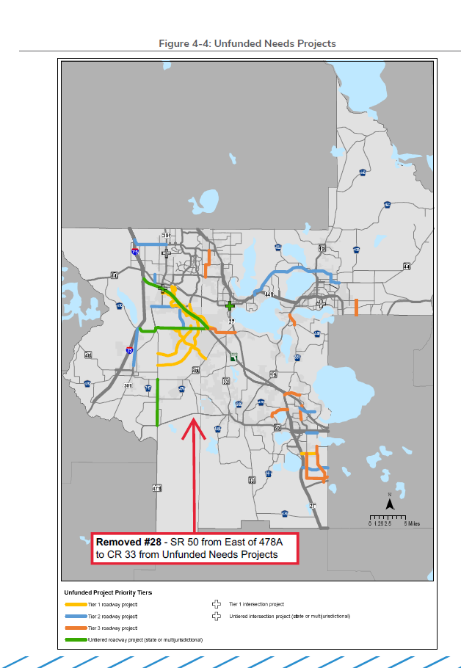
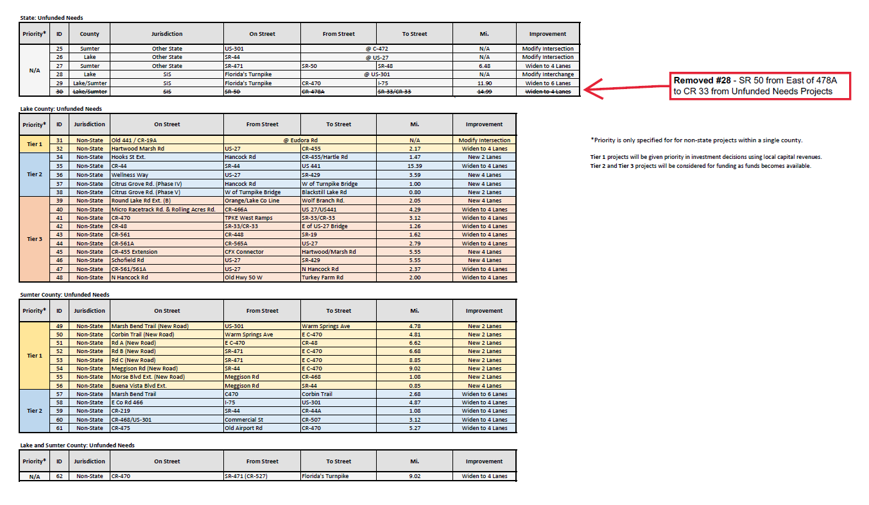

Slide 42
ACTION ITEM D.
Approval of the DRAFT Functional Classification Maps for Lake and Sumter Counties
The Functional Classification Review Process for LSMPO is now completed and the final draft maps for Lake and Sumter counties are ready for final approval.
Every 10 years, after the U.S. Census is completed, updated population numbers determine changes in Urban Boundaries, which are preliminarily adjusted by the Census Bureau. FHWA and FDOT can determine if further refinements should be made for reasons such as consistency with the approach to transportation planning. The Functional Classification of public roadways is updated during the same timeframe as Urban Boundary updates for efficiency.
Staff recommends approval of the DRAFT Functional Classification Maps as presented.

Slide 43
PRESENTATIONS, STATUS REPORTS
A. FDOT Report
B. FTE Report
C. Transit Reports-
D. County, City, MPO Updates

Slide 44
Florida Department of Transportation
719 South Woodland Boulevard DeLand, Florida 32720-6834
RON DESANTIS GOVERNOR
JARED W. PERDUE, P.E. SECRETARY
Lake and Sumter Counties Project Status Update as of May 31, 2023
The following is a brief status update on major FDOT road construction projects in Lake and Sumter counties as of the May cutoff. The next cutoff date is June 30, 2023. Information is also available on www.cflroads.com. For questions, please contact Melissa S. McKinney at 386-943- 5077 or via email at melissa.mckinney@dot.state.fl.us.
LAKE COUNTY
Upcoming Projects:
Current Projects:
445684-1 U.S. 441 Traffic Signals at C.R. 44C Eudora Rd.
Contract: T5750
Contractor: Chinchor Electric Inc.
Estimated Start: May 20, 2023
Estimated Completion: Fall 2023
Construction Cost: $1 Million
Description: The purpose of the project is to provide intersection improvements at U.S. 441/State Road (S.R.) 44 at County Road 44C (Eudora Road), including replacing the single diagonal span with a box span wire.
Update: The contractor is currently working on layout and MOT operations as well as directional bore conduit.
439142-1 S.R. 44 Milling and Resurfacing from Orange Ave. to east of Green Forrest Dr.
Contract: E55B1
Contractor: P & S Paving
Estimated Start: March 9, 2023
Estimated Completion: Spring 2024
Construction Cost: $6.2 Million
Description: This project will resurface State Road (S.R.) 44 from Orange Avenue to 500 feet east of Green Forest Drive. The project includes providing bicycle keyhole lanes at several intersections and making necessary roadside improvements.
Update: Preparations for a lane closure within project limits between C.R. 439 and east of Britt Road are underway. This lane closure is in aid of grouting operations currently taking place.
Improve Safety, Enhance Mobility, Inspire Innovation
www.fdot.gov

Slide 45
445294-1 S.R. 40 Milling and Resurfacing from Marion County Line to Volusia County Line
Contract: E58B2
Contractor: P & S Paving
Estimated Start: January 30, 2023
Estimated Completion: Late 2023
Construction Cost: $8.1 Million
Description: Work will consist of milling and resurfacing the roadway from Marion County Line to Volusia County Line. The project will also include pavement widening shoulder, drainage modifications and guardrail adjustments as needed. Other improvements consist of signing upgrades and pavement markings within the project limits.
Update: Side drainage work is 100% complete. Side Underdrain is also 100% complete. Milling and paving is ongoing and is 75% complete. Motorists should expect daytime lane closures within the project limits as needed.
443166-1 S.R. 50 Milling and Resurfacing from east of S.R. 471 to Lake County Line
Contract: T5771
Contractor: Anderson Columbia Co., Inc
Start: February 13, 2023
Estimated Completion: Fall 2023
Construction Cost: $3.9 Million
Description: Work will consist of milling and resurfacing the roadway from east of S.R. 471 to Lake County line. The project will cover approximately 6.4 miles and will include drainage improvements, signage, pavement markings and other incidental construction.
Update: Active work includes milling and paving operations as well as sodding and striping operations within the project limits. Motorists should expect nighttime lane closures.
445304-1 S.R. 25/500- Milling & Resurfacing from Morse Blvd. to north of SE 178TH Place
Contract: E50B9
Contractor: Anderson Columbia
Start: February 11, 2023
Estimated Completion: Spring 2024
Construction Cost: $8.1 million
Description: The purpose of the project is to rehabilitate the asphalt pavement to extend the service life of the existing roadway, including necessary roadside improvements.
Update: Contractor is currently working on grading and embankment on the SB sidewalks. Forming and pouring sidewalk is ongoing SB and NB and directional drilling has also begun at Morse Blvd.

Slide 46
442875-1 SR 44 from east of SR 35 (Main Street) to Lake Co line
Contract: T5721
Contractor: Anderson Columbia Co., Inc.
Start: June 15, 2022
Estimated Completion: Early 2024
Construction Cost: 18.6 million
Description: The purpose of this project is to resurface State Road (S.R.) 44 from east of
S.R. 35 / U.S. 301 (Main Street) to the Lake County line. This project also will make safety enhancements at the intersection of S.R. 44 and U.S. 301, including adding a second left turn lane from westbound S.R. 44 to southbound U.S. 301, and extend the northbound
U.S. 301 left turn lane to westbound S.R. 44. Also included in the project are drainage improvements, sidewalk construction, and adding new unmarked bicycle lanes.
Update: Daytime operations include the continuing of 6” sidewalk ramps, ditch grading and sod placement. The contractor is also working on the gravity wall in from of McDonalds. Nighttime operations include paving the turnouts, side streets and the median areas. Motorists should expect daytime and nighttime lane closures within the project limits.
238395-5 U.S. 441 widening from Lake Ella Road to Avenida Central in Lady Lake; includes elimination of U.S. 441 bridge over County Road 25 and creation of traditional intersection at that location.
Contract: T5650
Contractor: Southland Construction, Inc.
Start: July 27, 2020
Estimated Completion: Early 2024
Construction Cost: 45.3 million
Description: This is a project to widen U.S. 441/U.S. 27/State Road (S.R.) 500 from four to six lanes between Lake Ella Road and Avenida Central. Both northbound and southbound U.S. 441 will be expanded from two to three lanes, and bicycle lanes and sidewalks will be added along the length of the project. The FDOT will also do drainage work, add signage, make lighting upgrades, make median access changes, and improve the aesthetics of the roadway with new landscaping. A key aspect of the project will be the removal of U.S. 441 bridges over County Road (C.R.) 25, and the creation of a new, at-grade intersection at that location. C.R. 25 will connect with U.S. 441 on the east side of the highway via a signalized intersection but will end as a cul-de-sac on the west side of U.S. 441.
Update: Phase 3 active work includes signal, pipe, and subgrade operations as well as excavating at CR 25, and pouring concrete on curbs and sidewalks.

Slide 47
SUMTER COUNTY
Current Projects:
435859-3 Widening of State Road 50 from Hernando/Sumter County line to east of CR 478A.
Contract: E56A6
Contractor: Ranger Construction Industries, Inc.
Start: November 2, 2021
Estimated Completion: Early 2024
Description: The purpose of this project is to widen State Road (S.R.) 50 from two to four lanes. This is to provide increased capacity and improved safety. The project begins at the Hernando/Sumter County line and ends just east of County Road (C.R.) 478A.
Update: Active work includes grading, sodding, paving and drainage operations. The contractor is also working on completing punch list items for the bridge.
438562-3 Reconstructing the southbound rest area along Interstate 75 in Sumter County.
Contract: E51A0
Contractor: David Nelson Construction
Start: May 20, 2021
Estimated Completion: Spring 2023
Description: This project includes full reconstruction of the southbound rest area along Interstate 75 (I-75) in Sumter County. This project also includes expanding parking.
Update: Contractor is working on punch list items and making corrections accordingly. Testing and balancing of HVAC systems is ongoing.

Slide 48
Florida Department of Transportation
Turkey Lake Service Plaza Mile Post 263 | Bldg. #5315
P.O. Box 613069, Ocoee, Florida 34761
RON DESANTIS GOVERNOR
JARED W. PERDUE, P.E. SECRETARY
June 6, 2023
Contact: Siaosi Fine siaosi.fine@dot.state.fl.us
(407) 264-3494
FLORIDA DEPARTMENT OF TRANSPORTATION, FLORIDA’S TURNPIKE ENTERPRISE LAKE/SUMTER MPO
CONSTRUCTION UPDATE REPORT
PROJECT: NORTHERN TURNPIKE MAINLINE/SR 91 WIDENING PROJECT FROM SR 50/CLERMONT TO HANCOCK ROAD/MINNEOLA (MILEPOSTS 273 TO 279)
DETAILS: Florida’s Turnpike Enterprise is widening Florida’s Turnpike/SR 91 from four to eight lanes from Clermont/SR 50 to Minneola/ Hancock Road, in Lake and Orange counties.
DESCRIPTION: This project includes constructing a new Fosgate Road bridge over the Turnpike. The bridges at County Road (CR) 438 and CR 455 will also be replaced, as well as the Turnpike bridges over Jones Road, Old Highway 50, and Blackstill Lake Road. The West Orange Trail bridge over the Turnpike will be replaced with a prefabricated structure. New electronic tolling gantries and buildings will be installed, and the existing toll booths and canopies at the SR 50/Clermont entrance and exit ramps will be demolished. Safety improvements for this project include a new Intelligent Transportation System (ITS), new signage, new pavement markings, new signalization, new lighting, and new drainage systems.
The construction cost of the project is estimated at $162.3M. The project is anticipated to be completed in mid-2026.
CURRENT ACTIVITIES: Throughout the month of June, the contractor will begin demolition of the northbound Turnpike bridge over Jones Road and Old Highway 50 bridge with pile driving and substructure work following demolition. Pile driving and substructure construction for the Fosgate Road and Blackstill Lake Road bridges is ongoing and scheduled for late 2023 completion.
Construction on the West Orange Trail bridge is ongoing. The water main tie in is anticipated to be completed in June and the bridge opened in August 2023.
Other work within the project limits includes pond construction, temporary and permanent lighting, box culvert extensions, embankment, subgrade and base placement, temporary asphalt, fencing, temporary and permanent retaining wall construction along with temporary and permanent drainage. The next phase of construction for Phase III (the reconstruction of the northbound mainline) has begun. Toll

Slide 49
building foundation and conduit work at Highway 50 (milepost 272) has begun and is scheduled for mid-2024 completion.
PROJECT CONTACT:
Yasir Mercado, M.A., Community Outreach Specialist Yasir.Mercado@dot.state.fl.us
(954) 934-1138
CONTRACTOR: Jr. Davis Construction Company
PROJECT: NORTHERN TURNPIKE MAINLINE/SR 91 WIDENING PROJECT FROM MINNEOLA TO O’BRIEN ROAD (MILEPOSTS 279 TO 286)
DETAILS: Florida’s Turnpike Enterprise is widening Florida’s Turnpike/SR 91 from four to eight lanes from Minneola/Hancock Road to O’Brien Road, in Lake County.
DESCRIPTION: This project will widen Florida’s Turnpike from two to four lanes in each direction, for a total of eight lanes within the project limits. It also includes reconstruction of all bridges within the project limits, interchange improvements at US 27 South, and installation of new continuous LED lighting from the Minneola interchange to the US 27 South interchange and under Turnpike bridges over CR 561 and SR 19. This project also includes the installation of taller guardrails, highly reflective signage, Closed Circuit Television devices, ITS, and pavement markings.
The construction cost of the project is estimated at $233M. The project is anticipated to begin in late 2022 and be completed in mid-2028.
CURRENT ACTIVITIES: Throughout the month of June, the contractor will continue clearing and grubbing operations within the project limits. Sub-soil excavation continues ahead of earthwork and includes moving excavated materials from backslopes and new pond areas to fill locations. The contractor will work on temporary base and asphalt operations for upcoming traffic control shifts.
Work continues on the new storm water drainage system throughout the project with the construction of box culverts to extend the existing structures. MSE walls will be constructed at the Scrub Jay Lane and the US 27 off ramp bridges and bridge substructure work will follow. Pile driving operations will also begin for the new CR 561 bridge.
Other work within the project limits includes installation of temporary ITS.
PROJECT CONTACT:
Yasir Mercado, M.A., Community Outreach Specialist Yasir.Mercado@dot.state.fl.us
(954) 934-1138
CONTRACTOR: The Lane Construction Corporation
www.fdot.gov | www.floridasturnpike.com

Slide 50
PROJECT: SOUTHBOUND NORTHERN TURNPIKE MAINLINE/SR 91 RECONSTRUCT AND SAFETY IMPROVEMENTS FROM MILEPOST 289 TO MILEPOST 297
DETAILS: Florida’s Turnpike Enterprise is resurfacing the southbound lanes of Florida’s Turnpike/SR 91 from Milepost 289 to Milepost 297 in Lake County.
DESCRIPTION: This project includes resurfacing the southbound lanes of Florida’s Turnpike, rehabilitating culverts, replacing existing guardrails, installing signage, and adding new pavement markings. Bridge deck expansion joints will be replaced at the Palatlakaha Creek and CR 48 bridges.
The construction cost of the project is estimated at $8.7M. The project is anticipated to be completed in late 2023.
CURRENT ACTIVITIES: Throughout the month of May, the contractor completed asphalt replacement to cover the rumble strips along the shoulder and the dewatering and de-silting of 12 box culverts that required repairs. The contractor is working on permanent signage throughout the month of June. Deep mill paving operations began June 4, and will continue through mid-June, weather permitting. Mainline paving operations will begin once the deep mill operations have been completed.
PROJECT CONTACT:
Louis Grisoglio, Community Outreach Specialist Louis.Grisoglio@dot.state.fl.us
(407) 264-3069
CONTRACTOR: C.W. Roberts Contracting, Inc.
LANE CLOSURE INFORMATION:
Lane closures will generally take place during off-peak hours to minimize traffic congestion and delays for most drivers. Closures will be announced in advance in the Central and West Central Florida Weekly Lane Closures and Work Zone Advisory. https://floridasturnpike.com/traveler-resources/construction- updates/.
www.fdot.gov | www.floridasturnpike.com

Slide 51
LAKE COUNTY OFFICE OF TRANSIT SERVICES
LAKE-SUMTER MPO REPORT JUNE 28, 2023
Prepared by:
Lake County Office of Transit Services 2440 U.S. Highway 441/27 Fruitland Park, FL 34731
Phone: 352-323-5733
Website: RideLakeXpress.com

Slide 52
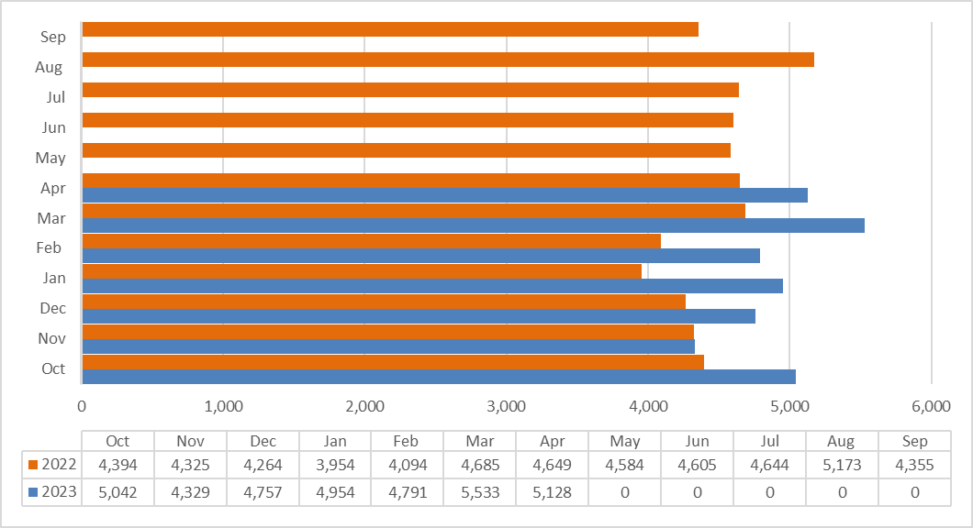
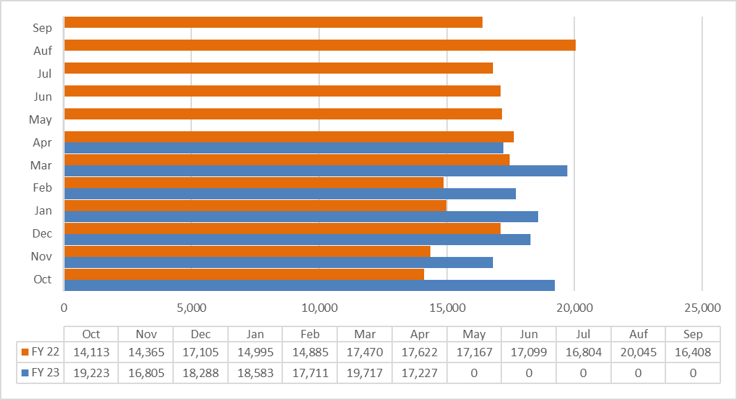
LAKE COUNTY CONNECTION RIDERSHIP COMPARISON
Fiscal Year 2023 ridership is 34,534. This is a 13.7% increase from the same period last year.
LAKEXPRESS RIDERSHIP FISCAL YEAR COMPARISON
Fiscal Year 2023 ridership is 127,554. Overall, 15.4% increase from the same period last year.

Slide 53
Transportation Projects
Current Formal Solicitations
Rebid of Touchless Fare Solution - Provision for a digital mobile ticketing solution that allows riders to purchase electronic bus fares from a free and secure web-based application.
Previous selected bidder took late exception to procurement documents, which could not be honored.
Rebid received three proposals, currently under review by the Selection Committee.
Upcoming Formal Solicitations
None scheduled at this time.

Slide 54
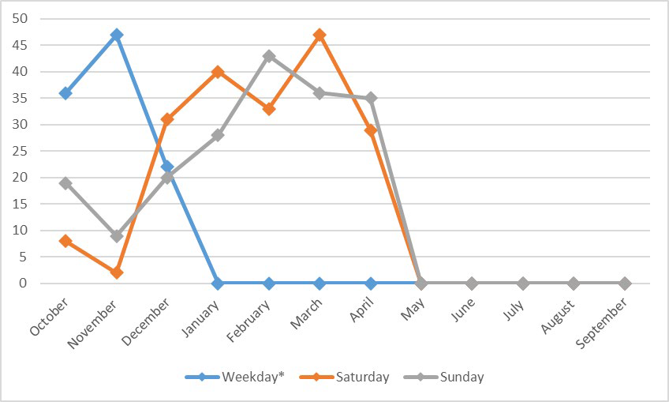
LYNX ROUTE 55 AVERAGE RIDERSHIP FOR LAKE COUNTY
*Weekday service provided by LakeXpress beginning December 12, 2022.
The average weekend ridership between October 2022 and April 2023 is 6.33 trips.
VAN POOL UPDATE
Enterprise continues to operate two vans in Lake County while VRide utilizes one van.

Slide 55
Committee member COMMENTS:
COMMITTEE MEMBER COMMENTS
Adjournment
Next Meeting: OCTOBER 11, 2023 @ 1:30 PM

Slide 56
Committee member COMMENTS:
COMMITTEE MEMBER COMMENTS
Adjournment
Next Meeting: OCTOBER 11, 2023 @ 3:00 PM

